Slide 1
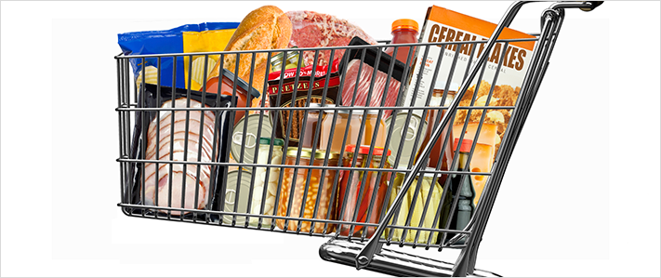
Sodium Reduction:
FDA’s Voluntary Initiative
Susan Mayne, Ph.D., Director
Center for Food Safety and Applied Nutrition
Food and Drug Administration

Slide 2
What is FDA Doing?
Issuing draft, voluntary guidance on sodium reduction targets
  Gradual approach:
    Short-term targets (2 years, goal=3,000 mg/day)
    Long-term targets (10 years, goal=2,300 mg/day)
  Targets for 150 categories of food that are sales weighted to focus on dominant sellers in each category
  Applies to food manufacturers, restaurants and food service operations
Draft targets serve as a basis for continued dialogue
  Additional data and information will help refine

Slide 3
Why Focus on Sodium?
Americans consume almost 50 percent more sodium than what most experts recommend
  Current intake is about 3,400 mg/day
  Recommendation is 2,300 mg/day
Expert bodies agree on the need to reduce sodium consumption to 2,300 mg/day for public health gains
  Institute of Medicine
  Evidence used for 2015-2020 Dietary Guidelines for Americans
  Healthy People 2020

Slide 4
Scientific Evidence
Totality of evidence supports sodium reduction from current levels
  Diverse and strong body of evidence, including clinical trials, support link between sodium consumption and blood pressure
    High blood pressure is a major risk factor for heart disease and stroke
  Sodium reduction could prevent hundreds of thousands of premature deaths and illnesses over a decade

Slide 5
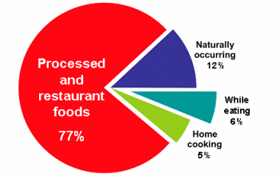
Why are Targets Needed?
Most sodium comes from salt added to processed and restaurant foods
It is difficult to meet recommended sodium intake with current food supply
Overall sodium content of food supply remains high, despite industry efforts
Variability in sodium across similar foods in food supply shows that reductions are possible
Mattes and Donnelly, 1991

Slide 6
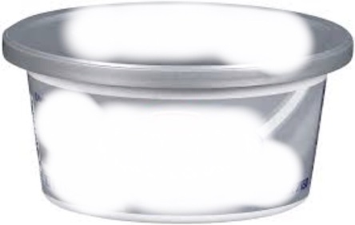
Example of Variability:
Cream Cheese
Country | Sodium (mg/100g) | Short-Term Mean Target (mg/100g) | Long-Term Mean Target (mg/100g)
U.S. | 403 | 380 | 340
U.K. | 300 | n/a | n/a
Ireland | 300 | n/a | n/a
Australia | 348 | n/a | n/a
New Zealand | 348 | n/a | n/a
Canada | 400 | n/a | n/a
Brazil | 410 | n/a | n/a
Spreadable

Slide 7
3-Step Process to Set Targets
1
Developed 150 food categories
Determined baseline sodium concentrations (mg/100g)
Set quantitative goals
  Target mean levels: apply to average sodium levels of foods in a category, not individual products
  Recommended upper bounds: apply to all individual products and discourage products with excessive sodium
2
3

Slide 8
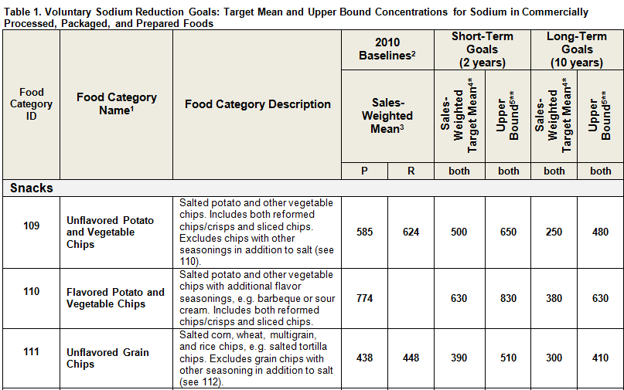
Target Table
P = Packaged; R = Restaurant; both = P and R; (baseline values are based on data available for P and R)
All values are in milligrams (mg) per 100 grams (g)

Slide 9
Key Information Considered
Survey of available food technology literature
  Role of sodium (e.g., food safety)
  Sodium reduction in food/food category
  Comments
Market surveys
  Sodium content of high-selling products
  Identified products in 2010 that had the lowest sodium concentrations
Consultation with experts
Reviewed other sodium reduction initiatives

Slide 10
Sales Weighting
Focus is on:
  Manufacturers whose products make up a significant proportion of national sales in one or more categories
  Restaurant and similar retail food chains that are national or regional in scope
Intended to provide more weight to commonly consumed products—the dominant sellers in each category
More reflective of the sodium intake from the U.S. food supply (10% of products account for top 80% of sales)
Company could assess own portfolio of products against category targets by determining sales-weighted mean for products in a category

Slide 11
Sample Category: Precooked Sausage
Top selling products on market
Shows how sodium concentrations compare (mg/100g)
Baseline, FDA short- and long-term targets overlaid
Many products already meeting short- and long-term targets
Note: Data on the number of products was obtained from Nielsen. Sodium concentration values were calculated from sodium values on nutrition labels obtained from Gladson and Mintel.

Slide 12
Sample Category:
Monterey Jack and Other Semi-Soft Cheese
Note: Data on the number of products was obtained from Nielsen. Sodium concentration values were calculated from sodium values on nutrition labels obtained from Gladson and Mintel.

Slide 13
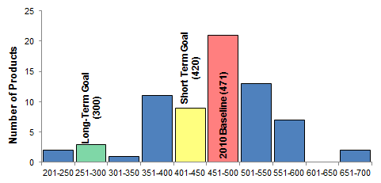
Sample Category:
Wheat and Mixed Grain Bread
Sodium Concentration (mg Na/100g) n = 69 products; 35 brands
Note: Data on the number of products was obtained from Nielsen. Sodium concentration values were calculated from sodium values on nutrition labels obtained from Gladson and Mintel.

Slide 14
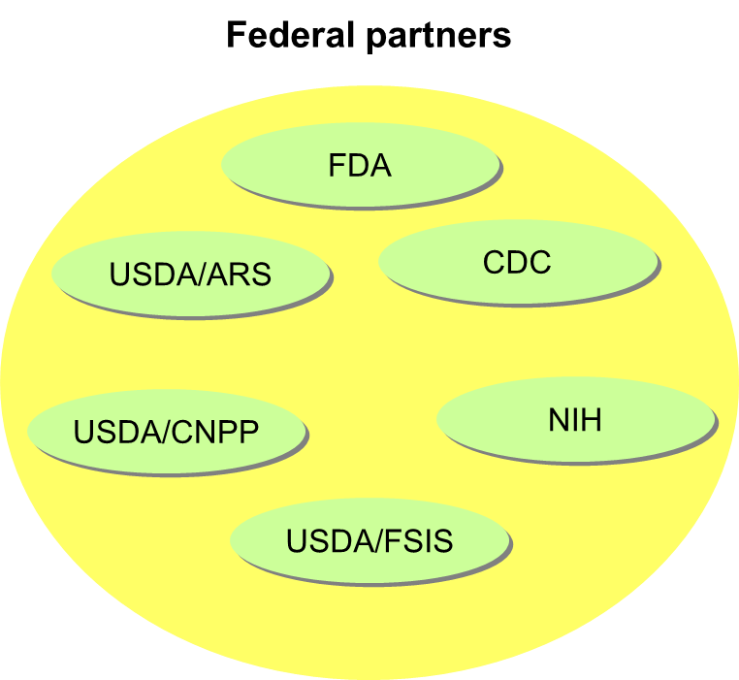
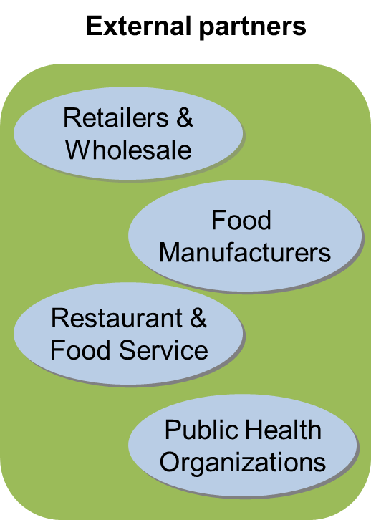
Stakeholder Participation Important
All parties must work together to see success

Slide 15
Comments
Separate comment periods for short- and long-term targets
  90 days on issues outlined in the Notice of Availability regarding the short-term targets
  150 days on issues outlined in the Notice of Availability regarding the long-term targets
Specifically on:
  Food categories
  Methods for quantifying sodium content and developing mean/recommended upper bound targets
  Challenges of implementing the voluntary goals

Slide 16
For More Information
Draft Guidance
Notice of Availability (references issues for comment)
Sodium reduction targets (available in excel or word format)
At a Glance fact sheet
Web QA
FDA Voice blog
Email: SodiumReduction@fda.hhs.gov

