Slide 1
FDA’s Food Related Emergency Exercise – Boxed Set (FREE-B)
Orientation webinar
August 17, 2011
12 pm EST
Jason P. Bashura, MPH. RS
General Health Scientist
FDA / CFSAN
Food Defense Oversight Team
www.FDA.gov/FoodDefense
FoodDefense@fda.hhs.gov

Slide 2
Welcome and Introductions
Presenters Subject Matter Experts
Refinement and Release
of the FREE-B

Slide 3
For today’s webinar…
Historical Perspective/ overview
Scenario descriptions
What’s next – FREE-B workshops:
Dr. Jennifer McEntire, IFT
Brief walk-through online
’Q’s and ‘A’s, thoughts, ideas….
PLEASE!!

Slide 4
FDA’s Food Defense Oversight Team
FDA works with other government agencies and private sector organizations to help reduce the risk of tampering or other malicious, criminal, or terrorist actions on the food and cosmetic supply.
The FDOT:
Promotes access to food defense awareness, education and training tools and resources through domestic and international outreach activities to and, in partnership with, industry, academia and all levels of the U.S. government (Fed/SLTT).
Currently working on a multitude of FSMA related efforts.

Slide 5
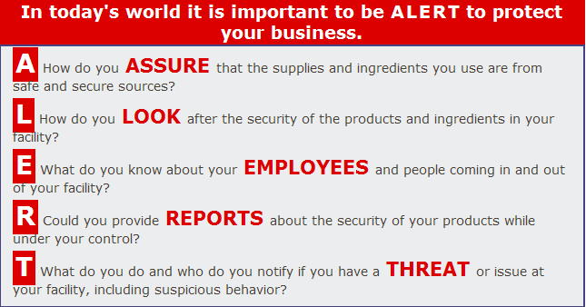
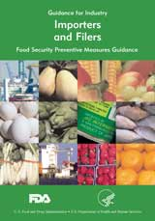
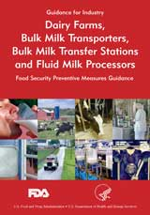
Food Defense Tools and Resources
Training Programs
ALERT and
Employees FIRST
CARVER+Shock
Vulnerability
Assessment
Software 2.0
Industry
Guidance
Self Assessment
Checklist
Mitigations
Strategies Database
‘Searchable’ Preventative
Measures, based on user
Selections to categories
and nodes
Coming Soon!
FDOT tools and resources webinar with the NCFPD – 9/9/11
www.FDA.gov/FoodDefense
Notes:
INDUSTRY GUIDANCE: FDA issued food defense preventive measures guidance for (1) Importers and Filers, (2) Retail Food Stores and Food Service Establishments, (3) Cosmetic Processors and Transporters, (4) Dairy Farms and Milk Processors and Transporters, and (5) Food Producers, Processors and Transporters. Self Assessment checklists were added as an appendix to each guidance document in 2009.
TRAINING PROGRAMS: FDA has put forth 2 food defense training programs: (1) ALERT – targeting food industry management; and (2) Employees FIRST – targeting front-line food industry workers. These programs include web-based modules and downloadable training materials and are available in multiple languages.
CARVER+Shock: FDA, in collaboration with USDA, has developed a vulnerability assessment software based on the CARVER+Shock method. A streamlined second generation version of the software was released in 2009.
COMING SOON: Currently FDA is working to complete the development of 2 new food defense tools: (1) a mitigations database – a web-based tool that will allow the user to search for a specific unit operation within the food production system to find a list of potential preventive measures. The mitigations are provided in 3 tiers: initial, moderate and comprehensive; and (2) FREE-B, the Food Related Emergency Exercise Boxed Set containing ready-to-go table top exercises designed to facilitate response to food safety and defense events.
These tools are all available free of charge and downloadable at www.fda.gov/food/fooddefense

Slide 6
Historical Perspective
Requests for food defense, emergency response training from our SLTT partners; as a result of previous exercises, feedback at mtgs., conferences
The need for HSEEP training / need to raise awareness of food defense issues
Access to ‘low to no’ cost tools to assist with food emergency response planning
These scenarios can be foundation to build an exercise and training calendar
FREE-B development!!

Slide 7
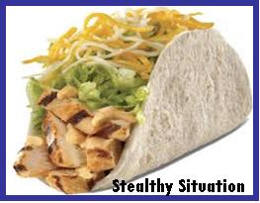
Three (3) FDA based scenarios
Two (2) USDA based scenarios

Slide 8
Overview of the FREE-B
5 scenarios, available online – FREE of charge!
www.FDA.gov/FoodDefense
Each scenario contains a lead planner’s guide, situation manual and facilitator’s guide
Guides are presented in an easy to follow approach, from establishment of the exercise planning committee to the distribution of certificates of participation - we’ve left no stone unturned!!

Slide 9
Overview of the FREE-B
This set is designed to provide jurisdictions with a variety of options to test and improve their capabilities to respond to human or animal health emergencies.
The five exercises in the set are designed so that jurisdictions can conduct them right out of the box with a minimal amount of effort and editing.
Each exercise is stand-alone. Collaboration and partnering with several jurisdictions and stakeholders may be needed to ensure a successful exercise.
FREE-B has been developed to be consistent with the Homeland Security Exercise and Evaluation Program (HSEEP) doctrine.

Slide 10
Recent Activity: 7/18 - 8/15/11
“Hits” to our FDOT webpage… 8,296
“Hits” to the FREE-B Main page… 4,659
“Hits” to the FREE-B download page… 1,952

Slide 11
Scenario Descriptions

Slide 12
How Sweet It Is(n’t)
This scenario focuses attention on the regulatory
traceback investigation that occurs after standard
product testing shows that a food product contains
excessive levels of a contaminant, as well as a recall
of contaminated food.

Slide 13
Stealthy Situation
This exercise is a comprehensive scenario and highlights
nuances encountered when a cluster of illness is
associated with a foodservice establishment. The
scenario includes the epidemiological investigation,
identification of affected product through traceback
procedures, implementation of a recall, and the role of
regulatory agencies.

Slide 14
Wilted Woes
This scenario begins at the outset of early signal
detection with clinical illness reports, and focuses on the
epidemiological investigation process to identify the
food vehicle when there is a human health emergency
caused by an unintentional contamination of produce
with E. coli O157:H7.

Slide 15
Highplains Harbinger
This scenario focuses on the investigation of animal
disease caused by intentional infection of cattle with
Foot and Mouth Disease (FMD) virus, highlighting the
various animal agriculture agencies (Federal, state,
local, territorial, and tribal) and their roles and
responsibilities, as well as introducing the roles and
responsibilities of law enforcement agencies during an
animal health emergency.

Slide 16
Insider Addition
This scenario focuses attention on the intentional aspect
of contamination of a raw meat product at the processor
with a chemical agent. Various nontraditional
organizations and expertise needed to investigate
intentional contaminations and the establishment of
collaborative processes and roles and responsibilities
with the traditional public health and regulatory
partners are highlighted.

Slide 17
Recent press on the FREE-B:
http://www.foodquality.com/details/article/1311605/Need_Practice_Preparing_for_Food_Safety_Crises.html Food Quality
http://www.foodsafetynews.com/2011/07/free-b-practicing-outbreaks-in-peace-time/ Food Safety News
Currently working on a ‘promotional’ article, as well; if you have something you’d like to share for consideration in the article, send your thoughts, contact information to FoodDefense@fda.hhs.gov

Slide 18
What’s next ….
Workshops using the FREE-B to learn how we can make the tool more effective, functional
- Jennifer McEntire, IFT

Slide 19
Thanks for your attention!
Does anyone have any experiences with the FREE-B or any of the FDOT tools you’d like to share?
Please contact us @ FoodDefense@fda.hhs.gov with any thoughts, questions, ideas

Slide 20
USDA efforts…
Food and Nutrition Service is conducting field tests of a table top exercise (TTX) toolkit.
The project is intended to assist program operators with developing and testing plans to prevent / prepare for the intentional contamination of food served in schools.
The release is targeted in 2012
For more info, send an email to FoodDefense@fda.hhs.gov
and in the subject line put “FNS exercise info”

Slide 21
Questions, thoughts, ideas??

Slide 22
“They all look like they’re very good representations of likely scenarios that would challenge the organizations involved and help them see how well they would respond to an emergency,” he said. He suggested that state agencies and representatives of the food industry should take advantage of these free tools and run some of the scenarios collaboratively.
Michael Doyle, PhD, Regents Professor of food microbiology and director of the Center for Food Safety at the University of Georgia in Griffin

Slide 23
Closing
Please send thoughts, questions, comments to: FoodDefense@fda.hhs.gov
For more Food Defense guidance, info, tools and resources, please go to the
Food Defense Oversight Team’s website: www.FDA.gov/FoodDefense

