Slide 1
Tips for Retailers: Preventing Sales to PERSONS UNDER 21 YEARS OF AGE
Presented by: Office of Compliance and Enforcement

Slide 2

agenda
    Tobacco-21(T-21) Update
    Retailer Training Programs
    Available FDA Training Materials
    Age Verification Techniques
    Conducting Internal Compliance Checks
    Hiring and Management Practices
    Other Training Materials

Slide 3
YOUTH TOBACCO USE
  Each day in the United States
  1,500 kids smoke their first cigarette¹
  200 kids become daily cigarette smokers¹
  Rates of youth use of e-cigarettes remain an ongoing concern
  2 Million U.S. middle and high school students reported currently using e-cigarettes in 2021, with more than 8 in 10 using flavored e-cigarettes²
  About 2 in 5 high school students who use e-cigarettes reported frequent use; about 1 in 4 reported daily use²
  Among current youth users, disposables are the most commonly used type of e-cigarette device²
  Retailers can help FDA keep harmful tobacco products out of the hands of our youth
Substance Abuse and Mental Health Services Administration. (2020). Key substance use and mental health indicators in the United States: Results from the 2019 National Survey on Drug Use and Health (HHS Publication No. PEP20-07-01-001, NSDUH Series H-55). Rockville, MD: Center for Behavioral Health Statistics and Quality, Substance Abuse and Mental Health Services Administration. Retrieved from https://www.samhsa.gov/data/.
Centers for Disease Control and Prevention. Tobacco Product Use and Associated Factors Among Middle and High School Students – National Youth Tobacco Survey, United States, 2021. MMWR Surveill Summ 2022;71(No. SS-5):1–29. DOI: http://dx.doi.org/10.15585/mmwr.ss7105a1

Slide 4
How to comply with FDA tobacco sale regulations
In order to comply with federal regulations, retailers that operate brick and mortar retail stores must:
  Only sell cigarettes, cigarette tobacco, roll-your-own tobacco, smokeless tobacco, and covered tobacco products to individuals 21 years of age or older.
Check photo IDs of any tobacco customer under the age of 30.
Retailers must continue to comply with all other applicable requirements under the FD&C Act and FDA’s tobacco product regulations.
There are NO exemptions from these requirements.

Slide 5
Update to Federal Law for Tobacco Products Containing Nicotine Not Derived from Tobacco
On March 15, 2022, the President signed legislation to amend the FD&C Act to extend FDA’s jurisdiction to products “containing nicotine from any source,” not just nicotine derived from tobacco.
Specifically, this legislation expanded the definition of “tobacco product” to include products containing nicotine from any source.
As of April 14, 2022, retailers of tobacco products containing nicotine not made or derived from tobacco must ensure compliance with applicable requirements under the FD&C Act resulting from this law. As such, it is illegal for a retailer to sell any tobacco product containing nicotine from any source – including cigarettes, smokeless tobacco, cigars, and e-cigarettes – to anyone under 21.
After July 13, 2022, a non-tobacco nicotine product can only be legally marketed in the United States if it has received a marketing granted order (MGO) from FDA.
This means that it is illegal for a retailer or distributor to sell or distribute a non-tobacco nicotine product that is not subject to a MGO from FDA. Without this MGO, a product is in violation of the law and its manufacturer, retailer, or distributor risks FDA enforcement.
Visit FDA’s website to learn more about the agency’s regulations and guidance on selling tobacco products in retail stores at https://www.fda.gov/tobacco-products/compliance-enforcement-training/retail-sales-tobacco-products.

Slide 6
Disclaimer
The FDA does not endorse any specific third-party POS (Point-of-Sale) systems, age-verification systems, or training programs.
The FDA does not charge for educational or training materials.

Slide 7
Retailer Training Programs
For a comprehensive overview of developing a training program for employees who make tobacco sales, please view:
The “Tobacco Retailer Training Programs” webinar at https://www.youtube.com/watch?v=s9ci-tHS0sU
    Guidance Document
    https://www.fda.gov/regulatory-information/search-fda-guidance-documents/tobacco-retailer-training-programs

Slide 8
“This Is Our Watch”
“This is Our Watch,” the Center for Tobacco Products’ (CTP) retailer education program, helps tobacco retailers better understand FDA tobacco regulations, the importance of compliance, and the greater purpose – protecting the nation's youth from the harms of tobacco use.
Materials are free and available for order or download via the CTP Tobacco Education Resource Library
https://digitalmedia.hhs.gov/tobacco/
The materials include:
      Posters
      Flyers
      Register signage
      Register stickers
      Age verification calendars

Slide 9
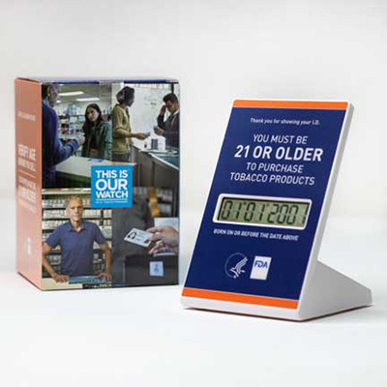

“This IS Our Watch”

Slide 10
Age Verification
Considerations when looking at photo IDs:
    Acceptable or unacceptable forms of photographic identification
    How to verify the authenticity of photographic identification
    Ways to determine whether photographic identification has been altered
    Importance of closely examining photographic identification

Slide 11
Examples of Acceptable Forms of Photo ID
Driver’s license or other state photo identification card issued by Department of Motor Vehicles (or equivalent)
Federally recognized tribal-issued photo ID
U.S. or Foreign government-issued passport
Canadian provincial driver's license or Indian and Northern Affairs Canada card
U.S. Citizenship and Immigration Services Employment Authorization Card (I-766)

Slide 12
Ways to identify invalid ID’s
Spelling errors
Word usage errors
    Ex: Weight: Brown; Height: 162; Eye color: 5’05”; etc.
Card is expired
Some Point-of-Sale (POS) systems have software that can confirm document authenticity
Even if the ID is valid, the customer may still be underage, so be sure to check the date of birth

Slide 13
Specific Age Verifying Technology
Stand-Alone Age Calculator Systems
Digital Age Verification Calendar
Point-of-Sale Systems that Prompt Clerk to Check ID
Point-of-Sale Systems that Prompt Clerk to Enter Date of Birth (DOB)
Point-of-Sale Systems that Require Scan of ID

Slide 14
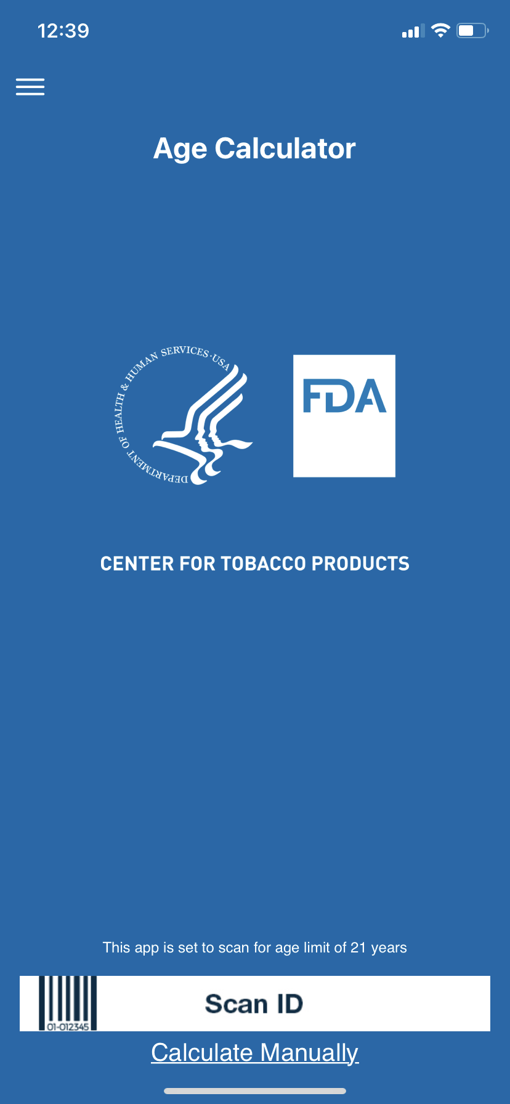
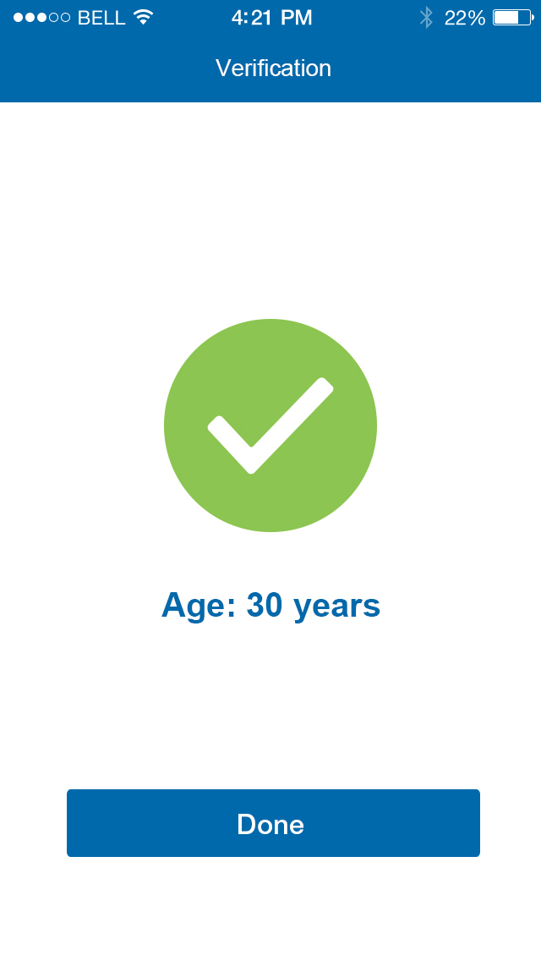


FDA Age Calculator

Slide 15
This is Our Watch: Digital Age Verification Calendar
CTP provides the digital age verification calendar as part of the “This is Our Watch” retailer education program.
Retailers who use CTP’s “This is Our Watch” digital age verification calendar need to update the minimum purchase age on the calendar to 21 years.
Retailers who would like a “This Is Our Watch” digital age verification calendar may order one free of charge from the CTP Tobacco Education Resource Library website: https://digitalmedia.hhs.gov/tobacco/print_materials/RE-34
    Operating instructions may be found at https://www.youtube.com/watch?v=m097Qh8xO0s

Slide 16
Stand-alone age calculator systems
FDA-developed Age Calculator App, FDA’s “This is Our Watch” digital age verification calendar:
  Advantages
    Great tool for calculating age to be able to complete or deny a sale
    Current POS system can be used in conjunction with age calculator
  Things to Consider
    Does not automatically stop the sale to the underage individual at the POS
    Only helpful if clerks utilize the calculator and deny the sale to individuals under the age of 21

Slide 17
POS Systems that prompt clerk to check id
  Advantages
    Reminds clerk to check ID
  Things to Consider
    Does not automatically stop the sale to the underage individual at the POS
    Clerk must calculate age manually based on customer’s ID and deny the sale to individuals under the age of 21.

Slide 18
POS Systems that prompt clerk to enter date of birth (Dob)
  Advantages
    Requires clerk to enter a date of birth
    Performs age calculation and prevents transaction from proceeding if purchaser is underage
  Things to Consider
    Clerk may enter incorrect DOB to complete sale
    Override codes may exist

Slide 19
POS Systems that Require Scan of ID
  Advantages
    Requires clerk to check ID
    Performs age calculation and prevents sale if underage
    Requires a valid ID to complete sale
  Things to Consider
    Customers may not be in possession of scan-ready ID cards
    May not work with out-of-state or other types of IDs
    Override codes may exist

Slide 20
Age-Verification Technologies
Age Verification | Advantages | Things to Consider
Stand-Alone Age Calculator Systems (e.g., FDA age calculator app) | Great if you need help calculating age to complete or deny a sale | App does not prevent sale Only helpful if clerk uses it and denies sale based on the info
Point-of-Sale Systems that Prompt Clerk to Check ID | Prompts clerk to verify customer’s age | Does not prevent sale Clerk may miscalculate age Clerk can continue sale without verifying age
Point-of-Sale Systems that Prompt Clerk to Enter Date of Birth (DOB) | Reminds clerk to check ID Performs the age calculation and prevents sale if underage | May enter incorrect DOB to complete sale May have override codes
Point-of-Sale Systems that Require Scan of ID | Reminds clerk to check ID Performs the age calculation and prevents sale if underage Requires a valid ID to complete sale | May not work with passports or other forms of ID Override codes may exist

Slide 21
Age-Verification Technologies
Each system has advantages and things to consider; however, the retailer needs to determine which system is best for their business
May need to implement other controls, such as internal compliance checks

Slide 22
Internal Compliance Checks
Routine compliance checks help ensure employees are following the law and store policies.
Examples:
    Hire a “secret shopper” or “mystery shopper” through a third-party contractor, where permitted
    Unannounced written tests
    Review security footage
    Review point-of-sale reports to determine compliance rate
    Combination of several techniques

Slide 23
Compliance Check Frequency
FDA recommends that compliance checks should be unannounced, but conducted routinely
Consider conducting compliance checks at varying hours of operation (for example during busy or slow times)
FDA recommends employees be made aware that their compliance will be reviewed. Consider conducting compliance checks for employees with various levels of experience:
    at times when experienced employees are working
    at times when new employees are working

Slide 24
Hiring and Management Practices
Hiring Practices:
    Consider requiring employees who sell tobacco products to be at least 21 years of age
Potential Management Practices:
    Take employee performance on compliance checks into account
    Include store’s compliance rate in retailer manager’s performance reviews, if permitted by law
    Require manager’s override for any discrepancies involving sales of tobacco products

Slide 25
State Training Materials
Many states have online trainings and resources to help retailers comply with state and federal laws.
    Examples include:
Alabama
Maryland
Massachusetts
Missouri
New York

Slide 26
Review
FDA Resources
Age Verification
Internal Compliance Checks
Hiring and Management Practices
Other Training Materials

Slide 27
ADDITIONAL Resources
The “Tobacco Retailer Training Programs” webinar at https://www.youtube.com/watch?v=s9ci-tHS0sU
Additional information on Retailer Training and Enforcement can be found at the FDA Center for Tobacco Products website https://www.fda.gov/TobaccoProducts/GuidanceComplianceRegulatoryInformation/Retail/ucm249332.htm
Please direct questions to: AskCTP@fda.hhs.gov or call us at 1-877-CTP-1373

