Slide 1
The 5 Ws of undercover buy compliance check inspections

Slide 2

agenda
      Types of Compliance Check Inspections
      Who conducts the inspections?
      What are the inspectors investigating?
      Where are inspections conducted?
      When will the inspections take place?
      Why does FDA conduct these inspections?
      Further Information Links
      Contacting CTP

Slide 3
TYPES OF COMPLIANCE CHECK INSPECTIONS

Slide 4
Types of compliance check inspections
    The Tobacco Control Act gives FDA authority to inspect retail establishments.
    CTP conducts two types of compliance check inspections to confirm retailer compliance with federal law:
      Advertising and Labeling Inspections
      Undercover Buy Inspections
Notes:
This is a basic content slide. To use it, click on it and drag-and-drop it into position in your slide deck. Highlight this text and type over it to input your own text content.
The slides that appear below this slide in this slide deck are optional. If you want to use any of them, click on them and drag-and-drop them into the desired position within your slide deck. You can then adapt them to suit your content.
If you don’t need this slide or any of these slides, you can delete them. Click on the slide(s) you want to delete and press the “Delete” key on your keyboard (or right-click on the slides and select “Delete”).
There are other slide layouts available that offer a variety of ways to display your text and image content. To access them and add them to your slide deck, follow these steps:
Normal view, on the Home tab, click the New Slide button drop-down arrow.
Scroll through the drop-down menu of slides and click on the slide you’d like to use.
That slide will now appear in your left slide deck list, and you can add your content to it.
Detailed instruction for using all of these slides appears in the User Instructions for CTP PowerPoint Presentations document.

Slide 5
5 Ws of UNDERCOVER BUY inspections

Slide 6
WHO
    Who conducts the Undercover Buy inspections?
      FDA commissioned inspectors complete FDA training and act on behalf of the FDA.
      FDA contracts with states, territories, and Tribes to inspect retail establishments within their jurisdictions, where feasible.
      FDA awards contracts to third-party entities that hire commissionable inspectors to conduct compliance check inspections of tobacco retailers in those states and territories where FDA has not been able to contract with a state agency.
      Inspectors conduct compliance check inspections of tobacco retailers and send evidence of potential violations to FDA for review.
Notes:
This is a basic content slide. To use it, click on it and drag-and-drop it into position in your slide deck. Highlight this text and type over it to input your own text content.
The slides that appear below this slide in this slide deck are optional. If you want to use any of them, click on them and drag-and-drop them into the desired position within your slide deck. You can then adapt them to suit your content.
If you don’t need this slide or any of these slides, you can delete them. Click on the slide(s) you want to delete and press the “Delete” key on your keyboard (or right-click on the slides and select “Delete”).
There are other slide layouts available that offer a variety of ways to display your text and image content. To access them and add them to your slide deck, follow these steps:
Normal view, on the Home tab, click the New Slide button drop-down arrow.
Scroll through the drop-down menu of slides and click on the slide you’d like to use.
That slide will now appear in your left slide deck list, and you can add your content to it.
Detailed instruction for using all of these slides appears in the User Instructions for CTP PowerPoint Presentations document.

Slide 7
What
    What occurs during an Undercover buy inspection?
      Undercover Buy Inspections involve the use of an underage purchaser under the supervision of an inspector(s).
      During the inspection, an underage purchaser will attempt to purchase a tobacco product, allowing FDA to determine whether the retailer is in violation by:
              Selling a tobacco product to an individual under 21; or
              Failing to request the photo ID of a person under the age of 30 who attempts to purchase a tobacco product.
    Retailers must not sell a tobacco product to an individual under the age of 21 and they must check the photo identification of anyone under the age of 30 who attempts to purchase a tobacco product.
Notes:
This is a basic content slide. To use it, click on it and drag-and-drop it into position in your slide deck. Highlight this text and type over it to input your own text content.
The slides that appear below this slide in this slide deck are optional. If you want to use any of them, click on them and drag-and-drop them into the desired position within your slide deck. You can then adapt them to suit your content.
If you don’t need this slide or any of these slides, you can delete them. Click on the slide(s) you want to delete and press the “Delete” key on your keyboard (or right-click on the slides and select “Delete”).
There are other slide layouts available that offer a variety of ways to display your text and image content. To access them and add them to your slide deck, follow these steps:
Normal view, on the Home tab, click the New Slide button drop-down arrow.
Scroll through the drop-down menu of slides and click on the slide you’d like to use.
That slide will now appear in your left slide deck list, and you can add your content to it.
Detailed instruction for using all of these slides appears in the User Instructions for CTP PowerPoint Presentations document.

Slide 8
What
    What other violations may be noted during an Undercover Buy inspection?
      Other potential violations of federal tobacco laws and regulations may also be reported to FDA by the inspector during this undercover buy inspection. These may include, but are not limited to, sale of individual cigarettes, and the ability to access a vending machine or self-service display in an area that is not age restricted.
Notes:
This is a basic content slide. To use it, click on it and drag-and-drop it into position in your slide deck. Highlight this text and type over it to input your own text content.
The slides that appear below this slide in this slide deck are optional. If you want to use any of them, click on them and drag-and-drop them into the desired position within your slide deck. You can then adapt them to suit your content.
If you don’t need this slide or any of these slides, you can delete them. Click on the slide(s) you want to delete and press the “Delete” key on your keyboard (or right-click on the slides and select “Delete”).
There are other slide layouts available that offer a variety of ways to display your text and image content. To access them and add them to your slide deck, follow these steps:
Normal view, on the Home tab, click the New Slide button drop-down arrow.
Scroll through the drop-down menu of slides and click on the slide you’d like to use.
That slide will now appear in your left slide deck list, and you can add your content to it.
Detailed instruction for using all of these slides appears in the User Instructions for CTP PowerPoint Presentations document.

Slide 9
WHERE
    Where are Undercover Buy inspections conducted?
    Undercover Buy inspections are conducted at brick-and-mortar tobacco retailer locations across the United States, U.S. territories, and on Tribal land.
Notes:
Removed retailer definition.
A ‘retailer’ under the Tobacco Control Act is any person, government, or entity who:
sells tobacco products to individuals for personal consumption or
operates a facility where vending machines and self-service displays of tobacco products are permitted.

Slide 10
WHEN
    When will these inspections take place?
      Compliance Check Inspections are not preannounced to the retailer.
      During Undercover Buy inspections, you will not be aware that you are being inspected by FDA.
      Neither the minor nor the inspector will identify themselves during an undercover buy inspection.
Notes:
This is a basic content slide. To use it, click on it and drag-and-drop it into position in your slide deck. Highlight this text and type over it to input your own text content.
The slides that appear below this slide in this slide deck are optional. If you want to use any of them, click on them and drag-and-drop them into the desired position within your slide deck. You can then adapt them to suit your content.
If you don’t need this slide or any of these slides, you can delete them. Click on the slide(s) you want to delete and press the “Delete” key on your keyboard (or right-click on the slides and select “Delete”).
There are other slide layouts available that offer a variety of ways to display your text and image content. To access them and add them to your slide deck, follow these steps:
Normal view, on the Home tab, click the New Slide button drop-down arrow.
Scroll through the drop-down menu of slides and click on the slide you’d like to use.
That slide will now appear in your left slide deck list, and you can add your content to it.
Detailed instruction for using all of these slides appears in the User Instructions for CTP PowerPoint Presentations document.

Slide 11
WHEN
    When will I hear from FDA if potential violations are found during an Undercover Buy inspection?
      If an inspector reports that an underage purchaser was able to enter your establishment and make a tobacco purchase during an inspection, FDA will mail a Compliance Check Inspection Notice shortly after the inspection.
      Once FDA has reviewed the inspection evidence, if violations are found:
      Generally, FDA sends Advisory Actions (e.g., Warning Letters) for the first time an inspection reveals a violation of federal tobacco laws and regulations
      Failure to promptly and adequately correct all violations and ensure compliance with all applicable laws and regulations may lead to:
      Administrative Actions (e.g., Civil Money Penalties or No-Tobacco-Sale Orders)
      Judicial Actions (e.g., seizure, injunction, or criminal prosecution)
Notes:
This is a basic content slide. To use it, click on it and drag-and-drop it into position in your slide deck. Highlight this text and type over it to input your own text content.
The slides that appear below this slide in this slide deck are optional. If you want to use any of them, click on them and drag-and-drop them into the desired position within your slide deck. You can then adapt them to suit your content.
If you don’t need this slide or any of these slides, you can delete them. Click on the slide(s) you want to delete and press the “Delete” key on your keyboard (or right-click on the slides and select “Delete”).
There are other slide layouts available that offer a variety of ways to display your text and image content. To access them and add them to your slide deck, follow these steps:
Normal view, on the Home tab, click the New Slide button drop-down arrow.
Scroll through the drop-down menu of slides and click on the slide you’d like to use.
That slide will now appear in your left slide deck list, and you can add your content to it.
Detailed instruction for using all of these slides appears in the User Instructions for CTP PowerPoint Presentations document.

Slide 12
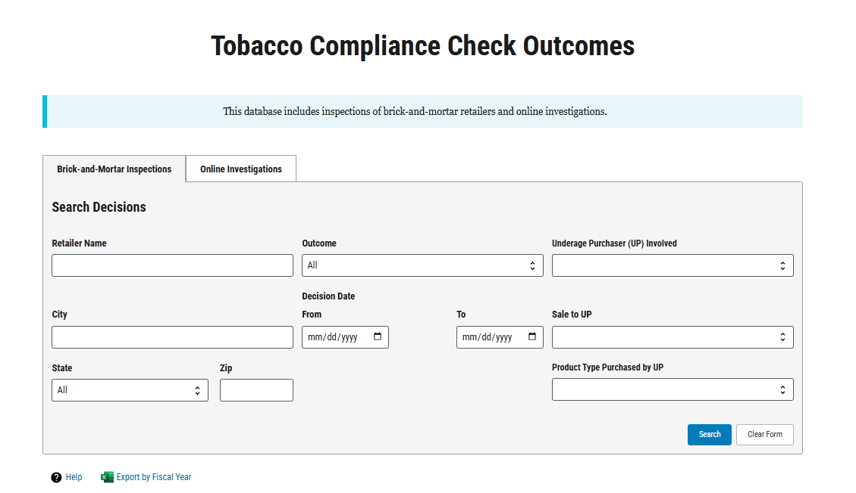
WHEN
    Brick and mortar retailers can check their inspection history on the FDA Tobacco Compliance Check Outcomes Database.
    Available at: https://timp-ccid.fda.gov.
Notes:
This is a basic content slide. To use it, click on it and drag-and-drop it into position in your slide deck. Highlight this text and type over it to input your own text content.
The slides that appear below this slide in this slide deck are optional. If you want to use any of them, click on them and drag-and-drop them into the desired position within your slide deck. You can then adapt them to suit your content.
If you don’t need this slide or any of these slides, you can delete them. Click on the slide(s) you want to delete and press the “Delete” key on your keyboard (or right-click on the slides and select “Delete”).
There are other slide layouts available that offer a variety of ways to display your text and image content. To access them and add them to your slide deck, follow these steps:
Normal view, on the Home tab, click the New Slide button drop-down arrow.
Scroll through the drop-down menu of slides and click on the slide you’d like to use.
That slide will now appear in your left slide deck list, and you can add your content to it.
Detailed instruction for using all of these slides appears in the User Instructions for CTP PowerPoint Presentations document.

Slide 13
WHY
Why does FDA conduct these inspections?
      The Center for Tobacco Products (CTP) is responsible for carrying out the Family Smoking Prevention and Tobacco Control Act.
      In 2009, the Family Smoking Prevention and Tobacco Control Act,(TCA), amended the Federal Food Drug, and Cosmetic Act (FD&C Act) to give the FDA authority to regulate the manufacture, distribution and marketing of cigarettes, cigarette tobacco, roll-your-own tobacco, smokeless tobacco, and other tobacco products that the agency, through regulation, deems to be subject to the law.
Notes:
https://www.fda.gov/news-events/press-announcements/statement-fda-commissioner-scott-gottlieb-md-forceful-new-actions-focused-retailers-manufacturers

Slide 14
why
The 2016 Deeming Rule extends FDA’s regulatory authority to cover additional products, except their accessories, that meet the definition of a tobacco product under Section 201(rr) of the FD&C Act. These deemed products include: e-cigarettes, pipe tobacco, cigars, hookah and oral nicotine products.
On Dec 20, 2019, the President signed legislation raising the federal minimum age for sale of tobacco products from 18 to 21 years. This legislation (known as “Tobacco 21” or “T21”) became effective immediately, and it is now illegal for a retailer to sell any tobacco product to anyone under 21.
On March 15, 2022, the President signed legislation to clarify that FDA’s tobacco product jurisdiction extends to tobacco products containing nicotine from any source, not just nicotine derived from tobacco. As such, retailers of tobacco products containing nicotine not made or derived from tobacco must ensure compliance with applicable requirements under the FD&C Act resulting from this law.
Notes:
This is a basic content slide. To use it, click on it and drag-and-drop it into position in your slide deck. Highlight this text and type over it to input your own text content.
The slides that appear below this slide in this slide deck are optional. If you want to use any of them, click on them and drag-and-drop them into the desired position within your slide deck. You can then adapt them to suit your content.
If you don’t need this slide or any of these slides, you can delete them. Click on the slide(s) you want to delete and press the “Delete” key on your keyboard (or right-click on the slides and select “Delete”).
There are other slide layouts available that offer a variety of ways to display your text and image content. To access them and add them to your slide deck, follow these steps:
Normal view, on the Home tab, click the New Slide button drop-down arrow.
Scroll through the drop-down menu of slides and click on the slide you’d like to use.
That slide will now appear in your left slide deck list, and you can add your content to it.
Detailed instruction for using all of these slides appears in the User Instructions for CTP PowerPoint Presentations document.

Slide 15
why
FDA conducts these inspections to further CTP’s mission to protect Americans from tobacco-related disease and death by regulating the manufacture, distribution, and marketing of tobacco products and by educating the public, especially young people, about tobacco products and the dangers their use poses to themselves and others.
We hope retailers will partner with the FDA to help protect their communities by knowing the law and making use of tools to prevent underage sales.
Notes:
This is a basic content slide. To use it, click on it and drag-and-drop it into position in your slide deck. Highlight this text and type over it to input your own text content.
The slides that appear below this slide in this slide deck are optional. If you want to use any of them, click on them and drag-and-drop them into the desired position within your slide deck. You can then adapt them to suit your content.
If you don’t need this slide or any of these slides, you can delete them. Click on the slide(s) you want to delete and press the “Delete” key on your keyboard (or right-click on the slides and select “Delete”).
There are other slide layouts available that offer a variety of ways to display your text and image content. To access them and add them to your slide deck, follow these steps:
Normal view, on the Home tab, click the New Slide button drop-down arrow.
Scroll through the drop-down menu of slides and click on the slide you’d like to use.
That slide will now appear in your left slide deck list, and you can add your content to it.
Detailed instruction for using all of these slides appears in the User Instructions for CTP PowerPoint Presentations document.

Slide 16
FOR FURTHER INFORMATION:
Retail Sales of Tobacco Products
https://www.fda.gov/tobacco-products/compliance-enforcement-training/retail-sales-tobacco-products
Summary of the Federal Rules for Selling Tobacco Products
https://www.fda.gov/tobacco-products/retail-sales-tobacco-products/selling-tobacco-products-retail-stores
Market and Distribute a Tobacco Product Summary
https://www.fda.gov/tobacco-products/products-guidance-regulations/market-and-distribute-tobacco-product
“This is Our Watch” Campaign for Retailers
https://www.fda.gov/tobacco-products/retail-sales-tobacco-products/our-watch
What a Brick and Mortar Retailer Should Do After Receiving and Warning Letter – Webinar
https://www.youtube.com/watch?v=jv_NYEDEMPk
Social Media Links (E.g.: Twitter, Facebook, YouTube)
https://www.fda.gov/tobacco-products/contact-ctp/connect-ctp
Sign up for CTP E-mail updates
https://www.fda.gov/tobacco-products/ctp-newsroom

Slide 17
What is the best way to contact FDA with additional questions?
  For additional questions, you can contact FDA:
    CTP General E-mail: AskCTP@fda.hhs.gov
    Call: 1-877-287-1373 (9am EST-4pm EST)
    For Small Business Assistance E-mail: SmallBiz.Tobacco@fda.hhs.gov

