Slide 1

Open Public Comment
Moderator:
Dayle Lewis Cristinzio,
Director, Stakeholder Engagement,
Office of External Affairs, FDA

Slide 2
Comments with Slides
Speaking Order
54. John Bailey
55. Christopher Ho
56. Don Ye
57. Tim Parrent
58. Geoff Waby
59. Caroline Bassoni
60. Alexandra Kowcz
61. Iain Moore
62. Brandi Reinbold
63. Matteo Zanotti Russo
Currently Speaking
John Bailey
EAS Consulting Group, VA

Slide 3

MoCRA
GMPs
FDA Listening Session
John Bailey
EAS Consulting Group
June 1, 2023

Slide 4
My Background
30 + years at FDA including serving as Director of Office of Cosmetics and Colors and Office of Applied Research and Safety Assessment.
10 years at PCPC serving as Director of Cosmetic Chemistry and Senior Vice President for Science.
10 + years as Independent Advisor for Cosmetics and Colors at EAS Consulting Group.

Slide 5
MoCRA – Elements
Registration of establishments (as a condition of doing business).
Reporting of products (qualitative reporting of ingredients).
Safety substantiation (the Dossier concept).
*Good manufacturing Practices (by regulation)*
Serious adverse event reporting (mandatory).
Adverse event record keeping (6 years).
Mandatory recall (determined by FDA).
Professional use products (labeling).
Records access by FDA (during inspections or “when needed”).
Fragrance allergen labeling (aka European model).
Issuance of talc regulation.
PFAS report to congress. …and more

Slide 6
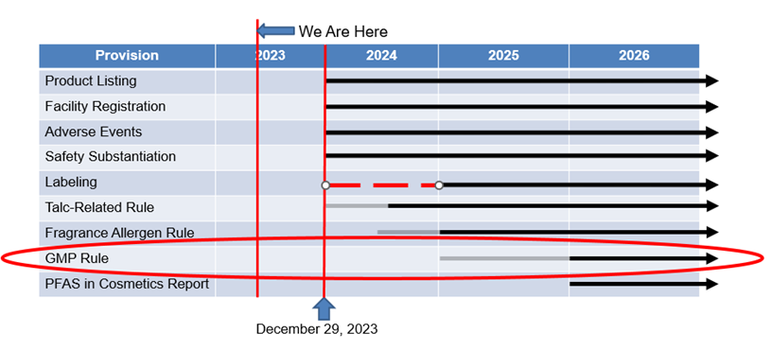
MoCRA Implementation Timeline

Slide 7
MoCRA – Good Manufacturing Practices (Sec. 606)
The Secretary (FDA) shall by regulation establish good manufacturing practices for facilities that are consistent, to the extent practicable, and appropriate, with national and international standards.
The regulations shall be intended to protect the public health and ensure that cosmetic products are not adulterated.
The regulations may allow FDA to inspect records necessary to demonstrate compliance with GMPs during an inspection conducted under section 704 (establishment inspections).
The regulations shall include simplified GMPs for smaller businesses.
FDA shall consult with cosmetics manufacturers, including smaller businesses, consumer organizations, and other experts selected by FDA (in preparation of the regulations).
FDA shall publish a notice of proposed rulemaking not later than 2 years after enactment of MoCRA (12/29/24) and shall publish a final such rule not later than 3 years after such date of enactment (12/29/25).

Slide 8
Key Characteristics of Cosmetic GMPs
One size does not fit all products and companies.
Flexibility is a necessity.
Great opportunity to achieve international alignment while advancing product safety.
Third-party auditing should be embraced for cosmetics.
A reasonable ruler must be applied (in other words – cosmetics are not drugs or foods).
There are existing models that can be used – no need to reinvent the wheel.

Slide 9
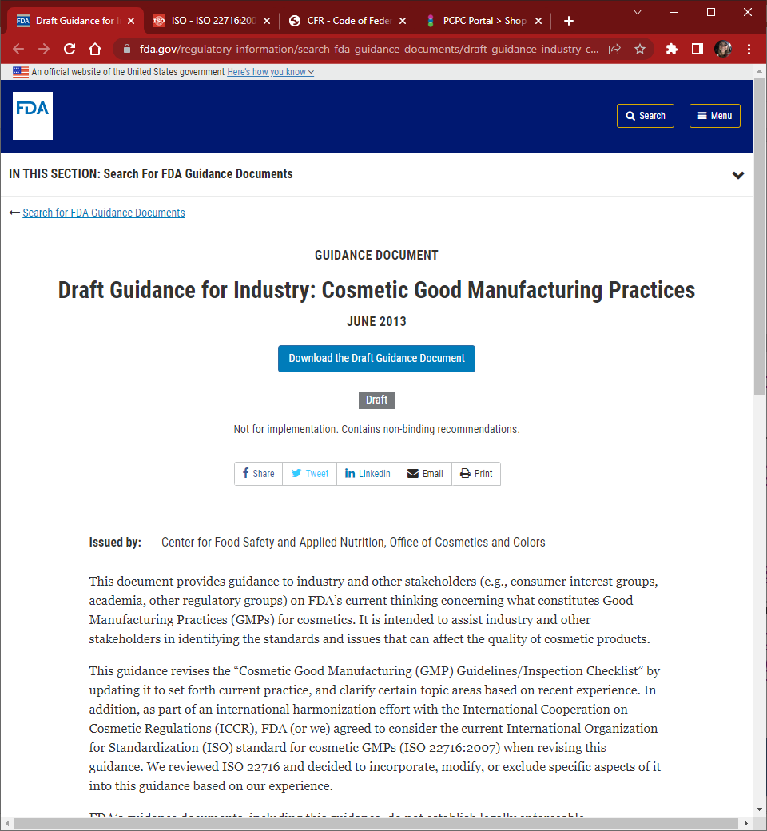
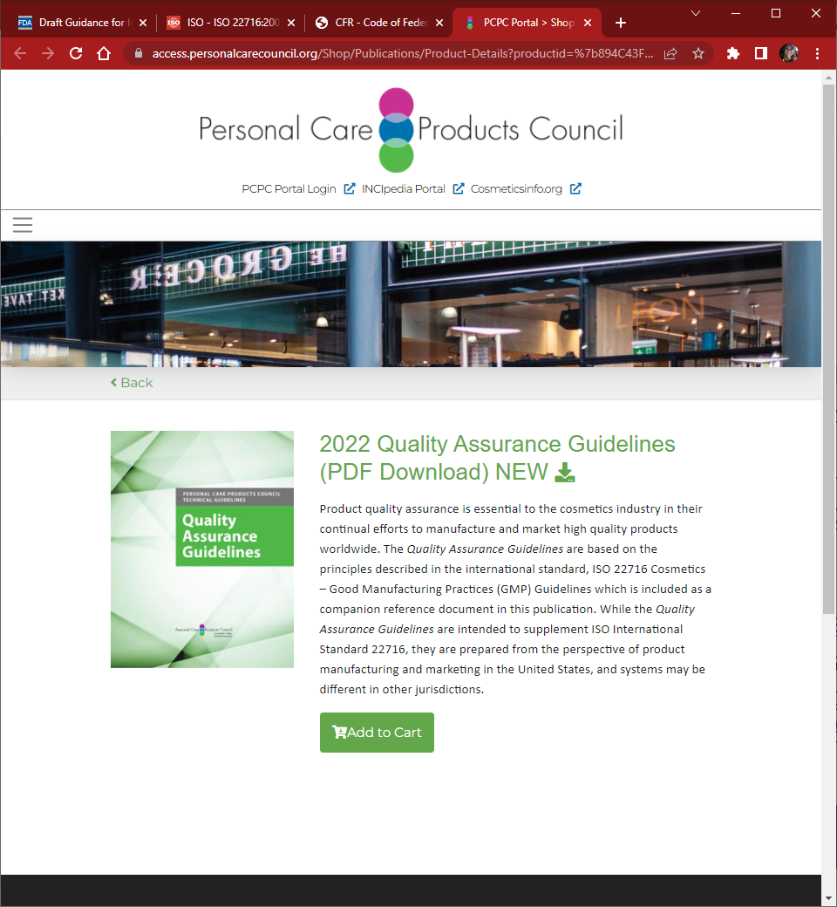
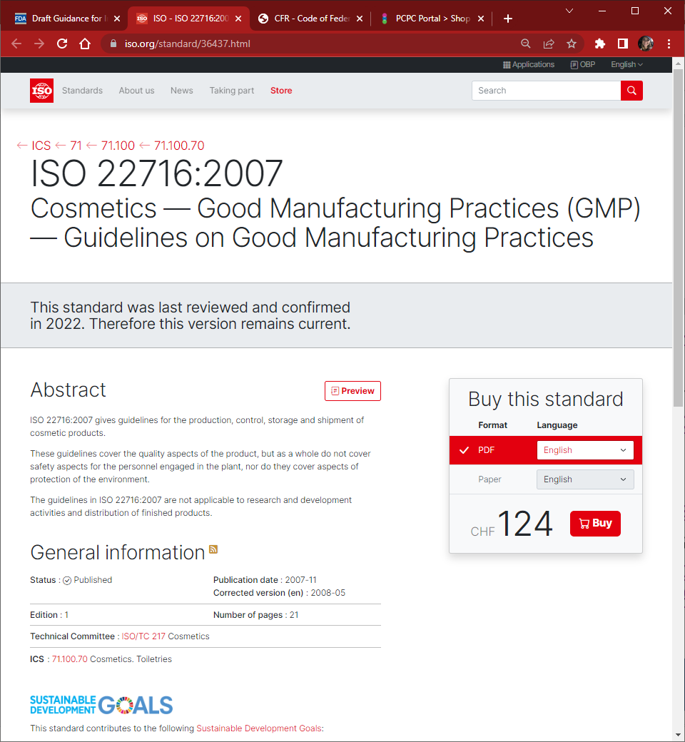
Possible Models for FDA GMP Regulations:
Existing FDA Draft Cosmetic GMP Guidelines
https://www.fda.gov/regulatory-information/search-fda-guidance-documents/draft-guidance-industry-cosmetic-good-manufacturing-practices June 2013
ISO Technical Committee 217: Standard 22716
https://www.iso.org/standard/36437.html (Same as Europe)
2022 PCPC Quality Assurance Guidelines
https://access.personalcarecouncil.org/Shop/Publications/Product-Details?productid=%7b894C43FA-B045-ED11-BBA2-00224824EA23%7d

Slide 10
GMP Recommendations
Adopt ISO Standard 22716 (by reference) – Europe has already accepted.
FDA inspectors will have to be trained to understand cosmetic GMPs. (Corollary - Only trained inspectors should conduct cosmetic establishment GMP inspections).
Only true safety-related GMP violations should trigger FDA regulatory action.
FDA should accept 3rd party inspections (certified auditors).
Implementation will be a learning experience for everyone.

Slide 11

Thank you

Slide 12
Comments with Slides
Speaking Order
54. John Bailey
55. Christopher Ho
56. Don Ye
57. Tim Parrent
58. Geoff Waby
59. Caroline Bassoni
60. Alexandra Kowcz
61. Iain Moore
62. Brandi Reinbold
63. Matteo Zanotti Russo
Currently Speaking
Christopher Ho
Loreal, NJ

Slide 13
U.S. Food and Drug Administration (FDA) Public Meeting
Good Manufacturing Practices for Cosmetic Products Listening Session
June 1, 2023
10:00 – 4:00 pm
Zoom Webinar
Docket No. FDA-2023-N-1466
Submitted by Christopher Ho
Representing PCPC GMP Working Group

Slide 14
Topics Related to Good Manufacturing Practices
2. Describe what constitutes sufficient flexibility within good manufacturing practices for cosmetic products to ensure regulations are practicable for all sizes and types of facilities to which such practices may apply. Please take into account the size and scope of the businesses engaged in the manufacture of cosmetic products and the risks to public health posed by cosmetic products.
The requirement for consumer safety and product quality should be the same irrespective of facility type and size.
GMPs should be flexible and allow for the consideration of risk based on product type, and manufacturing process and controls. The assessment of risk should be holistic and consider the production facility, equipment, process, specifications, testing, product formulation and intended use.
Flexibility with implementing GMPs should include consideration of:
  Usage of digital and paper records (digital and paper should be equivalent)
  Appropriate sampling and testing frequency
  Appropriate water source quality
  Alternative approach to identify and appropriately control for risks inherent in the existing infrastructure and equipment

Slide 15
Comments with Slides
Speaking Order
54. John Bailey
55. Christopher Ho
56. Don Ye
57. Tim Parrent
58. Geoff Waby
59. Caroline Bassoni
60. Alexandra Kowcz
61. Iain Moore
62. Brandi Reinbold
63. Matteo Zanotti Russo
Currently Speaking
Don Ye
Estee Lauder Companies, NY

Slide 16
U.S. Food and Drug Administration (FDA) Public Meeting
Good Manufacturing Practices for Cosmetic Products Listening Session
June 1, 2023
10:00 – 4:00 pm
Zoom Webinar
Docket No. FDA-2023-N-1466
Submitted by Don Ye
Estee Lauder Companies

Slide 17
Cosmetic Good Manufacturing Practices
Current Cosmetic GMP Standard
  ISO 22716:2007 Good Manufacturing Practices (GMPs) – International standard
  ANSI 455-3 Good Manufacturing Practices for Cosmetics – US national standard
  Benefits of Existing GMP standard
    Many companies are already certified.
    Expertise, Education, Experience availability due to maturity of existing standard
    ISO 22716 has international recognition
Regulatory Scheme and Enforcement
  Voluntary Qualified Importer Program (VQIP) model
  FDA accreditation of certifying bodies/agents
  Use of standards certificate to support flexible for cause and/or risk inspection model
Alternative Cosmetic GMP Regulation
  High Level Principle based GMP keeping current through public forums and guidance releases
Intended and Unintended consequences of new GMP

Slide 18
Comments with Slides
Speaking Order
54. John Bailey
55. Christopher Ho
56. Don Ye
57. Tim Parrent
58. Geoff Waby
59. Caroline Bassoni
60. Alexandra Kowcz
61. Iain Moore
62. Brandi Reinbold
63. Matteo Zanotti Russo
Currently Speaking
Tim Parrent
Mary Kay Inc., TX

Slide 19
U.S. Food and Drug Administration (FDA) Public Meeting
Good Manufacturing Practices for Cosmetic Products Listening Session
June 1, 2023
10:00 am – 4:00 pm
Zoom Webinar
Docket No. FDA-2023-N-1466
Submitted by Tim Parrent
Mary Kay, Inc.

Slide 20
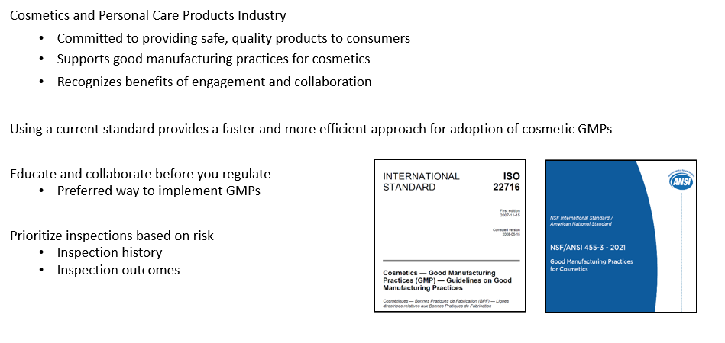
Cosmetic Good Manufacturing Practices

Slide 21
Comments with Slides
Speaking Order
54. John Bailey
55. Christopher Ho
56. Don Ye
57. Tim Parrent
58. Geoff Waby
59. Caroline Bassoni
60. Alexandra Kowcz
61. Iain Moore
62. Brandi Reinbold
63. Matteo Zanotti Russo
Currently Speaking
Geoff Waby
Obelis USA LLC, OH

Slide 22
U.S. Food and Drug Administration (FDA) Public Meeting
Good Manufacturing Practices for Cosmetic Products Listening Session
    June 1, 2023
    10:00 – 4:00 pm
    Zoom Webinar
    Docket No. FDA-2023-N-1466
Submitted by Geoff R. Waby
Obelis USA
West Chester, Ohio

Slide 23
US Food and Drug Administration (FDA) Public Meeting
Good Manufacturing Practices for Cosmetic Products Listening Event
Geoff R Waby, Regulatory Affairs and Vigilance Officer
June 1, 2023

Slide 24
FDA GMP Listening Event
  Obelis s.a. has 35 years of experience in regulatory compliance
  Based in Brussels, Belgium, it is one of the largest compliance centers in Europe
  Focused on cosmetics, medical devices and in-vitro diagnostics
  Co-founder of the European Responsible Person Association (ERPA)
  Active participant in European Commission Working Groups
  Clients in 65 countries, manufacturing and supplying products to key markets, including the EU, UK, Switzerland and now the US
  Publishers of CosLaw a regulatory database of relevant regulations

Slide 25
FDA GMP Listening Event
Existing practicable international standards to protect public health and avoid adulteration of cosmetics
  ISO 22716:2007 is the most widely accepted standard in the world for cosmetic products
  Created by international working group and accepted by regulatory bodies for safe production, control, storage and shipment
  Includes regular inspections by accreditation bodies
  About a third of cosmetics in the US are imported, to protect US consumers, GMP regulations need to be global, and globally inspected
Flexibility in GMP regulations to accommodate company size and scope and minimize risk to public health
  Existing FDA OTC drug model is good – GMP regulations describe expectations and principles
  Further detail on ‘how’ is covered by published guidance and practical factors – e.g., paper-based or computer-based systems
Recommendations to avoid imposing undue economic hardship
  The FDA has to build an inspection arm for cosmetics
  If the FDA adopts a US-centric standard which relies on FDA enforcement, domestic companies, of all sizes could be at a competitive disadvantage due to spending to become compliant

Slide 26
FDA GMP Listening Event
Recommendations on appropriate compliance times
  The time for compliance is highly dependent on the GMP regulations which are adopted
  If the FDA chooses to align with international standard ISO 22716:2007, many companies, of all sizes, are already compliant
    FDA will have to decide the approach to cosmetic manufacturers and processors with pre-existing ISO accreditation
    FDA will also need to decide how to treat ISO certification post-implementation of US GMPs, particularly for non-US manufacturers
    This includes the option to request evidence of certification, up to and including audit reports
  If the FDA chooses to issue cGMP requirements independent of ISO, the FDA and industry need to co-operate in training for global manufacturers and processors, and FDA inspectors

Slide 27
FDA GMP Listening Event
Recommendations on appropriate compliance times continued
  Food Safety Modernization Act (FSMA) is a good model for collaboration between the FDA, industry and academia to create training programs for both inspectors and industry to understand cGMP requirements and maximize compliance
  The first inspection cycle for each site should focus on clear understanding of principles, elimination of clear and present risk, and a plan for implementing systems not already in place, the second inspection should expect acceptable progress on implementing the plan
  Inspection cycles likely to be two/three years (unless a ‘for cause’ inspection is needed for higher risk product categories) to several years for low-risk product categories
  Product risk and regulatory history should be used to inform compliance expectations and inspection cycle time
  Facilities manufacturing both cosmetics and drugs, with a record of No Action Indicated in past drug inspections, may be considered low risk and low priority for a cosmetics inspection
  ISO 22716:2007 has a built in 5-year review cycle, enabling requirements to be upgraded globally as information and expectations change

Slide 28
Comments with Slides
Speaking Order
59. Caroline Bassoni
60. Alexandra Kowcz
61. Iain Moore
62. Brandi Reinbold
63. Matteo Zanotti Russo
Verbal Presentations
64. Sophie Chen
65. David Manley
66. Prerna Vashisht
Currently Speaking
Caroline Bassoni
Cosmed Association, France

Slide 29

FDA Public Meeting
Good Manufacturing Practices for Cosmetic Products
JUNE 1, 2023
Caroline bassoni – cosmed
Regulatory affairs director

Slide 30
Who is Cosmed ?
French trade association for cosmetics
Created in 2000
More than 1000 members
Representative of SMEunited for Cosmetics in Europe (association of Crafts and SMEs in Europe with around 70 member organizations from over 30 European countries)
  Contribution in the European Commission working group for cosmetics

Slide 31
ISO 22716: EU official and recognized standard for cosmetic GMPs
ISO 22716:2007 provides guidelines for the production, control, storage and shipment of cosmetic products
ISO 22716:2007 is the official harmonized standard under EU Regulation (EC) No 1223/2009 of the European Parliament and of the Council of 30 November 2009 on cosmetic products
Global recognition of the standard ISO22716
  The American National Standard Institute contributed and supported its development
  Officially endorsed by ICCR (The International Cooperation on Cosmetics Regulation) to which FDA contributes
  Supports legal compliance at international level under a majority of regulations
  Facilitates international exchanges on quality concepts
  Facilitates the maintenance of quality in companies with only one standard to apply

Slide 32
ISO 22716: EU official and recognized standard for cosmetic GMPs
A standard existing since 2007 and proven to be effective in :
  Ensuring quality and safety compliance throughout every stage of the supply chain
  Leading to better quality products while ensuring a safe environment for employees
  Saving time on processes
  Supporting establishment of a comprehensive system to deal with product deviations, complaints, and recalls
  Supporting competitiveness
Adaptable to all company sizes and complexities
Adaptable to all products types

Slide 33
SMEs important key considerations
European experience with SMEs: ISO 22716 implementation possible and successful !
Key considerations for SMEs:
    More transition time to implement full GMP
    More education from authorities and associations
    Accompanying tools such as guidelines or checklists
    Financial support
Supporting SMEs to understand and manage FDA future GMPs inspections

Slide 34
Comments with Slides
Speaking Order
59. Caroline Bassoni
60. Alexandra Kowcz
61. Iain Moore
62. Brandi Reinbold
63. Matteo Zanotti Russo
Verbal Presentations
64. Sophie Chen
65. David Manley
66. Prerna Vashisht
Currently Speaking
Alexandra Kowcz
Personal Care Products Council (PCPC), Washington, DC

Slide 35
U.S. Food and Drug Administration (FDA) Public Meeting
Good Manufacturing Practices for Cosmetic Products Listening Session
June 1, 2023
10:00 – 4:00 pm
Zoom Webinar
Docket No. FDA-2023-N-1466
Submitted by Alex Kowcz
Personal Care Products Council
Washington, DC

Slide 36

U.S Food and Drug Administration (FDA) Public Meeting
Good Manufacturing Practices for Cosmetic Products Listening Session
Alexandra Kowcz, Chief Scientist
June 1, 2023

Slide 37


About PCPC
Founded in 1894, the Personal Care Products Council (PCPC) is the leading national trade association representing cosmetics and personal care products companies and serving as the voice on scientific, legal, regulatory, legislative and international issues for the $529.3 billion global industry.
PCPC’s 600 member companies represent more than 90% of the U.S. beauty industry and are some of the most beloved brands in beauty and personal care today. They manufacture, distribute and supply the vast majority of personal care products marketed in the U.S. and are global leaders committed to product safety, quality and innovation.
Notes:
For those unfamiliar with the Personal Care Products Council, we are one of the most well-established trade organizations in Washington, D.C., founded in 1894. Our member companies consist of small-, medium- and large-sized entities that manufacture, distribute and supply the vast majority of cosmetics and personal care products in the U.S. However, our companies are global and are committed to providing safe, innovative products that enhance quality of life for all of us.
PCPC works tirelessly to ensure our members are able to operate their businesses successfully, advocates for regulatory harmonization globally and effectively communicates what companies do to put safe, effective products on the market.
PCPC provides valuable scientific expertise, strategic public affairs counsel, global industry representation and other information essential to member companies’ success.

Slide 38
Topics Related to Good Manufacturing Practices
Identify any national or international standard (e.g., International Organization for Standardization (ISO) standard 22716:2007) and the extent to which it would be practicable for good manufacturing practice regulations for cosmetic products to be consistent with such standard. Please include whether there are specific items in the standard which are perceived to be burdensome or for which a less burdensome alternative exists that would protect the public health and ensure that cosmetic products are not adulterated.
Two practicable GMP standards to consider are:
  ISO 22716:2007 Good Manufacturing Practices (GMPs) – International standard
  ANSI 455-3 Good Manufacturing Practices for Cosmetics – US national standard
Incorporating a recognized standard into FDA GMP regulations would be less burdensome. Benefits include:
  Adoption of an existing standard would allow cosmetic GMPs to evolve (i.e., cGMPs) without having to update GMPs through rulemaking.
  Training is available based on existing standards.
  Many companies have systems in place based on the existing standards which would facilitate implementation and compliance. Some have been assessed against these standards.
Alternative to Standard Adoption
  Have high-level principle based GMP regulations utilizing public forums and guidance documents to propagate more specific requirements and evolving expectations (i.e., cGMPs).

Slide 39
Topics Related to Good Manufacturing Practices
2. Describe what constitutes sufficient flexibility within good manufacturing practices for cosmetic products to ensure regulations are practicable for all sizes and types of facilities to which such practices may apply. Please take into account the size and scope of the businesses engaged in the manufacture of cosmetic products and the risks to public health posed by cosmetic products.
The requirement for consumer safety and product quality should be the same irrespective of facility type and size.
GMPs should be flexible and allow for the consideration of risk based on product type, and manufacturing process and controls. The assessment of risk should be holistic and consider the production facility, equipment, process, specifications, testing, product formulation and intended use.
Flexibility with implementing GMPs should include consideration of:
  Usage of digital and paper records (digital and paper should be equivalent)
  Appropriate sampling and testing frequency
  Appropriate water source quality
  Usage of existing infrastructure and equipment to allow for identification and control of risks.

Slide 40
Topics Related to Good Manufacturing Practices
3. Describe what constitutes simplified good manufacturing practices requirements for cosmetic products for smaller businesses to ensure regulations do not impose undue economic hardship.
GMPs should be the same for all businesses (large and small) since final cosmetic products to the consumer should meet the same safety and quality requirements. All businesses making cosmetic products should have established procedures for ensuring GMPs are followed, including appropriate water quality with regard to the type of product.
Simplified approaches can be implemented to assure GMPs and include the following suggestions:
  Responsibilities for GMPs fall on many areas of the facility including Production & Operations, as well as the Quality Unit. Different organizational structures should be considered to cover the quality responsibilities where staffing (or number of employees) is limited.
  Additional time allowances should be considered for companies to develop systems to comply with the new regulations.
  To facilitate compliance, provide free online training for the new codified cosmetic GMPs.
  Establish a Small Business Assistance Representative (similar to FDA’s ORA program) and technical assistance website (similar to FDA’s CVM).

Slide 41
Topics Related to Good Manufacturing Practices
4. Describe appropriate compliance times for good manufacturing practices regulations.
Compliance with the new cosmetic GMP regulations should follow FDA’s approach to implementing FSMA, and that is to “educate before regulate.” GMPs need to focus on the principles of protecting consumers, performing as designed, and preventing adulteration and misbranding. The regulations should be rolled out following a non-punitive, educational first year.
Considerations include the following:
  To ensure company awareness of the compliance times and forthcoming GMP regulations, include information at the time of facility/product registrations.
  Compliance timing is highly dependent on if/what standard is adopted.
  There should be alignment on what is compliance time vs enforcement time.
  Inspections should be prioritized.

Slide 42
Comments with Slides
Speaking Order
59. Caroline Bassoni
60. Alexandra Kowcz
61. Iain Moore
62. Brandi Reinbold
63. Matteo Zanotti Russo
Verbal Presentations
64. Sophie Chen
65. David Manley
66. Prerna Vashisht
Currently Speaking
Iain Moore
European Federation for Cosmetic Ingredients, Belgium

Slide 43


EFfCI Submission to FDA Listening Session
1st June 2023
Iain Moore, Chair GMP Committee

Slide 44
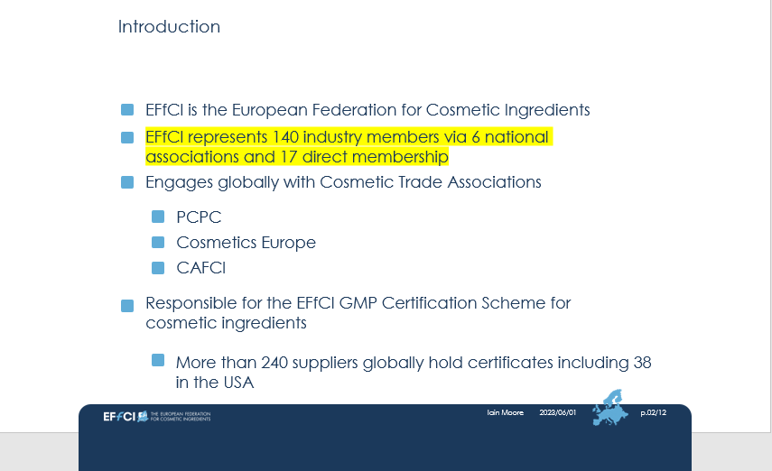
Introduction

Slide 45
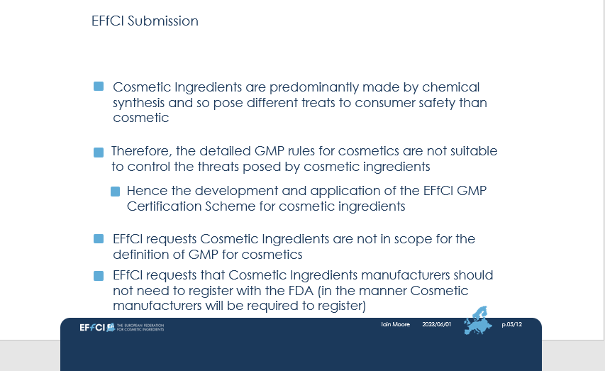
EFfCl Submission

Slide 46
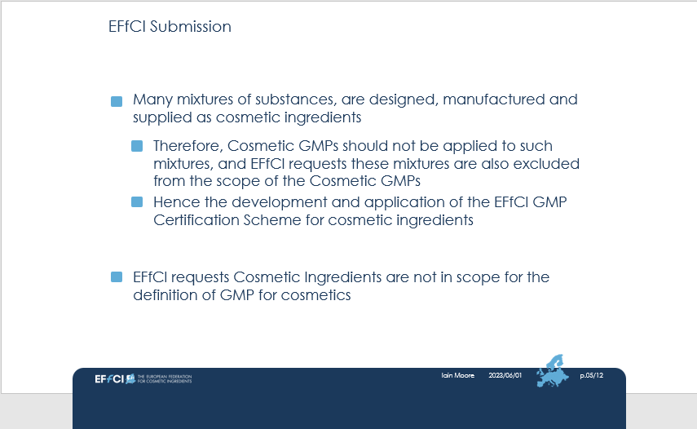
EFfCI Submission

Slide 47
Comments with Slides
Speaking Order
59. Caroline Bassoni
60. Alexandra Kowcz
61. Iain Moore
62. Brandi Reinbold
63. Matteo Zanotti Russo
Verbal Presentations
64. Sophie Chen
65. David Manley
66. Prerna Vashisht
Currently Speaking
Brandi Reinbold
NSF International, MI

Slide 48
The National GMP Standard
June 1, 2023
NSF/ANSI 455-3 Cosmetics Good Manufacturing Practices
Brandi Reinbold
Senior Manager, Global Certification
Docket No. FDA-2023-N-1466

Slide 49
NSF/ANSI 455-3 Good Manufacturing Practices For Cosmetics
Scope includes ISO 22716:2007 and FDA Guidance, to which industry largely already complies
  ISO 22716:2007 meets the international compliance needs of global companies.
  FDA Guidance meets US needs and further protects public health.
An American National Standards Institute (ANSI) consensus standard
Key Features:
As an Accredited National Standard (ANS) there exists more US control than with ISO.
Anyone can participate in the ANSI process today.
Provides a regular forum for formal discussion between interested parties.
Voting interests require balance between industry, public health and users of the standard.
Requires substantial consensus for change – one interest cannot take precedence.
Includes a companion guidance document used to communicate flexible expectations.
FDA can choose to not include the certification requirements procedural section 5 or use accredited third-party certification to make risk-based inspection decisions.

Slide 50
Standards Incorporated by Reference in Regulation
There is a long history of use of voluntary consensus standards and related conformity assessment activities by federal agencies supported in law by the National Technology Transfer Act (NTTAA) of 1996 and in guidance to federal agencies in OMB A-119.
Benefits:
Reduces cost and time for agency to develop a government - unique regulation
Utilizes private sector technical and business expertise
Aligns regulation with existing industry best practices reducing confusion and compliance time
Engages balanced interests in the process
Utilization of third-party conformance assessments allows agency to maximize use of limited inspection resources
Limitations:
Federal law requires version reference
Official changes to version are complex
NSF/ANSI 455-3
Maximizes benefits
Moderates the limitations

Slide 51
Sr. Manager, Global Certification
Brandi Reinbold breinbold@nsf.org
Standard Liaison:
Rachel Brooker rbrooker@nsf.org
For More Information

Slide 52
Comments with Slides
Speaking Order
59. Caroline Bassoni
60. Alexandra Kowcz
61. Iain Moore
62. Brandi Reinbold
63. Matteo Zanotti Russo
Verbal Presentations
64. Sophie Chen
65. David Manley
66. Prerna Vashisht
Currently Speaking
Matteo Zanotti Russo
Angel Consulting, PA

Slide 53



Dr. Matteo Zanotti Russo
Dr. Matteo Zanotti Russo

Slide 54

Suggestions for improving Cosmetic GMP
The hidden link between GMP and Safety Substantiation
Introducing the Risk Analysis

Slide 55
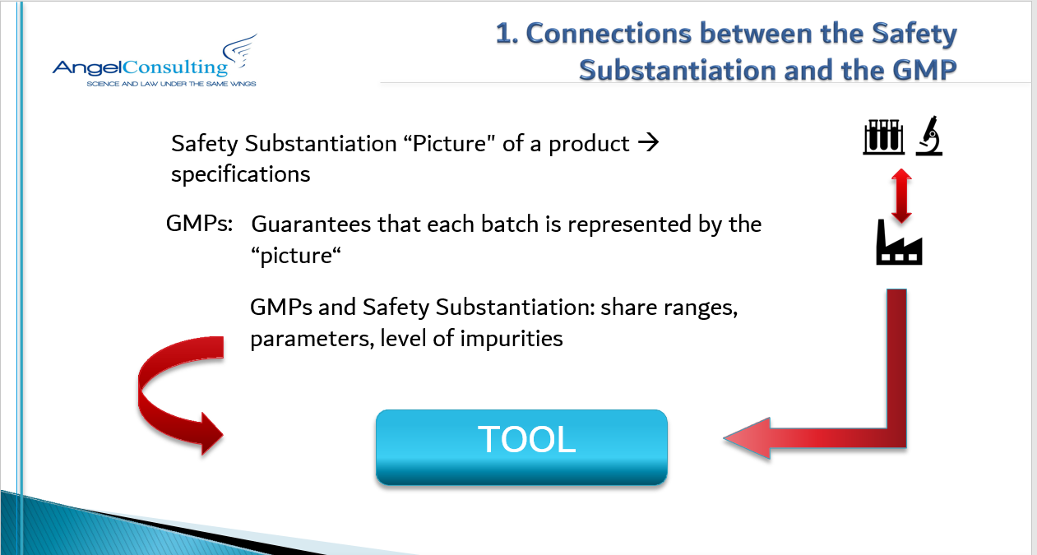
1. Connections between the safety substantiation and the GMP

Slide 56
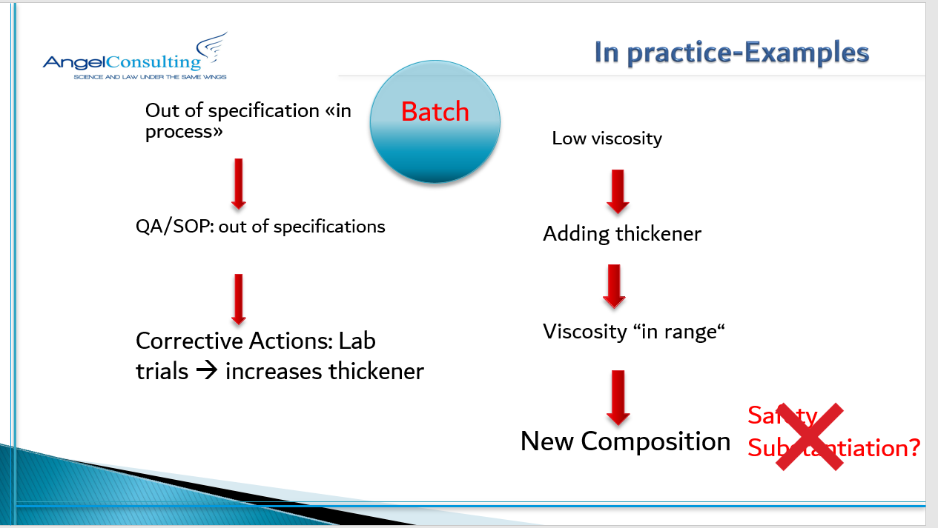
Examples

Slide 57

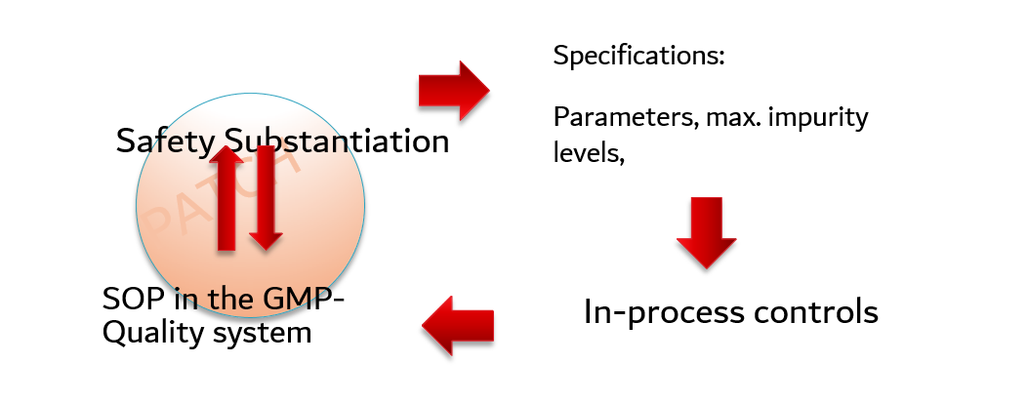






Best Practice: SOPs

Slide 58
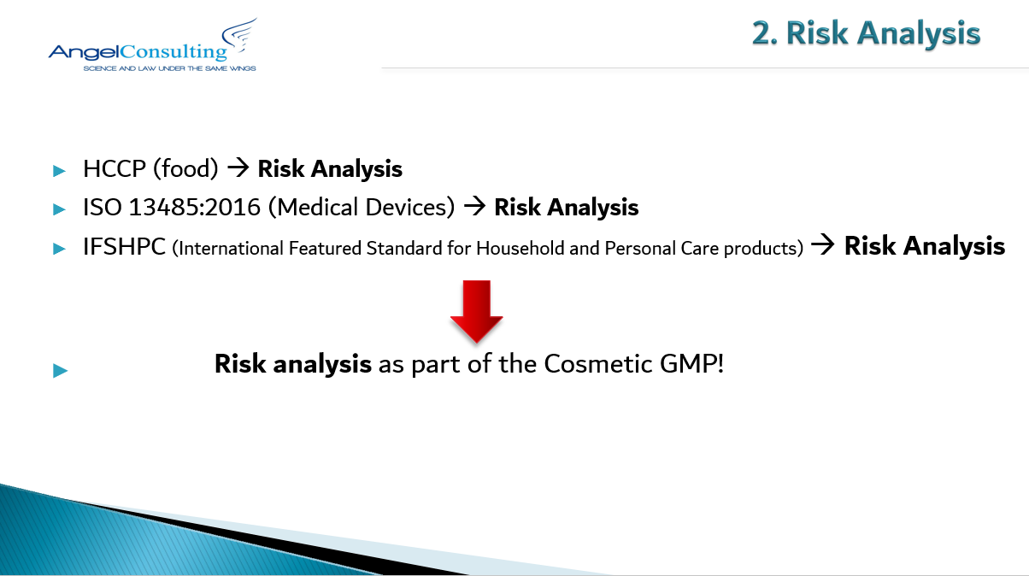
Risk Analysis

Slide 59

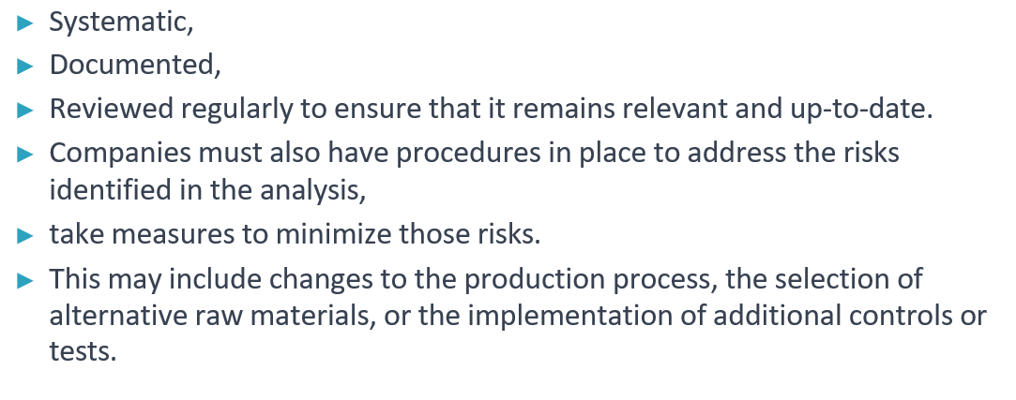
Risk Analysis

Slide 60

Thanks for your attention!

Slide 61
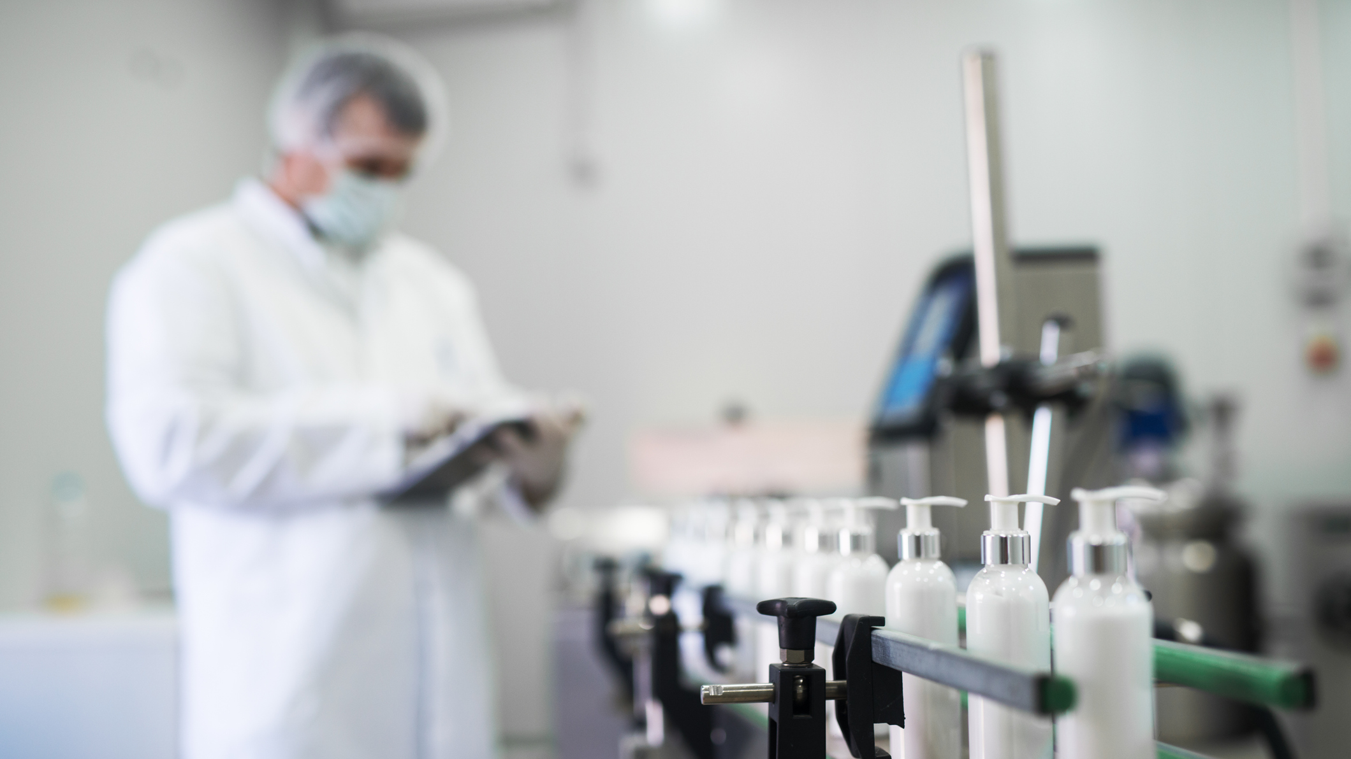


U.S. Food and Drug Administration (FDA) Public Meeting: Good Manufacturing Practices for Cosmetic Products Listening Session
PUBLIC MEETING:
Good Manufacturing Practices for Cosmetic Products Listening Session
June 1, 2023
10:00 AM - 4:00 PM (Virtual) FDA-2023-N-1466 ​
June 1, 2023
10:00 am - 4:00 pm
Virtual Meeting
Docket No. FDA-2023-N-1466
61

