Slide 1
Biosimilar and Interchangeable Products
Foundational Concepts
Level 1

Slide 2
Contents
What is a Biological Product?
  What Is a Biological Product?
  What Is a Biosimilar?
  What Is an Interchangeable Biosimilar Product?
Approved Biosimilars and the US Health Care Market
  The Promise of Biosimilars
  Biosimilars and Interchangeable Biosimilar Product Availability
Inherent Variation in Biologics
  Biologics Contain Inherent Variation
  Role of Clinical Studies
Differences Between Generics and Biosimilars
  Biosimilars Are Not Generics
  Comparing and Contrasting Generics and Biosimilars
Biological Product Approval Pathway
  Biological Product Development
  Analytical Studies Form the Foundation of the Biosimilar Application Pathway
Practical Considerations for Using Biosimilars and Interchangeable Biosimilars
  Biologics Naming Convention
  Prescribing Biosimilars and Interchangeable Biosimilars
  Biosimilar and Interchangeable Products in Primary Care and Community Practice: Insulins
  The Purple Book
Adoption of Biosimilars
  Adoption of Biosimilars and Interchangeable Biosimilars
  Adoption of Biosimilars
  Formulary Coverage and Reimbursement for Biosimilars
Resources
Key Takeaways
Knowledge Assessment
  Multiple Choice Questions

Slide 3
What Is a Biological Product?

Slide 4


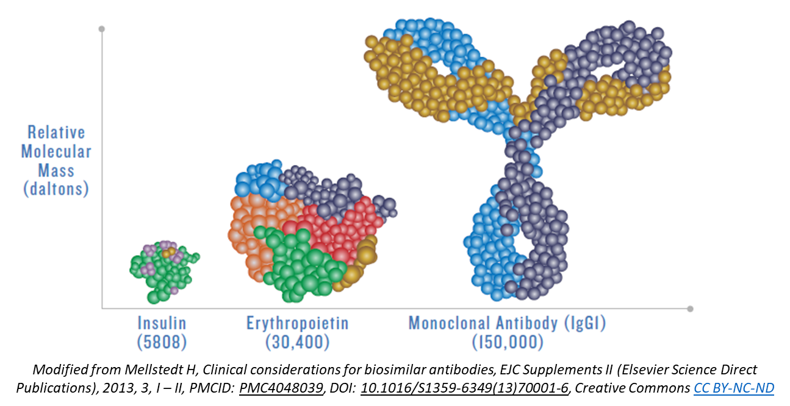
What Is a Biological Product?
Biological products (also called biologics) are generally large, complex molecules that range in size and complexity. Typically, they are produced in living systems (e.g., microorganisms, plant cells, animal cells) using recombinant DNA technology. This presentation refers to reference products, biosimilar products (also called biosimilars), and interchangeable biosimilar products (also called interchangeable biosimilars).
Biologics, including biosimilar and interchangeable biosimilars, can be used to prevent, treat, or cure a range of diseases and medical conditions. Many types of biologics are approved for use in the United States, including therapeutic proteins; vaccines; blood, blood components or derivatives; allergenic products; and monoclonal antibodies.

Slide 5
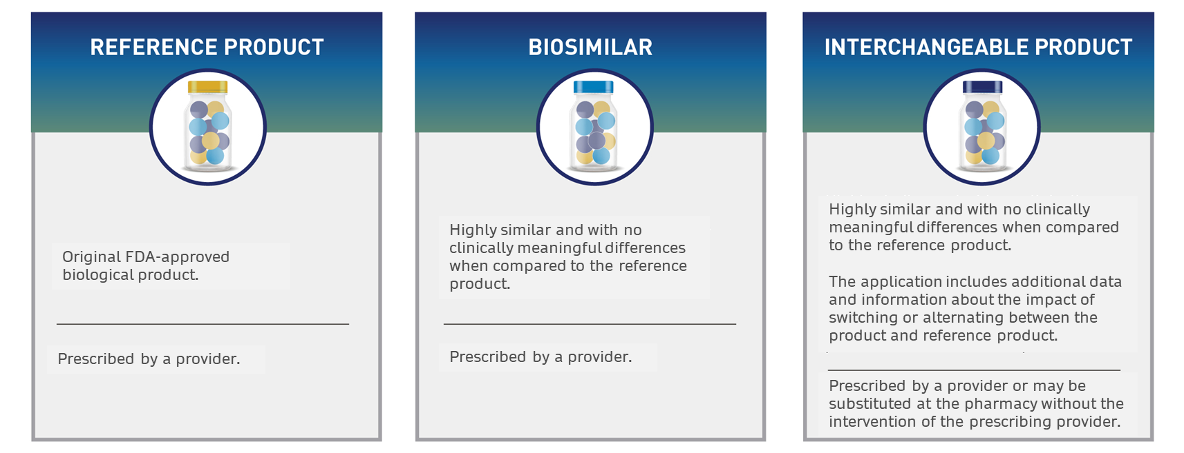
What Is a Biosimilar?
Compared to a reference product:
A biosimilar has no clinically meaningful differences in terms of the safety, purity, and potency (i.e., safety and effectiveness).
Biosimilars are made from the same types of sources, are administered the same way, and have the same strength, dosage, potential treatment effects, and potential side effects as the reference product.
All FDA-approved biosimilars undergo a rigorous evaluation to ensure they are as safe and effective as their reference products.

Slide 6
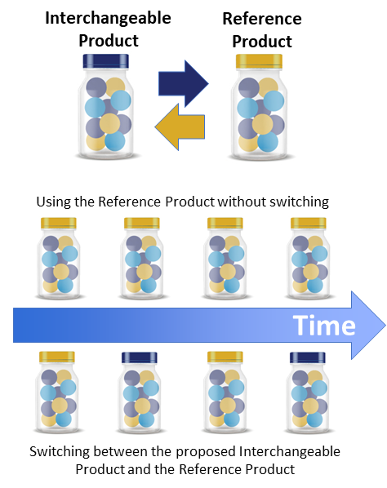
What Is an Interchangeable
Biosimilar Product?
An interchangeable product is a biosimilar that may be substituted for a reference product without the intervention of the prescribing healthcare provider, depending on state pharmacy laws.
FDA-approved interchangeable biosimilars can be expected to produce the same clinical result as the reference product in any given patient, and the risk in terms of safety or diminished efficacy of alternating or switching between the interchangeable biosimilar and the reference product is not greater than the risk of using the reference product without such alternation or switch.
Manufacturers generally conduct switching studies in which patients alternate between the reference product and the interchangeable biosimilar and compare them to patients who are just being treated with the reference product and results must show no decrease in effectiveness or increase in risk when switching.
While this additional information helps FDA to determine if a biosimilar is interchangeable with its reference product, this does not mean that an interchangeable biosimilar is safer or more effective than other biosimilars.

Slide 7
Approved Biosimilars and the US Health Care Market

Slide 8
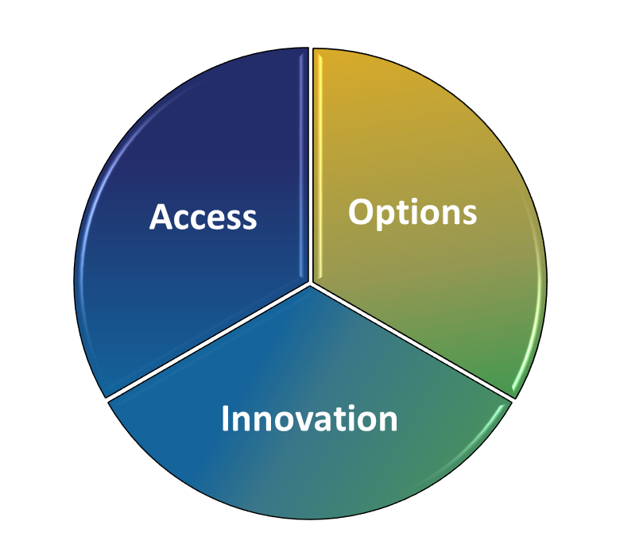
The Promise of Biosimilars
Biosimilars and interchangeable biosimilars may offer significant benefits:
Enable cost savings to the patient, payor, and the health system through greater access to life-saving medicines.
Provide more treatment options for patients and access to innovative therapies.
Support competition, which may drive innovation and technological advancement among originator biologics.

Slide 9
Biosimilar and Interchangeable
Biosimilar Product Availability
The continued development and availability of biosimilar and interchangeable biosimilar products presents a major opportunity for savings in the U.S. healthcare market, with some estimates projecting a savings of $180 billion over the next five years as a result of biosimilars.¹
Not all FDA-approved biosimilars will be available on the U.S. healthcare market due to multiple factors, such as ongoing patent litigation, formulary availability, and exclusivity protections that delay market entry.
As of 2023, biosimilars have been launched for
12 originator products representing 14% of biologics spending.
Biosimilars are already in development for an additional 30 therapeutic products without a currently approved biosimilar or interchangeable product.
$180B
The U.S. biologics market has grown an average of 12.5% annually over the past five years, and now comprises 46% of total medicine spending.
12
30
46%
Savings as a result of biosimilars are projected to exceed $180 billion between 2023 – 2027, representing a four-fold increase from estimates of the preceding five years.
694 Million Patient Days
¹ IQVIA (2023). Biosimilars in the United States 2023–2027: Competition, Savings, and Sustainability.
Notes:
Launched biosimilars account for 24% of competitive molecule/biologics volume, and 11% of total biologics spending
14% (38bn) of biologics market (260bn) molecules facing biosimilar competition
36% 96bn worth of biologics market (260bn) have biosimilars in development
46% of market spending is on biologics
By 2027, spending on biosimilars expected to reach $20-49bn and reach $129bn cumulatively over next five years
Savings resulting from biosimilars over next five years projected at $180bn

Slide 10
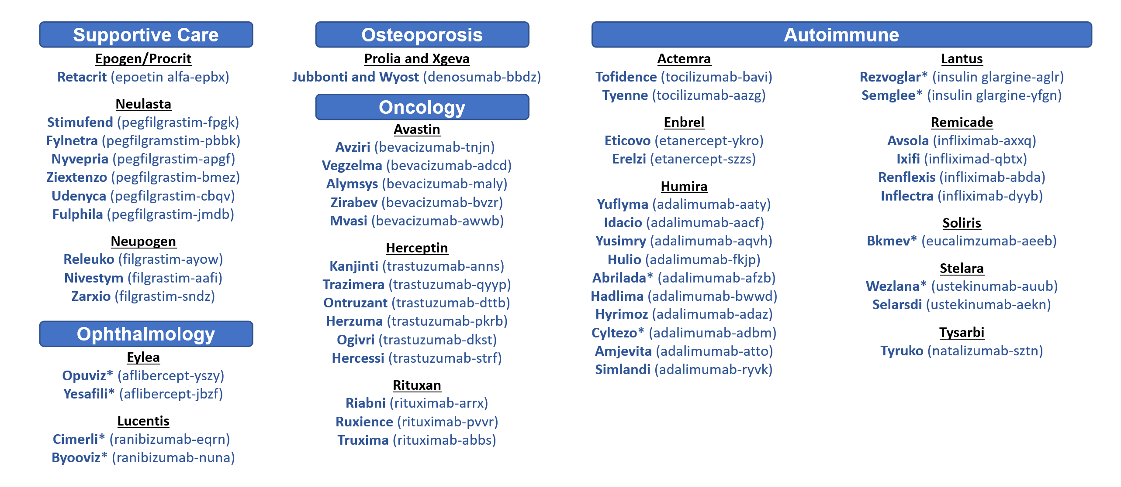
Reference Products and Approved
Biosimilars as of May 2024 (53 total)
Note: Products with an asterisk have the 351(k) Interchangeable designation.

Slide 11
Inherent Variation in Biologics

Slide 12
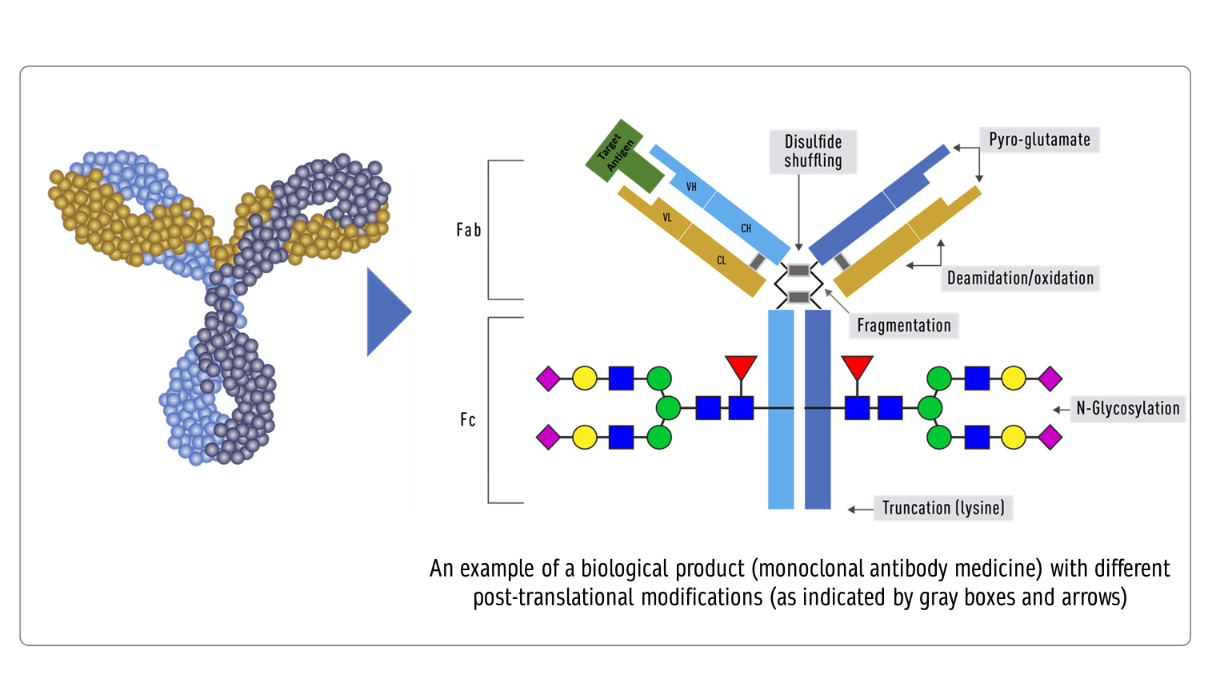
Biological Products Contain
Inherent Variation
Cells can make exact copies of the protein, but after the protein is made, other variations (e.g., add-ons and changes) may occur, like the addition of sugar molecules or the modification of certain amino acids.

Slide 13
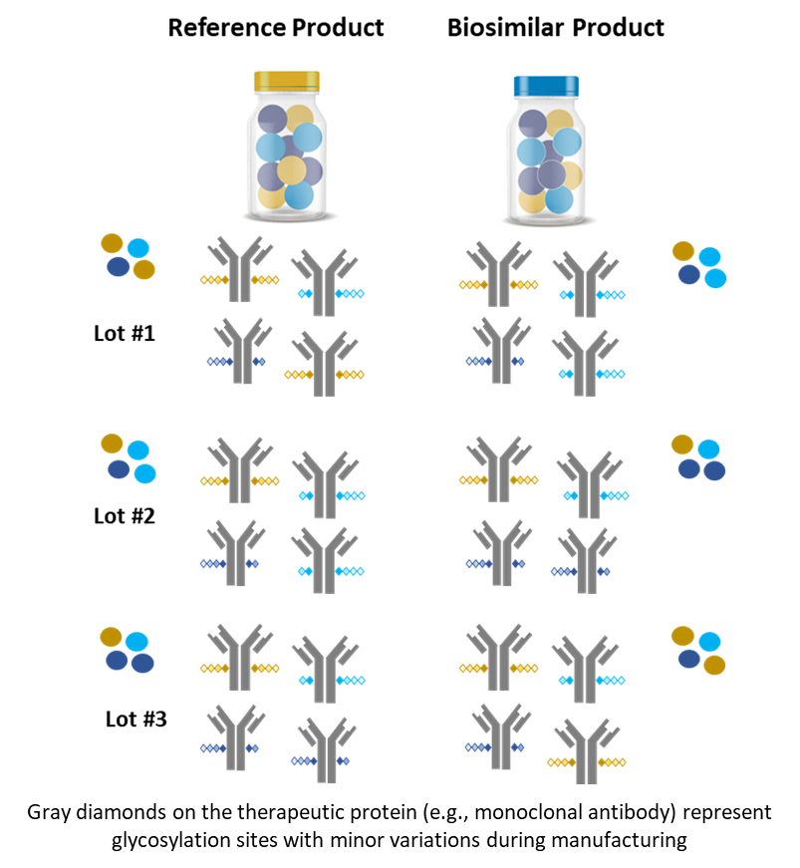
Biological Product Lot-to-Lot Variability
Because biologics are generally made in cells, there are inherent variations that result from the manufacturing process. Inherent variation may also exist within lots and between different lots of reference products and biosimilars. A lot of a reference product and biosimilar can contain millions of slightly different versions of the same protein or antibody.
As part of the approval process for both reference products and biosimilars, FDA assesses a biosimilar manufacturer’s strategy to control for the pattern and degree of variations between different lots to help ensure consistent safety and effectiveness.
Manufacturers must demonstrate that their proposed biosimilar product has similar variations compared to the reference product and that their product has no clinically meaningful differences in terms of safety and effectiveness. Compared to the reference product, the effect of the biosimilar is the same, dosing is the same, and administration is the same.

Slide 14
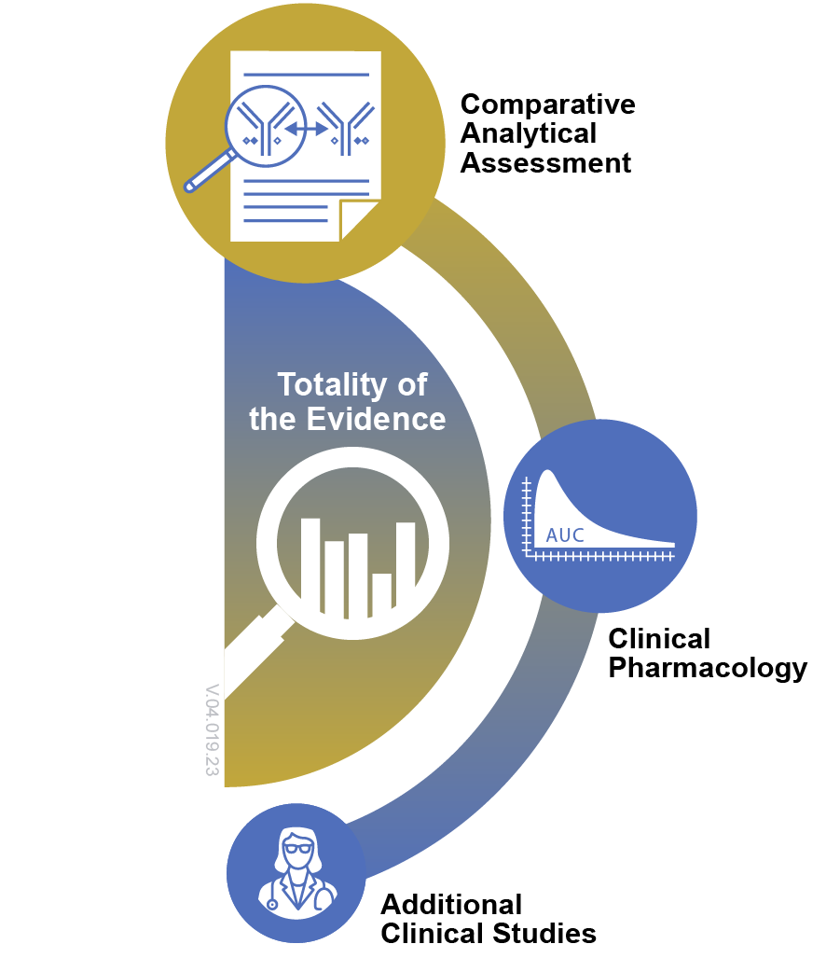
Role of Clinical Studies
As a scientific matter, FDA expects:
An adequate clinical PK comparison, and PD comparison if relevant, between the proposed biosimilar and reference product.
An assessment of immunogenicity for the proposed biosimilar product.
A comparative clinical study in patients can contribute to the totality of the evidence supporting biosimilarity.

Slide 15
Difference Between Generics and Biosimilars

Slide 16
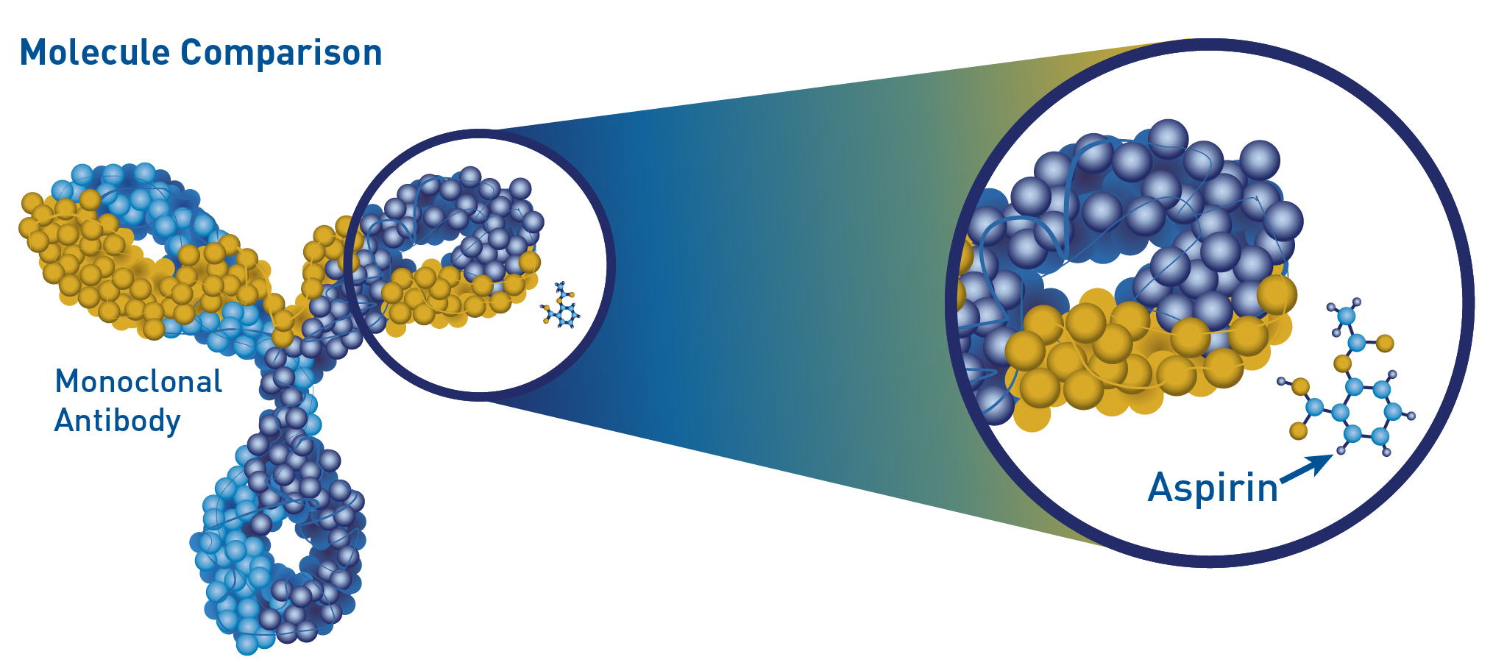
Biosimilars Are Not Generics
Biosimilars and generic drugs are both versions of original brand-name medicines that may offer patients more affordable treatment options. There are, however, important differences:
Generic drugs are usually chemically synthesized while biological products, including biosimilars, are generally manufactured from living sources.
Because the active ingredients of generic drugs generally are smaller and simpler, they are usually easier to copy.
Biologics generally cannot be copied exactly, because the product (e.g., monoclonal antibody) contains a mix of many slight variations of a given protein that occurs during its production from living sources, which introduces inherent variation.

Slide 17
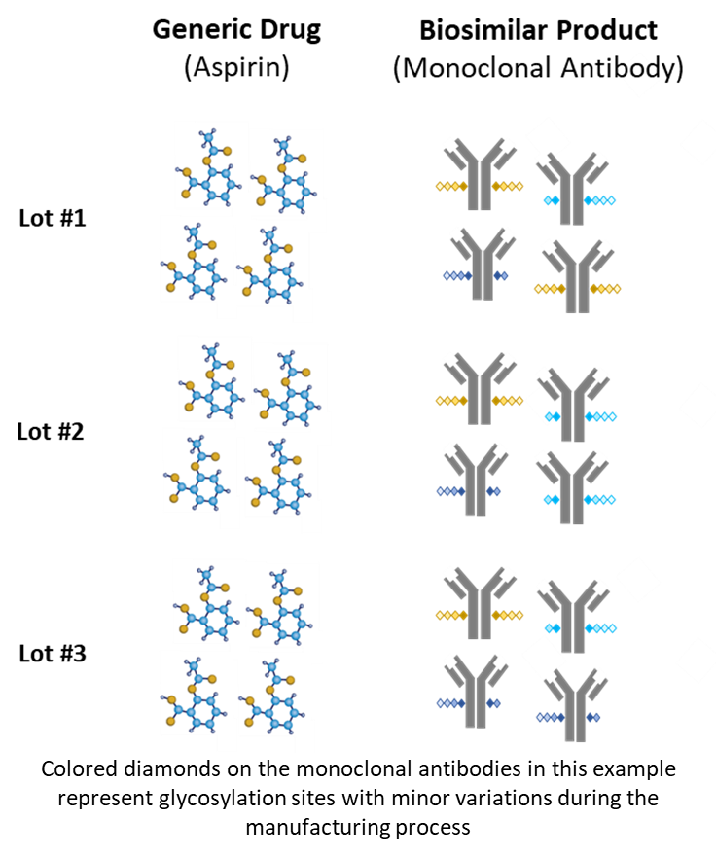
Comparing and Contrasting Generics and Biosimilars
Biosimilars, including interchangeable biosimilars, and generic drugs are both versions of brand-name medicines, which may offer more affordable treatment options to patients. Examples of important differences between biosimilars and generics are in the table below.
Generics | Biosimilars
Typically manufactured through chemical synthesis. | Typically manufactured from living sources.
Generally smaller, simpler molecules. | Generally larger, complex molecules.
Identical active ingredient between lots (i.e., no variation). | Inherent variability (i.e., small variations in protein molecules) exists from lot to lot. The FDA assesses manufacturers’ strategies to control for variability to ensure consistency in safety and effectiveness.
Must demonstrate active ingredient is the same as in the reference listed drug. | Must demonstrate highly similar to the reference product with only minor differences allowed/expected in inactive ingredients.
Must demonstrate bioequivalence to the reference listed drug. | Must demonstrate no clinically meaningful differences from the reference product.

Slide 18
Biological Product Approval Pathways

Slide 19
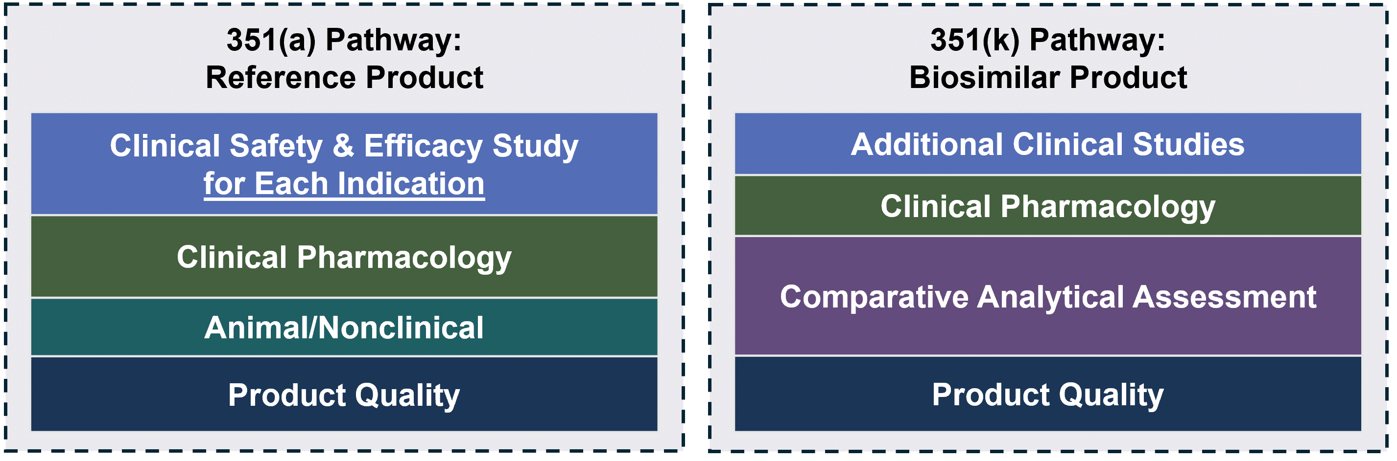
Biological Product Development
Development programs for a new biological product (reference product) and a biosimilar have different goals. The goal of biosimilar development is not to independently establish the safety and effectiveness of the proposed product, but to demonstrate that the proposed biosimilar is highly similar to and has no clinically meaningful differences from the FDA-approved reference product. When seeking approval, this generally means that manufacturers of biosimilars do not need to repeat expensive and lengthy clinical trials. This may potentially lead to additional therapeutic options and reduced costs for patients.
For biosimilars:
The analytical assessment serves as the foundation for demonstrating biosimilarity. The assessment compares multiple physicochemical and functional attributes of the proposed biosimilar and the reference product.
Finally, manufacturers conduct comparative clinical studies comparing the proposed biosimilar to the reference product, which typically include comparison of pharmacokinetics (PK), pharmacodynamics (PD), and immunogenicity, when applicable.

Slide 20
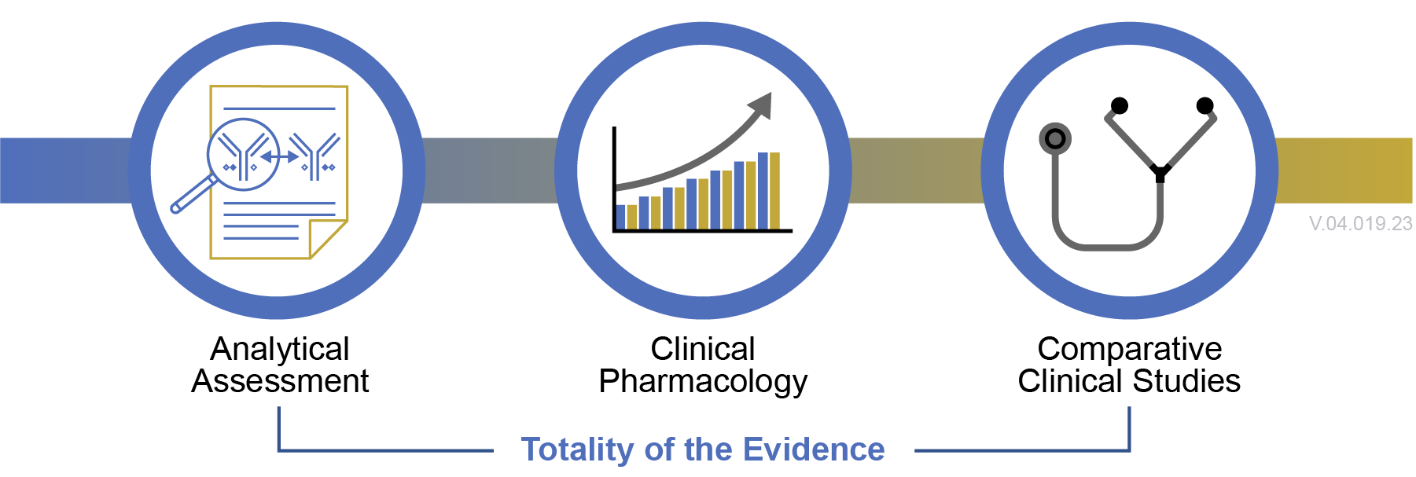
Analytical Studies Form the Foundation of the Biosimilar Application Pathway
Approval of a biosimilar is based on the totality of the evidence submitted by the applicant to provide an overall assessment that the proposed product is biosimilar to the reference product. Analytical studies form the foundation of the assessment and may be supported by clinical studies.
The nature and scope of clinical studies will depend on the extent of residual uncertainty about the product’s biosimilarity, if any, after conducting structural and functional characterization studies comparing the biosimilar to the reference product.

Slide 21
Practical Considerations for Using Biosimilars and Interchangeable Biosimilars

Slide 22
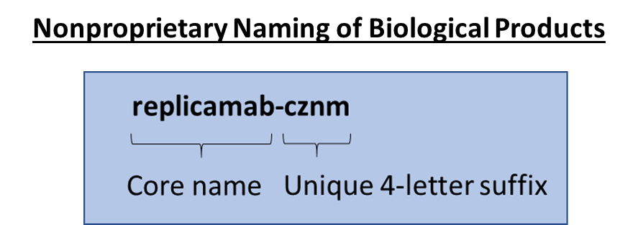
Biologics Naming Conventions
Many biologics*, including reference, biosimilar, and interchangeable biosimilar products, are subject to FDA’s naming policy.
The naming convention is a combination of a nonproprietary core name and a unique, product-identifying 4-letter suffix to help distinguish products.
FDA adopted the naming convention to help with pharmacovigilance and safe use for all biologics and to help patients and
providers know which biologic medicine is being prescribed and dispensed.
Health care professionals should include the 4-letter suffix when ordering, prescribing, dispensing, and in recordkeeping and pharmacovigilance practices, including reporting adverse events to MedWatch, the FDA Safety Information and Adverse Event Reporting Program.
The biosimilar or interchangeable biosimilar will share the same core name as its reference product.
*Note: Some reference products approved prior to implementation of the naming convention may not have a suffix.

Slide 23
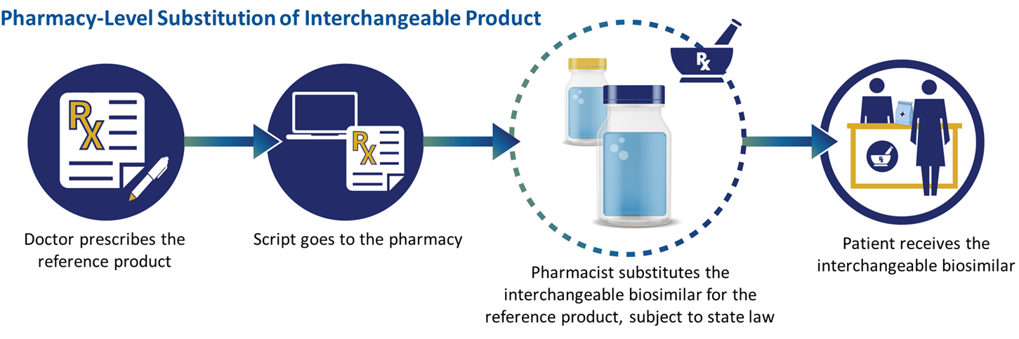
Prescribing Biosimilar and
Interchangeable Biosimilars
Health care professionals can prescribe biosimilars and interchangeable biosimilars by name, just as they would prescribe other medications.
Interchangeable biosimilars may be substituted for the reference product without the intervention of the prescribing health care provider, subject to state laws. State laws that address substitution of biological products at the pharmacy vary; therefore, it is important for prescribers and pharmacists to understand the pharmacy practices in their state.
Health care providers do not need to wait for a biosimilar to be approved as an interchangeable product to prescribe it. FDA does not approve a product as interchangeable unless a company specifically seeks an interchangeability determination. Biosimilars are as safe and effective as the reference product to which they were compared.
Pharmacy-Level Substitution of Interchangeable Biosimilars

Slide 24

The Purple Book
The Purple Book: Database of Licensed Biological Products is a user-friendly online database with information on all FDA-approved biologics. It provides patients, payors, clinicians, and others with an accessible, easy-to-use online search engine with information about FDA-approved biologics, including whether a specific biologic is a reference product, biosimilar, or interchangeable biosimilar.
Features of the Purple Book
  Simple and advanced search options
  Auto-suggest search function
  Additional search filters
  Data download options
  Links to product labels (Drugs@FDA)
  Ability to show/hide sortable columns of information
  Ability to print or export search results
  Searchable glossary of terms
purplebooksearch.fda.gov

Slide 25
Adoption of Biosimilars

Slide 26
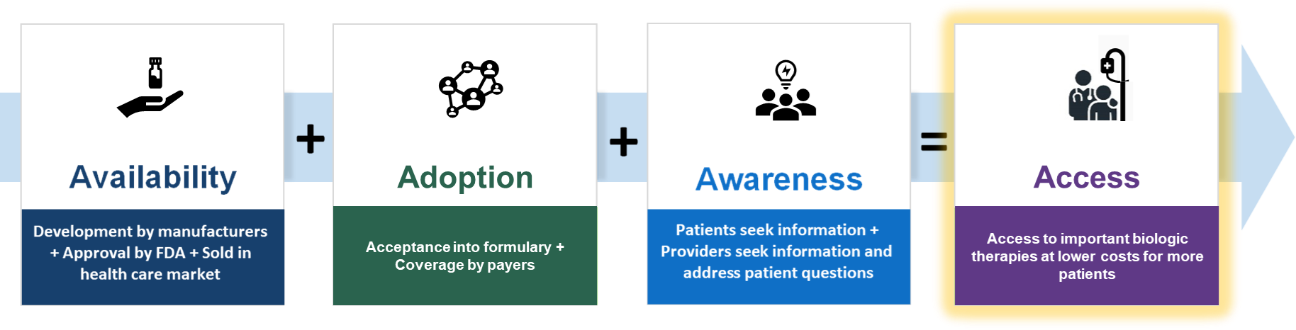
Adoption of Biosimilar and
Interchangeable Biosimilar
Adoption of biosimilars and interchangeable biosimilars and increased access to important therapies in the United States require not just the approval of these medicines by FDA and adoption by health care institutions (e.g., formulary inclusion, payor coverage), they also require awareness and acceptance by patients and health care providers.

Slide 27
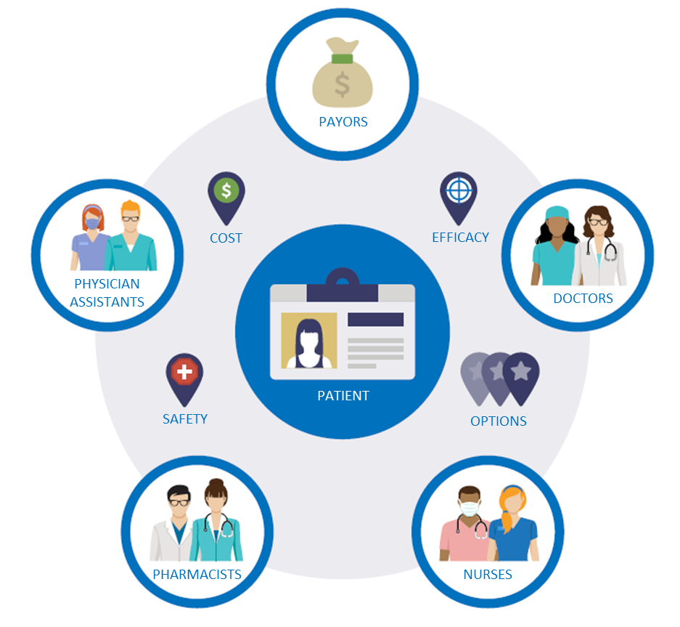
Adoption of Biosimilars
Patients seek information primarily from their health care providers (e.g., doctors, nurses, physician assistants, pharmacists) as trusted sources on the safety and effectiveness of potential treatment options.
Understanding patients’ needs for information related to biosimilars can support health care providers as they have conversations about biosimilars in the shared decision-making process.
As the number of available biosimilar and interchangeable products grow, providers will increasingly encounter patients taking a biosimilar product in primary care and community health settings (e.g., patients taking insulin)

Slide 28
Formulary Coverage and
Reimbursement for Biosimilars
While the FDA does not have a direct role in drug pricing, FDA supports a competitive marketplace for biologics, including biosimilars and interchangeable biosimilars, to improve patient access to medicines and facilitate the reduction of health care costs. FDA recognizes that coverage and reimbursement significantly impact the adoption of biosimilar and interchangeable products and depend on many factors, such as insurance plans, formulary coverage, and an adequate understanding of biosimilarity and the FDA’s approval standards. Understanding the impact on workflow and patient acceptance, as well as cost and reimbursement issues, is also a factor. As more biosimilars and interchangeable biosimilars enter the market, understanding of coding and payment rates is becoming increasingly important.
Resources on Coverage of Biosimilars and Interchangeable Biosimilars:
Center for Medicare & Medicaid Services (CMS): Part B Biosimilar Biological Product Payment and Required Modifiers
US Commercial Health Plans: Plans vary on how particular biosimilars are covered. According to an analysis of publicly available data on coverage decisions, U.S. commercial health plans only covered biosimilars as “preferred” products in 14% of coverage decisions in 2019 (Chambers JD et al., 2020, JAMA)
Payors: Biosimilars: Considerations for Payers (Smeeding J et al., 2019, P&T)
States: State laws and legislation related to biologic medications and substitution of biosimilars (National Conference of State Legislatures [NCSL])

Slide 29
Resources

Slide 30
Resources
FDA Pages
  Biosimilar materials
  Provider materials
  Patient materials
  Purple Book
  Drugs@FDA (Drug Information)
  Search page for FDA guidances
  Advisory committee materials for biosimilars
  Biosimilar approval process information
Additional Resources for Health Care Students
  Resource Guide for Teaching Faculty
  Slide Decks (Levels 1 and 2):
    Foundational Concepts
    Regulatory and Scientific Concepts
  Case study (Levels 1 and 2):
    What Is a Biosimilar?
    Biosimilars in Patient Care
    Interchangeable Biosimilars
    Insulins/Interchangeable
    Comparative Analytical Assessment
  Info sheets (Levels 1 and 2):
Biological Products, Biosimilar Products, and Interchangeable Biosimilars Products
Generics and Biosimilars
Manufacturing and Variation
Biosimilar Regulatory Approval Pathway
Variation in Biological Products
Comparative Clinical Studies
Prescribing Biosimilar Products and Interchangeable Biosimilar Products
Purple Book
Insulins/Interchangeable
Comparative Analytical Assessment
Quality Attributes
Labeling/Package Insert
  Explanatory Videos (Level 2):
    Manufacturing and Inherent Variation
    Biosimilar Approval Process
    Critical Quality Attributes
    Interchangeability
    Purple Book
    Procedural Purple Book
    Totality of the Evidence
    Comparative Analytical Assessment
  Discussion Questions (Levels 1 and 2)
    Foundational Concepts
    Regulatory and Scientific Concepts
  Exercises (Levels 1 and 2) Provided in the Resource Guide for Teaching Faculty
  Resources

Slide 31
Key Takeaways

Slide 32
Key Takeaways
What is a biosimilar? | Generics and biosimilars | Variation in biologics and safety of biosimilars | Prescribing and substitution | Potential impacts of biosimilars in US health care
Biosimilars are biological products that are highly similar to and have no clinically meaningful differences from an FDA-approved reference product. | Comparing biosimilars to generics is a useful analogy at a high level, but remember there are important differences. For example: Generics generally are chemically synthesized and usually can be copied more easily. Biosimilars are more complex and cannot be copied exactly. | Reference products and biosimilars are approved through different regulatory pathways. All biologics (both reference products and biosimilars) contain slight, natural variation as they are typically manufactured from living sources. Assessments are performed to compare the biosimilar to the reference product to ensure that any inherent variability in the final product does not result in any clinically meaningful differences in terms of safety and effectiveness. | Health care professionals can prescribe biosimilars and interchangeable biosimilars just as they would prescribe other medications. FDA-approved interchangeable biosimilars may be substituted for the reference product without the intervention of the prescribing health care provider, subject to state laws. Laws differ by state on biological product substitution. | Biosimilars can offer more treatment options at potentially lower costs than the reference product. Multiple factors drive product availability on the market such as patents, exclusivity protections, business decisions by the manufactures, and policies/coverage by payors. Health care leaders can help educate stakeholders to encourage biosimilar inclusion in formularies and coverage by payors.

Slide 33
Knowledge Assessment

Slide 34
Multiple Choice Questions – 1 of 11
Section: What is a biological product?
Q1: What is a biosimilar product?
A biosimilar is a biological product.
A biosimilar is highly similar to an FDA-approved biological product, also called the reference product.
A biosimilar has no clinically meaningful differences from the reference product (i.e., patients and providers can expect the same benefits and risks as the reference product).
*All of the above.
None of the above.

Slide 35
Multiple Choice Questions – 2 of 11
Section: What is a biological product?
Q2: Which of the following statements about interchangeable biosimilar products are true?
All interchangeable biosimilar products are biosimilar products.
All biosimilar products are interchangeable products.
To be approved as an interchangeable biosimilar product, biosimilar manufacturers must demonstrate that the risk in terms of safety or diminished efficacy of alternating or switching between the interchangeable biosimilar product and the reference product is not greater than the risk of using the reference product alone.
*A and C.
B and C.

Slide 36
Multiple Choice Questions – 3 of 11
Section: What is a biological product?
Q3. A biosimilar product…
Is a biological product that is highly similar to an FDA-approved biological product, called the reference product.
Has no clinically meaningful differences from the reference product (i.e., patients and providers can expect the same benefits and risks as the reference product).
Has the same dosage, route of administration, potential benefits and risks, safety, and efficacy as the reference product.
A and C.
*All of the above.

Slide 37
Multiple Choice Questions – 4 of 11
Section: What is a biological product?
Q4. An interchangeable biosimilar product…
Is a biosimilar product.
Can be expected to produce the same clinical result in patients as the reference product.
Has the same safety and efficacy as the reference product when alternated with the reference product.
May be substituted without the intervention of a medical prescriber, subject to state laws.
*All of the above.

Slide 38
Multiple Choice Questions – 5 of 11
Section: Approved Biosimilars and the US Health Care Market
Q5. Biosimilar products play a role in the US health care market by:
Increasing competition thereby potentially decreasing cost of biological products.
Decreasing access.
Expanding treatment options.
*A and C.
A and B.

Slide 39
Multiple Choice Questions – 6 of 11
Section: Difference Between Generics and Biosimilar Products
Q6: Which of the following statement(s) is true regarding biosimilar products and generic drugs?
Biosimilar products generally are large complex molecules that are manufactured from living cells while most generic products are small molecules that are typically manufactured chemically.
Biosimilars are made up of identical molecules with no variation.
Manufacturers must demonstrate that generics are highly similar and have no clinically meaningful differences from the reference product.
The active ingredient in generics is the same as the active ingredient in the reference listed drug.
*A and D.

Slide 40
Multiple Choice Questions – 7 of 11
Section: Biological Product Approval Pathway
Q7: Which statement(s) is false regarding the biosimilar 351(k) approval process?
*Biosimilar products and reference products are approved through the same regulatory approval pathway by FDA.
Reference products are approved in a stand-alone application through the 351(a) regulatory approval pathway by FDA whereas biosimilar products are approved through a different, abbreviated regulatory approval pathway by FDA.
The abbreviated regulatory approval pathway for biosimilar products can be less expensive and less time-consuming than the pathway for reference products in part because biosimilar manufacturers can rely on FDA’s finding of safety and effectiveness for the reference product.
FDA ensures that biosimilar manufacturers demonstrate that the biosimilar product is highly similar to and has no clinically meaningful differences from the reference product in terms of safety, purity, and potency.
B and C.

Slide 41
Multiple Choice Questions – 8 of 11
Section: Biological Product Approval Pathway
Q8. Which of the following is true regarding the biosimilar 351(k) approval process?
Biosimilar manufacturers must demonstrate that biosimilar products are highly similar to and have no clinically meaningful differences from the reference product.
Comprehensive comparative analytical studies form the foundation of the data package submitted by biosimilar manufacturers.
FDA generally expects additional comparative clinical pharmacological data (pharmacokinetics and pharmacodynamics) and comparative clinical efficacy studies (human studies) for a proposed biosimilar product based on the totality of the evidence presented by the biosimilar manufacturer for a particular indication.
A and B.
*All of the above.

Slide 42
Multiple Choice Questions – 9 of 11
Section: Biologics Naming System
Q9: Which statement is true about the naming convention for biological products?
Many biological products and all biosimilar products use a nonproprietary name that consists of a core name plus a unique, product-identifying 4-letter suffix that is devoid of clinical or pharmacological meaning.
The naming convention is intended to help patients and medical providers track which biological product is being administered (reference product vs. biosimilar product vs. interchangeable biosimilar product).
The naming convention aids in postmarket surveillance.
*A, B, and C.
A and C.

Slide 43
Multiple Choice Questions – 10 of 11
Section: Prescribing and Substitution
Q10. Which statement is true about prescribing biosimilar products and interchangeable biosimilar products?
Biosimilar products and interchangeable biosimilar products can be used in patients who have previously been treated with the reference product (i.e., treatment-experienced), as well as in patients who have not previously been treated with the reference product (i.e., treatment-naïve).
Interchangeable biosimilar products may be substituted without the intervention of the healthcare provider, subject to state laws.
State laws that address substitution of biological products at the pharmacy level vary; therefore, it is important for prescribers and pharmacists to understand the pharmacy practices in their state.
*All of the above.
None of the above.

Slide 44
Multiple Choice Questions – 11 of 11
Section: Adoption of Biosimilars
Q11. Adoption of biosimilar products in the US health care market may be affected by which of the following factors, among others:
Cost to manufacture individual biosimilar products is different for different products.
Biosimilar coverage is dependent on individual payors and type of insurance. Different payors (e.g., insurance companies, Medicare, Medicaid) may or may not have biosimilar products on their formularies. Therefore, not all biosimilar products may be covered by payors or insurance types.
Even though a biosimilar product may be approved for use in the United States by FDA, it may not be marketed because of existing patents on the reference product, among other reasons.
*All of the above.
None of the above.

