Slide 1

Microphysiological Systems (MPS): Bridging Human and Animal Research
An FDA/CDER Perspective
Amy Avila, PhD
Pharmacology/Toxicology Reviewer
FDA/CDER/Office of New Drugs
Division of Pharmacology/Toxicology for Neuroscience
January 19-20, 2021

Slide 2
Disclaimer
The content of this presentation represents the opinions of the speaker and does not necessarily represent the official position of CDER and FDA.

Slide 3
New Approach Methodologies (NAMs):
The CDER Definition
“CDER considers NAMs to include a broad range of methods such as in vitro, in chemico, and in silico methods. In vivo methods can also be considered NAMs when they improve predictivity, shift studies to phylogenetically lower animals, or otherwise help replace, reduce, and refine animal use (i.e., the 3Rs) in development programs.”
Avila, et al. An FDA/CDER perspective on nonclinical testing strategies: Classical toxicology approaches and new approach methodologies (NAMs). Regulatory Toxicology and Pharmacology 114 (2020).

Slide 4
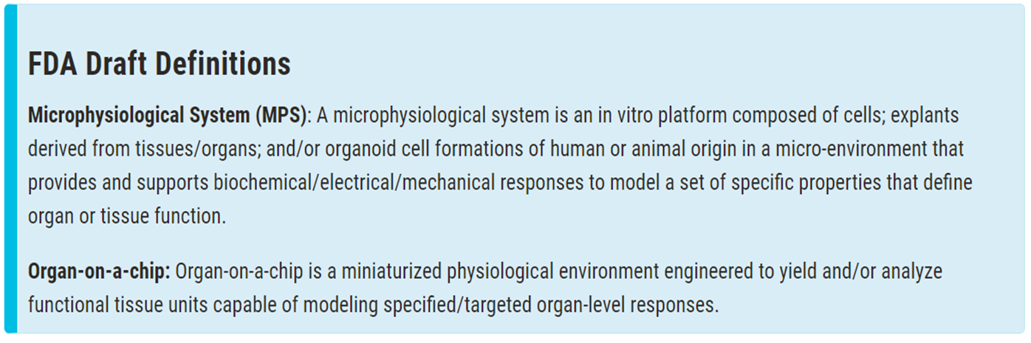
FDA Draft Definition

Slide 5
CDER experience with complex in vitro models in regulatory applications
Searched CDER’s electronic document room for study reports in section M4 of IND/NDA/BLAs
Microphysiological: 15 results – but all are just in literature references
Liver chip: 2 results – but just in a discussion about possible follow up studies
Reconstructed human epidermis: 115 – mostly skin corrosivity and irritation
Organoids: 83 results – mostly pharmacology; examples: bronchial epithelium, intestinal (including from patients with disease), retinal
Spheroids: 760 results – many are histopath results; 78 in “other toxicity studies” – mostly hepatocyte, also thyroid, and angiogenic assays
iPSC: 178 results – mostly pharmacology; hepatocytes, neurons, cardiomyocytes
No hits for organ chip, tissue chip, brain chip, kidney chip, microbrain, microphysiological systems

Slide 6
Code of Federal Regulations
21 CFR Part 312.23
  (8) Pharmacology and toxicology information. Adequate information about pharmacological and toxicological studies of the drug involving laboratory animals or in vitro, on the basis of which the sponsor has concluded that it is reasonably safe to conduct the proposed clinical investigations.
  (ii) Toxicology. (a) An integrated summary of the toxicological effects of the drug in animals and in vitro. Depending on the nature of the drug and the phase of the investigation, the description is to include the results of acute, subacute, and chronic toxicity tests; tests of the drug's effects on reproduction and the developing fetus; any special toxicity test related to the drug's particular mode of administration or conditions of use (e.g., inhalation, dermal, or ocular toxicology); and any in vitro studies intended to evaluate drug toxicity.

Slide 7
ICH Guidance
M3(R2) Nonclinical Safety Studies for the Conduct of Human Clinical Trials and Marketing Authorization for Pharmaceuticals
I. INTRODUCTION. A. Objectives of the Guidance (1.1)
This guidance should facilitate the timely conduct of clinical trials, reduce the use of animals in accordance with the 3R (reduce/refine/replace) principles, and reduce the use of other drug development resources. Although not discussed in this guidance, consideration should be given to use of new in vitro alternative methods for safety evaluation.

Slide 8
Some Guidances Explicitly Describe Alternative Approaches
ICH S3 Q&A - microsampling
ICH S5(R3) - in vitro, ex vivo and nonmammalian embryofetal toxicity
ICH S10 - in chemico and in vitro phototoxicity
FDA Draft Nonclinical Immunotoxicity guidance– in silico, in chemico, and in vitro skin sensitization methods
Other alternatives routinely accepted
Ocular irritation - OECD Guidelines 437, 438, 460, 491, 492, 494
Skin irritation – OECD Guideline 439

Slide 9
Guidances Allow Justified Use of Alternative Methods
Example FDA guidance wording:
“FDA supports the principles of the 3Rs (replace/reduce/refine) for animal use in testing when feasible. FDA encourages sponsors to consult with review divisions when considering a nonanimal testing method believed to be suitable, adequate, and feasible. FDA will consider whether the alternative method is adequate to meet the nonclinical regulatory need.”
FDA Draft Guidance for Industry: Nonclinical Safety Evaluation of the Immunotoxic Potential of Drugs and Biologics (Feb 2020)

Slide 10
The CDER Perspective
Potential of NAMs
Improve Regulatory Efficiency
Expedite Drug Development
Answer Unmet
Needs

Slide 11
Current safety testing paradigm (CDER)
Key Issues Addressed by Pharmacology and Toxicology
Studies Supporting Pharmaceutical Development
  Pharmacological effects and mechanism(s) of action
  Risk attributes of drug ADME
  Safe “first in human” starting dose
  Safe maximum exploratory doses in early clinical trials
  Possible consequences of chronic exposure
  Risks for special populations (e.g., pediatrics)
  Specific parameters to monitor more closely in clinical trials
  Risks that are difficult or unethical to assess in humans
  Mechanistic understanding of an adverse biological change observed in animals or humans

Slide 12
General Considerations for a NAM
Scientific Evidence
Scientific Confidence
Does the scientific community agree the assay is suitable?
Scientific Need
Is the assay fit for its intended purpose?
Does the method improve the current testing strategy?
Does the new method inform on the safe use of a drug?
Will the new approach add value?
Is there a clear regulatory need for the assessment?

Slide 13
Moving Toward Regulatory Use
Does an assay provide data that can be used to answer fundamental drug development questions?
Assay Maturity
Endpoints
Scientific Validity
Applicability Domain
Criteria for Success

Slide 14
Context of Use
What Scientific Question Needs to Be Answered And For What Purpose?
How much “validation/qualification” is needed for a particular assay will depend on the particular context of use.
Replacement of pivotal nonclinical safety study
Discovery/Screening
Helps define acceptable applicability domain and limitations
Context could be expanded over time

Slide 15
Principles for Validation
Rationale for assay – need and purpose
Relationship of endpoint to in vivo effect of interest, also limitations
Detailed protocol
Intra-test variability, repeatability and reproducibility of the test method within and amongst laboratories
Test method’s performance must have been demonstrated using a series of reference chemicals
Performance of a test method should be evaluated in relation to existing relevant toxicity data
Data supporting the validity must be available for review
Data should be obtained in accordance with GLPs
*ICH S5(R3) Annex 2: Qualification of Alternative Test Systems for Regulatory Acceptance
(adapted from OECD Guidance Document on the Validation and International Acceptance of New or Updated Test Methods for Hazard Assessment)

Slide 16
How the Agency Supports NAMs
Partnerships with Scientific Organizations
Internal Scientific Working Groups
Alternative Methods Working Group (AMWG)
PTTC Subcommittees
Training and Seminars
Collaborations with FDA Laboratories/Stakeholders
ICH
ICCVAM
CiPA/HESI
Giving presentations as well as attending
IQ Consortium
Division of Applied Regulatory Science (DARS/CDER) technology evaluations
NCTR evaluations
Both internal and external (this talk!)
Alternative Methods Working Group (AMWG)
ISTAND
Toxicology Working Group

Slide 17
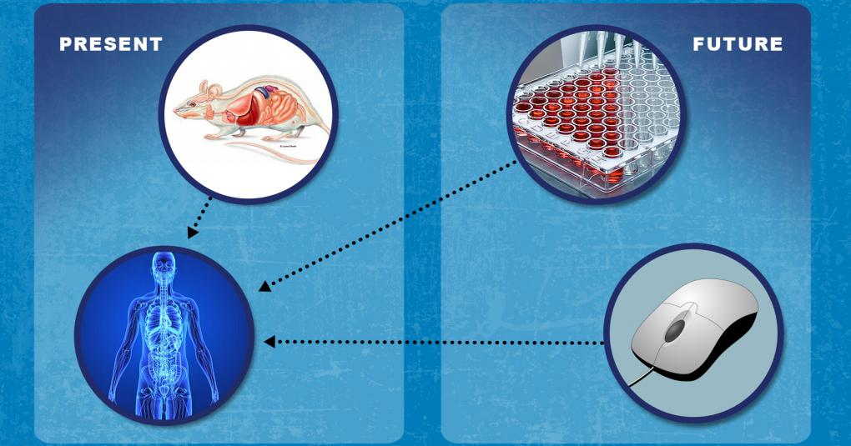
Alternative Methods Working Group (AMWG)
Under Office of Chief Scientist, Office of Commissioner, FDA
  Contact: Alternatives@fda.hhs.gov
Strengthen FDA’s commitment to promote/use of new technologies to better predict efficacy and safety
Coordinate research, training, and discuss around new, emerging methodologies across FDA
Interact with partners/stakeholders to facilitate discussion and development of performance criteria for assays
Explore use of such technology for regulatory science applications

Slide 18
The Innovative Science and Technology Approaches for New Drugs (ISTAND)
Pilot creates a pathway for developers to submit proposals for novel approaches that don’t have an existing regulatory path.
The pilot provides:
  Early engagement with developers and early FDA input – before the novel approach is tried in an IND development program or submitted within an NDA
  New mechanisms to efficiently collaborate and share knowledge of new tools throughout divisions, offices, and centers, creating more consistency on FDA’s advice to external parties
Potential outcomes:
  Qualification of novel drug development tools (DDT)
  If not optimal for DDT qualification: Public meeting, White Paper, Guidance
ISTAND Web page

Slide 19
NAMs in CDER
Goals
Improve predictivity while not compromising current safety evaluations
Contribute to the 3Rs
FuturePlans
Participation in the development and regulatory use of NAMs
Determine metrics that can be used to measure the success of NAMs and how they should be evaluated for utility in drug development

