Slide 1

Testing Methodologies for Elongate Mineral Fibers in Talc-Containing Consumer Products and Source Materials (Ore Samples)
Who: Steven P. Compton, Ph.D.
What: Microscopist with doctoral degree in Condensed Matter Physics
When: Studying asbestos, talc, nanoparticles, and other IH/environmental materials for over 10 years
Where: MVA Scientific Consultants
Why: Here to discuss testing methods & real world applications performed for industry and litigation
Disclaimer: Industry results are considered confidential; any results provided today were from testing performed at the expense of plaintiffs’ attorneys with publication rights reserved
FDA 2020
Notes:
Good afternoon! My name is Steven Compton. I am a microscopist with a degree in Condensed Matter Physics. I’ve been studying microscopic particles both natural and engineered for over a decade with Dr. Millette and other scientists at MVA. As it relates to the topic today, I have been retained by clients in industry and in litigation to test mineral samples and talcum powder products for the presence of asbestos. Since non-litigation work is considered confidential, any scientific results I may discuss will be from litigation cases where MVA was retained by attorneys representing plaintiffs; however, the science does not change depending on who our client is.

Slide 2
Method Development
Instrumentation Options
Sample Prep Options
X-Ray Diffraction
Polarized Light Microscopy
Transmission Electron Microscopy
Unaltered
Ashing
Acid Digestion
Acid/Base Digestion
Elutriation
Density Separation
Notes:
Any proposed method needs to address two components: what instrument is used to analyze the sample and how is the sample prepared for analysis.

Slide 3
Instrumentation Options
X-Ray Diffraction
Polarized Light Microscopy
Transmission Electron Microscopy
Capable of cataloging major crystalline components
Poor sensitivity likely to produce false negatives
Cannot determine if detected mineral is fibrous
Notes:
XRD is capable of cataloging the major and some minor crystalline components in a powder. This can be a useful screening tool; however, the lack of sensitivity when compared to other methods makes it likely to produce false negatives and it is not a visual technique, so it provides no information on mineral fibrosity

Slide 4
Instrumentation Options
X-Ray Diffraction
Polarized Light Microscopy
Transmission Electron Microscopy
Good visual inspection tool
Cannot detect thinnest fibers
Optical properties become difficult to discern for thinner fibers
Minerals may have overlapping optical properties
Notes:
PLM, on the other hand, does provide a visual representation of a sample and is the workhorse of the asbestos testing industry when it comes to building materials and consumer products which may have been formulated with commercially viable asbestos as an ingredient. It struggles with very thin fibers (i.e. samples which have been ground or milled into a fine powder) and optical properties can at times be ambiguous or difficult to determine either because the fiber is too thin or because of arbitrary human-determined cutoffs in solid solution series minerals.

Slide 5
Instrumentation Options
X-Ray Diffraction
Polarized Light Microscopy
Transmission Electron Microscopy
Capable of unequivocal identification based on fundamental mineral properties
Smaller sample sizes
Notes:
TEM looks at fundamental properties of every individual particle, like elemental composition and crystal structure – the properties used by geologists to define minerals. The drawback with this method is sample size. For a positive result, this may not be an issue; but how meaningful is a negative result when you have only examined a fraction of a gram as a representation of an entire batch or a mine?

Slide 6
Instrumentation Comparison (2014 Study of Historic Cosmetic Talc)
Sample Number | XRD Result | PLM Result | TEM Result
U0654 (CB-1930s) | ND | <1% | 3 MFPG
U0655 (CB-1967) | ND | <1% | 28 MFPG
U0656 (CB-1959/1960) | ND | <1% | 167 MFPG
U0657 (CB-1967) | ND | <1% | 202 MFPG
U0658 (CB-1962/1963) | ND | ND | 4.5 MFPG
U0659 (CB-1967) | ND | ND | 84 MFPG
Y1099/U1986 (CB-1967) | ND | ND | 55 MFPG
Y1100 (CB-1967/1970s) | 4% Anth | <1% | 19 MFPG
Y1147 (CB-1973/1975) | ND | ND | 3 MFPG
Y1740 (CB-1973/1977) | ND | <1% | 5 MFPG
Y1741 (CB-1973/1977) | 4% Anth | 2-4% | 18 MFPG
Y2215 (CB-Late 1960s) | ND | ND | 70 MFPG
Y2235 (CB-1967) | ND | <1% | 200 MFPG
Total Positive Samples | 2 (15%) | 8 (62%) | 13 (100%)
Notes:
We can look at a real world study of a historical off-the-shelf cosmetic talc product to see how the three approaches compare. 13 samples of the same product, all containing Italian-sourced talc, were analyzed using XRD, PLM, and TEM. All 13 samples were found to contain asbestos at varying concentrations when analyzed by TEM. Asbestos was detected in only 8 of the samples (62%) when analyzed by PLM and in only 2 samples (15%) when analyzed by XRD. The data produced from the investigation of this product was published in 2014 by Gordon, Fitzgerald, and Millette.

Slide 7
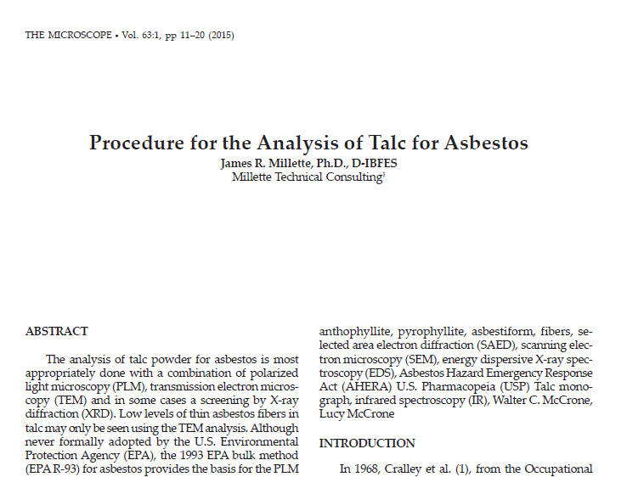
Notes:
And in 2015, Dr. Millette published the procedure and discussed these three methods at length ultimately coming to the recommendation that…

Slide 8
XRD
PLM
Optional
Mandatory
TEM
Notes:
XRD may be useful as a screening tool, but a combination of PLM and TEM is most appropriate for the investigation of asbestos in talc.

Slide 9
XRD
PLM
Optional
Mandatory
TEM
Important note: A negative result by one method does
not override a positive result by another mandatory method
Notes:
One thing Dr. Millette did not explicitly state, no doubt because he believed it was obvious, is that a negative result by one mandatory method cannot negate a positive result by another.

Slide 10
XRD
PLM
Optional
Mandatory
TEM
Important note: A negative result by one method does
not override a positive result by another mandatory method
Implications:
One method, if positive, is sufficient
TEM or PLM alone, if negative, may be insufficient
Notes:
This carries with it two important implications. First, that one method may be a sufficient stopping point if the result is positive. And second, PLM or TEM alone, if negative, may be insufficient.

Slide 11
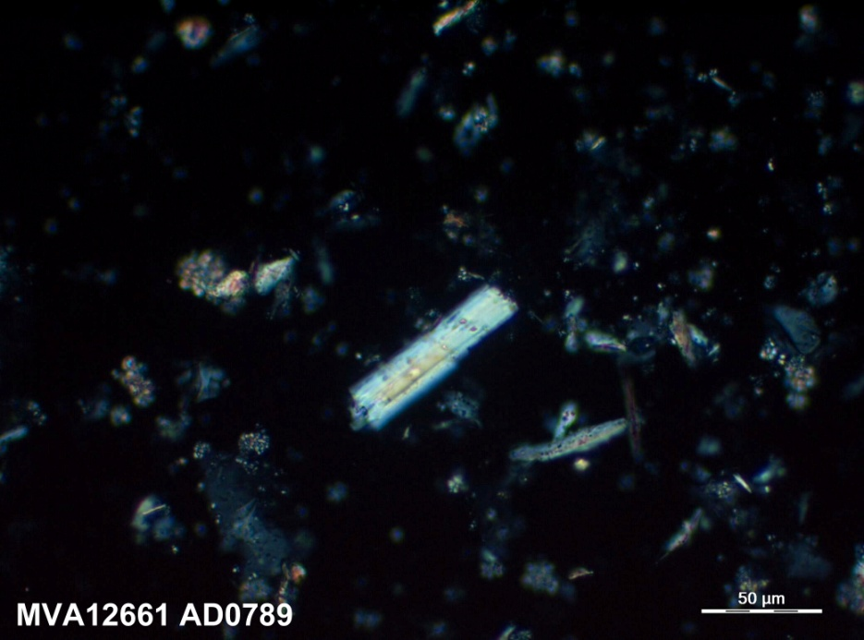
Cosmetic Talc MVA12661
PLM Micrograph
TEM Micrograph
Notes:
There is not a 100% overlap of particles detectable by PLM and TEM. Here’s an example of an off-the-shelf finished cosmetic product where mean aspect ratios of single fibers identified by TEM were approx 7:1, however, bundles of fibers were observed under PLM.

Slide 12
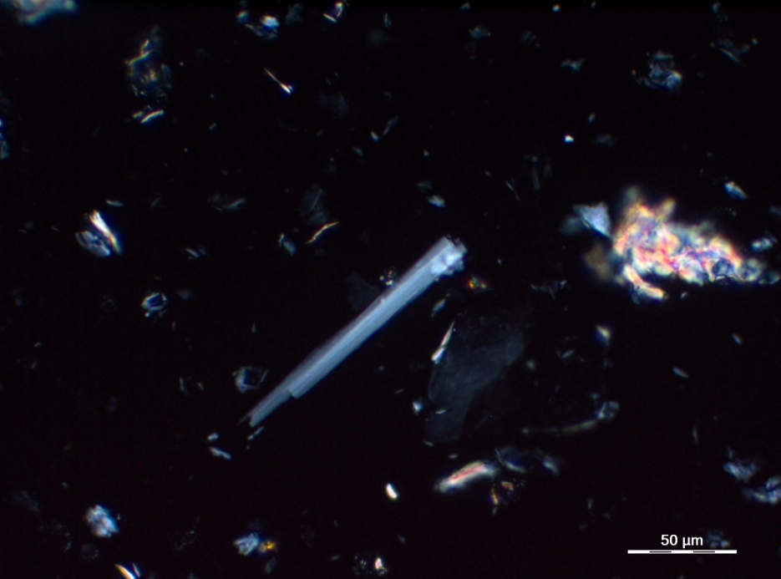
Cosmetic Talc MVA12856
Four samples from 3 decades
PLM Micrograph
Sample Results
Sample ID | PLM Results | TEM Results
AD1544 | NAD | 28 MFPG
AD1545 | NAD | 12.3 MFPG
AD1546 | NAD | ND (<12.5)
AD1547 | <1% | ND (<10.4)
Notes:
This set of samples from a single producer illustrate the important overlap of PLM and TEM. Two samples tested positive for asbestos by TEM. The third and fourth samples were negative by TEM, but asbestos was detected by PLM in the fourth sample. These samples were analyzed without any pre-concentration, so it would be interesting to see if the introduction of such a sample prep approach would reveal the presence of asbestos at lower levels.

Slide 13
Sample Prep Options
Unaltered
Ashing
Acid Digestion
Acid/Base Digestion
Elutriation
Density Separation
Lowest potential for sample loss
Sensitivity suffers from time spent looking through non-fibrous particles
TEM prep should be filtered for quant-ifiable results at low concentrations
Notes:
As for sample prep, there are a variety of ways in which a sample can be prepared for analysis, whether that analysis is XRD, PLM, or TEM. Unaltered samples have the lowest potential for sample loss or changes to fiber chemistry, but this approach will require additional time at the instrument in order to improve sensitivity levels.

Slide 14
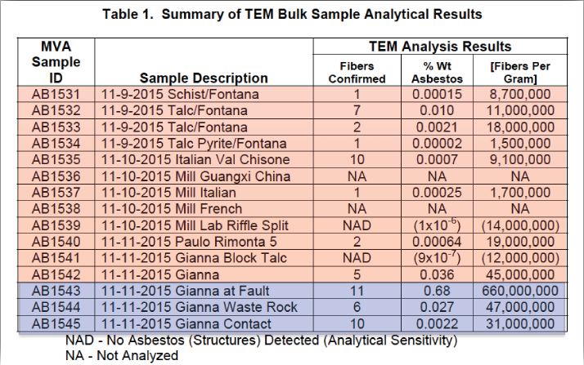
MVA Testing of Italian Talc (Cosmetic Grade Ore
and Surrounding Rock) for Asbestos
Positive Results Range from 1. 5 million to 660 Million Fibers Per Gram
Notes:
We can look at some real world test results in order to gain some understanding of the capabilities of a sample analyzed without pre-concentration. In 2017 a TEM analysis of mineral samples collected from the Val Chisone mine property in Italy indicate samples positive for asbestos ranging in concentration, but as low as 1.5 million fibers per gram. Non detect samples had an analytical sensitivity as high as 14 million fibers per gram.

Slide 15
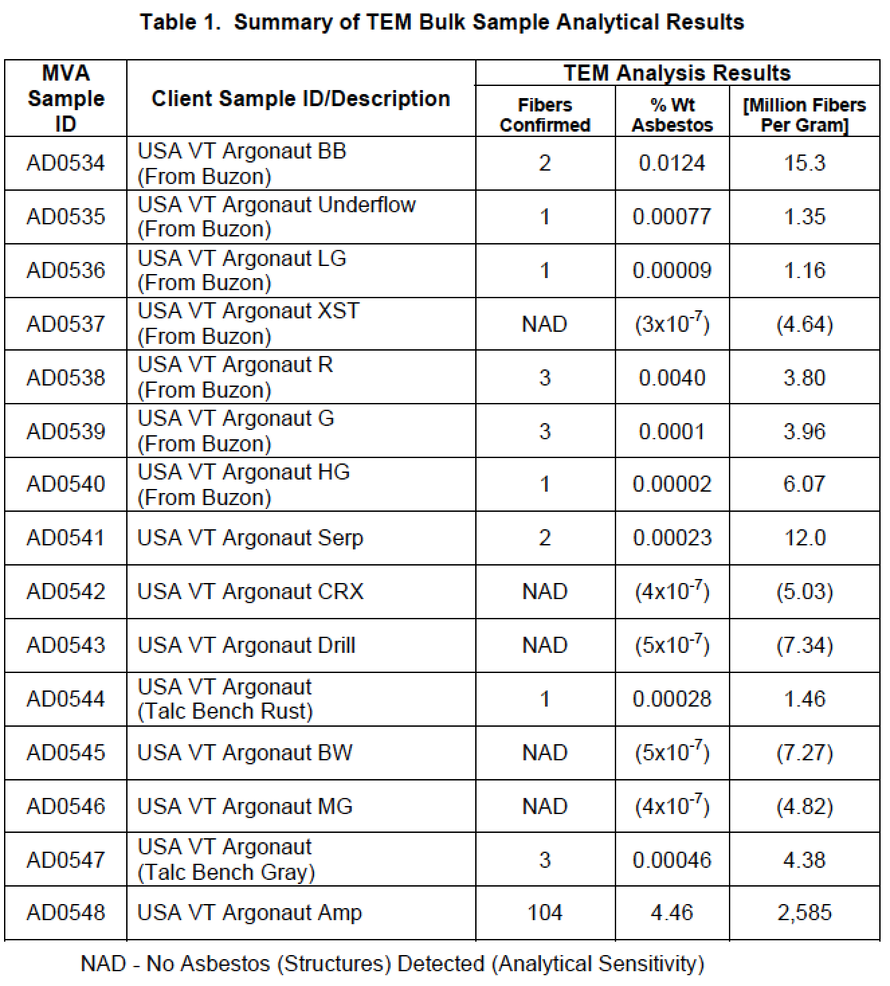
MVA Testing of Vermont Talc (Cosmetic Grade Ore
and Surrounding Rock) for Asbestos
Positive results range from
1.35 million to 2.59 billion
fibers per gram
Notes:
In 2018, TEM analyses of samples collected from the Argonaut mine property in Vermont were capable of detecting asbestos at levels as low as 1.35 million fibers per gram. Non detect samples had an analytical sensitivity as high as 7 million fibers per gram. To improve the sensitivity of TEM we can either examine additional grid openings or we can incorporate steps to eliminate particles that aren’t of interest from the sample during the sample prep phase.

Slide 16
Sample Prep Options
Unaltered
Ashing
Acid Digestion
Acid/Base Digestion
Elutriation
Density Separation
Beneficial for removal of organic materials (e.g. starch)
Ideal temperature 450°C (between 300°C to 500°C)
Notes:
Ashing and acid digestion are commonly used for non-friable organically bound building products

Slide 17
Sample Prep Options
Unaltered
Ashing
Acid Digestion
Acid/Base Digestion
Elutriation
Density Separation
Beneficial for removal of carbonates and other acid soluble components (calcite, gypsum, dolomite)
HCl most commonly used,
acetic and formic acid less common
Notes:
These are standardized approaches, but they do nothing to eliminate platy talc from the sample.

Slide 18
Sample Prep Options
Unaltered
Ashing
Acid Digestion
Acid/Base Digestion
Elutriation
Density Separation
Beneficial for removal of wider range of minerals (including chrysotile)
Preliminary tests show this is not effective at reducing talc
Notes:
Acid/base digestion is very effective at removing some minerals in order to isolate amphiboles.

Slide 19
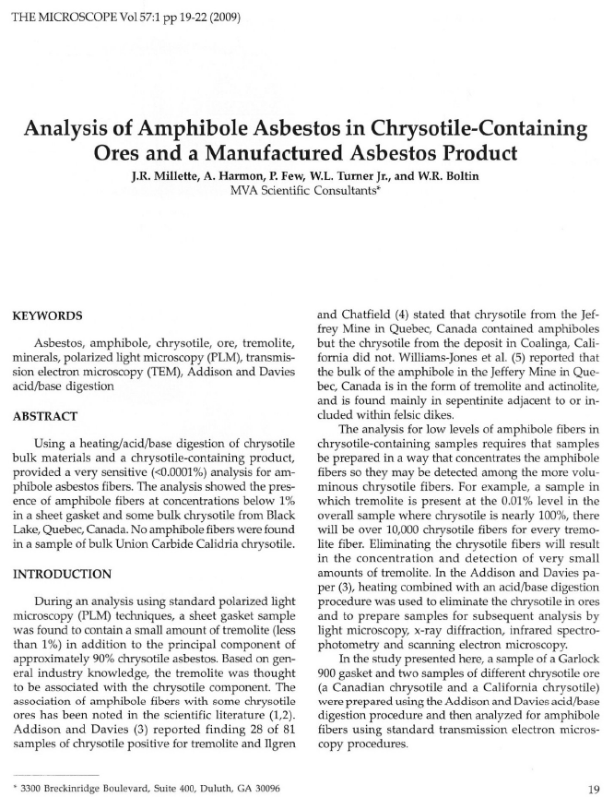
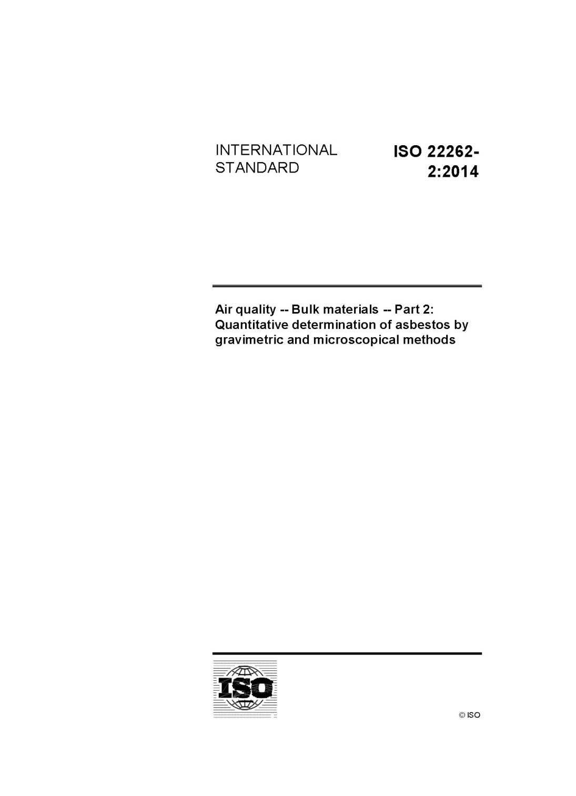
Millette, et al., 2009
ISO 22262-2
Notes:
This is also a standardized approach, commonly used for the detection of amphibole present at low levels as accessory minerals. Unfortunately, talc appears to be resistant to this approach.

Slide 20
Sample Prep Options
Unaltered
Ashing
Acid Digestion
Acid/Base Digestion
Elutriation
Density Separation
Can be performed in solution (aqueous) or in air
Can be used to isolate theoretically respirable fraction
Potential loss of small fibers associated with large aggregates
Notes:
Elutriation, using air flow or water flow to isolate respirable particles seems like a good idea, but great care should be taken that fibers are not lost in the prep

Slide 21
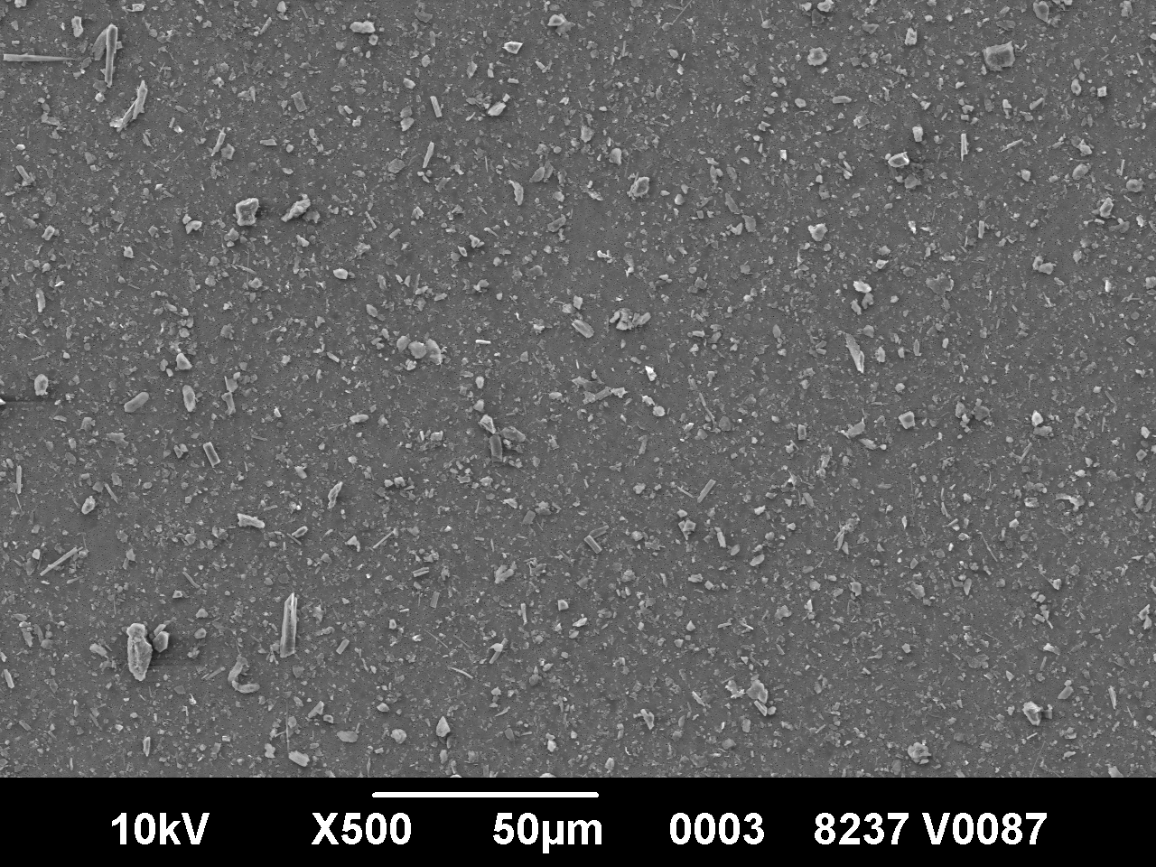
2010 Study of Mineral Fiber Extraction from Talc (Compton)
Prior to Aqueous Elutriation
After Aqueous Elutriation (Targeting PM2.5)
Notes:
This 2010 I performed a study of aqueous elutriation on an industrial talc. The image on the left is an SEM micrograph of an unaltered prep of the sample. The image on the right was also taken using the same instrument at the same magnification after aqueous elutriation. This prep was designed to recover all PM2.5 particles. In theory, aerodynamic equivalent diameter of mineral fibers should be dominated by the fiber width, not length, so I was surprised to see that the long thin fibers evident by the unaltered prep were not present in the elutriated sample. If this approach is utilized great care should be taken to validate the results using carefully selected samples, not just talc with some commercially viable asbestos added.

Slide 22
Sample Prep Options
Unaltered
Ashing
Acid Digestion
Acid/Base Digestion
Elutriation
Density Separation
Heavy liquids of varying densities can be used to isolate iron-rich amphiboles from talc
Two liquids may be required for separation of particles with densities greater than and less than talc
Potential loss of anthophyllite
Notes:
Of all the concentration methods available, density separation shows the most promise because it is the only method that provides a mechanism for removing talc from the sample. But it is not without issues as well. The method may require as many as two different liquids to separate particles with densities less than or greater than talc; however, mineral fibers with an overlapping density, like some forms of anthophyllite, will be removed along with the talc particles and talc fibers.

Slide 23
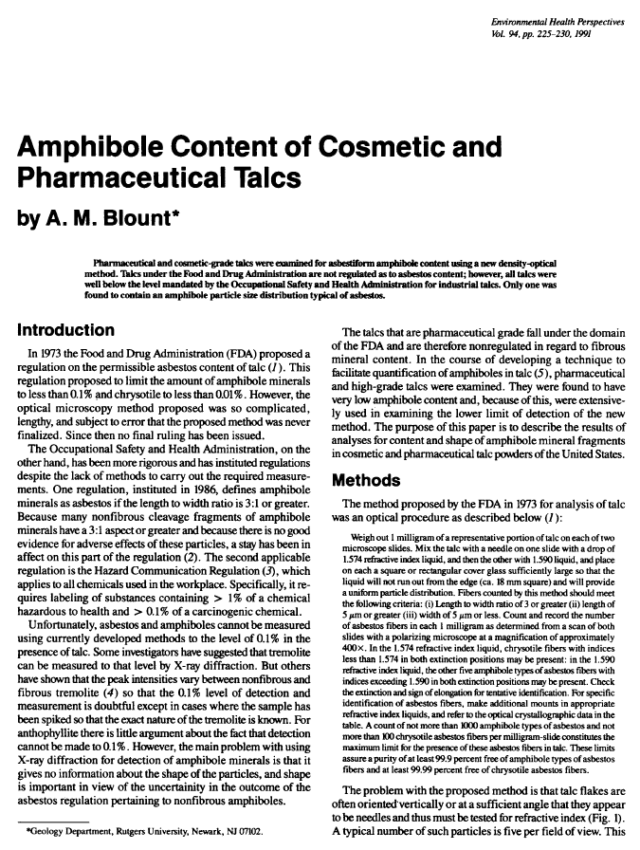
Blount, 1991
ISO 22262-2
Notes:
This is also a standardized approach that has been published both in peer review literature and by consensus standards.

Slide 24
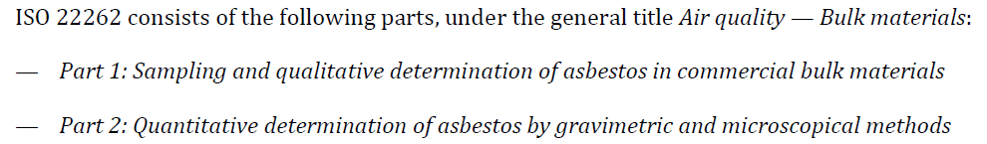
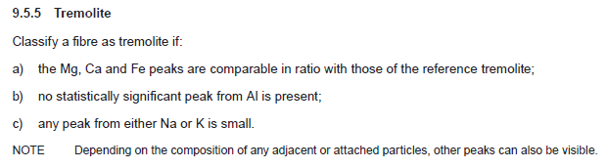

Imprecise classification recommendations in conflict with USGS recommendations
Reporting results as a mass fraction with an unexplained shape factor “G” of 0.5
Notes:
But the ISO method is not without fault. It contains imprecise classification schemes which contradict published USGS recommendations for mineral classification . It does not provide details on how to report results as a numeric concentration (f/g) and the calculation for mass percent has a “shape factor” of 0.5 used to estimate the thickness of an amphibole fiber without any explanation on how this number was decided upon. When compared to an assumption that a fiber is as thick as it is wide, this shape factor under-represents the mass percent by 50%.

Slide 25
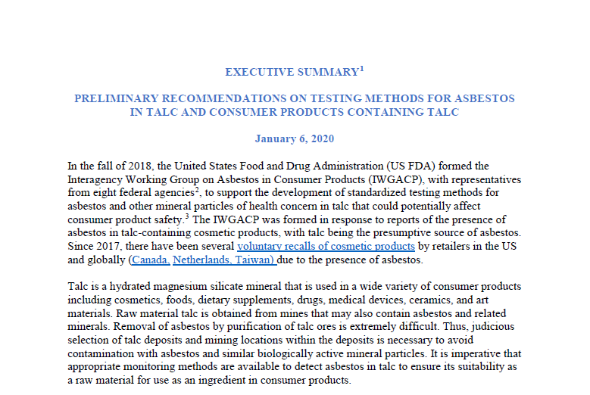
Notes:
This may feel like a lot to consider, but the Executive Summary issued by the IWGACP is on the right track for developing a clear and concise set of definitions for laboratories to utilize. That is exactly what laboratories need.

Slide 26
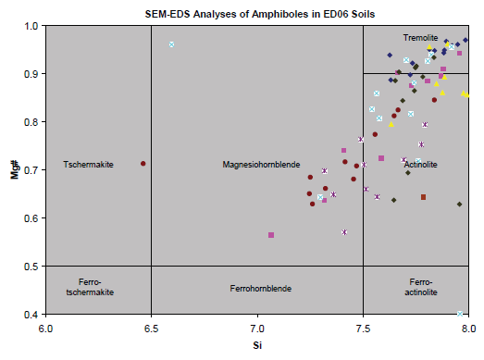
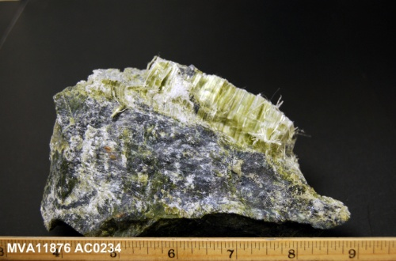
Some take away points
Combination of TEM and PLM
Sample Prep Concentration
Counting rules should consider biological response and not be confined by
  Historic geologic naming conventions (discounting fibers based on low levels of aluminum, sodium, potassium…)
  Attempts at source determination (discounting fibers based on mean aspect ratios for “populations” of asbestos fibers)
(TEM or PLM alone if positive)
USGS Report 2006-1362
Notes:
But my take away message today is that a combination of TEM and PLM has proven in the past to be ideal. Pre-concentration is a tool that we must not be afraid to implement, but we should do so with an understanding of potential limitations. And regulations should be constructed based on recommendations by the medical community and not constricted by historic conventions used to describe the commercial viability of a specific subset of minerals.

Slide 27
Questions?
scompton@mvainc.com

Slide 28
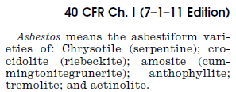
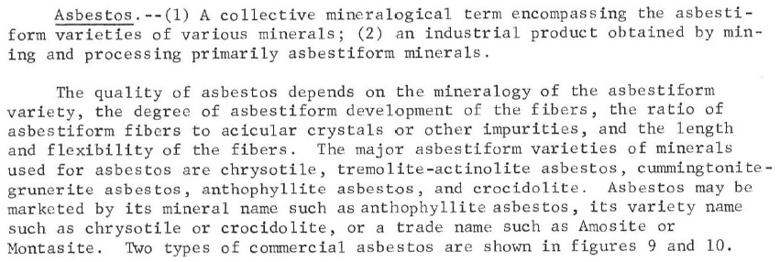
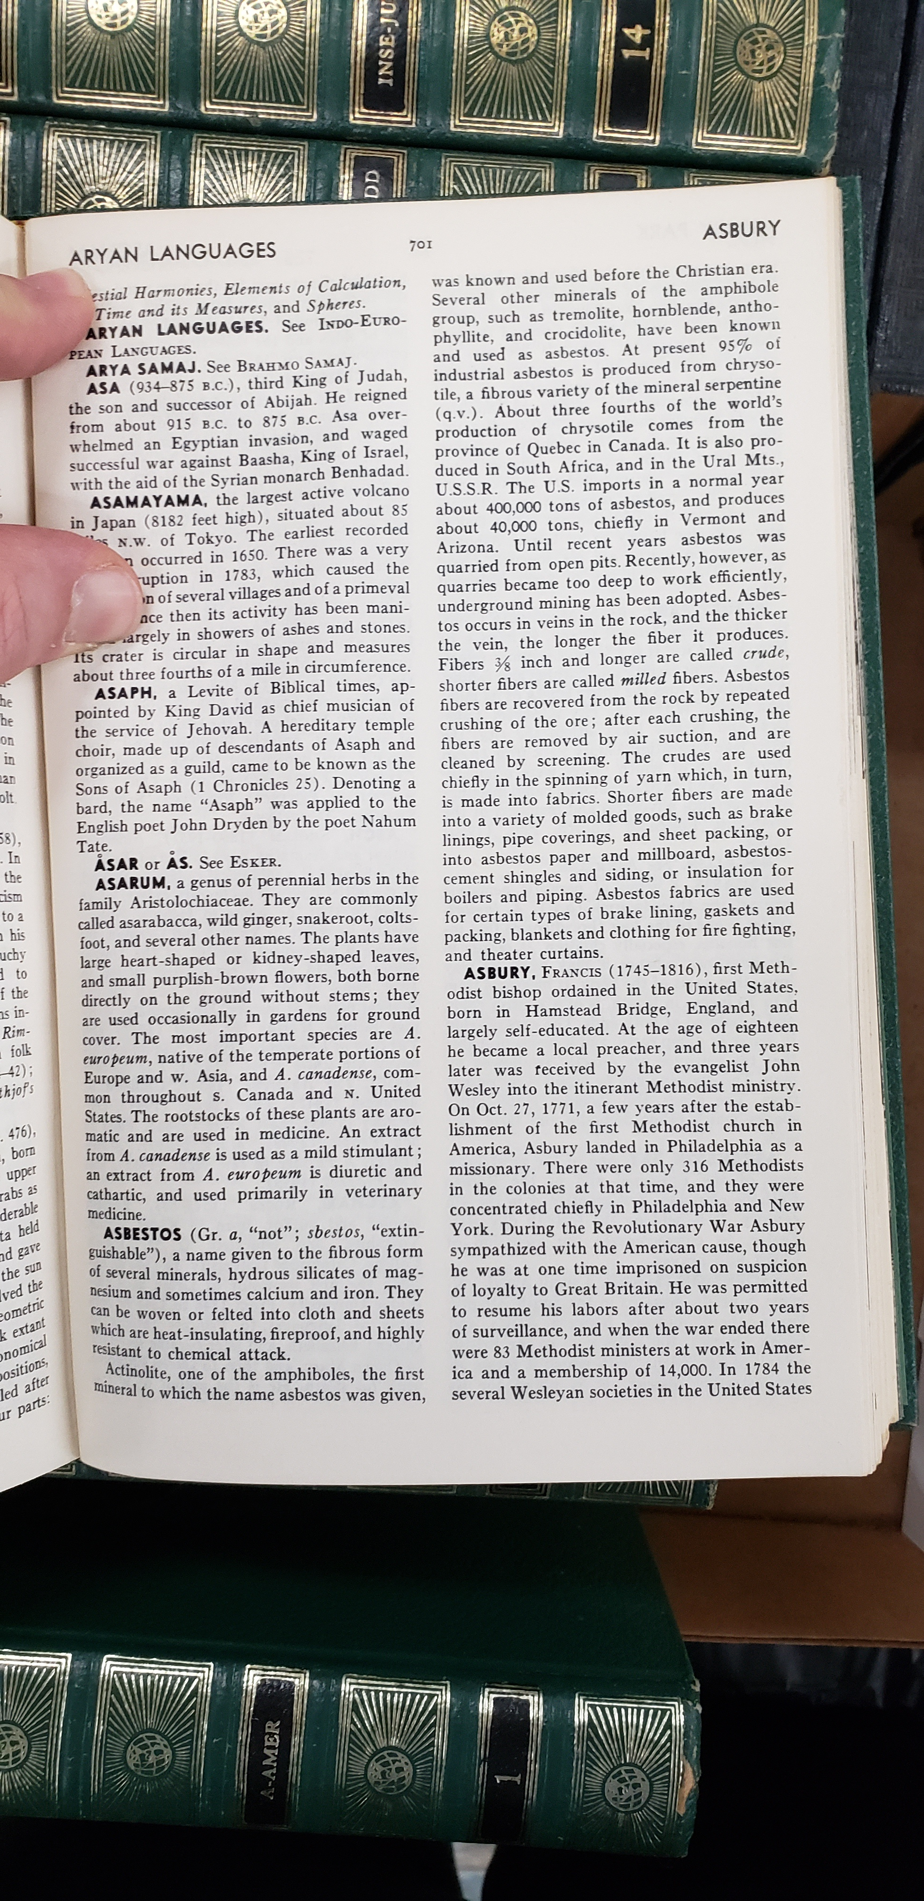
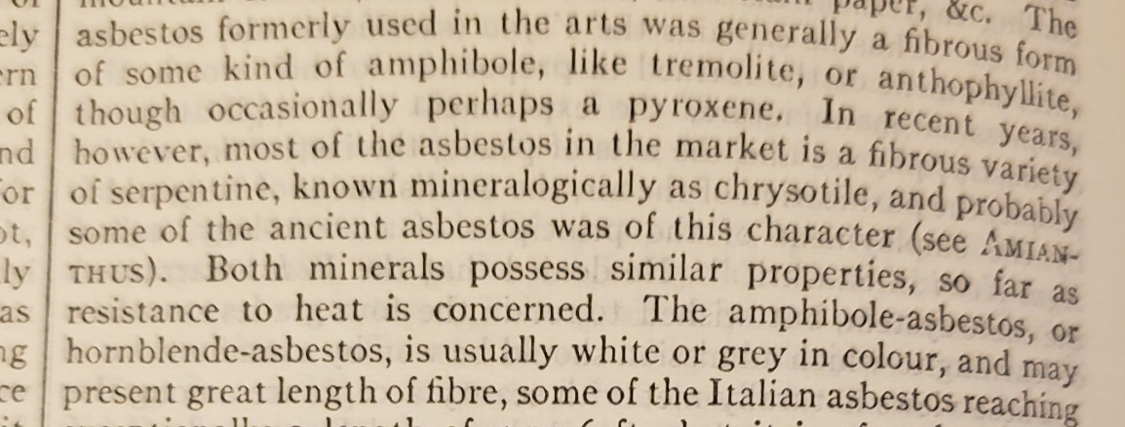
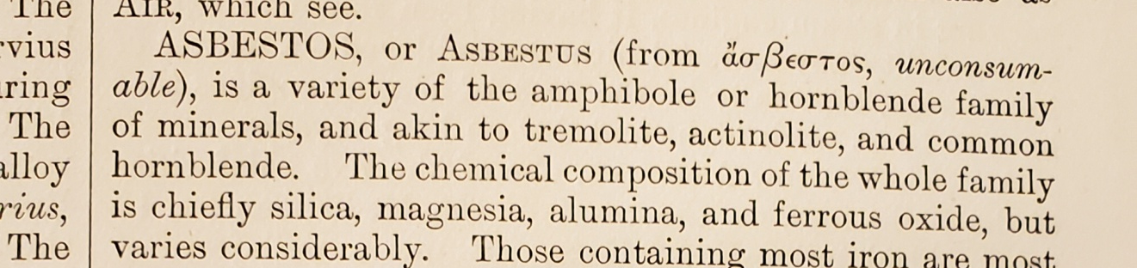
Has “asbestos” always been limited to the regulated six?
1987
1959
1875
1977
1910
Notes:
Let’s look at 40 CFR from 1987. Here we see the regulated six clearly spelled out.

Slide 29
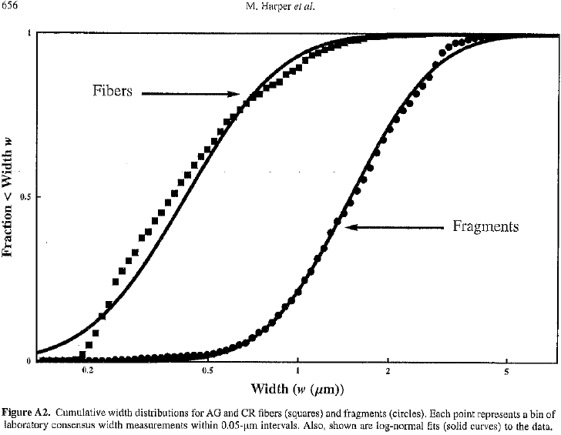
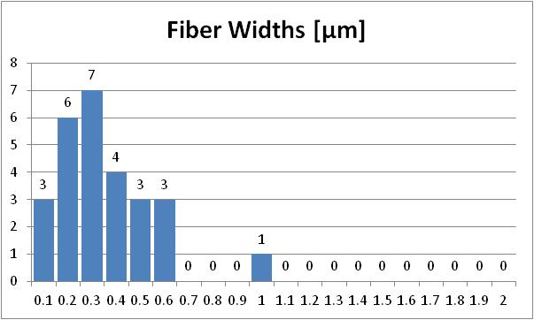
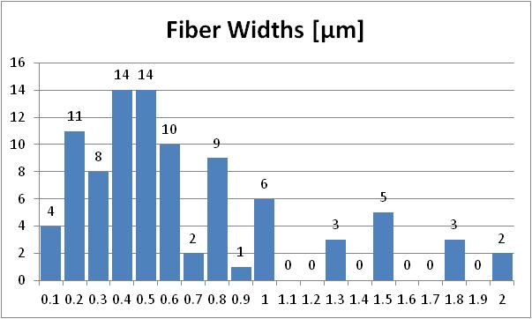
Amphibole Single
Fibers in Talc
Talc Ore from
Italy and Vermont
Talc from Cosmetic and
Pharmaceutical Products
Notes:
As with the two previous samples, the majority of the structures have a single fiber width of less than 1 micrometer

