Slide 1
Scott Faber
Environmental Working Group

Slide 2
“You have not provided evidence that asbestos contaminated talc-containing cosmetic products are currently being marketed.”

Slide 3




Slide 5
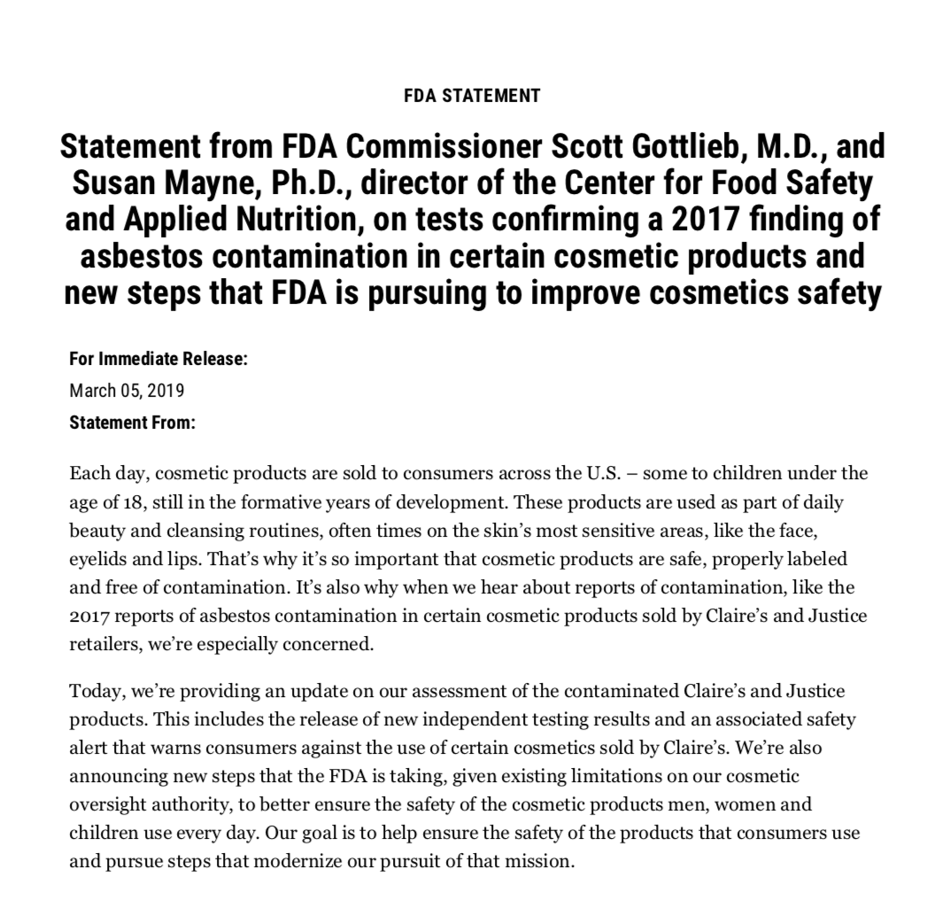

Slide 6
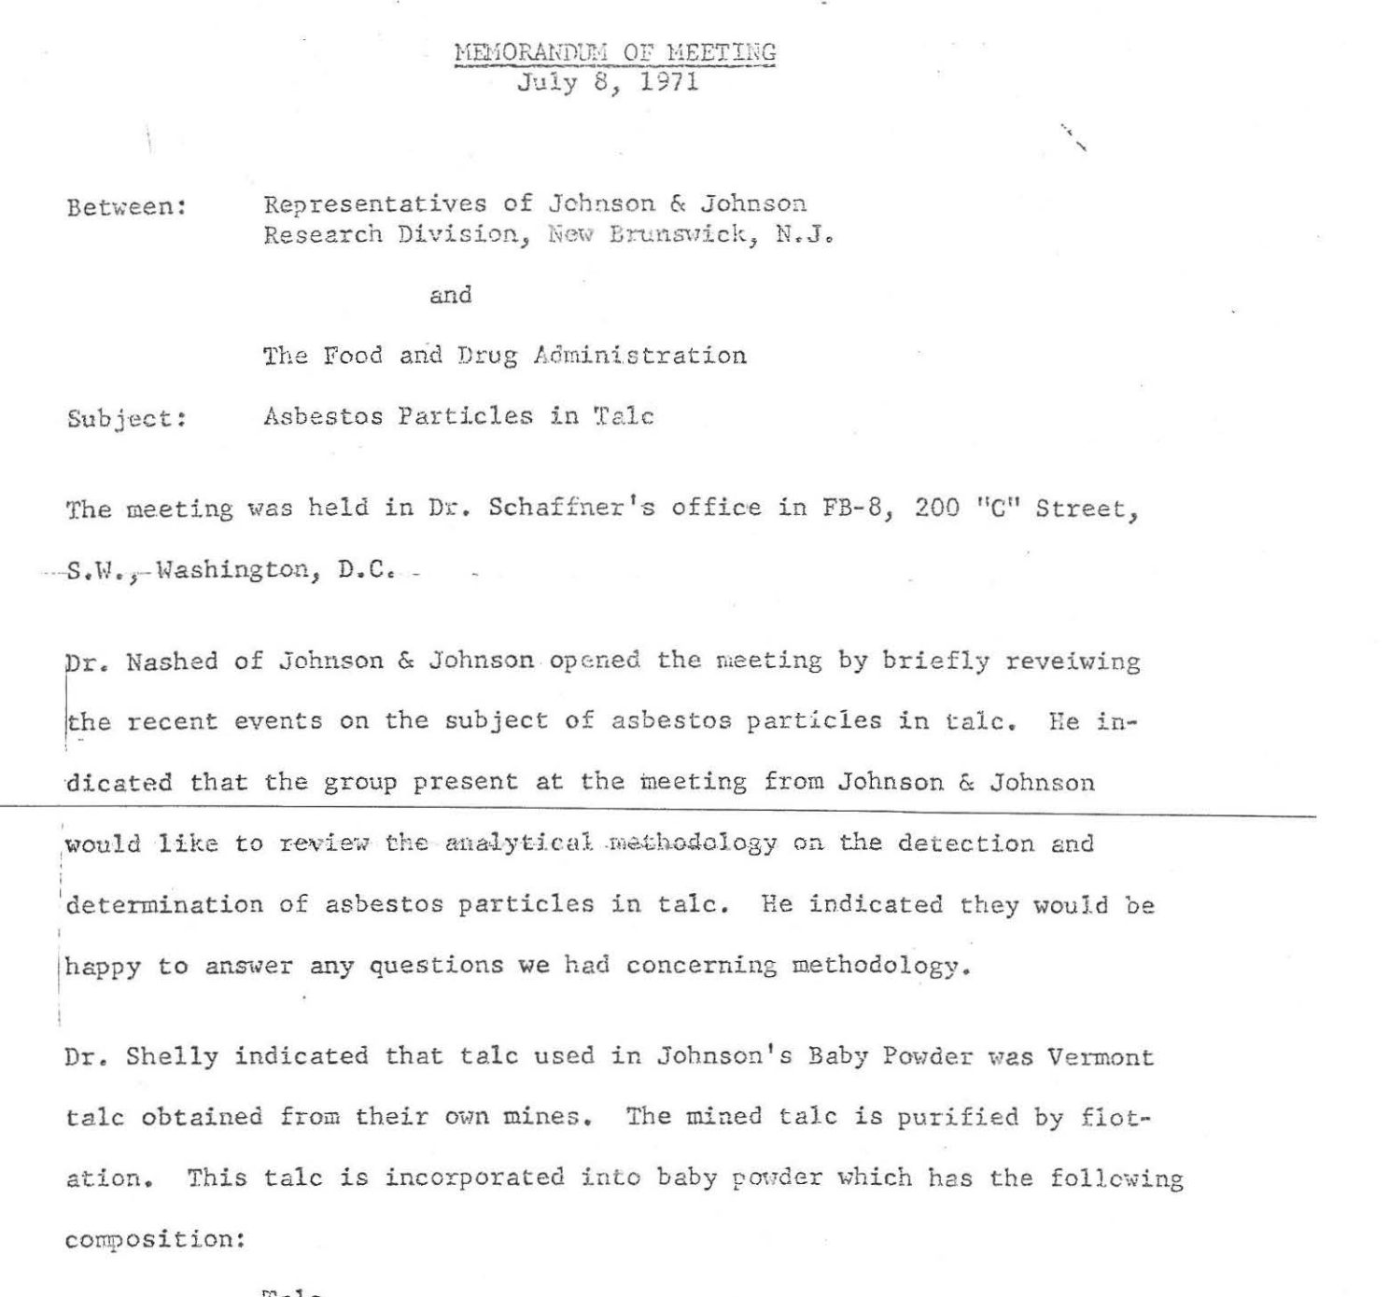
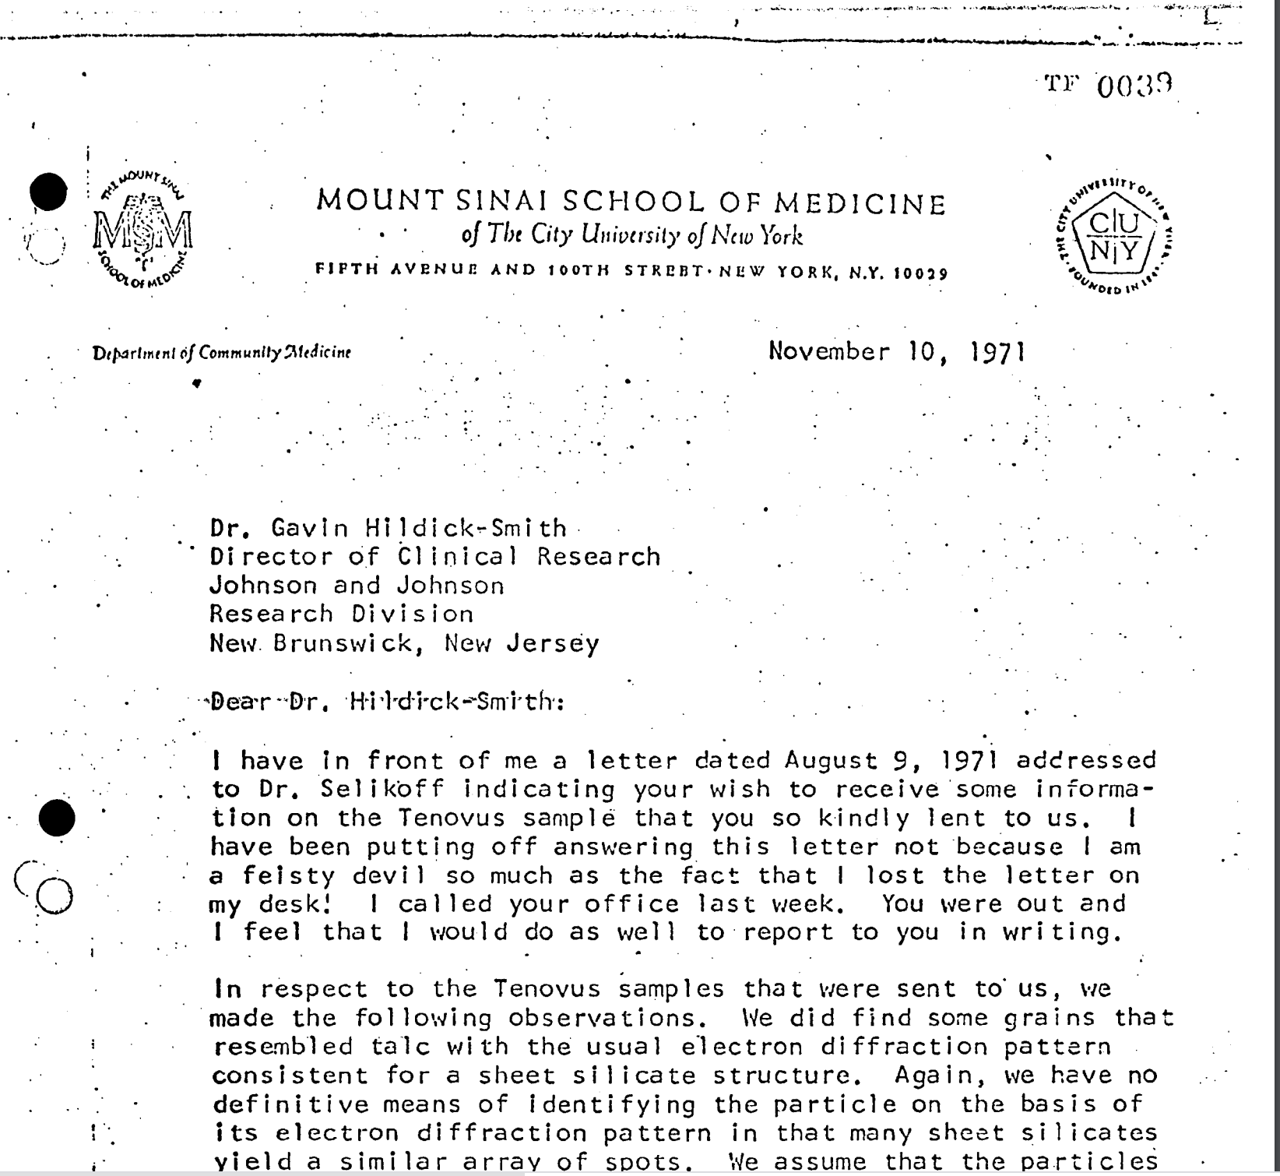
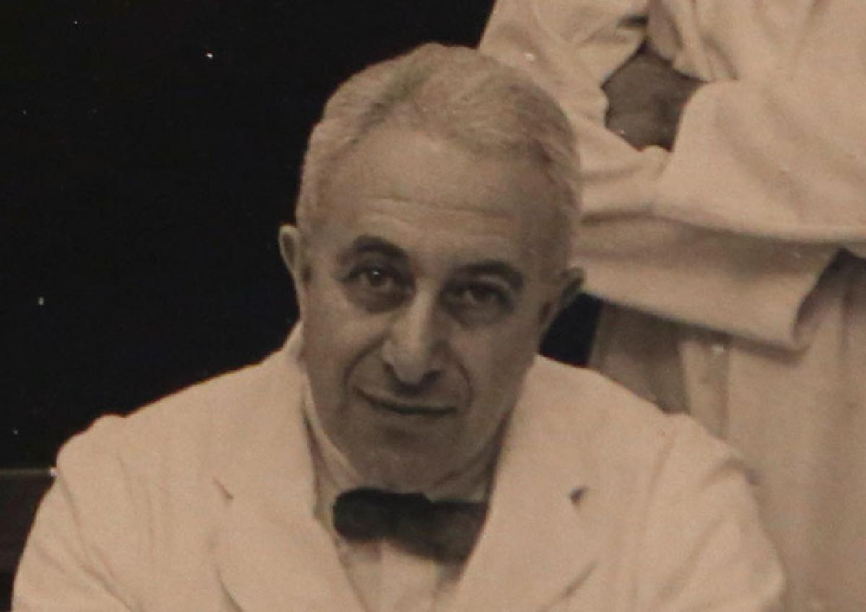

Slide 7
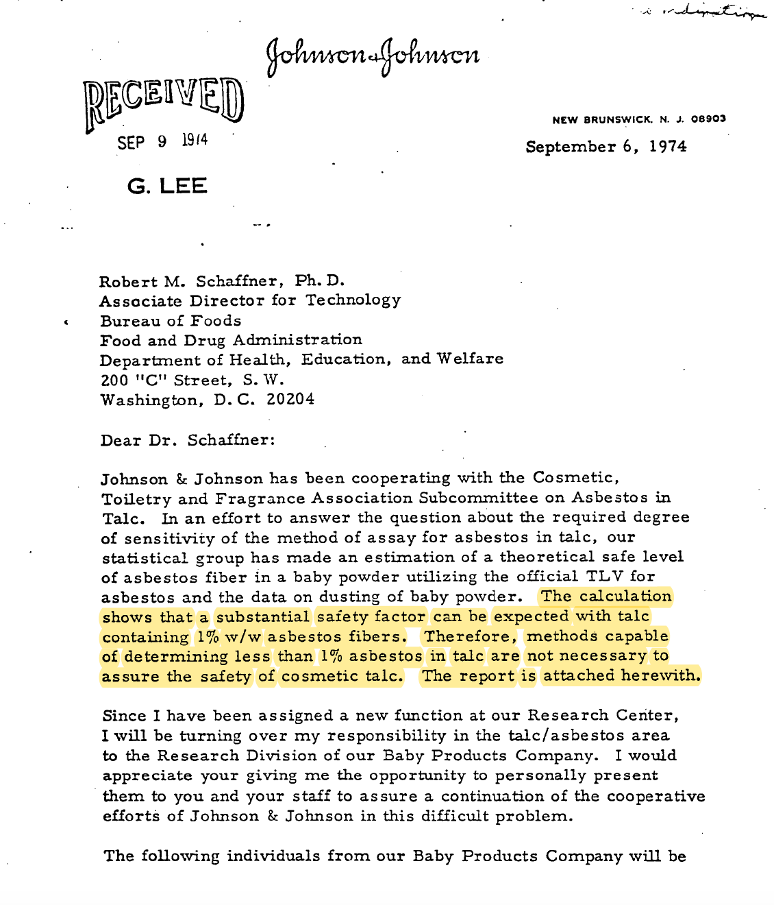
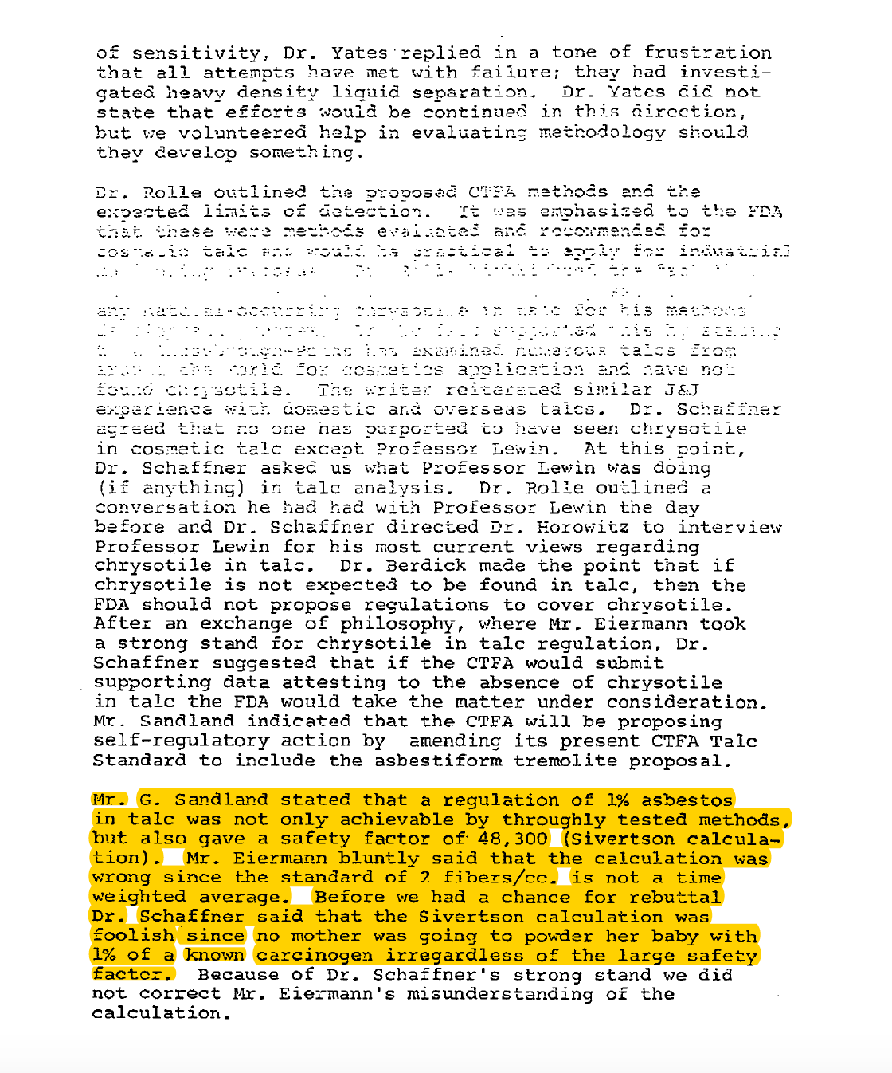

Slide 8
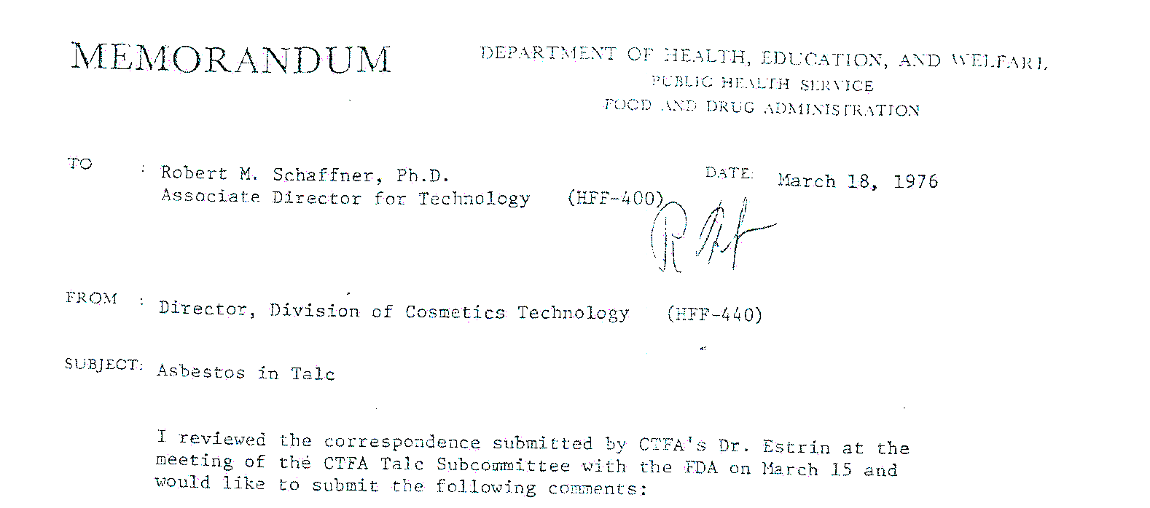
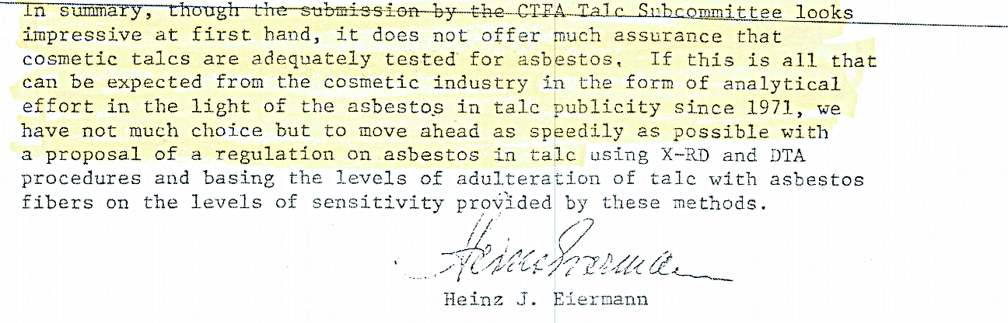

Slide 9
Product form | Products with talc
Liquids, soaps and other solids | 927
Loose powder | 123
Pressed powder | 1,051
Aerosol spray | 18
Total with talc | 2,119
Talc-Based Products in EWG’s Skin Deep® Database
Source: EWG, from Skin Deep consumer products database

Slide 10
Require a warning
Routine inspections
Demand safety data

