Slide 1
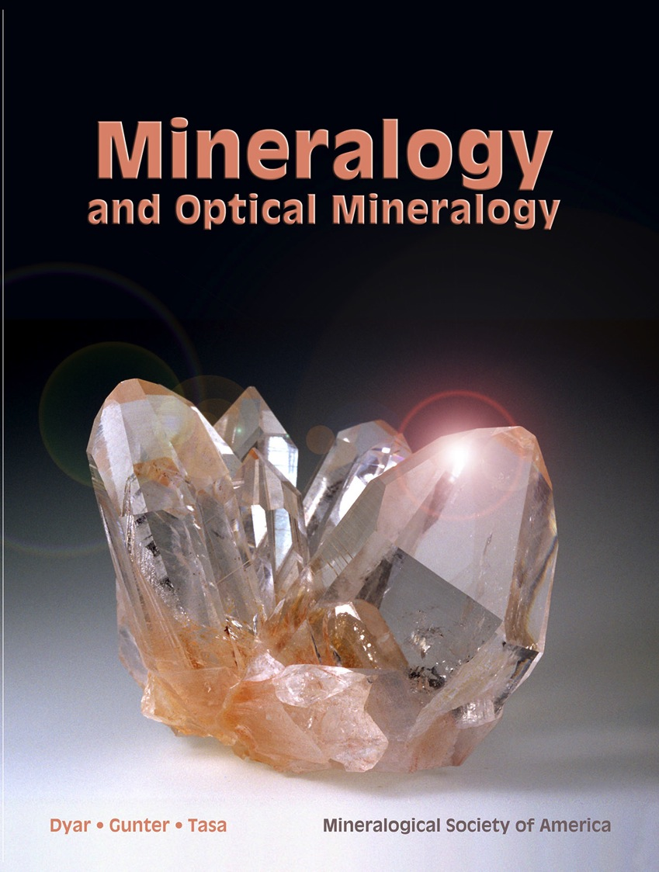
Talc, elongate minerals & mineral (mis)identification
Mickey Gunter
* Emeritus University Distinguished Professor at University of Idaho
* Past President Mineralogical Society of America
* Member Idaho State Board of Professional Geologists
* President of C2/m Mineralogy, LLC – industry consultant & defense expert witness

Slide 2
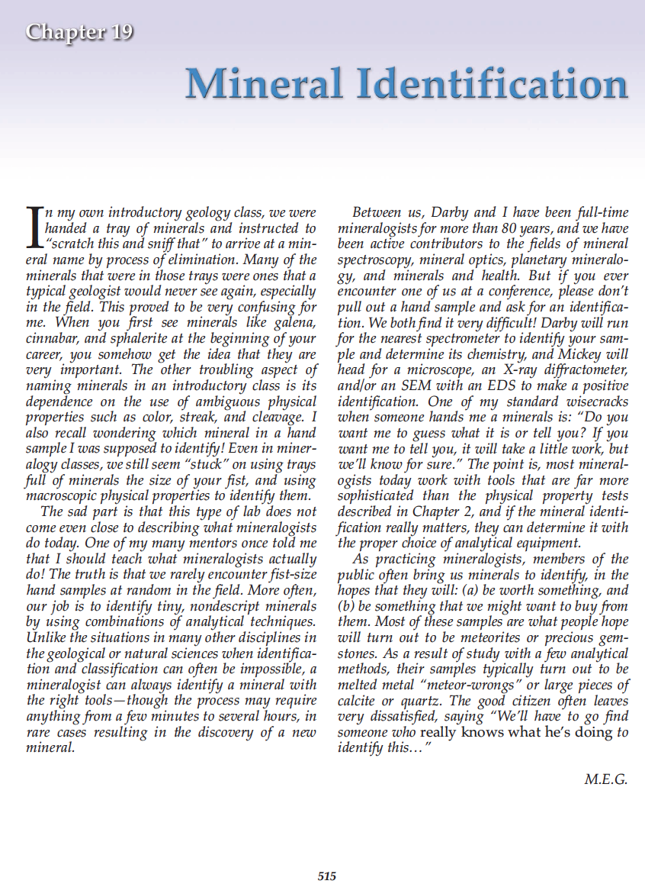
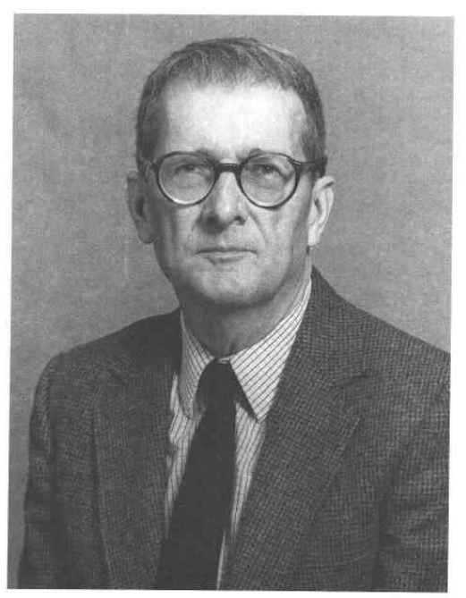
Presentation overview
Dedicated to Mac Ross
American Mineralogist (1990) p 1744
Dyar & Gunter (2019)

Slide 3
Mineralogy EMP
Minerals are classified based on crystal structure (i.e., the arrangement of the atoms) and composition (i.e., the type of atoms)
Thus minerals are identified based on the crystal structure and composition
Also, the physical properties (i.e., things that can be measured or observed) of minerals are related to their crystal structure and composition.

Slide 4
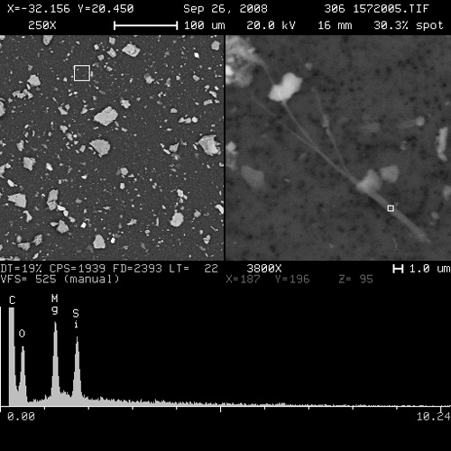
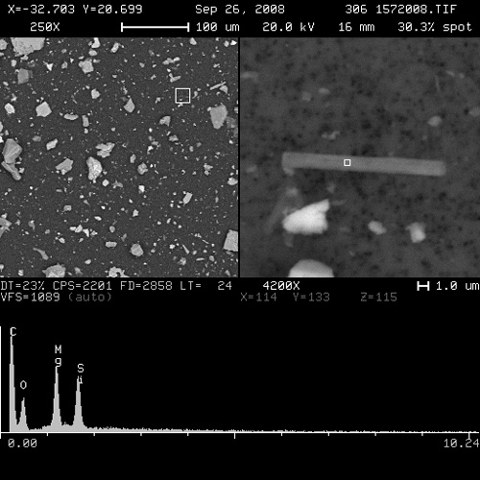
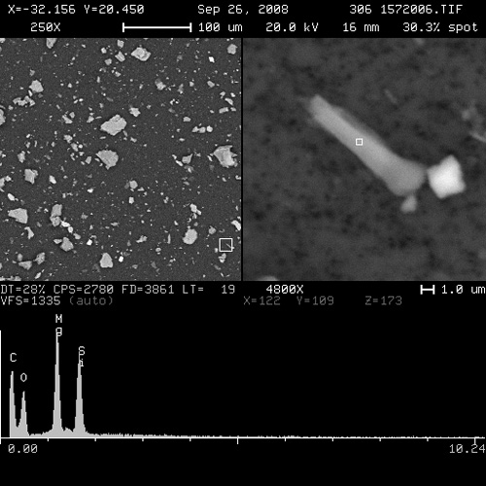
Asbestos morps to EMPs = 3 to 1, 5 to 1, 10 to 1?
2% of Earth’s surface

Slide 5
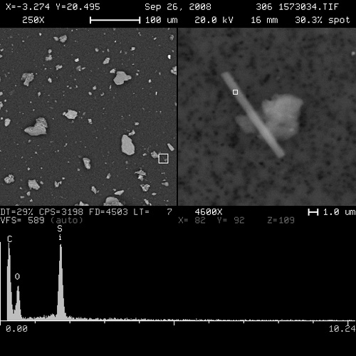
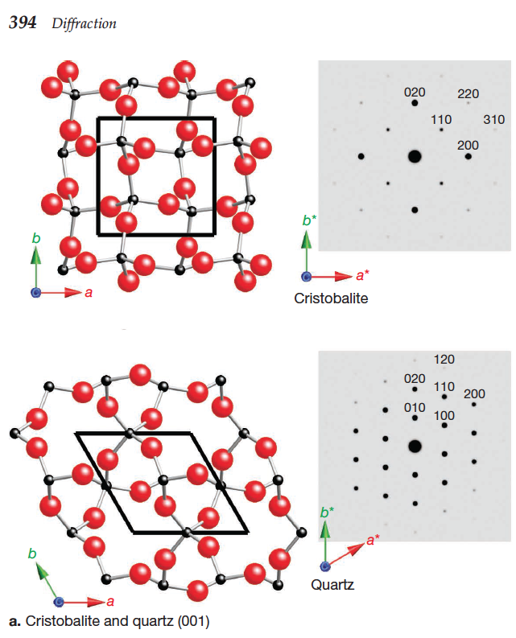
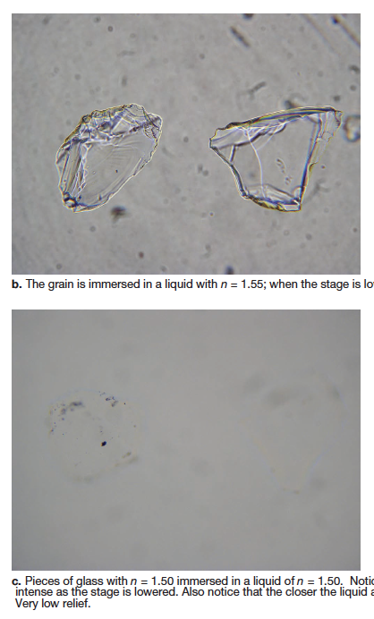
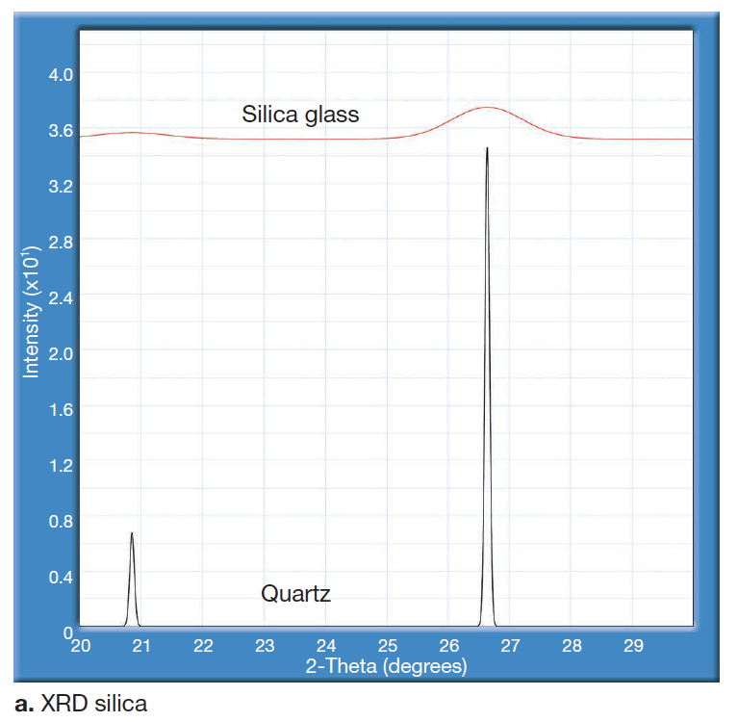
Vermont gravel – mineral quiz

Slide 6
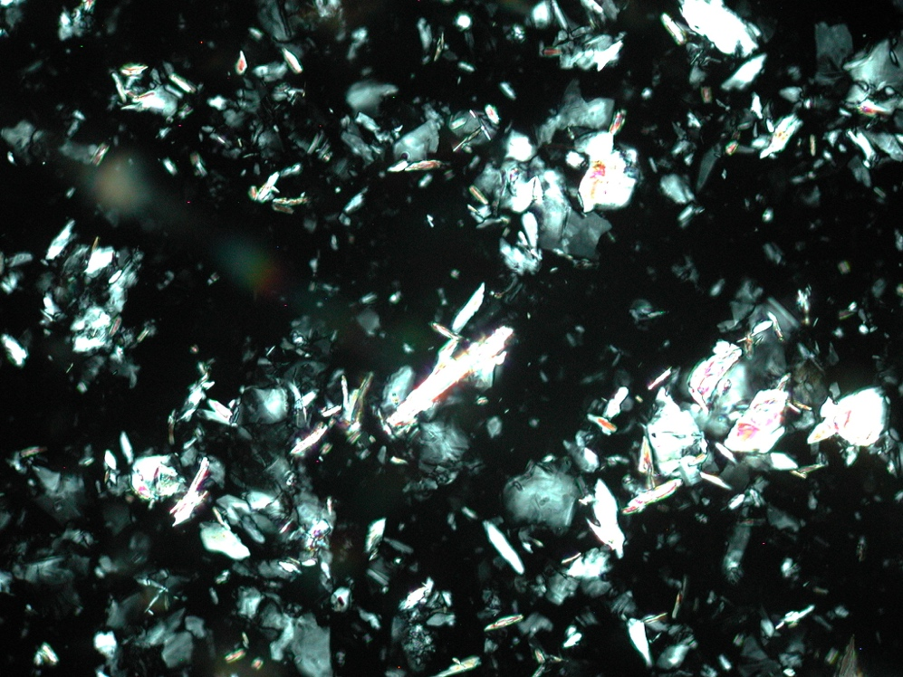
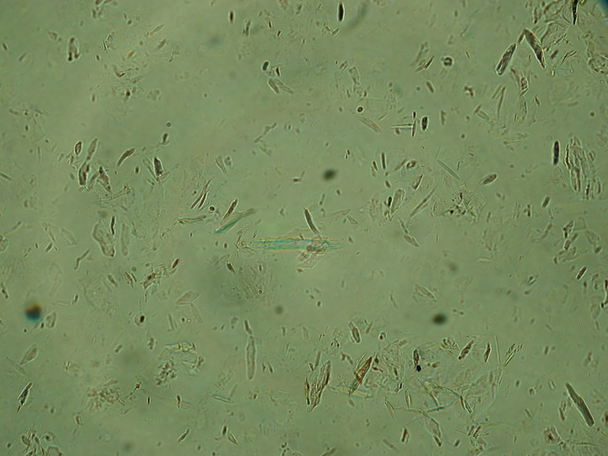
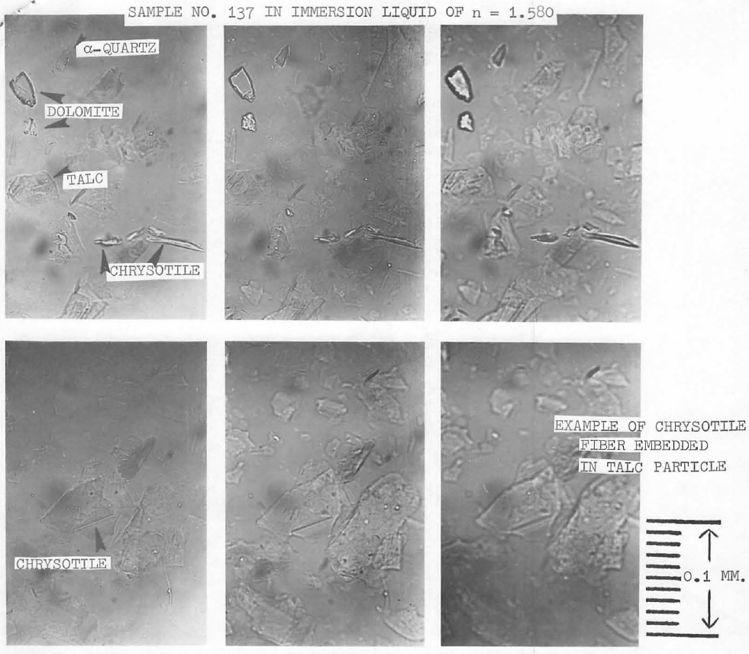
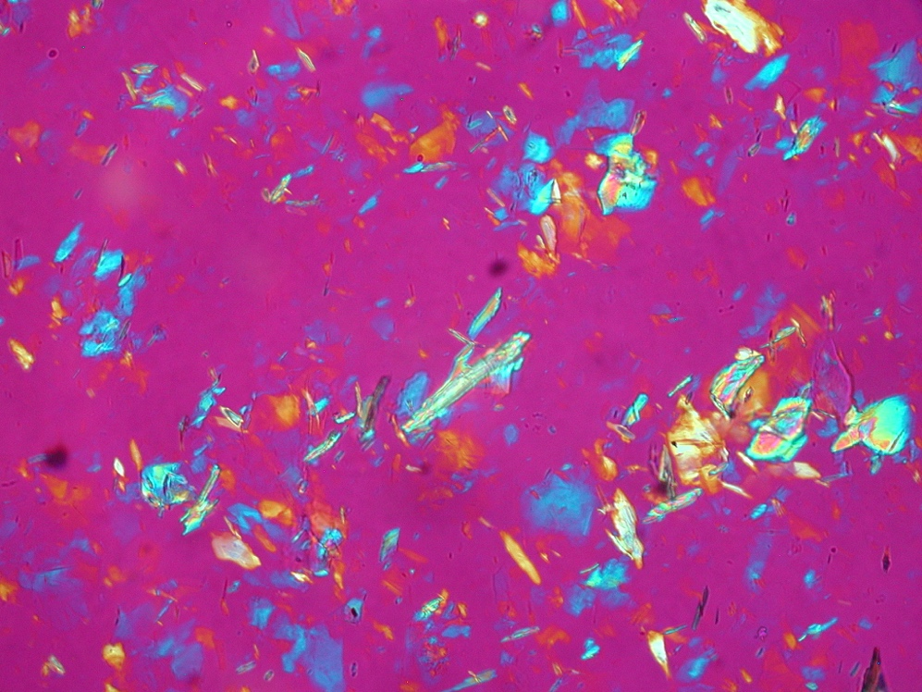
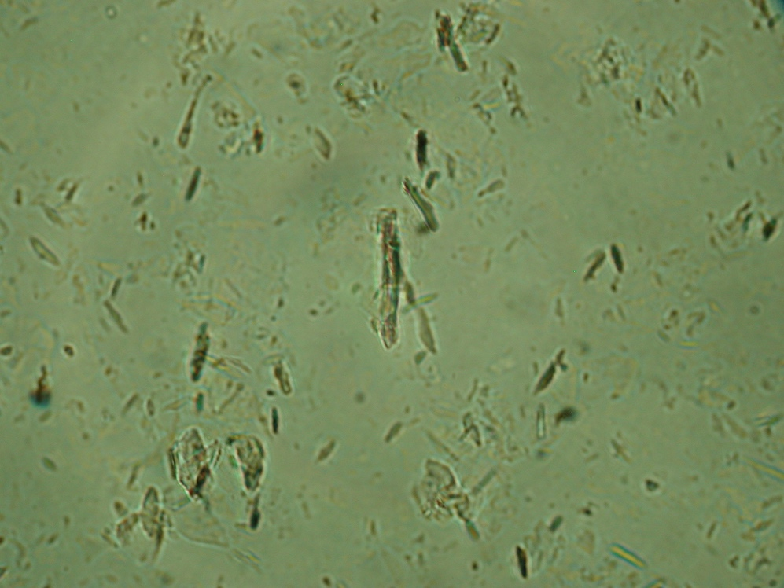
PLM photos of crushed talc ore (FOV = 500 μm, in 1.585)
a.
c.
b.
d.
JOJO-MA2546-00140

Slide 7
Talc structure and SAEDs

Slide 8
Kremer & Millette (1990)

Slide 9
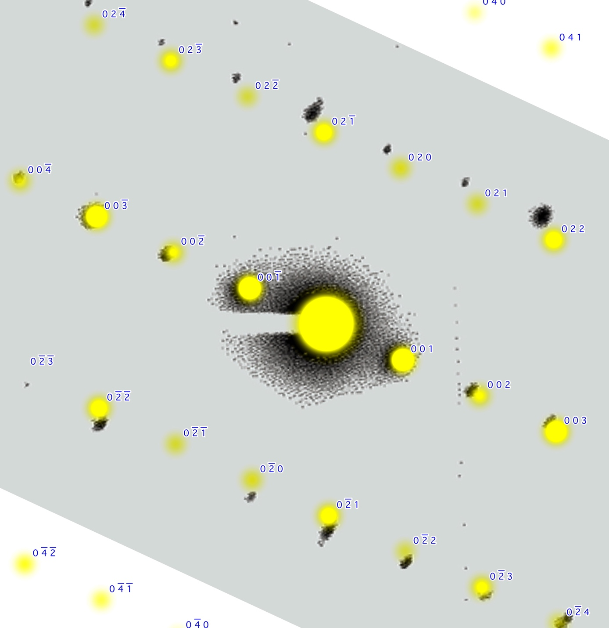
talc [100] zone axis, plus indexed

Slide 10
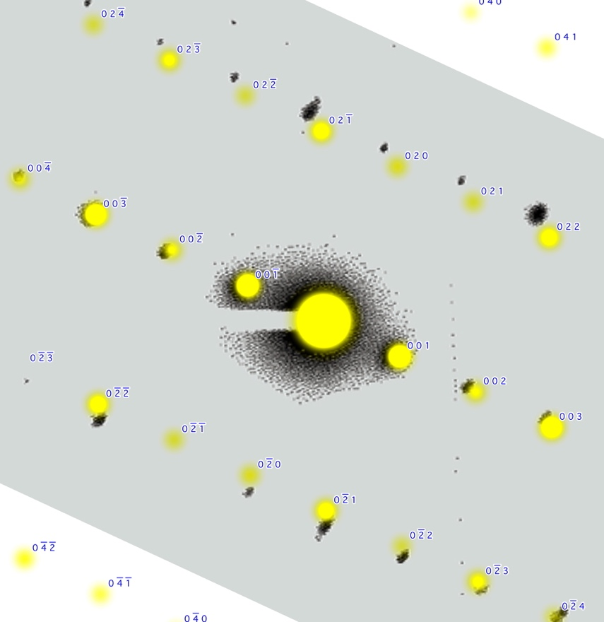
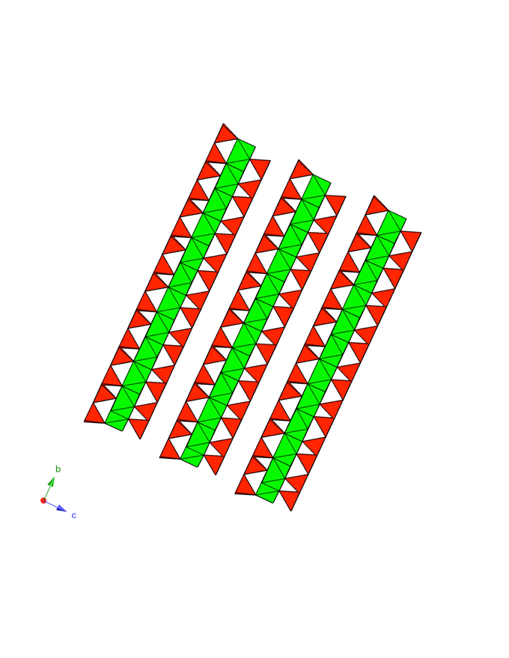
“triology”

Slide 11
composition & unit cell data
(i.e., size and shape of grid)
anthophyllite
Mg₇Si₈O₂₂(OH)₂
  a = 18.6 Å
  b = 18.0 Å
  c = 5.3 Å
talc
Mg₃Si₄O₁₀(OH)₂
  a = 5.3 Å
  b = 9.2 Å
  c = 9.5 Å

Slide 12
anthophyllite 100 (green) / talc 001 (red)
c = 5.3
a = 5.3
b = 18.0
b = 9.2

Slide 13
The math
Dyar & Gunter (2019)

Slide 14
More math
Dyar & Gunter (2008) - iBooked

Slide 15
Last math and…

Slide 16
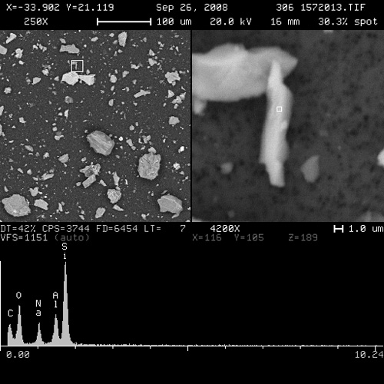
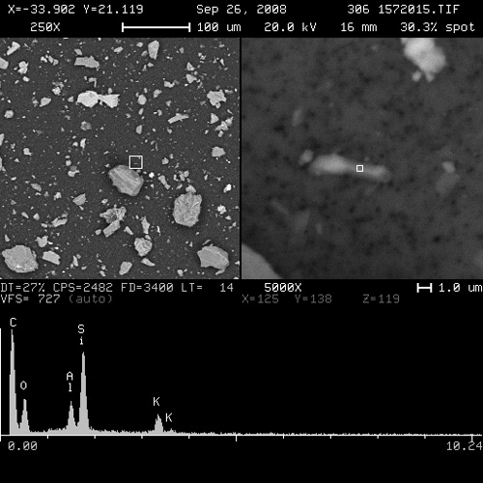
Vermont gravel – mineral quiz

Slide 17
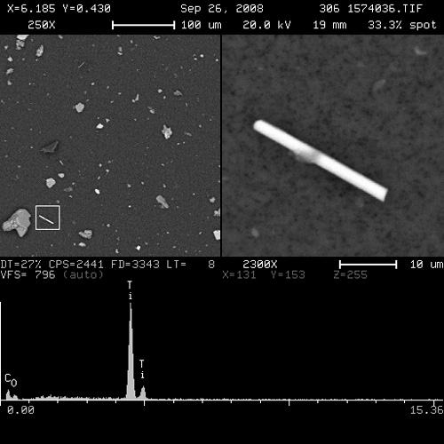
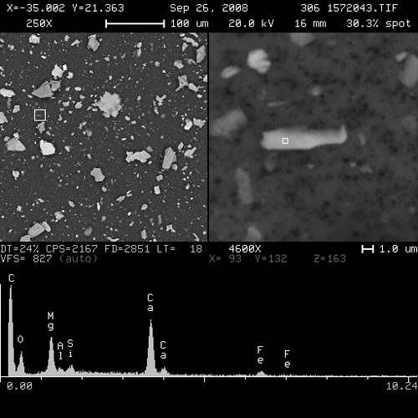
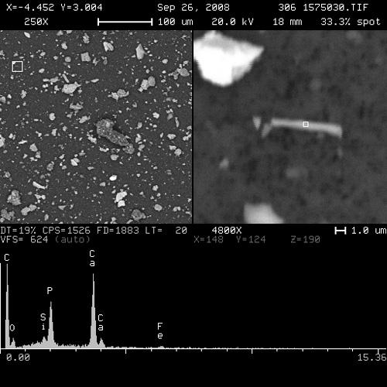
More Vermont – more mineral quiz

Slide 18
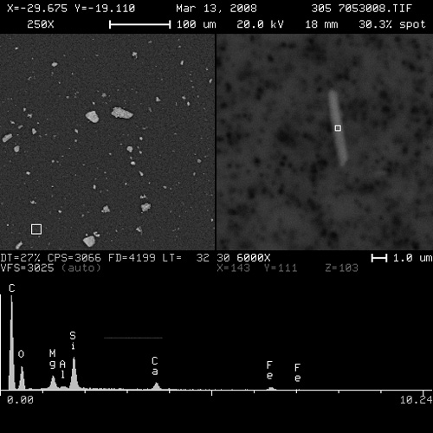
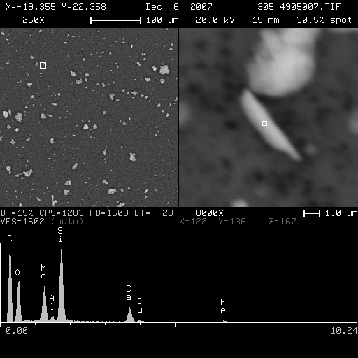
Coast to coast amphiboles
15% of Earth’s surface

Slide 19
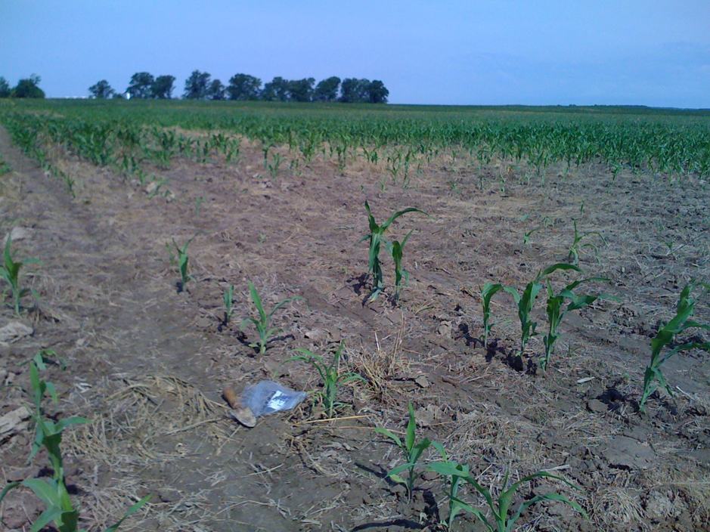
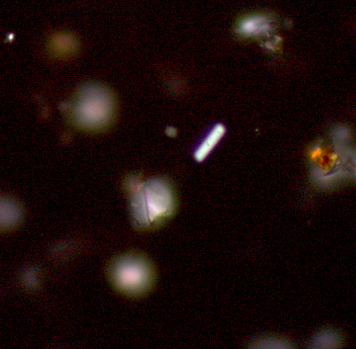
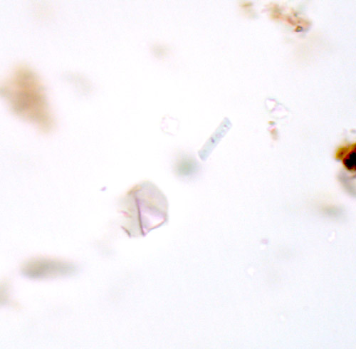
Results: farm fields – Illinois corn
amphibole = 2.3 %
3 x 16 μm
Gunter (2010)

Slide 20
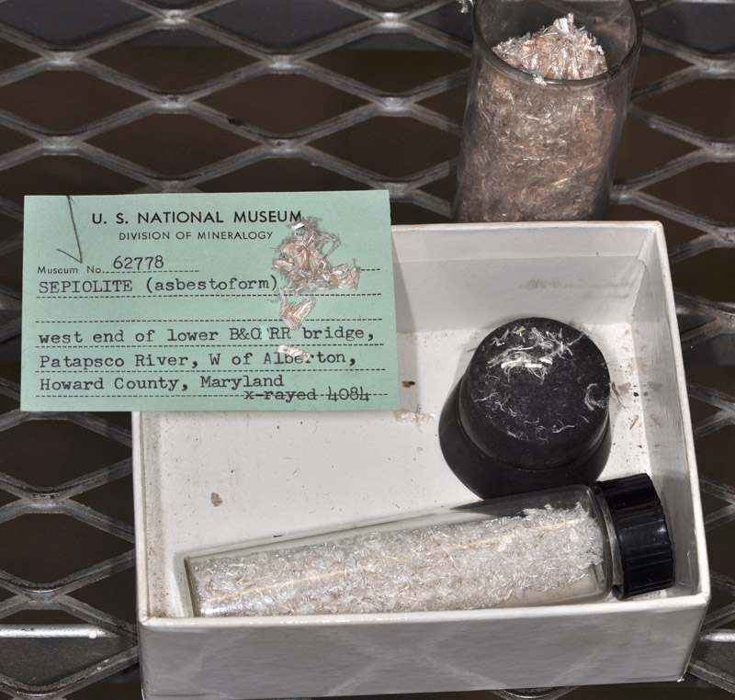
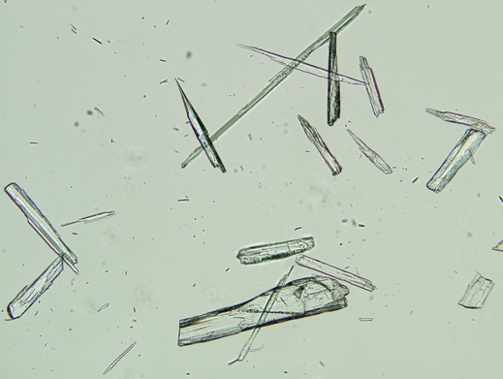
IARC mineral classifications
Group 1:
  asbestos
  crystalline silica (i.e., quartz & cristobalite)
  erionite
  talc containing asbestiform fibers
Group 2B:
  talc body powder (perineal use of)
Group 3:
  amorphous silica
  sepiolite
  talc not containing asbestos or asbestiform fibers
  wollastonite
  zeolites other than erionite (clinoptilolite, phillipsite, mordenite, non-fibrous Japanese zeolites, synthetic zeolites)

Slide 21
In summary
EMPs are ubiquitous
Minerals can always be correctly identified
Historically talc has been misidentified as an asbestos mineral
Along with mineralogy, an understand of geology and talc formation is a good thing.

Slide 22
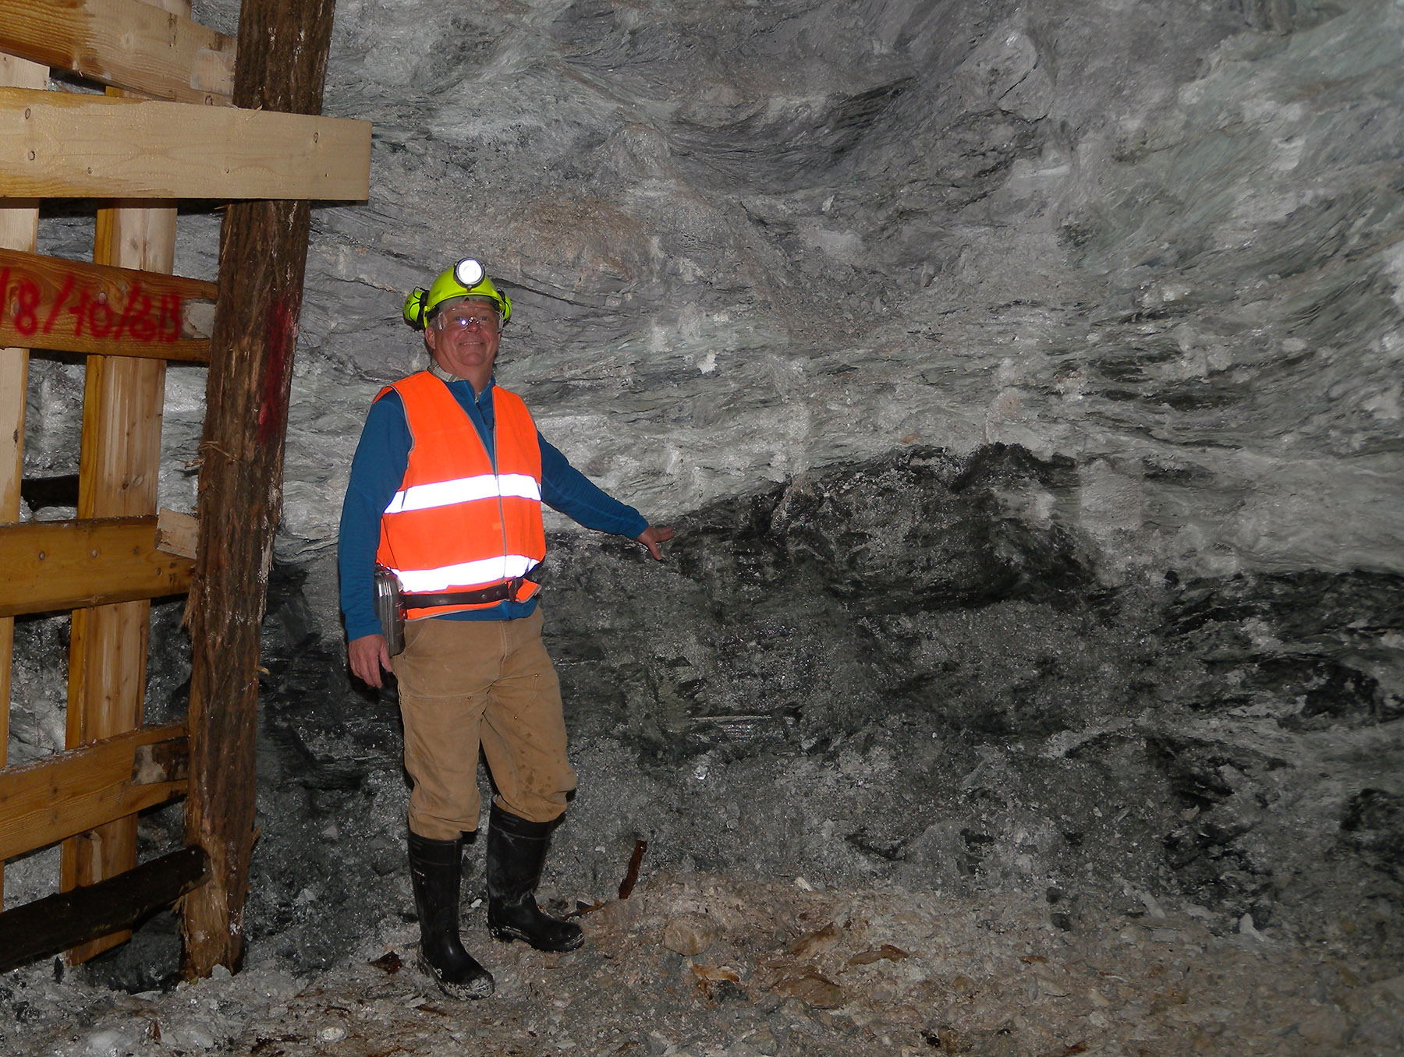
Mineral identification in black & white or…
talco
non-talco

Slide 23

In summary

