Slide 1

P. Leigh O’Dell
Counsel for Plaintiffs
Marvin Salter
Surviving Son of Jackie Fox
Deborah Giannecchini
Ovarian Cancer Victim

Slide 2
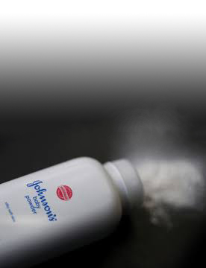
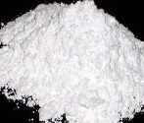
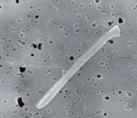
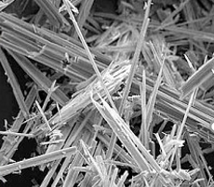

Toxic Constituents in Johnson’s Baby Powder & Shower to Shower
The constituents shown below are found in Johnson’s Baby Powder and Shower to Shower.
CONSTITUENTS IN BABY POWDER
PLATY TALC
COBALT
Inflammatory
Fibrogenic
2B carcinogen (IARC)
Found in BP & S2S
Oxidative stress
2B carcinogen (IARC)
Co
NUMEROUS
KNOWN OR
SUSPECTED
CARCINOGENS
CHROMIUM
FIBROUS TALC
Found in BP & S2S
Inflammation, OS, DNA damage
Group 1 carcinogen (IARC)
Cr
Inflammatory; genotoxic
Direct & indirect genotoxicity
Group 1 carcinogen (IARC)
NICKEL
Found in BP & S2S
Induces DNA damage
Group 1 carcinogen (IARC)
Ni
ASBESTOS
Frequently present
Direct & indirect genotoxicity
All forms are Group 1 (IARC)
FRAGRANCE CHEMICALS
Toxins & irritants
Carcinogens – styrene (2A), and coumarin, eugenol, and
d-limone (2B)

Slide 3
Fibrous talc =
talc fibers = “asbestiform” talc

Slide 4
Fibrous talc is an Elongated
Mineral Particle (EMP).

Slide 5
AMA Analytical Testing of Johnson’s Baby Powder
Platy Talc
Fibrous Talc
308006-6 Talc Particle, AMA Analytical Report, p.8 (Oct. 11, 2019)
308006-6 Talc Particle, AMA Analytical Report, p.11 (Oct. 11, 2019)

Slide 6
AMA Analytical Testing of Johnson’s Baby Powder
Fibrous Talc
Chrysotile
308006-6 Talc Particle, AMA Analytical Report, p.11 (Oct. 11, 2019)
308006-6B Talc Particle, AMA Analytical Report, p.6 (Oct. 11, 2019)

Slide 7
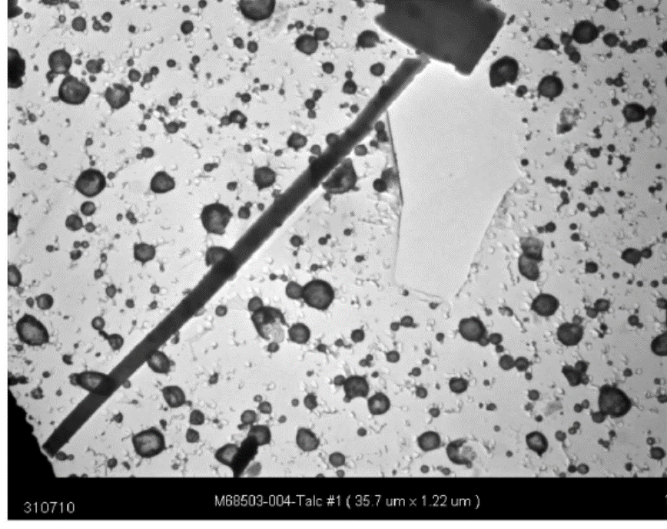
Fibrous Talc v. Asbestos
Fibrous Talc
Anthophyllite Asbestos
(Longo & Rigler Expert Rpt., p. 184)
(Longo & Rigler Expert Rpt., p. 232)

Slide 8
Transitional Talc Fibers – Talc + Asbestos
(Bulletin 62, NIOSH (2011))

Slide 9
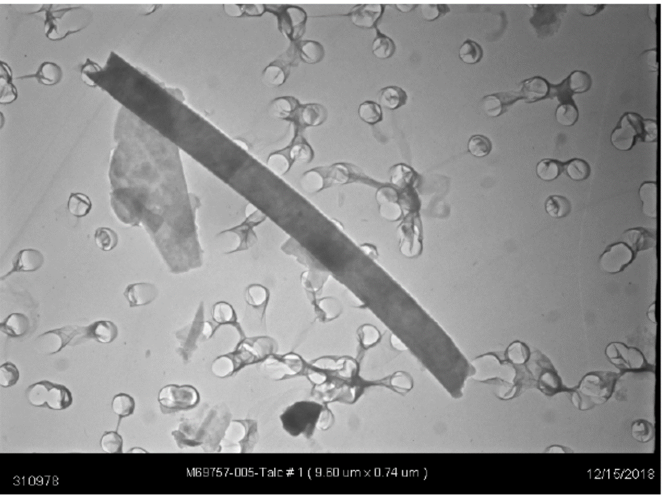
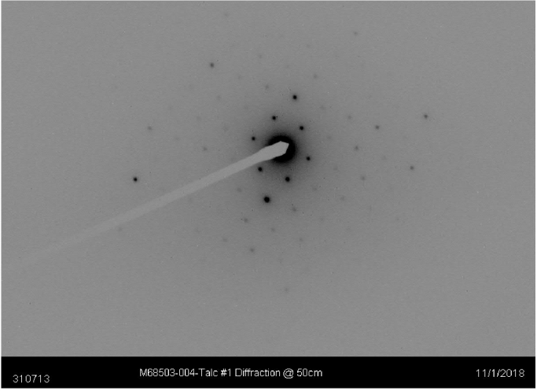
Three-Step Method for EMP Analysis
Step 1: Morphology
Step 2: EDXA
Step 3: SAED
Fibrous Talc

Slide 10
Johnson’s Baby Powder & Shower to Shower
98% of historical samples tested
positive for fibrous talc

Slide 11
Johnson’s Baby Powder & Shower to Shower
Results by Decade | Range of Talc EMPs/Fibers per 10 oz. bottle
1960s | 82,215,000 to 254,016,000 fibers
1970s | 170,950,500 to 289,170,000 fibers
1980s | 155,358,000 to 176,904,000 fibers
1990s | 114,250,500 to 254,583,000 fibers
2000s | 123,039,000 to 133,528,500 fibers

Slide 12
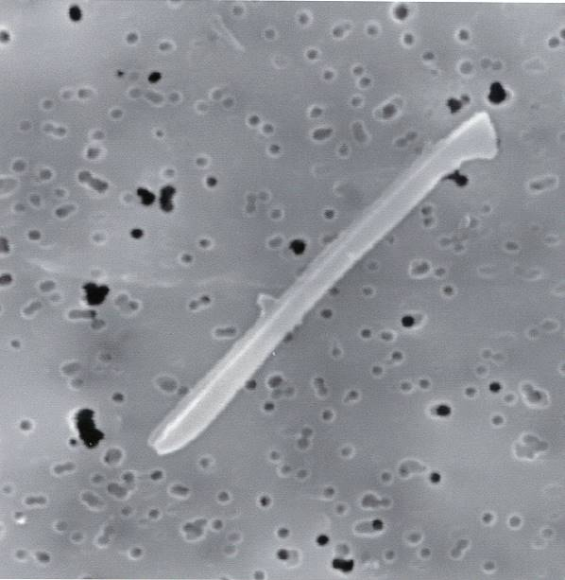
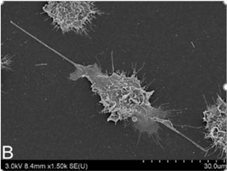
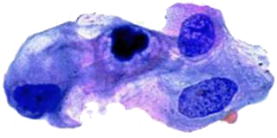
The Impact of EMPs/Fibers on Carcinogenesis
Inflammation
Talc Fiber
DIRECT
DNA breaks & oxidized bases in DNA
Fibers interfere with mitotic apparatus by direct physical interaction
INDIRECT
Oxidative stress
Epigenetic alterations
Actuation of signaling pathways
Resistance to apoptosis
Stimulation cell proliferation
Genotoxicity
Carcinogenesis
References: IARC (2012); Egilman (2019); Mossman (2018); Mossman (2012); Ghio (2001); Jaurand (1997); Jaurand (1991).

Slide 13

IARC – Fibrous Talc Is A Group 1 Carcinogen
IARC (2010)
““The review of talc in Supplement 7 led to evaluations for two agents: talc containing asbestiform fibres and talc not containing asbestiform fibres. The term ‘asbestiform fibre’ has been mistaken as a synonym for ‘asbestos fibre’ when it should be understood to mean any mineral, including talc, when it grows in an asbestiform habit.” p.277
IARC (2012)
“The conclusions reached in this Monograph about asbestos and its carcinogenic risks apply to these six types of fibres wherever they are found, and that includes talc containing asbestiform fibres.” p. 219
“Talc may also form true mineral fibres that are asbestiform in habit.” p. 230

Slide 14
P. Leigh O’Dell
Counsel for Plaintiffs
leigh.odell@beasleyallen.com
(334) 269-2343

