Slide 1
Laura M. Plunkett, Ph.D, DABT
Integrative Biostrategies, LLC
Houston, TX
lmplunkett@inbiostrat.com
281-493-5702

Slide 2
Who am I?
Worked in consulting since 1989
  ENVIRON Corporation 1989-1997 (Arlington, VA and Houston, TX)
  Plunkett & Associates 1997-2001 (Houston, TX)
Owner Integrative Biostrategies LLC
  Consulting company in Houston, TX (2001- present)
  Assist clients that develop and market products
  Provide expert testimony
  Currently providing expert testimony regarding regulation of cosmetics and talc body powder toxicology on behalf of women with ovarian cancer
Credentials
  Ph.D. Pharmacology (1984)
  Board-certified in toxicology (DABT 1993-present)
  Registered Patent Agent (USPTO 1999-present)

Slide 3
What do scientists know?
It is not just asbestos
  Talc body powders are made from talc ore and contain a variety of toxic particles and fibers
  Fibrous talc and asbestos are two types of fibers that are found in talc body powders
  Fibers, including talc fibers, have toxic properties that are known to be associated with carcinogenesis
  When talc particles and fibers contact and deposit into body tissues, they pose a risk to human health

Slide 4
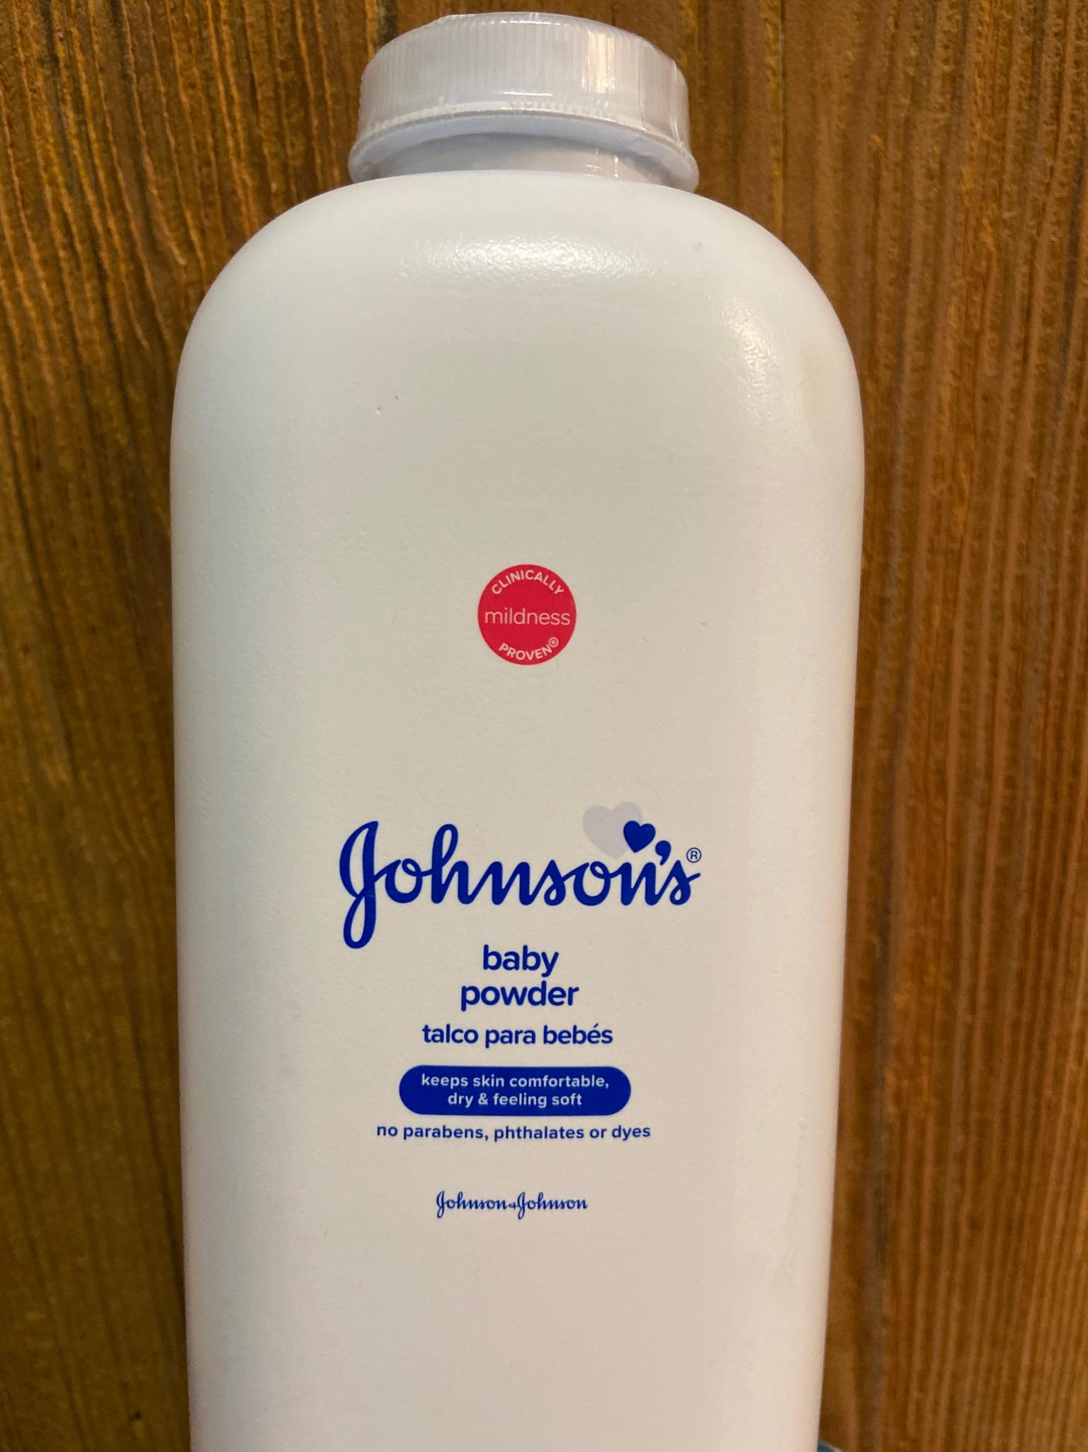
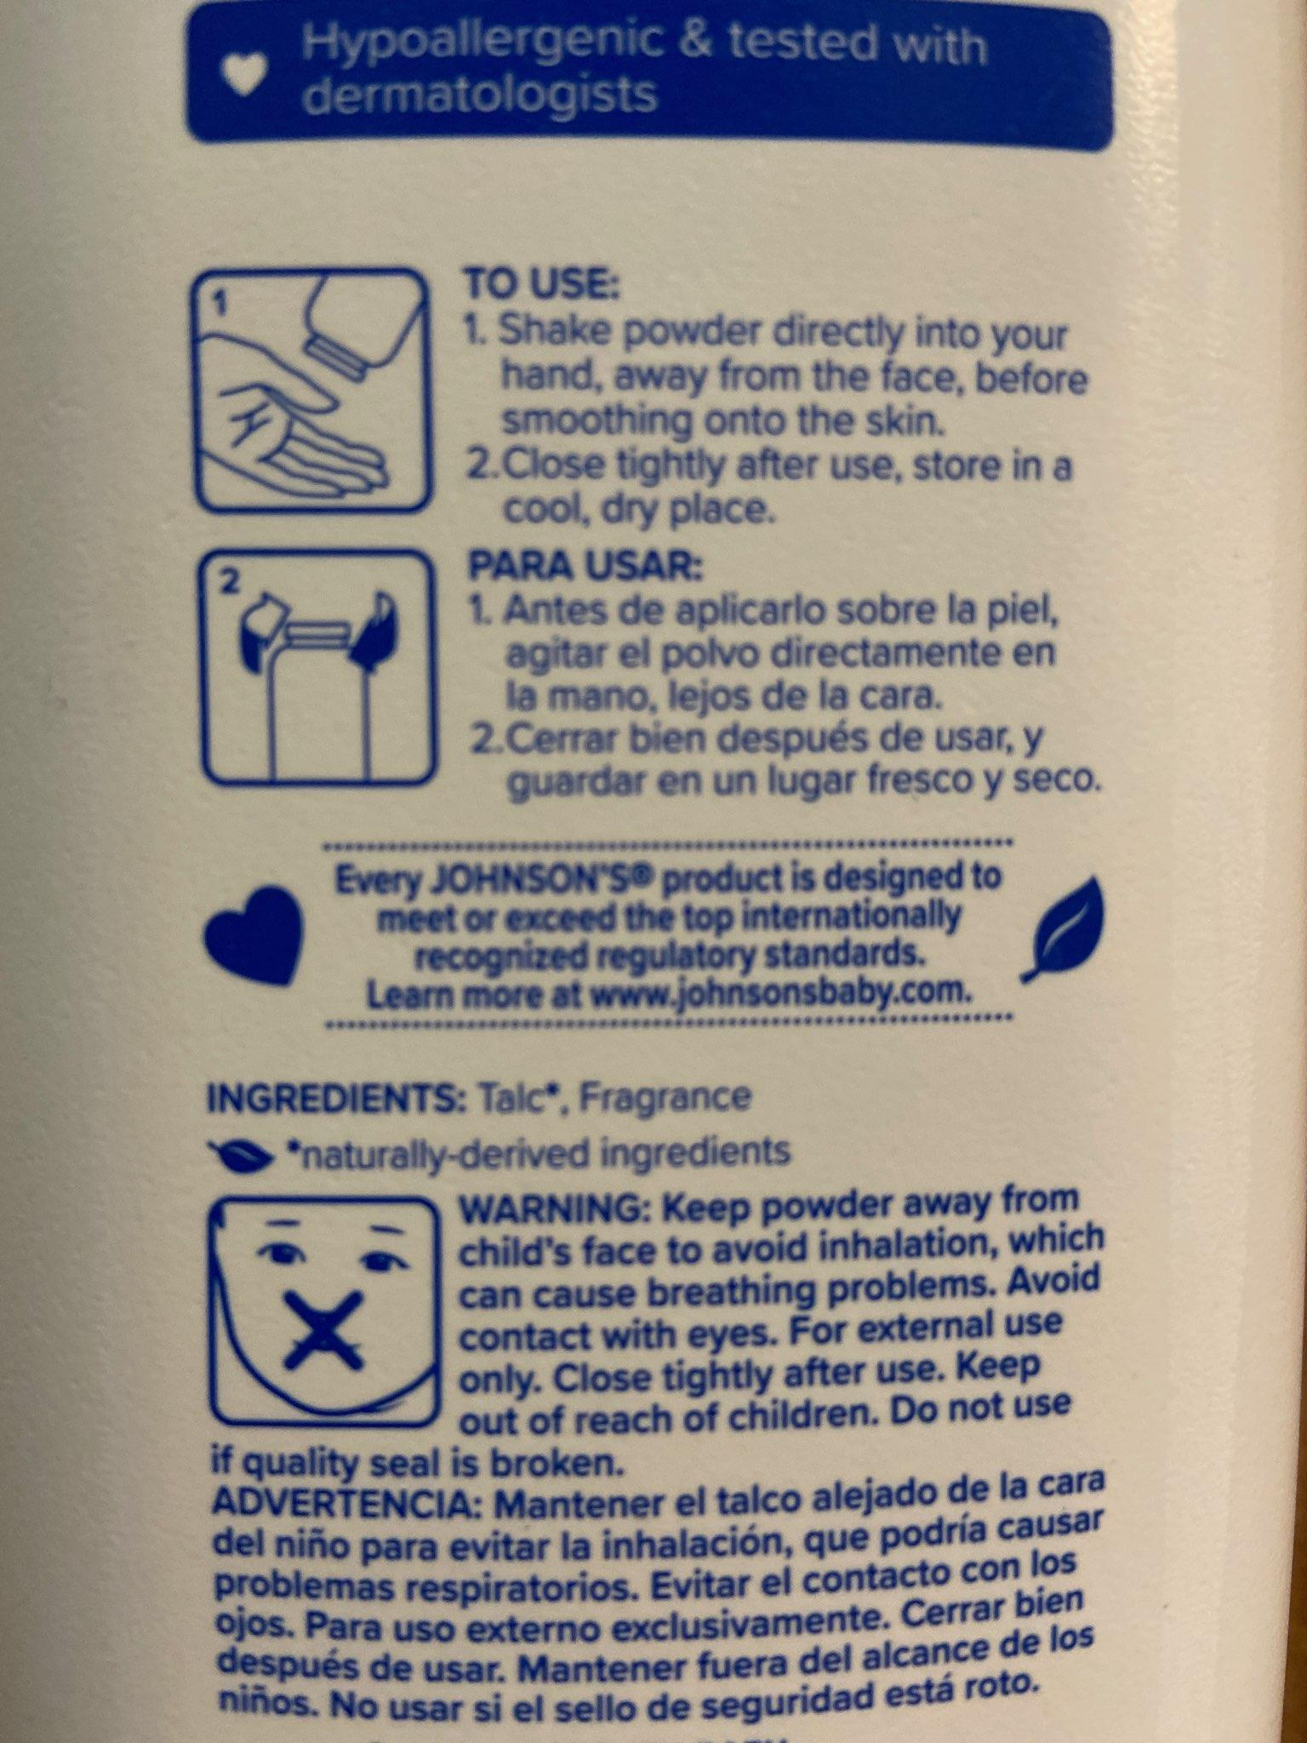
Talc Body Powder
Constituents
1) Talc body powder is more than “platy” talc
2) Each bottle is a mixture of constituents that include
Platy talc
Fibrous talc
Asbestos
Heavy metals
Fragrance
3) Constituents include compounds identified as “possible” and “known” human carcinogens

Slide 5
Fibers in Talc Body Powders
(Publicly Available Sources)
Fibrous talc (F) and asbestos (A) have been repeatedly found in talc body powders
  Pooley and Rowlands, 1975 (pre-processed; F and A)
  Rohl et al. 1976 (cosmetic grade; F and A)
  Paoletti et al. 1984 (pharmaceutical grade talc; F and A)
  Blount, 1991 (pharmaceutical grade; F and A)
  Mattenklott, 2007 (cosmetic grade; A)
  Gordon et al. 2014 (cosmetic grade; A)
  Anderson et al. 2017 (cosmetic grade; F)
  FDA Safety Alert of October 18, 2019 (cosmetic grade samples 2017-2019; F and A)

Slide 6
Fiber Toxicity and Carcinogenicity
Fibrous talc is the same as “asbestiform” talc and talc fibers
Fiber toxicity is a function of the chemical nature of the fiber as well as its physical form (e.g., Williams and Weisberger, 1991*; Brandenberger et al. 2015)
Fibrous talc and fibers of asbestos both can trigger responses in tissues that are associated with mechanisms of carcinogenesis (tumor formation)
IARC has classified fibrous talc as a “known” human carcinogen (IARC, 2012), same classification as asbestos
* From textbook Casarett & Doull’s Toxicology: The Basic Science of Poisons, 4th edition; similar discussion in all editions of the textbook including most recent in 2019 (9th edition)

Slide 7
Fibrous Talc = IARC Group 1
IARC (2010, page 277): “The review of talc in Supplement 7 led to evaluations for two agents: talc containing asbestiform fibres and talc not containing asbestiform fibres. The term ‘asbestiform fibre’ has been mistaken as a synonym for ‘asbestos fibre’ when it should be understood to mean any mineral, including talc, when it grows in an asbestiform habit.”
IARC (2012, page 219): “The conclusions reached in this Monograph about asbestos and its carcinogenic risks apply to these six types of fibres wherever they are found, and that includes talc containing asbestiform fibres.”
IARC (2012, page 230): “Talc may also form true mineral fibres that are asbestiform in habit.”

Slide 8
Fiber Toxicity and Carcinogenesis
Particles and Fibers
Talc Body Powder
Chronic
Inflammation
Fibers
DIRECT
Direct damage to DNA (DNA breaks, oxidation of DNA bases)
Fibers interfere with mitotic apparatus by direct physical interaction
Genotoxicity
INDIRECT
Oxidative stress
Epigenetic alterations
Altered signaling pathways
Stimulation of cell proliferation
Preneoplastic
Cells
Tumors

Slide 9
Talc Body Powder-Induced Tissue Toxicity
Numerous studies document adverse effects of talc as a complex mixture, adverse effects of talc fibers and/ or adverse effects of asbestos in tissues (bibliography to be provided)
These effects include those linked to the carcinogenic process (tumor formation)
Therefore, focus should be on more than asbestos in terms of talc body powder safety

Slide 10
Bibliography in Support of PLUNKETT Slide 8
Studies* describe direct and indirect effects of talc body powder and its constituents related to carcinogenesis
  DNA breaks and oxidized bases in DNA (Jaurand, 1991; Jaurand, 1997; IARC, 2012; Egilman et al. 2019)
  Interference with mitotic apparatus via direct interaction (IARC, 2012; Mossman, 2018)
  Oxidative stress (Mandarino et al. 2020; Fletcher et al. 2019; Shim et al. 2015; Mossman et al. 2013; IARC, 2012; Buz’Zard and Lau, 2007)
  Altering signaling pathways (IARC, 2012; Shukla et al. 2009)
  Stimulating cell proliferation (Hamilton et al. 2001)
  Tumor promotion (Stenback and Rowland, 1978)
  Preneoplastic lesion induction (Mossman, 2018; Buz’Zard and Lau, 2007; NTP, 1993; Hamilton et al. 1984; Wagner et al. 1975; Trautwein and Helmboldt, 1967)
* There are other studies as well that provide similar discussion/ data, in particular regarding asbestos

Slide 11
Bibliography in Support of PLUNKETT Slide 9
Adverse effects of talc and its constituents in tissues
  Trautwein and Helmboldt, 1967 Pott and Friedrichs, 1972
  Nam and Gracey, 1972 Wagner et al. 1975
  Stenback and Rowland, 1978 Davies et al. 1983
  Kupryjanczyk, 1989 Hamilton et al. 1984
  Hamilton et al. 2001 NTP, 1993
  Buz’Zard and Lau, 2007 Shukla et al. 2009
  Shim et al. 2015 Fletcher et al. 2019
  Jaurand, 1991 Jaurand, 1997
  Mossman, 2018 Egilman et al. 2019
  Mossman et al. 2013 IARC, 2010
  IARC, 2012 Brandenberger et al. 2015
  Mandarino et al. 2020

