Slide 1
Identification of Platy Talc and Fibers in the Female Genital Tract
John J. Godleski, MD
Professor of Pathology Emeritus, Harvard Medical School
CEO/CFO, John J. Godleski, MD PLLC
Disclosure of Potential Commercial Conflicts of Interest:
Expert witness for plaintiffs and defendants in multiple product liability litigations.
Expert witness for plaintiffs in talc litigations.
Expert witness for plaintiffs and defendants in environmental exposure litigation.

Slide 2
Why Identify Foreign Material in Human Tissue?
The specific identification of foreign particulate material in human tissues confirms exposure to materials associated with the development of malignant tumors and other disease processes.

Slide 3
Preparation Techniques to Find Particulate Material in Tissues
Tissue digestion with strong acid, Clorox®, or incineration-- isolation of inorganic particulate-- chemical characterization by EM/EDS/ED.
In Situ identification of particles with SEM characterized by EDS.
  Advantages:
  1. Tissue context remains.
  2. Much less preparation when using variable pressure SEM/EDS because the face of a paraffin tissue block can be used.
  Disadvantages:
  1. Sensitivity issues -- The particulate concentrations in the tissues need to be very high because the tissue volume sampled is relatively very small.

Slide 4
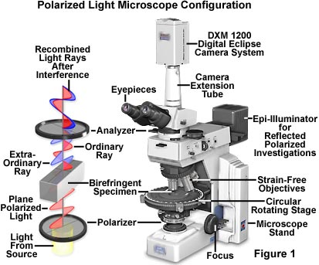
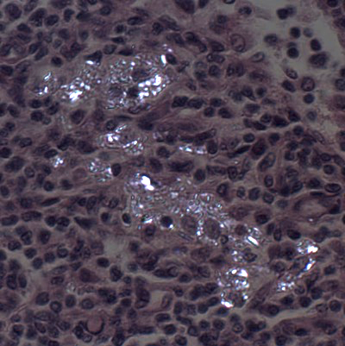
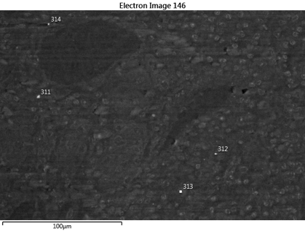
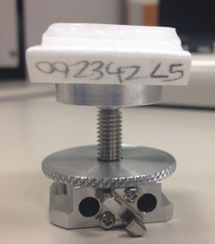
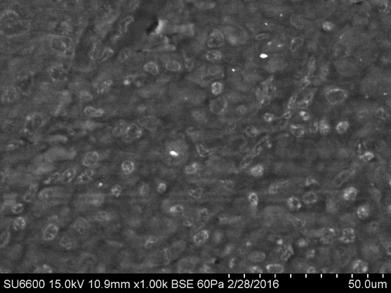
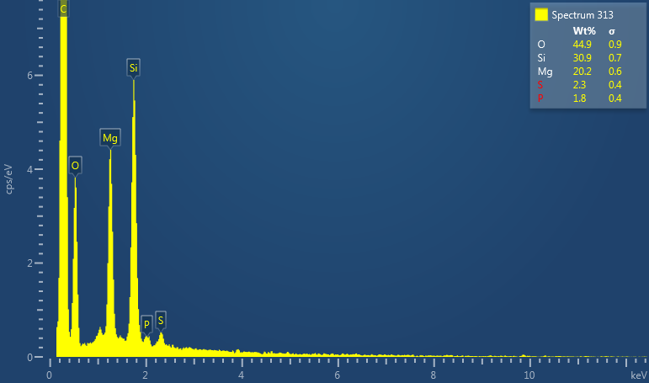
Our in Situ Approach

Slide 5
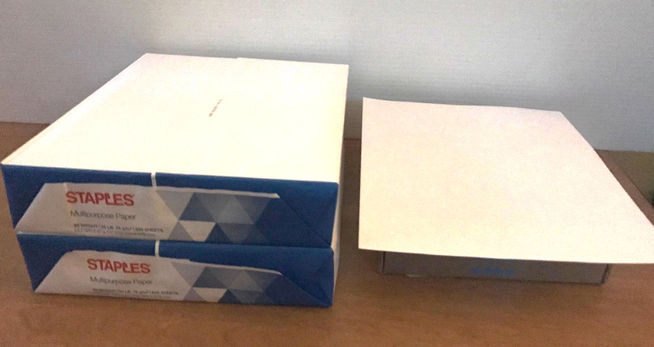
How Much Tissue is Examined by the in Situ Method?
By Analogy
The area of tissue in paraffin blocks prepared in pathology from surgical resections can be as much as 20x20x2mm (length x width x depth).
The length and width can depend on the tissue, but the depth (~2mm) is standardized by tissue processing.
SEM/EDS assesses to a depth of about 2µm. (1mm = 1000µm)
The in situ method assesses
1/1000 of the tissue

Slide 7
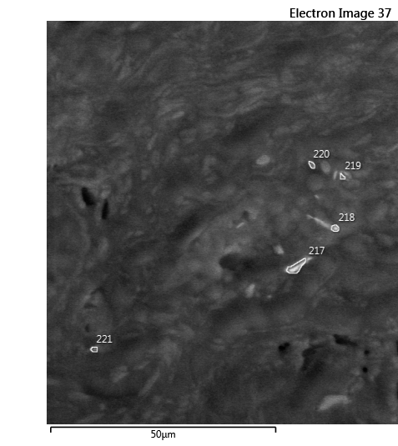
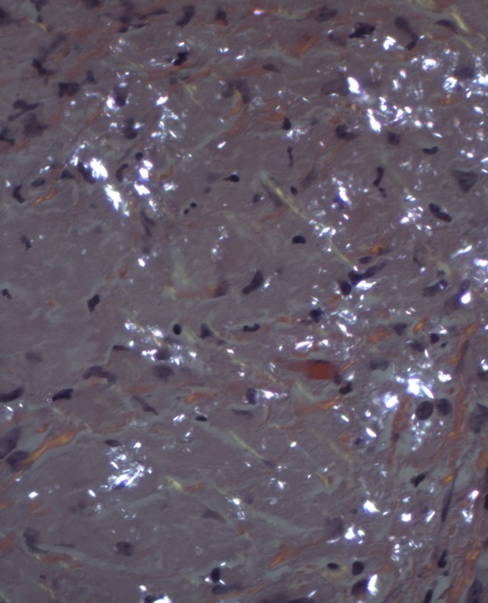
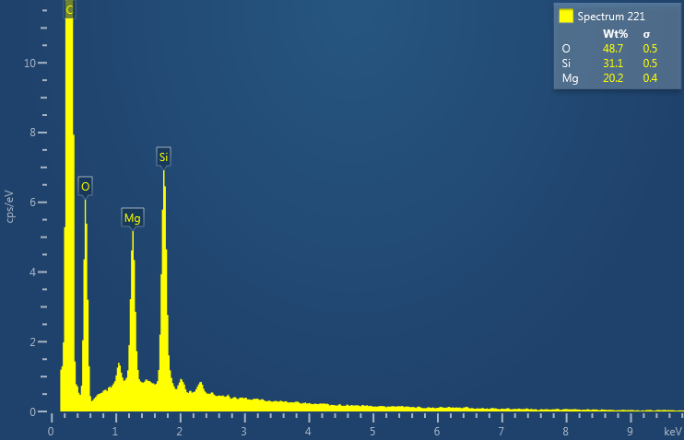
Accumulation of Talc in the Ovary
Mg/Si=0.649
Campion A, Smith KJ, Fedulov AV, Gregory DZ, Fan Y, Godleski JJ. Identification of Foreign Particles in Human Tissues Using Raman Microscopy.
Analytical Chemistry 2018 90 (14), 8362-8369

Slide 8
Migration of Talc From the Perineum to Multiple Pelvic Organ Sites
Sandra A. McDonald MD, Yuwei Fan PhD, William R. Welch MD, Daniel W. Cramer MD ScD, and
John J. Godleski MD American Journal of Clinical Pathology 152: 590-607 2019
Total Numbers of Talc Particles found by SEM/EDS In Situ in Pelvic Tissue Locations of Five Talc-Exposed Patients
Case | Cervix/ Uterus | Fallopian Tubes | Ovaries | Lymph Nodes
1 | 52(1) | ND | 8(1) | 126(2)
2 | 54(2) | 31(1) | 57(5) | 120(4)
3 | 36(1) | 3(2) | 24(2) | NS
4 | ND | ND | 4(2) | 28(1)
5 | ND | 0 | 8(2) | 13(1)
( ) - # of blocks studied
ND - Not done by SEM/EDS
NS - Not Sampled at Surgery
Table 3 -- Abridged

Slide 9
Talc in Deep Cervical Tissue Sites From Patient #1
Light Microscopy(400X) Polarized Light Microscopy(400X) SEM(500X)
Left: By Light microscopy, scattered macrophages had slightly glassy, grayish cytoplasm in dense collagenous cervical tissue.
Center: By Polarized light microscopy of the same field, the macrophages had numerous birefringent cytoplasmic particles 1 to 10 μm in diameter.
Right: By SEM from the same tissue block, but a different level, numerous particles are within the cytoplasm of macrophages, the majority of which had a spectrum characteristic of talc.

Slide 10
Accumulation of Talc in Pelvic Lymph Nodes
Light Microscopy (400X) Polarized Light Microscopy(400X) SEM(500X)
Left: By light microscopy of this pelvic lymph node, aggregates of macrophages are apparent.
Center: With Polarized Light of the same field, numerous, 1-5µm-sized, birefringent particles are observed within these macrophages.
Right: By SEM of the same area of the tissue block, but another level, again numerous particles are observed within the cytoplasm of macrophages, and most have spectra characteristic of talc.

Slide 11
Representative Fibers with Greater than 5:1 Aspect Ratios
Within the Tissues of our 5 Patients
Left: Long aspect ratio fibers (arrows) composed of calcium, magnesium, aluminum, iron, and silicon found in patient case 2 (right ovary). Based on atomic weight percent calculations, these were neither talc nor asbestos.
Center: Fiber (arrow) aspect ratio ~6:1 from case 2 with Mg-Si spectra with atomic weight percent ratio of talc.
Right: Talc fiber-like particle (arrow) from case 3 with ~ 6:1 aspect ratio and spectrum of talc. All images are 500X.

Slide 12
Summary of Our Experience with Talc and Asbestos in Pelvic Tissues of Patients with Perineal Exposure
Total Number of Patients with or without Birefringent Particles Assessed by Polarized Light Microscopy.
Total Number of Patients with or without Talc Particles Assessed by SEM/EDS.
Average Number of Talc Particles per Patient
Number of Patients with >15 Talc Particles by in Situ Analyses
Number of Patients with Fibers by
in Situ Analyses
+ | - | + | - |  |  | Talc | Asbestos
180 | 16 | 82 | 9 | 40 | 24 | 21 | 9
196
91
Median=10
28
2 patients with both

Slide 13
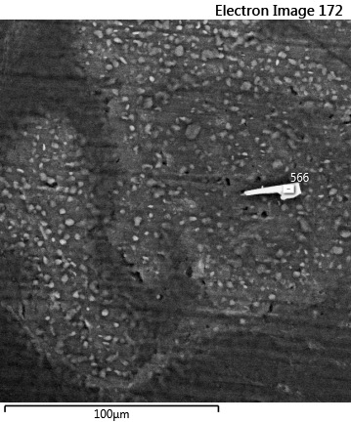
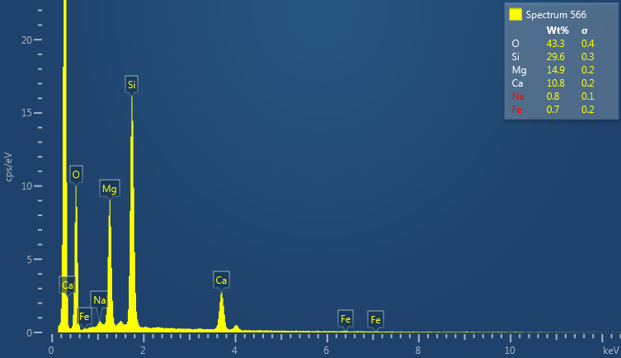
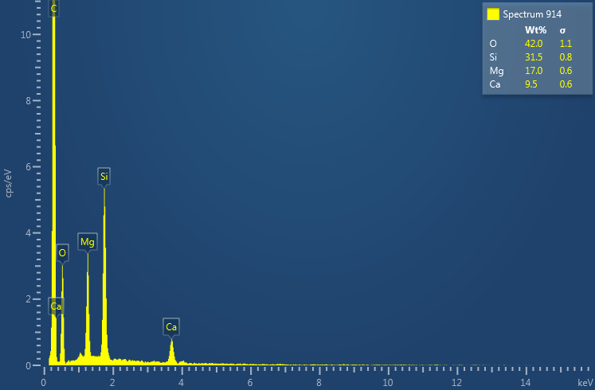
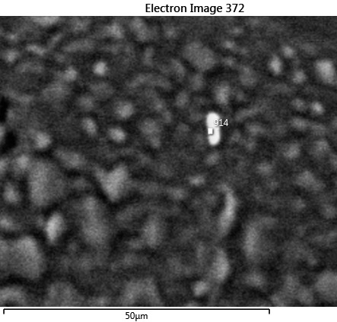
Examples of Tremolite Asbestos Fibers found by In Situ SEM in Two Patients

Slide 14
Summary and Conclusions
Identification of platy talc, fibrous talc, and asbestos in tissue documents exposure and retention of these materials in the pelvis.
In Situ SEM/EDS can identify all forms of talc and asbestos within the context of the tissue.
Fibrous talc and asbestos are more likely to be found by In Situ SEM in cases with evidence of high tissue particle burdens.

