Slide 1


Technical Committee Operations
Committee D22 on Air Quality
Sub-Committee D2207 on Sampling, Analysis, Management of Asbestos, and Other Microscopic Particles
Frank Ehrenfeld
Laboratory Director – Vice President, iATL
Chair ASTM D22.07
9000 Commerce Parkway
Suite B
Mt. Laurel, NJ 08054
frankehrenfeld@iatl.com

Slide 2
Summary
ASTM International
D22 Air Quality
D2207 Asbestos
D2207 Roster
D2207 Consensus Standards Process
D2207 Current Status Asbestos/Talc
D2207 Next Steps / Expectations

Slide 3
Summary
ASTM International
D22 Air Quality
D2207 Asbestos
D2207 Roster
D2207 Consensus Standards Process
D2207 Current Status Asbestos/Talc
D2207 Next Steps / Expectations

Slide 4

ASTM International
Operating Globally
ASTM is one of the world’s largest Standards Developing Organizations, with global reach and influence
With over a century of experience, ASTM offers trusted, relevant, and high quality standards that are accepted globally
  Established in 1898
  30,000 volunteer members from 154 countries
  148 main committees and 2,053 subcommittees, covering over 90 industry sectors
The choice for many global industries
– 46% outside USA
12,800+
ASTM standards operate globally
Notes:
ASTM is one of the world’s largest SDOs, but it’s the scale of our involvement and influence that counts for more.
We work across political, cultural and geographic borders – recognizing expertise, not country of origin. This promotes a massive range of activity and a phenomenal exchange of knowledge.
Trusted and known for market relevance and technical quality, our standards are the choice for many global industries – almost 50% outside the USA.
We also believe in the power of standards to inspire and enable people and economies.
Our global outreach activities increase understanding about standards and their application.
And our Memorandum of Understanding Program provides tangible encouragement to developing economies.

Slide 5
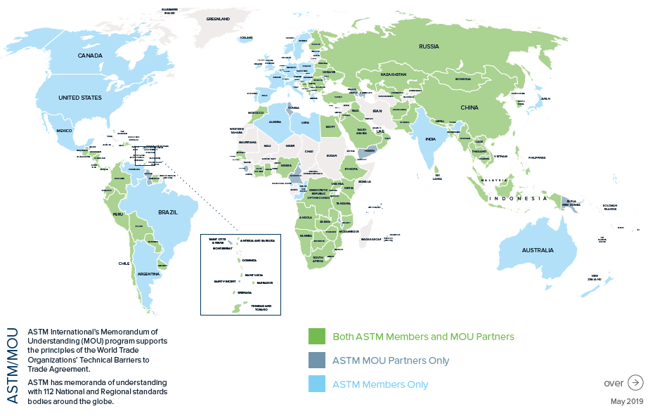
Where is ASTM?
Notes:
As of August 2019, ASTM has 112 Memorandum of Understanding Partners with National and Regional Standards Bodies from around the world. This map provides a visual representation of ASTM International memberships.
Map of ASTM membership around the world:
Green – MOU partners and ASTM members
Navy – MOU partners
Light Blue – ASTM members

Slide 6

International Standards
WTO TBT Committee Decision
WTO/TBT Principles
Transparency
Openness
Impartiality and Consensus
Effectiveness and relevance
Coherence
Consideration of developing nations
The World Trade Organization (WTO) Technical Barriers to Trade (TBT) Committee Decision on Principles for the Development of International Standards, Guides and Recommendations provides guidance
  in the form of six principles; does not designate SDOs
  helps regulators determine which international standards may be relevant for the purposes of the TBT Agreement
  Industry embraces these concepts; ASTM is committed to demonstrating each principle

Slide 7
Memorandum of Understanding (MOU)
ASTM International
Full collection of ASTM Standards (that may be used for reference, adoption, as basis of national standards, and consultation)
Membership at no cost to participants from the country/region
Information, training, and partnership
MOU Partner
Access to ASTM through a link on the homepage
Encourage active participation of stakeholders in ASTM technical committees
Adopt or use ASTM standards to develop national standards
Annual Report on use of ASTM standards
112 MOU partners worldwide
6 Regional Standards Bodies
Notes:
– Our global outreach activities increase understanding about standards and their application.
– And our Memorandum of Understanding Program provides tangible encouragement to developing economies.
Initiated in 2001, ASTM International's MOU program promotes communication between ASTM International and national standards bodies worldwide, fostering awareness of the standardization systems of all parties involved. Through the program, each signatory receives a free set of ASTM’s 12,000 technical standards and the ability to add any technical expert to an ASTM technical committee at no cost. The national standard body partners are asked to annually submit a report to ASTM detailing the use of ASTM standards and any other related activity. ASTM MOU partners have special additional rights and obligations when it comes to the use of ASTM International standards.
Regional Standards Bodies:
African Organization for Standardization (ARSO)
CARICOM Regional Organisation for Standards and Quality (CROSQ)
Eurasian Council on Standardization (EASC)
Eurasian Economic Commission (EEC)
Standardization Organization of the Gulf Cooperation Council (GSO)
South African Development Community Cooperation in Standards (SADCSTAN)

Slide 8

Mission Statement:
Committed to serving global societal needs, ASTM International positively impacts public health and safety, consumer confidence and overall quality of life. We integrate consensus standards, developed with our international membership of volunteer technical experts, and innovative services to improve lives—Helping our world work better.
Five Strategic Objectives
Leadership
Global Technical Expertise
Standards and Technical Content Development
Service Provider
Organizational Vitality

Slide 9
Mission Statement:
Committed to serving global societal needs, ASTM International positively impacts public health and safety, consumer confidence and overall quality of life. We integrate consensus standards, developed with our international membership of volunteer technical experts, and innovative services to improve lives—Helping our world work better.
Five Strategic Objectives
Leadership
Global Technical Expertise
Standards and Technical Content Development
Service Provider
Organizational Vitality

Slide 10
Committee D22 on Air Quality
Organized in 1951
More than 550 Members
11 Subcommittees
229 Published Standards
Scope – The promotion of knowledge, the development of test methods, practices, guides, and terminology pertaining to sampling and analysis of atmospheres, interpretation of data, the standardization of recognized and practiced methods for measurement of atmospheric quality, and sponsoring of discussions among those active in the study of air quality.
The work of the Committee will be coordinated with other ASTM Committees and other organizations having mutual interest.

Slide 11
D22 Subcommittees
D22.01 Quality Control
D22.03 Ambient Atmospheres and Source Emissions
D22.04 Workplace Air Quality
D22.05 Indoor Air
D22.07 Sampling, Analysis, Management of Asbestos, and Other Microscopic Particles
D22.08 Assessment, Sampling, and Analysis of Microorganisms
D22.09 ISO TAG for ISO/TC 146
D22.11 Meteorology
D22.12 Sampling and Analysis, of Lead, for Exposure and Risk Assessment
D22.90 Executive
D22.91 Strategic Planning

Slide 12
D22 Subcommittees
D22.01 Quality Control
D22.03 Ambient Atmospheres and Source Emissions
D22.04 Workplace Air Quality
D22.05 Indoor Air
D22.07 Sampling, Analysis, Management of Asbestos, and Other Microscopic Particles
D22.08 Assessment, Sampling, and Analysis of Microorganisms
D22.09 ISO TAG for ISO/TC 146
D22.11 Meteorology
D22.12 Sampling and Analysis, of Lead, for Exposure and Risk Assessment
D22.90 Executive
D22.91 Strategic Planning

Slide 13
Technical Committee Structure:
Organization of Volunteer Members
D22 Main Committee
Technical Committees Address specific industry subjects
Subcommittees
Address subsets of specialized subject matter
Subcommittee
D22.01
Subcommittee
D22.07
Subcommittee
D22.08
Task Groups
Organized by subcommittees: standards get drafted, revised, and developed at this level
Task Group on a new standard
Task Group on a revision
ASTM Balloting Sequence and Requirements
Notes:
There are currently total of 148 Technical Committees at ASTM. These Technical Committees develop and maintain ASTM’s standards and they are grouped by designation according to related activates within a particular scope of work.
Any interested stakeholder can participate on an ASTM Technical Committee through membership. Non-members can attend and contribute in drafting standards, but are not allowed to vote. The number of producer votes are to never exceed the number of user and general interest votes.
Each technical committee in ASTM has the same, basic 3-tiered structure as shown here.
Main Committee: semi-autonomous group approved by the ASTM Board of Directors and is responsible for developing standards in a given subject area. 60% ballot return is required with 90% affirmative of the affirmative and negative votes.
Subcommittee: formed as needed to address specific subjects or areas within the scope of the main committee. These include technical as well as administrative and strategic planning functions. 60% ballot return is required with 2/3 affirmative of the combined affirmative and negative votes.
Task Group: small working groups responsible for a specific assignment (revision or development of standards) within a given time period. Task group members do not need to be ASTM members. No formal requirements to initiate or proceed to the next level.
Example:
TC F15 on Consumer Products
SC F15.22 on Toy Safety
ASTM F963 – Standard Consumer Safety Specification for Toy Safety

Slide 14
Technical Committee Structure:
Organization of Volunteer Members
Additional operations & support above this level…
D22 Main Committee
Technical Committees Address specific industry subjects
Subcommittees
Address subsets of specialized subject matter
Subcommittee
D22.01
Subcommittee
D22.07
Subcommittee
D22.08
Task Groups
Organized by subcommittees: standards get drafted, revised, and developed at this level
Task Group on a new standard
Task Group on a revision
ASTM Balloting Sequence and Requirements
Notes:
There are currently total of 148 Technical Committees at ASTM. These Technical Committees develop and maintain ASTM’s standards and they are grouped by designation according to related activates within a particular scope of work.
Any interested stakeholder can participate on an ASTM Technical Committee through membership. Non-members can attend and contribute in drafting standards, but are not allowed to vote. The number of producer votes are to never exceed the number of user and general interest votes.
Each technical committee in ASTM has the same, basic 3-tiered structure as shown here.
Main Committee: semi-autonomous group approved by the ASTM Board of Directors and is responsible for developing standards in a given subject area. 60% ballot return is required with 90% affirmative of the affirmative and negative votes.
Subcommittee: formed as needed to address specific subjects or areas within the scope of the main committee. These include technical as well as administrative and strategic planning functions. 60% ballot return is required with 2/3 affirmative of the combined affirmative and negative votes.
Task Group: small working groups responsible for a specific assignment (revision or development of standards) within a given time period. Task group members do not need to be ASTM members. No formal requirements to initiate or proceed to the next level.
Example:
TC F15 on Consumer Products
SC F15.22 on Toy Safety
ASTM F963 – Standard Consumer Safety Specification for Toy Safety

Slide 15
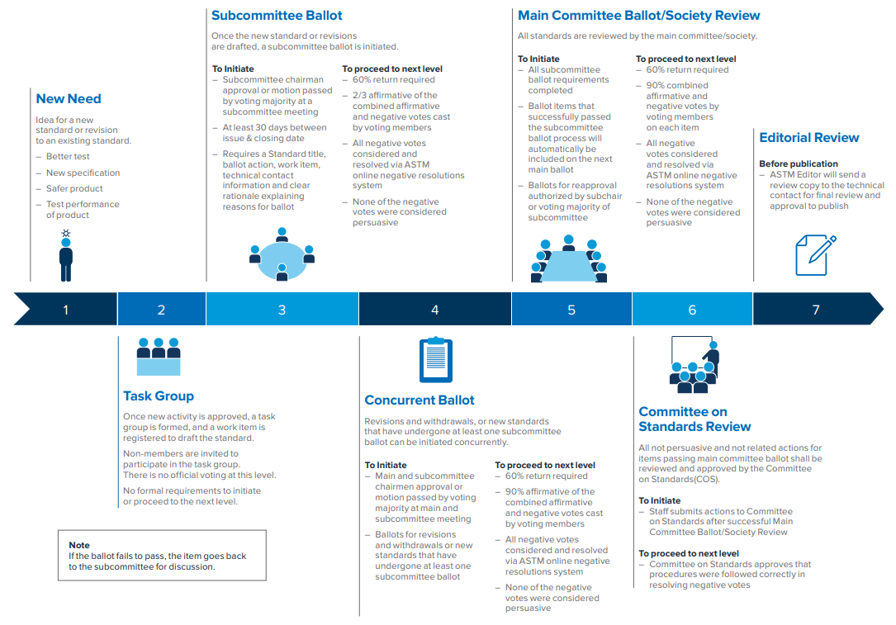
Balloting Sequence and Requirements

Slide 16
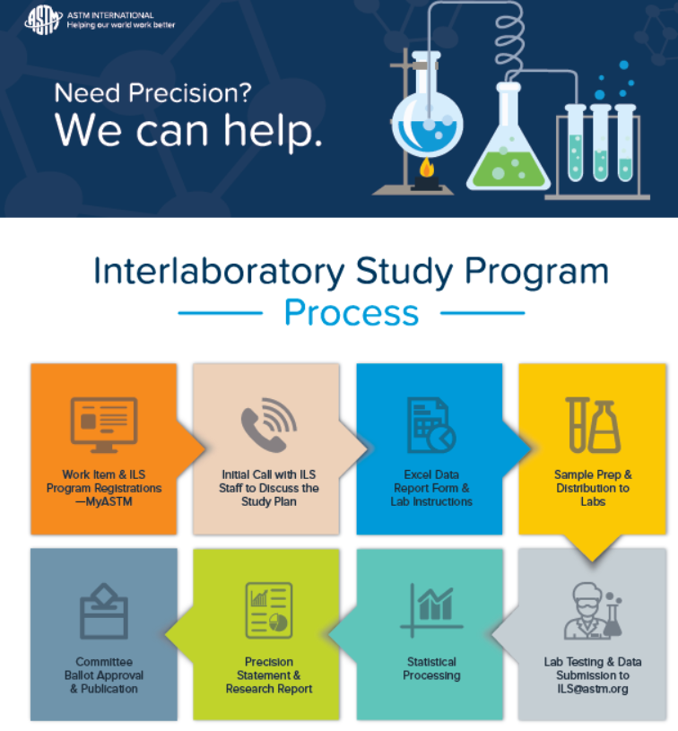
Previous Studies

Slide 17
Method Valuation
Utility
Effectiveness
Economy
Technology
Simplicity
Understandable
Controlled
Peer Reviewed
Reproducible
Repeatable
Validation
Verification
InterLaboratoryStudy (ILS)
Stands test of time yet, undergoes routine rigorous review and revision process
VALUE

Slide 18
Method Valuation
“To retain respect for sausages and laws, one must not watch them in the making.”
- Otto von Bismarck
Utility
Effectiveness
Economy
Technology
Simplicity
Understandable
Controlled
Peer Reviewed
Reproducible
Repeatable
Validation
Verification
InterLaboratoryStudy (ILS)
Stands test of time yet, undergoes routine rigorous review and revision process
VALUE
and consensus standards

Slide 19
Method Valuation
“To retain respect for sausages and laws, one must not watch them in the making.”
- Otto von Bismarck
Utility
Effectiveness
Economy
Technology
Simplicity
Understandable
Controlled
Peer Reviewed
Reproducible
Repeatable
Validation
Verification
InterLaboratoryStudy (ILS)
Stands test of time yet, undergoes routine rigorous review and revision process
VALUE
and consensus standards

Slide 20
D2207 Standards
D5755-09(2014)e1 Standard Test Method for Microvacuum Sampling and Indirect Analysis of Dust by Transmission Electron Microscopy for Asbestos Structure Number Surface Loading
D6056-96(2011) Standard Test Method for Determining Concentration of Airborne Single-Crystal Ceramic Whiskers in the Workplace Environment by Transmission Electron Microscopy
D6057-96(2011) Standard Test Method for Determining Concentration of Airborne Single-Crystal Ceramic Whiskers in the Workplace Environment by Phase Contrast Microscopy
D6058-96(2016) Standard Practice for Determining Concentration of Airborne Single-Crystal Ceramic Whiskers in the Workplace Environment
D6059-96(2011) Standard Test Method for Determining Concentration of Airborne Single-Crystal Ceramic Whiskers in the Workplace Environment by Scanning Electron Microscopy
D6281-15 Standard Test Method for Airborne Asbestos Concentration in Ambient and Indoor Atmospheres as Determined by Transmission Electron Microscopy Direct Transfer (TEM)
D6480-05(2010) Standard Test Method for Wipe Sampling of Surfaces, Indirect Preparation, and Analysis for Asbestos Structure Number Concentration by Transmission Electron Microscopy
D6620-19 Standard Practice for Asbestos Detection Limit Based on Counts
D7200-12 Standard Practice for Sampling and Counting Airborne Fibers, Including Asbestos Fibers, in Mines and Quarries, by Phase Contrast Microscopy and Transmission Electron Microscopy
D7201-06(2011) Standard Practice for Sampling and Counting Airborne Fibers, Including Asbestos Fibers, in the Workplace, by Phase Contrast Microscopy (with an Option of Transmission Electron Microscopy)
D7390-18e1 Standard Guide for Evaluating Asbestos in Dust on Surfaces by Comparison Between Two Environments
D7521-16 Standard Test Method for Determination of Asbestos in Soil
D7712-18 Standard Terminology for Sampling and Analysis of Asbestos
D7886-14 Standard Practice for Asbestos Exposure Assessments for Repetitive Maintenance and Installation Tasks
E1368-14 Standard Practice for Visual Inspection of Asbestos Abatement Projects
E1494-18 Standard Practice for Testing Physical Properties of Friable Surfacing Materials
E2356-18 Standard Practice for Comprehensive Building Asbestos Surveys
E2394-11 Standard Practice for Maintenance, Renovation and Repair of Installed Asbestos Cement Products
WK28561 New Test Method for Airborne Carbon Nanotube Concentration in Ambient and Indoor Atmospheres as Determined by Transmission Electron Microscopy Direct Transfer (Technical Contact: Steven Compton)
WK30024 New Test Method for Polarized Light Microscopy (PLM) Analysis of Cosmetic and Pharmaceutical Talc for Asbestos (Technical Contact: Sean Fitzgerald)
WK30039 New Test Method for Transmission Electron Microscopy (TEM) Analysis of Mineral Powders for Asbestos (Technical Contact: Julie Pier)
WK30352 New Test Method for XRD analhysis of cosmetic and pharmaceutical talc for asbestos (Technical Contact: Gary Tomaino)
WK52022 Respirable/Releasable Fiber Concentration of Asbestos and Other Fibers using the Fluidized Bed Aerosol Segregator (Technical Contact: Edward Cahill)
WK52495 Qualitative Determination of Asbestos and other Amphibole Fibers in Loose Fill Vermiculite by Transmission Electron Microscopy (Technical Contact: Jeanne Spencer) Ballot D22 (18-04) Item 005;
WK58498 Analysis of Non-Friable Organically Bound (NOB) Materials by Polarized Light Microscopy (PLM) and Transmission Electron Microscopy (TEM) (Technical Contact: Andreas Saldivar)
WK65640 Determination of Natural Occurrences of Asbestos (NOA) by Polarized Light Microscopy, X-Ray Diffraction, Scanning Electron Microscopy, and Transmission Electron Microscopy. (Technical Contact: Mark Bailey)
1 of 2

Slide 21
D2207 Standards
D5755-09(2014)e1 Standard Test Method for Microvacuum Sampling and Indirect Analysis of Dust by Transmission Electron Microscopy for Asbestos Structure Number Surface Loading
D6056-96(2011) Standard Test Method for Determining Concentration of Airborne Single-Crystal Ceramic Whiskers in the Workplace Environment by Transmission Electron Microscopy
D6057-96(2011) Standard Test Method for Determining Concentration of Airborne Single-Crystal Ceramic Whiskers in the Workplace Environment by Phase Contrast Microscopy
D6058-96(2016) Standard Practice for Determining Concentration of Airborne Single-Crystal Ceramic Whiskers in the Workplace Environment
D6059-96(2011) Standard Test Method for Determining Concentration of Airborne Single-Crystal Ceramic Whiskers in the Workplace Environment by Scanning Electron Microscopy
D6281-15 Standard Test Method for Airborne Asbestos Concentration in Ambient and Indoor Atmospheres as Determined by Transmission Electron Microscopy Direct Transfer (TEM)
D6480-05(2010) Standard Test Method for Wipe Sampling of Surfaces, Indirect Preparation, and Analysis for Asbestos Structure Number Concentration by Transmission Electron Microscopy
D6620-19 Standard Practice for Asbestos Detection Limit Based on Counts
D7200-12 Standard Practice for Sampling and Counting Airborne Fibers, Including Asbestos Fibers, in Mines and Quarries, by Phase Contrast Microscopy and Transmission Electron Microscopy
D7201-06(2011) Standard Practice for Sampling and Counting Airborne Fibers, Including Asbestos Fibers, in the Workplace, by Phase Contrast Microscopy (with an Option of Transmission Electron Microscopy)
D7390-18e1 Standard Guide for Evaluating Asbestos in Dust on Surfaces by Comparison Between Two Environments
D7521-16 Standard Test Method for Determination of Asbestos in Soil
D7712-18 Standard Terminology for Sampling and Analysis of Asbestos
D7886-14 Standard Practice for Asbestos Exposure Assessments for Repetitive Maintenance and Installation Tasks
E1368-14 Standard Practice for Visual Inspection of Asbestos Abatement Projects
E1494-18 Standard Practice for Testing Physical Properties of Friable Surfacing Materials
E2356-18 Standard Practice for Comprehensive Building Asbestos Surveys
E2394-11 Standard Practice for Maintenance, Renovation and Repair of Installed Asbestos Cement Products
WK28561 New Test Method for Airborne Carbon Nanotube Concentration in Ambient and Indoor Atmospheres as Determined by Transmission Electron Microscopy Direct Transfer (Technical Contact: Steven Compton)
WK30024 New Test Method for Polarized Light Microscopy (PLM) Analysis of Cosmetic and Pharmaceutical Talc for Asbestos (Technical Contact: Sean Fitzgerald)
WK30039 New Test Method for Transmission Electron Microscopy (TEM) Analysis of Mineral Powders for Asbestos (Technical Contact: Julie Pier)
WK30352 New Test Method for XRD analhysis of cosmetic and pharmaceutical talc for asbestos (Technical Contact: Gary Tomaino)
WK52022 Respirable/Releasable Fiber Concentration of Asbestos and Other Fibers using the Fluidized Bed Aerosol Segregator (Technical Contact: Edward Cahill)
WK52495 Qualitative Determination of Asbestos and other Amphibole Fibers in Loose Fill Vermiculite by Transmission Electron Microscopy (Technical Contact: Jeanne Spencer) Ballot D22 (18-04) Item 005;
WK58498 Analysis of Non-Friable Organically Bound (NOB) Materials by Polarized Light Microscopy (PLM) and Transmission Electron Microscopy (TEM) (Technical Contact: Andreas Saldivar)
WK65640 Determination of Natural Occurrences of Asbestos (NOA) by Polarized Light Microscopy, X-Ray Diffraction, Scanning Electron Microscopy, and Transmission Electron Microscopy. (Technical Contact: Mark Bailey)
2 of 2

Slide 22
ASTM D2207 – Asbestos / Talc History
Approached by USP, CTFA/PCPC ~2010 about Method Development
Pharma, Cosmetics, Food, other considered (industrial grade)
Suite of Methods Proposed (ex. XRD, PLM, TEM)
Roster of technical experts assigned
Reference Materials Obstacles (geologic and processed grades)
Formulations (manipulation monitoring)
Separation / Concentration
Using current standardized approaches and customizing for talc and related mineral assemblages
Research and regular reports (ex. round robins, milling results, etc.)
Balloting / Re-evaluation

Slide 23
ASTM D2207 – Asbestos / Talc Work Items
WK30039 * New Test Method for Transmission Electron Microscopy (TEM) Analysis of Mineral Powders for Asbestos (Technical Contact: Julie Pier)
WK30352 * New Test Method for XRD Analysis of Cosmetic and Pharmaceutical talc for Asbestos (Technical Contact: Gary Tomaino)
WK30024 * New Test Method for Polarized Light Microscopy (PLM) Analysis of Cosmetic and Pharmaceutical Talc for Asbestos (Technical Contact: Ann Wylie)
WK58498 * Analysis of Non-Friable Organically Bound (NOB) Materials by Polarized Light Microscopy (PLM) and Transmission Electron Microscopy (TEM)
(Technical Contact: Andreas Saldivar)

Slide 24
ASTM D2207 – Asbestos / Talc Work Items
WK30039 * New Test Method for Transmission Electron Microscopy (TEM) Analysis of Mineral Powders for Asbestos (Technical Contact: Julie Pier)
WK30352 * New Test Method for XRD Analysis of Cosmetic and Pharmaceutical talc for Asbestos (Technical Contact: Gary Tomaino)
WK30024 * New Test Method for Polarized Light Microscopy (PLM) Analysis of Cosmetic and Pharmaceutical Talc for Asbestos (Technical Contact: Ann Wylie)
WK58498 * Analysis of Non-Friable Organically Bound (NOB) Materials by Polarized Light Microscopy (PLM) and Transmission Electron Microscopy (TEM) (Product)
(Technical Contact: Andreas Saldivar)

Slide 25
ASTM D2207 – Asbestos / Talc Work Items
WK30039 * New Test Method for Transmission Electron Microscopy (TEM) Analysis of Mineral Powders for Asbestos (Technical Contact: Julie Pier)
WK30352 * New Test Method for XRD Analysis of Cosmetic and Pharmaceutical talc for Asbestos (Technical Contact: Gary Tomaino)
WK30024 * New Test Method for Polarized Light Microscopy (PLM) Analysis of Cosmetic and Pharmaceutical Talc for Asbestos (Technical Contact: Ann Wylie)
WK58498 * Analysis of Non-Friable Organically Bound (NOB) Materials by Polarized Light Microscopy (PLM) and Transmission Electron Microscopy (TEM) (Product)
(Technical Contact: Andreas Saldivar)
Work Items Rosters Include:
Edward Cahill, Steven Compton, Frank Ehrenfeld, James Lambert, H.B. Fuller, Andrew Oberta, Drew Van Orden, Andreas Saldivar, Alan Segrave, Jim Millette, Ann Wylie, James Webber, Gary Tomaino, and others all who have experience in laboratory analytical method development setting.

Slide 26
ASTM D2207 – Asbestos / Talc Work Items
TEM
XRD
PLM
Product

Slide 27
ASTM D2207 – Asbestos / Talc Work Items
TEM
XRD usually for investigations of raw or processed ore, but can have applications to finely processed talc minerals and or select products
PLM [see Table]
Product usually for investigations of finished product, cosmetic, pharma, etc.
[see Table]

Slide 28
ASTM D2207 – Asbestos / Talc Work Items
Method | Matrix | Est DL (%) | Prep | Comment / Utility | Counting / Binning | Qualitative Flexibility | Mass Reporting
XRD | Mineral | 0.1 | Std | Screening tool for mineral aggregate qual/quant | NA | NA | Limited
PLM | Mineral | 0.1 | Std | Screening tool for mineral aggregate qual/quant | Limited | Wide Range of Identification | Limited
TEM | Mineral | 0.001 | Std | Detailed examination for qual/quant of samples | Inclusive | Wide Range of Identification | Option
Product PLM/TEM | Product | 0.001 | Std | Gravimetric reduction to estimate mineral content | Inclusive | Wide Range of Identification | Option
Matrix – Can be various grades of unprocessed through to highly refined mineral samples and finished formulated consumer product (ex. cosmetics) that include other organic components
Est DL – Early interlaboratory round robins indicate a range of sensitivity depending on matrix factors
Preparation – Standard preparation techniques employed for reducing interferences and, in some cases, concentrating suspect mineral. Options that may alter initial mineral dimensions (ex. milling) may have to be carefully (re)considered. Established methods from ASTM, NIOSH, EPA, and ISO incorporated into these work items.
Count/Bin – TEM have option to count ‘everything’ and allow investigators to sort in bins according to project guidelines. This may include aspect ratio, length/width, etc. criteria.
Qualitative - Technology and methods can provide range of mineral identification.
Mass Reporting – TEM methods option for complete sizing and determination of mass with primary and secondary structure determinations. Mass percent may be limited due to preferential influence of large structures.

Slide 29
ASTM D2207 – Asbestos / Talc Work Items
Method | Matrix | Est DL (%) | Prep | Comment / Utility | Counting / Binning | Qualitative Flexibility | Mass Reporting
XRD | Mineral | 0.1 | Std | Screening tool for mineral aggregate qual/quant | NA | NA | Limited
PLM | Mineral | 0.1 | Std | Screening tool for mineral aggregate qual/quant | Limited | Wide Range of Identification | Limited
TEM | Mineral | 0.001 | Std | Detailed examination for qual/quant of samples | Inclusive | Wide Range of Identification | Option
Product PLM/TEM | Product | 0.001 | Std | Gravimetric reduction to estimate mineral content | Inclusive | Wide Range of Identification | Option
Countable EMPs
Matrix – Can be various grades of unprocessed through to highly refined mineral samples and finished formulated consumer product (ex. cosmetics) that include other organic components
Est DL – Early interlaboratory round robins indicate a range of sensitivity depending on matrix factors
Preparation – Standard preparation techniques employed for reducing interferences and, in some cases, concentrating suspect mineral. Options that may alter initial mineral dimensions (ex. milling) may have to be carefully (re)considered. Established methods from ASTM, NIOSH, EPA, and ISO incorporated into these work items.
Count/Bin – TEM have option to count ‘everything’ and allow investigators to sort in bins according to project guidelines. This may include aspect ratio, length/width, etc. criteria.
Qualitative - Technology and methods can provide range of mineral identification.
Mass Reporting – TEM methods option for complete sizing and determination of mass with primary and secondary structure determinations. Mass percent may be limited due to preferential influence of large structures.
Covered Minerals

Slide 30
ASTM D2207 – Asbestos / Talc Work Items
Method | Status | R&D | RR | Ballot / Status | ILS | Publication | Challenges
XRD | Draft | Ref Mat’l | RR1 RR2 | Draft | 2023 | 2022 | USP/FDA Direction Reference Materials
PLM | Draft | Std | RR1 RR2 | (2) Ballots / Withdrawn | 2022-2023 | 2022 | USP/FDA Direction Reference Materials
TEM | Draft | Std | RR1 | (2) Ballots / Withdrawn | 2022-2023 | 2022 | USP/FDA Direction Reference Materials
Product PLM/TEM | Draft | Std | NA | (1) Ballot / Withdrawn | 2023-2024 | 2023 | USP/FDA Direction Reference Materials

Slide 31
Why ASTM Int’l D22.07
Roster
Consensus Standard Process
Develop Effective ‘Tools’ for Multiple Matrices
Current Work Items
Future Plans for Completion
Current Challenges
Invitation
www.astm.org
Frank Ehrenfeld
Chair D2207
frankehrenfeld@iatl.com

