Slide 1
Measuring Asbestos: Implications for Public Health
Diana Zuckerman, PhD, President
National Center for Health Research
dz@center4research.org

Slide 2
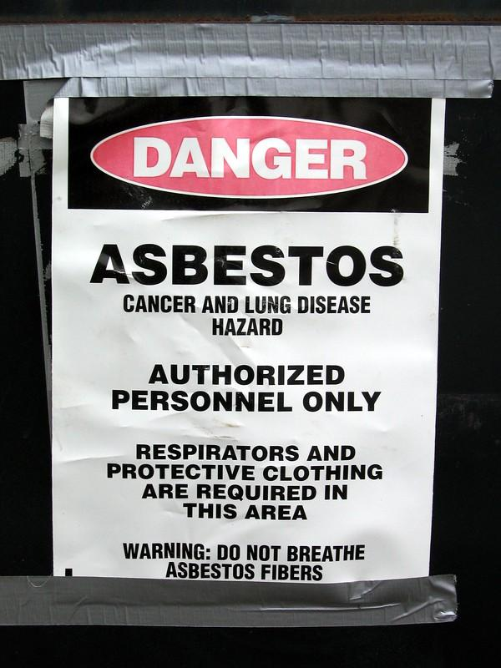
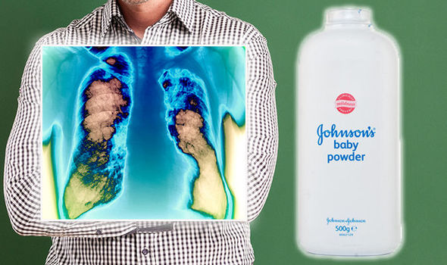
No Known Safe Level of Asbestos (WHO)
Avoid contamination with asbestos and similar mineral particles
Inhalation can cause the formation of scar-like tissue in the lung
May result in lung cancer and mesothelioma

Slide 3

Talc
Talc fibers can be very similar to asbestos and can form from asbestos
Mine Safety and Health Administration (MSHA) and OSHA use the same exposure limits for fibrous talc and asbestos
Animal studies found lesions caused by talc exposure
Talc fibers found in lung tissue in people with cancer

Slide 4

The Relationship: Talc and Asbestos
Talc is obtained from mines that also contain asbestos
Removal of asbestos by purification of talc ores is "extremely difficult"
Monitoring methods are needed to detect asbestos in talc

Slide 5
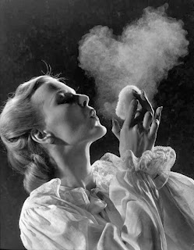
The Distinction is Irrelevant
There is no consensus
Working Group agrees with NIOSH Bulletin 6210 regarding adopting the term "elongate mineral particle" or "EMP”
EMP is "any mineral particle with a minimum aspect ratio [i.e., length: width ratio] of 3:1”
EMP includes asbestiform and non-asbestiform particles that have dimensions that are respirable
Photo source (left): Getty images

Slide 6
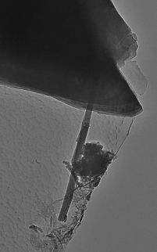
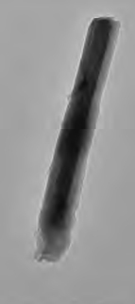
Is It Asbestos or Talc?
TEM image for asbestos (left)
TEM image for talc (right)
Source (pictures): FDA Office of Cosmetics & Colors, COC 308006-6, 6A, 6B/D58. AMA Analytical Services, Inc.

Slide 7
Asbestos Toxicity is Determined By:
Fiber dimensions/surface area
Biopersistence at the site of the tumor or scarring
Chemical composition
Surface properties

Slide 8
Likely Mechanisms to Explain Asbestos Carcinogenicity
Direct interaction with cellular macromolecules
Production of reactive oxygen species (ROS)
Cell-mediated mechanisms, such as inflammation

Slide 9
Clues from Animal Studies
Carcinogenic effects with different sizes and form of particles
Asbestos fibers and "cleavage fragments": both types cause cancers

Slide 10
Asbestos vs. Talc
Talc can form fibers/particles similar to asbestos and cause similar lung cancers.
Talc fiber in lung tissue, Dodson & Poye, Ultrastructural Pathology

Slide 11
Are Long, Thin Fibers >5 µm x <3 µm (ratio >3:1) the Only Ones That are Dangerous?
No, that’s due to how counted
Short fibers are common in lungs and tumors, and can cause ROS and cell death.

Slide 12
IARC
Asbestiform/fibrous talc is carcinogenic
"The term "asbestiform fibre" means "any mineral, including talc, when it grows in an asbestiform habit.”

Slide 13
Measurement Issues
Very thin or small fibers are difficult to detect with certain methods, leading to false negatives.
Transmission electron microscope is much more sensitive but also likely to miss crucial info
If FDA defines a lower limit based on certain methods, as Working Group suggests, results could be misleading
Better methods could lead to detection of smaller particles, which could be inhaled deep into the lung.

Slide 14
Standardized Analysis
Interagency Working Group recommends a standardized method to analyze asbestos and other biologically active EMPs in talc
For government regulatory authorities, industry, and contracting laboratories:
  Rigorous training requirements, quality assurance, and quality control needed to implement them

Slide 15
NIOSH Bulletin 62 Also Introduced 2 Terms
"Covered mineral" is encompassed by a regulation or standard
"Countable EMP is "a particle that meets specified dimensional criteria and is to be counted according to an established protocol."
But NIOSH uses different recommendations for talc

Slide 16
Interagency Working Group Recommends
Define EMP as "any mineral particle with a minimum aspect ratio of 3:1"
Testing laboratories report all EMPs having length ≥ 0.5 µm
Specify reportable EMPs identified as amphibole or chrysotile particles as covered minerals
Test methods require the counting and reporting of covered EMPs as a function of sample mass

Slide 17
Recommendations (cont’d)
Use TEM at nominally 20,000x magnification, in addition to PLM
Use TEM with energy dispersive X-ray spectroscopy (EDS) and selected area electron diffraction (SAED) analyses

Slide 18
Measuring Asbestos: Implications for Public Health
Diana Zuckerman, PhD, President
National Center for Health Research
dz@center4research.org

