Slide 1
David Egilman MD, MPH
Impurity Standards - DL Never 0
Asbestiform "cleavage" fragments cause cancer
No known safe exposure
February 4, 2020
degilman@brown.edu
Dr. David Egilman is Clinical Professor of Family Medicine at the Alpert School of Medicine at Brown University. He has served as an expert witness in litigation at the request of people who were injured as the result of using talcum powders. He has also served as an expert witness at the request of companies who have been sued for exposure to asbestos. He is not being compensated for his work related to FDA interactions and no lawyers have had input into this presentation.

Slide 2
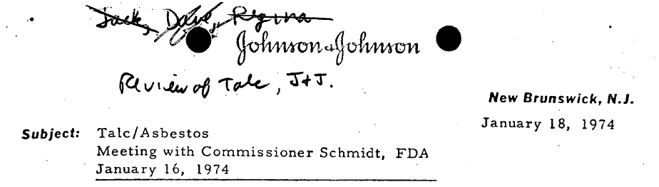
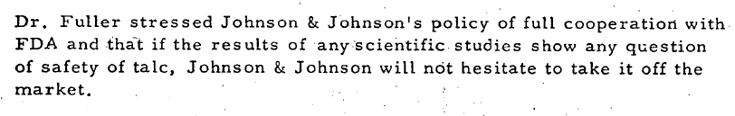
J&J to FDA 1974 – Will not sell if any “question of safety”

Slide 3
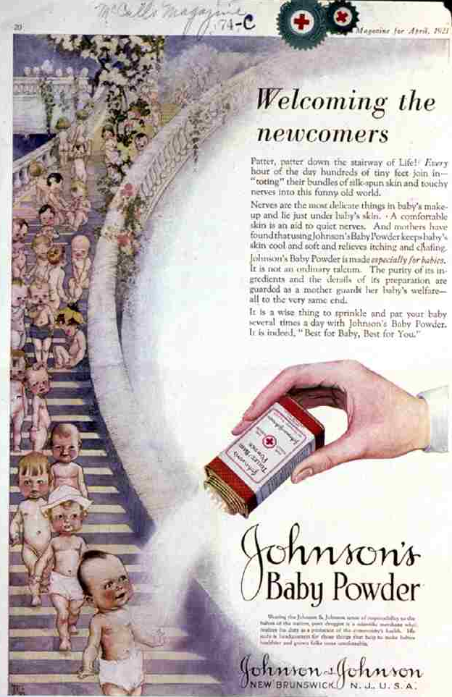
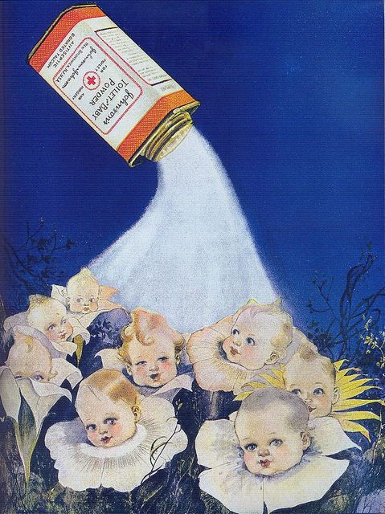
More than 200 million baby bottoms

Slide 4

Fibers in the Lung - the best test filter
A tennis court of surface area for 30 years
Sara Errani

Slide 5
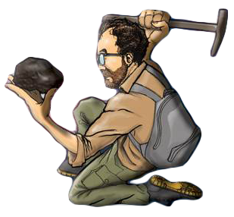

Who should decide which particles should be counted?
Health professionals
Geologists
Meeker USGS (2009): “The job of Earth scientists is not to decide what is toxic; our job is to assist the health community and regulators by carefully describing the physical and chemical properties of natural materials.”
“Asbestos Sans Mineralogy? A View from a Different Hilltop,” Elements (2009): 269.

Slide 6
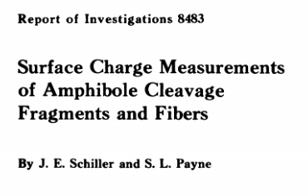
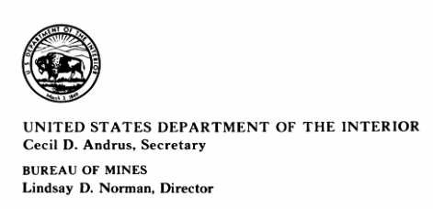
Amphibole “Cleavage fragments” that I discuss.
Not limited to OSHA asbestos definition e.g. winchite, richterite others
Amphibole “Cleavage fragments”
Same properties = Same health effects
Same size and shape, length (same morphology)
Same chemistry
Same surface charge

Slide 7
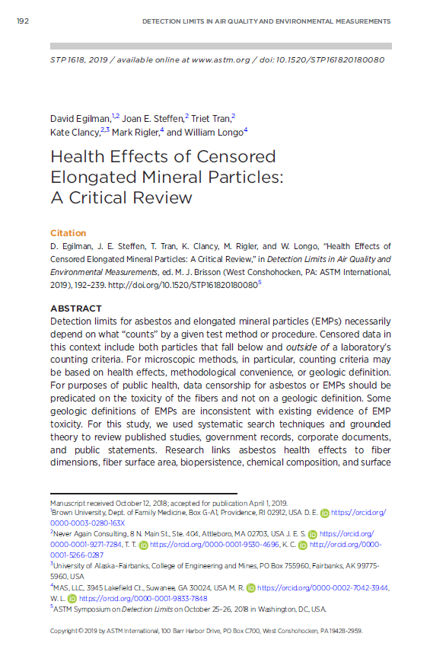
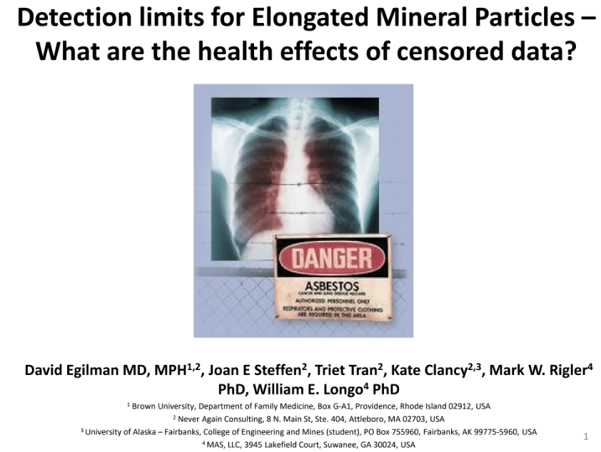
2019 – Review of Health effects of “cleavage fragments”
https://repository.library.brown.edu/studio/item/bdr:1078473/
Egilman D. Health Effects of Censored Elongated Mineral Particles: A Critical Review. In: Brisson M, ed. Detection Limits in Air Quality and Environmental Measurements. West Conshohocken, PA: ASTM International2019:192-239.

Slide 8
Hill's Considerations - Cleavage Fragments cause Mesothelioma
Consideration | Met? | Evidence
Strength | YES | Human cohort studies
Consistency | YES | Animal studies, human cohorts
Specificity | NO | Linked to both lung cancer and mesothelioma
Temporality | YES | Exposure precedes disease
Biological Gradient | YES | Dose-response in taconite miners
Plausibility | YES | Same mechanism as asbestos
Coherence | YES | Consistent with definition of asbestos fiber
Experiment | YES | Stanton and Davis animal studies
Analogy | YES | Asbestos fibers
https://repository.library.brown.edu/studio/item/bdr:1078473/

Slide 9
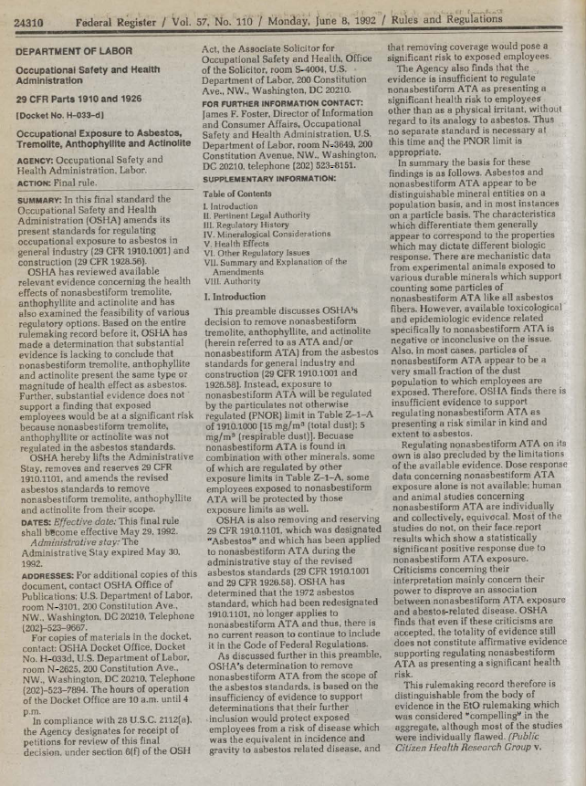
1992 – Asbestiform Cleavage Fragments cause cancer
“NIOSH concludes for regulatory purposes that cleavage fragments of the appropriate aspect ratio and length from the nonasbestiform minerals should be considered as hazardous as fibers from the asbestiform minerals.”
-1992 OSHA Register
Occupational Safety and Health Administration (OSHA). Final Asbestos Standard, Intro to 29 CFR Parts 1910 and 1926, Occupational Exposure to Asbestos, Tremolite, Anthophyllite and Actinolite, Section 4 – Mineralogical Considerations. 1992.

Slide 10
1992 – Asbestiform Cleavage Fragments cause cancer
“The American Thoracic Society (ATS) concluded that “at present, the prudent public health policy course is to regard appropriately sized (non asbestiform) tremolite “fibers’’ in sufficient exposure dose (concentration and duration), as capable of producing the recognized asbestos related diseases, and they should be regulated accordingly.”
-1992 OSHA Register
Occupational Safety and Health Administration (OSHA). Final Asbestos Standard, Intro to 29 CFR Parts 1910 and 1926, Occupational Exposure to Asbestos, Tremolite, Anthophyllite and Actinolite, Section 4 – Mineralogical Considerations. 1992.

Slide 11
1992 – Animal studies – CF’s cause mesothelioma
“NIOSH found that the Davis et al. study showed that all forms of tremolite asbestos should be considered carcinogenic, and that it presents no clear evidence indicating that non asbestiform tremolite is not carcinogenic.”
Occupational Safety and Health Administration (OSHA). Final Asbestos Standard, Intro to 29 CFR Parts 1910 and 1926, Occupational Exposure to Asbestos, Tremolite, Anthophyllite and Actinolite, Section 4 – Mineralogical Considerations. 1992.

Slide 12
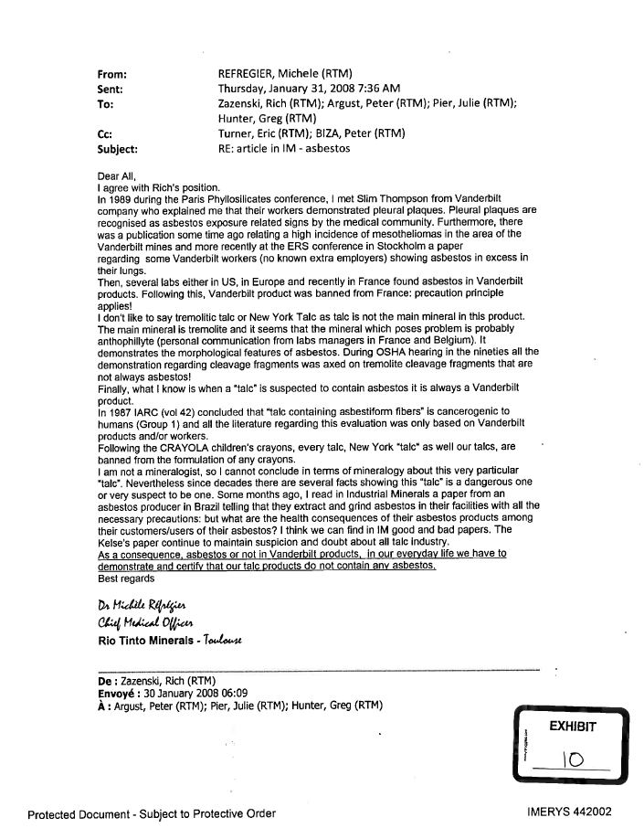
Imerys says OSHA “threw in the towel” in 1992
“Geologically, it doesn't make sense to me that you can have a mineral deposit that just contains ‘non-asbestiform’ tremolite…
…there is not enough medical data to conclude that "blocky" tremolite is simply a nuisance dust…
…Essentially, OSHA ‘threw in the towel’ rather than expend their limited resources any longer on this issue. Their decision by no means should be interpreted as a vindication of Vanderbilt's arguments.”
- Zazenski (Imerys) in 2008
http://www.asbestosandtalc.com/Asbestos%20in%20talc%20paper/61.pdf

Slide 13
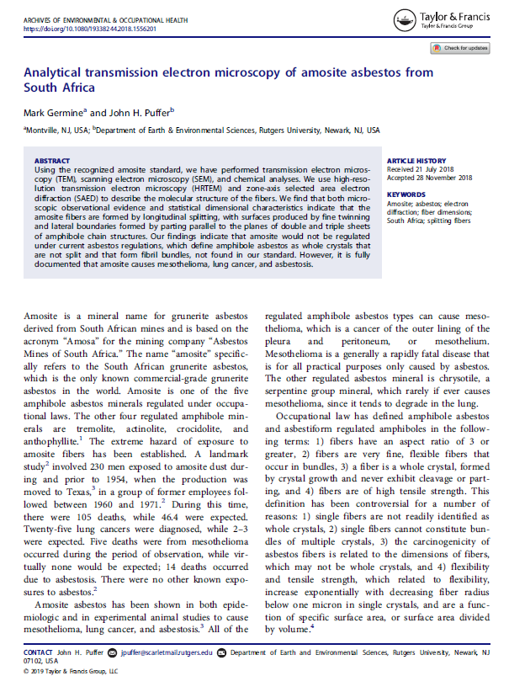
2019 – Amosite are not present in asbestiform habit
Amosite causes mesothelioma etc.
“Amosite would not be regulated under current [OSHA] asbestos regulations, which define amphibole asbestos as whole crystals that are not split and that form fibril bundles.”
-Germine et al. (2019)
Germine MP, J. Analytical transmission electron microscopy of amosite asbestos from South Africa. Archives of Environmental & Occupational Health. 2019.

Slide 14
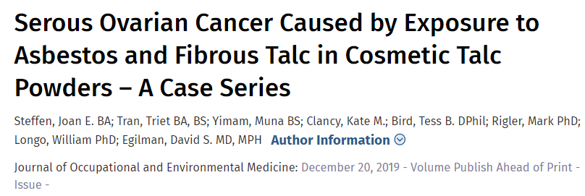
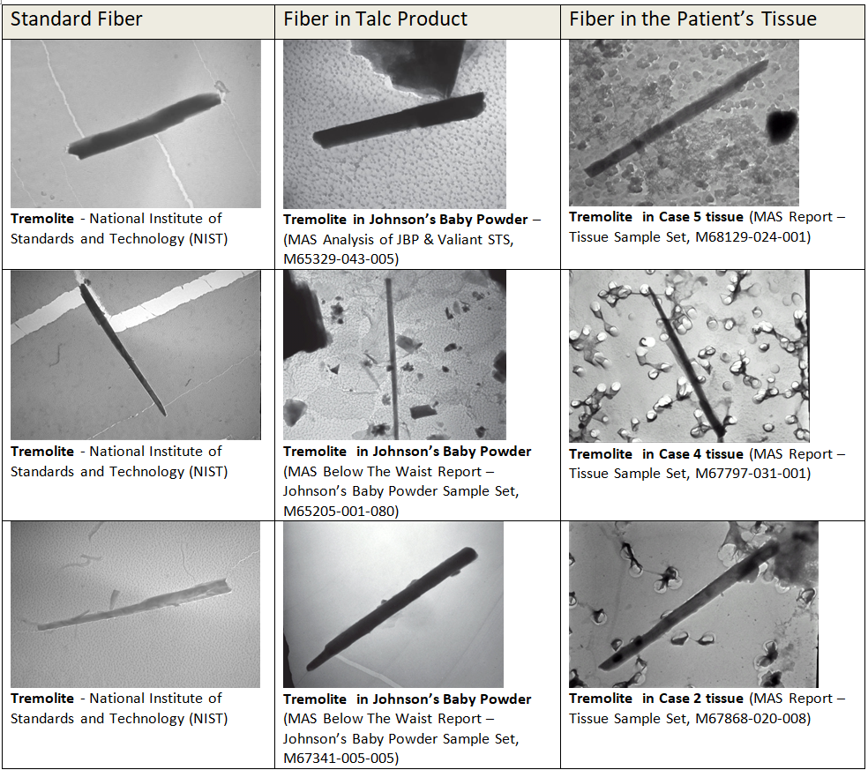
https://journals.lww.com/joem/Abstract/publishahead/Serous_Ovarian_Cancer_Caused_by_Exposure_to.98284.aspx

Slide 15
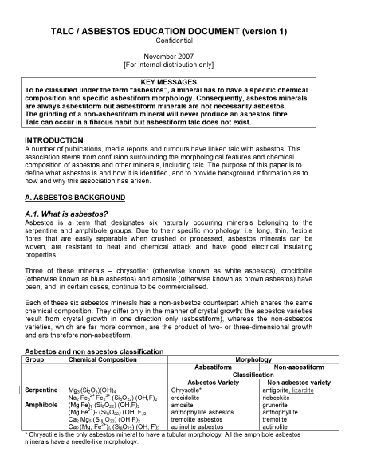
2007 – Milling talc breaks up bundles
“The asbestiform morphological criteria as defined by Wylie may not apply to fibers that have been aggressively milled and are of the size range below the resolution of the light microscope.” - Imerys
http://asbestosandtalc.com/astm/86.pdf

Slide 16
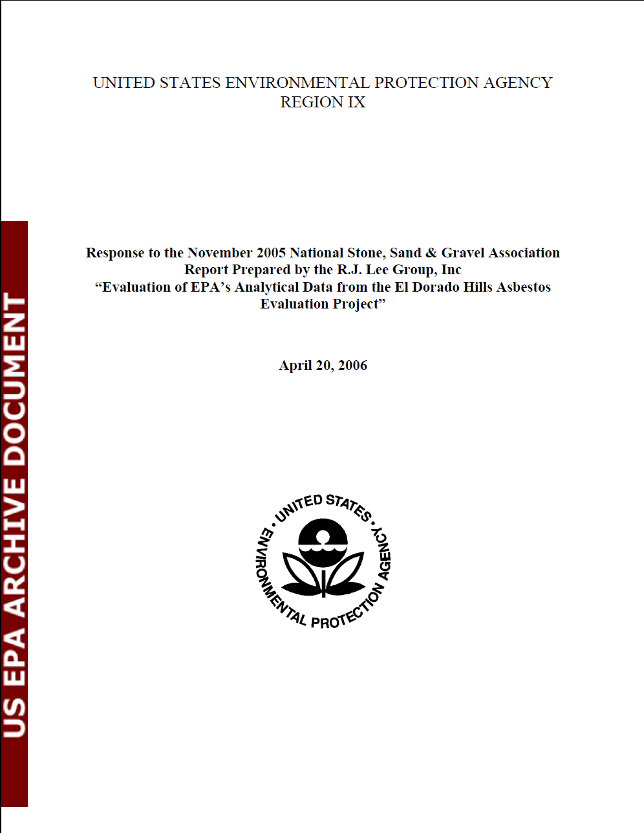
2006 – The EPA says cleavage fragments are carcinogens
“For the purposes of public health assessment and protection, EPA makes no distinction between fibers and cleavage fragments of comparable chemical composition, size, and shape. … The most recent panel of experts to review asbestos risk assessment methods, the 2003 Peer Consultation Panel convened by EPA, concluded that ‘it is prudent at this time to conclude equivalent potency [of cleavage fragments and fibers] for cancer,’…”
http://www.asbestosandtalc.com/Ex.%2016%20-%202005_RJ%20Lee%20Group%20%27EPA%20Region%209%20Response.pdf

Slide 17
J&J to FDA 1974 – Will not sell if any “question of safety”

Slide 18
Vanderbilt talc - asbestos cleavage fragments - 10 mesotheliomas in workers in cosmetcsa
Mickey Gunter Testimony in Fishbain vs. Colgate Palmolive- July 15,2015

Slide 19

No known safe level and No medical benefit
“From a product safety standpoint, it is necessary that the talc powder be free of asbestiform minerals.” - J&J
“JOHNSON’s Baby Powder is not presented as having a medical benefit. It is definitely not designed to treat or cure diaper rash.”
- J&J
“There is no safe level of asbestos in cosmetic grade talc.” - CTFA
http://www.asbestosandtalc.com/JNJTALC000528267.pdf
http://www.asbestosandtalc.com/ctfa%20no%20safe%20level%202000%20JNJ000019616.pdf
http://www.asbestosandtalc.com/87%20Final%201984.01.23%20JJ%20-%20safety%20requires%20NO%20asbestos%20in%20talc%20JNJ000235080.pdf

Slide 20
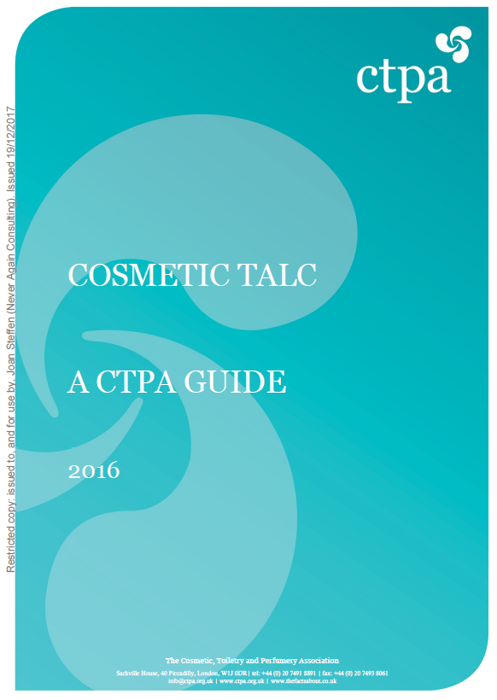
1990-2018 Talc with asbestos chemistry should not be used in cosmetics
“However, in order to eliminate any hazard to the consumer
which might arise from the need to interpret fibre shape and dimensions…, the CTPA view is that if an amphibole is detected by X-ray diffraction, that batch of talc is unacceptable for cosmetic use, whether or not subsequent examination by optical or electron microscopy shows that the contaminant is not fibrous.”
- 2016 CTPA Guide
http://www.asbestosandtalc.com/2016%20Cosmetic%20Talc%20-%20A%20CTPA%20Guide.pdf

Slide 21
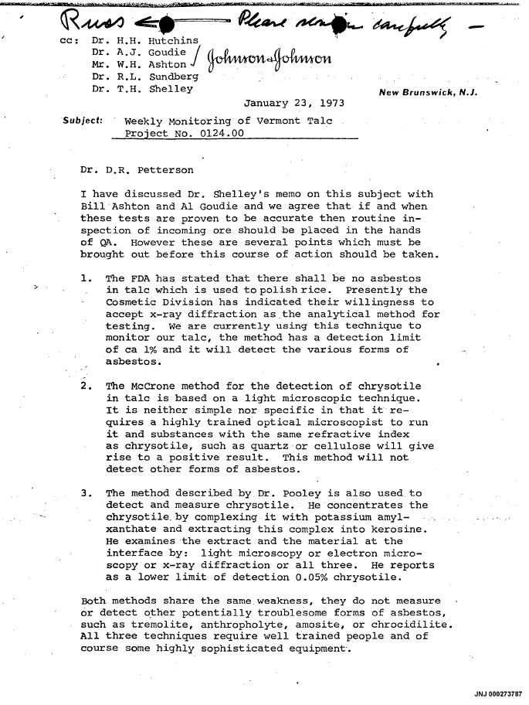
1972 J&J: Talc with asbestos chemistry should not be used in cosmetics
“We must decide what course of action we will take if any sample gives rise to a positive test. It is clear to me that if we find asbestos by the straight x-ray diffraction technique we can not use that batch of talc.”
-J&J’s Dr. Goodman
http://www.asbestosandtalc.com/JNJ000273787.pdf

Slide 22
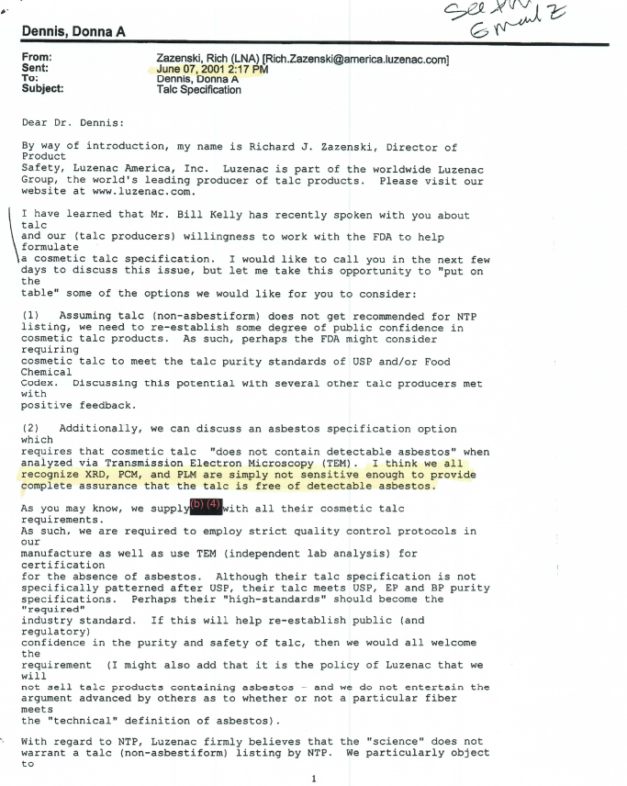
2001 – Talc with asbestos chemistry should not be used in cosmetics
“I might also add that it is the policy of Luzenac that we will not sell talc products containing asbestos - and we do not entertain the argument advanced by others as to whether or not a particular fiber meets the ‘technical’ definition of asbestos.”
- R. Zazenski (Imerys) to the FDA
http://www.asbestosandtalc.com/2001.06.07%20%20Email%20from%20Zazenski%20%28Luzenac%29%20to%20FDA%20re%20talc%20testing%20methods.pdf

Slide 23
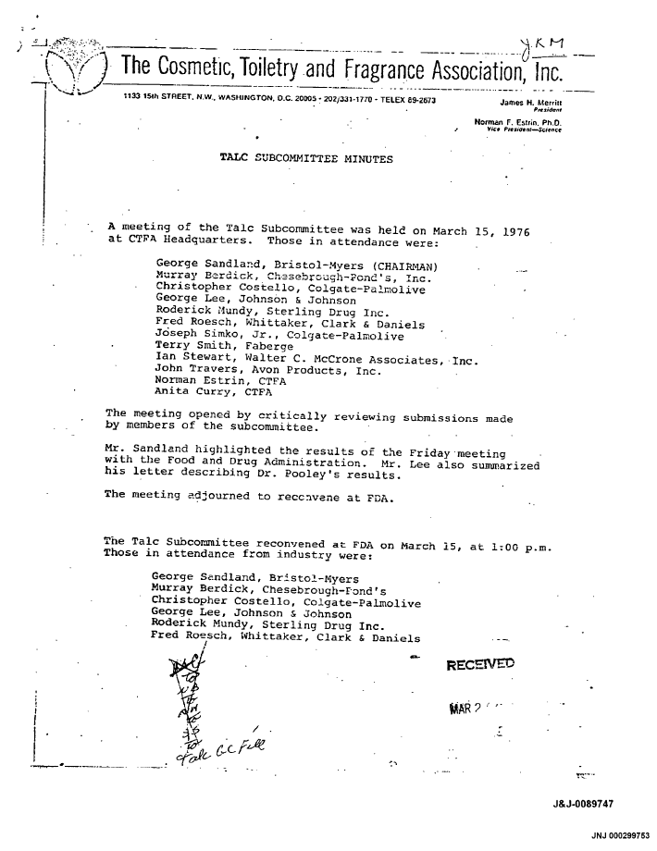
1976 – Asbestos/talc is not homogenous mix
“Dr. Berdick [CTFA] stated categorically it was not feasible to develop a statistically valid sampling plan for talc.”
- CTFA
http://asbestosandtalc.com/Part%201/33.pdf

Slide 24


Chocolate Chips (asbestos) vs Chocolate ice cream

Slide 25
There has been a 50-year campaign to
de-regulate “cleavage fragments”

Slide 26
The 50-year campaign de-regulate cleavage fragments
1972
  OSHA applies to fibrous talc and cleavage fragments
1974
  RTV requests relief from asbestos standard
  OSHA de-regulated cleavage fragments FM-74-92
1977
  NIOSH complains - finds an lung cancer in RTV talc miners
  OSHA re-regulates cleavage fragments
1986
  RTV sues and OSHA stays standard for non-asbestiform anthophyllite, tremolite, and actinolite. (ATA)
1992
  OSHA deregulates non-asbestiform ATA
1993
  Bulk test for asbestos follows habit definition
  20:1 average, population, etc Not adopted.
  Not applicable to talc
Fed Reg. Vol 57 N. 110 RTV Talc was used in cosmetics

Slide 27
Concentration method is necessary
“As the impurity level becomes very low (<<1 %). it is necessary to examine increasingly larger amounts of sample in order to detect the impurity. As a result of the requirement to detect the proverbial ‘needle in a haystack,’ we have evolved a procedure which preconcentrates the impurities prior to examination.”
    - Colorado School of Mine
“England is considering method of preconcentrating the asbestos so as to be able to analyze by X-ray…They find (Pooley) 0. 05% of a tremolite-type in Vermont…The limitation of this method is that it may be too sensitive.”
          - J&J
http://asbestosandtalc.com/ASTM%20paper/66.pdf
http://www.asbestosandtalc.com/Asbestos%20in%20talc%20paper/30.pdf

Slide 28
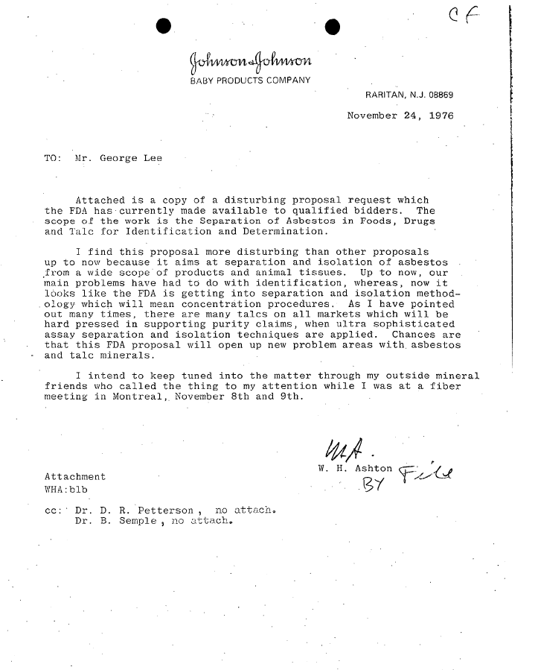
1976 J&J called FDA interest in concentration methods “disturbing”
“I find this proposal more disturbing than other proposals up to now because it aims at separation and isolation of asbestos from a wide scope of products and animal tissues. Up to now, our main problems have had to do with identification, whereas, now it looks like the FDA is getting into separation and isolation methodology which will mean concentration procedures. As I have pointed out many times, there are many tales on all markets which will be hard pressed in supporting purity claims, when ultra sophisticated assay separation and isolation techniques are applied. Chances are that this FDA proposal will open up new problem areas with asbestos and talc minerals.”

