Slide 1



Mineral Fibers in the Lung: Exposure and Toxicity
Christopher P. Weis, Ph.D., DABT.
Toxicology Liaison / Senior Advisor
Office of the Director
National Institute of Environmental Health Sciences
NIEHS
Notes:
1

Slide 2
Today’s Discussion
Lung anatomy, physiology as related to Elongate Mineral Particles (EMP).
How EMPs initiate progressive inflammatory responses in relation to their shape.
EMP below the resolution of light microscopy represent the largest contribution to exposure.
  Characteristics of all EMP are vital for understanding disease
2

Slide 3
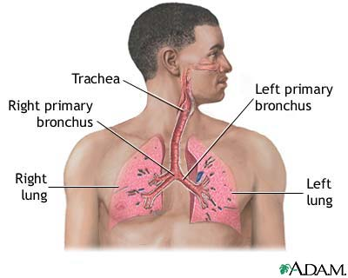
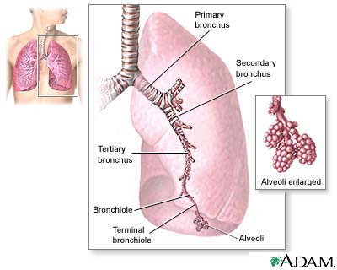
Basic Respiratory Anatomy
Images developed under contract to the National Institutes of Health.
3

Slide 4
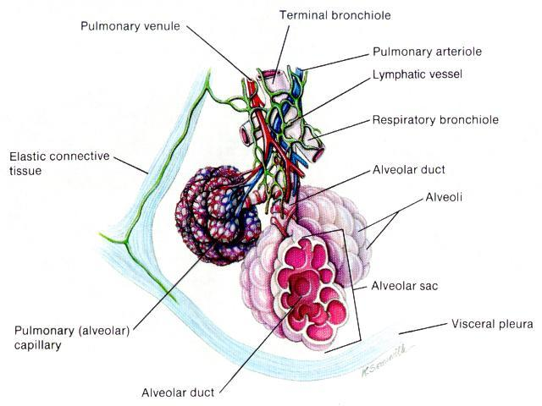
Anatomy of the Bronchiolar Alveolus Clusters
5

Slide 5
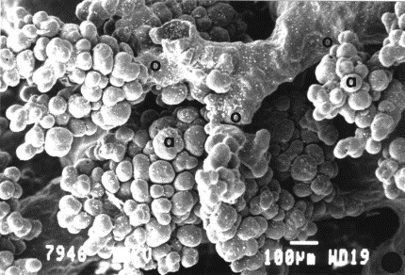
Bronchiole Alveolar Structure
Maina & van Gils (2001) Comp. Biochem and Physiol. 130(4)781-798.
6

Slide 6
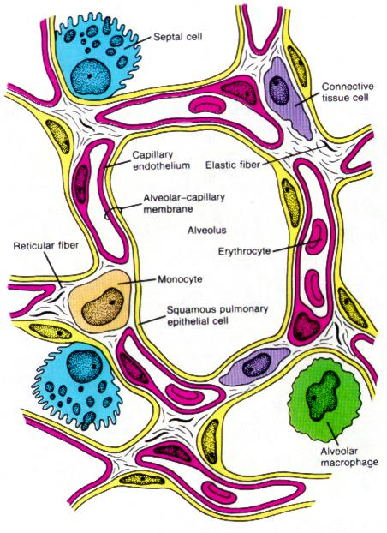
Gas Exchange in the Lung
Blood volume
in capillary space
is about 70 mL.
The alveolar-
capillary membrane
is just 0.2 microns
thick.
Blood flow through
the lung is about
5L/min.
7

Slide 7
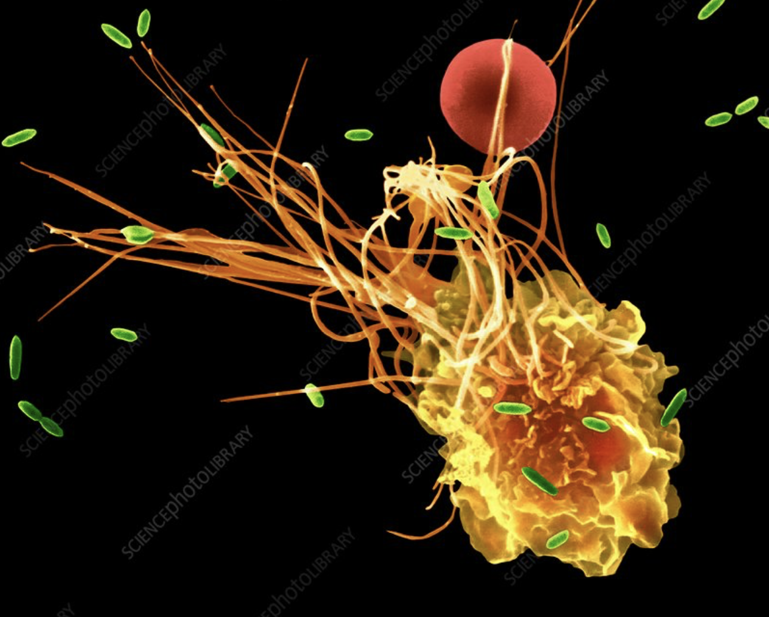
Pulmonary Alveolar Macrophage:
Searching for Foreign Material
SciencePhotoLibrary.com – Dennis Kunkel, with permission (756696).
8

Slide 8
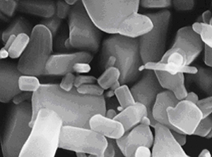
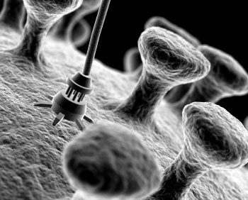
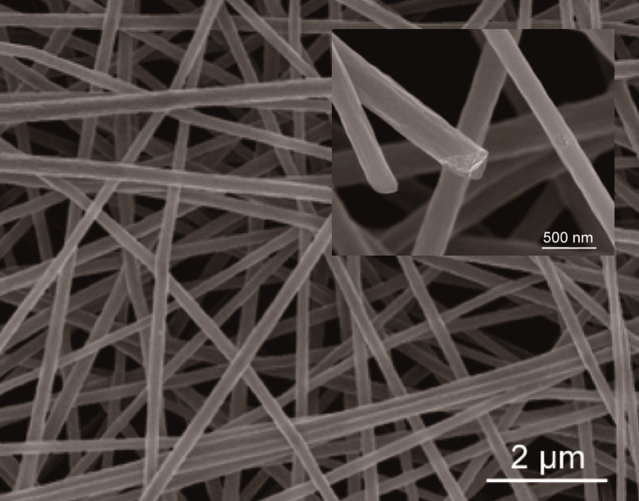
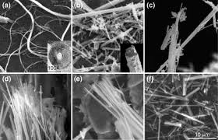
9

Slide 9
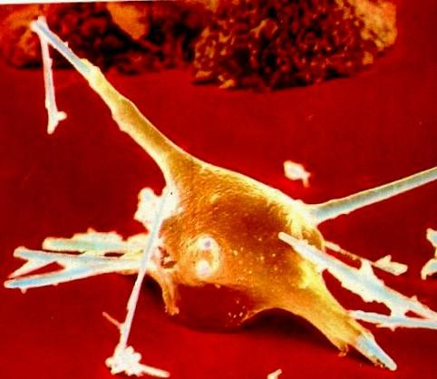
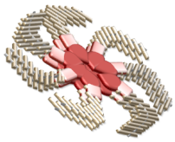
Frustrated phagocytosis of EMP
Macrophage
lysosome
NALP3
IL-1β
pro-IL-1β
IL-1β
N
Inflammasome activation
Ji, Xia, Wang, Nel, Zink ACS Nano 2012
9

Slide 10
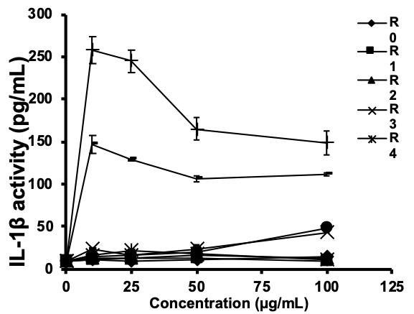
Frustrated phagocytes release cytokines that can cause inflammation
THP-1 phagocyte cells
Exposed to Particles <2um
Macrophage
lysosome
NALP3
IL-1β
pro-IL-1β
IL-1β
AR 6:1
N
Inflammasome activation
AR 7:1
AR < 5:1
Ji, Xia, Wang, Nel, Zink ACS Nano 2012
10

Slide 11
EMP-Related Lung Diseases
Pleural Effusions
Pleural Plaques and Diffuse Pleural Thickening
Pulmonary Fibrosis
Malignant Mesothelioma
Bronchogenic Carcinoma
11

Slide 12
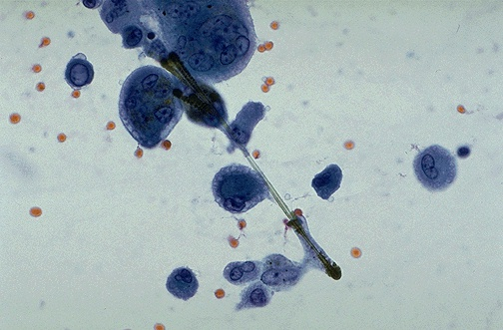
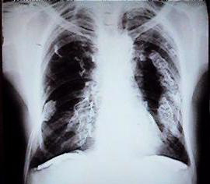
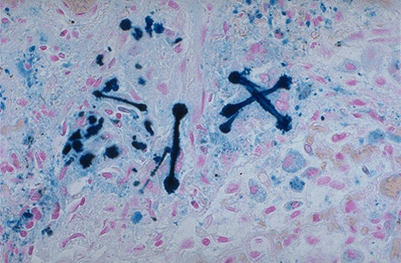
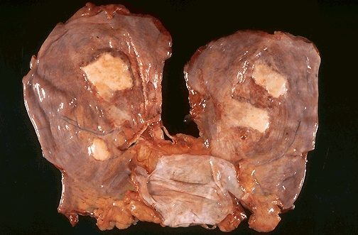
Microscopic and Macroscopic Lung Abnormalities Caused by Durable Fibers
Radiograph of
Pleural plaques
‘mineral bodies’
Anatomy of
Pleural plaques
‘ferruginous bodies’
Attribution: Med. Digital Library. Univ. of Michigan
13

Slide 13
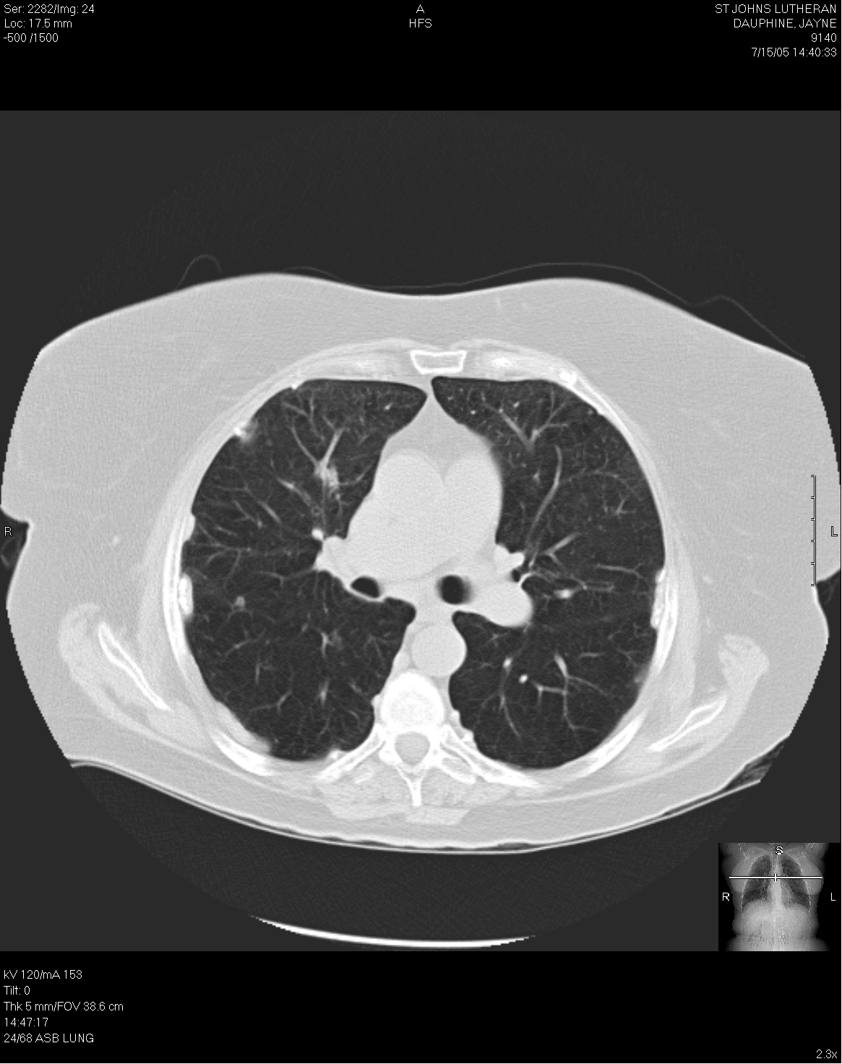
High Resolution Computerized Tomography (HRCT) image of Localized Pleural Thickening.
Courtesy of Dr. J Lockey, University of Cincinnati.
13

Slide 14
Mechanisms of Exposure and Pathogenesis by Inhaled Mineral Dusts
Inhaled EMP accumulate in lung
Macrophages engulf trapped particulates and release cytokines associated with inflammation
Biopersistent particles that reach the terminal bronchioles and alveoli activate an inflammatory response in the lung
EMP-related respiratory diseases are initiated by chronic inflammation and typically develop over a long period of time
14

Slide 15

Elongate Mineral Particles from Western Montana
Attribution:
17

Slide 16
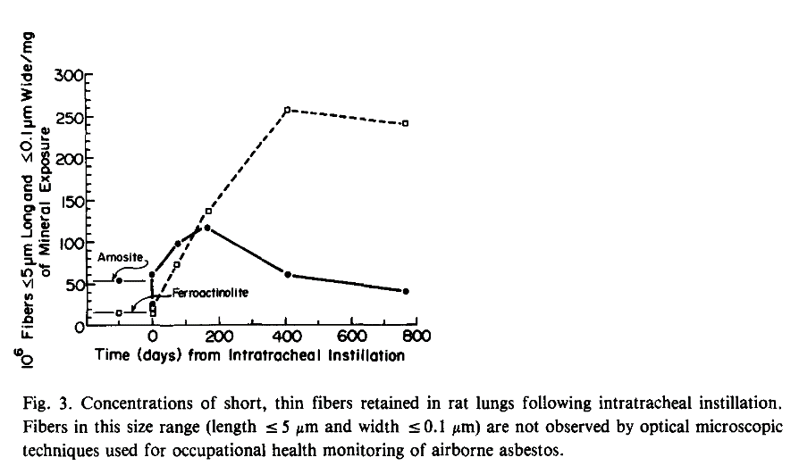
EMP can disaggregate in vivo following exposure.
Cook, P.M., L.D. Palekar, and D.L. Coffin, Interpretation of the carcinogenicity of amosite asbestos and ferroactinolite on the basis of retained fiber dose and characteristics in vivo. Toxicol Lett, 1982. 13(3-4): p. 151-8.
16

Slide 17
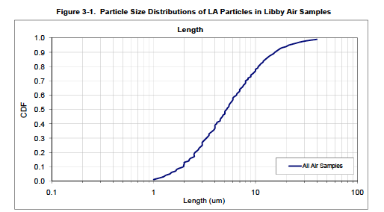
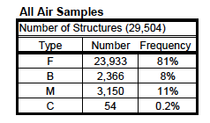
EMP length distributions of airborne EMP collected in Libby, MT
>5 uM
Frequency
<5 uM
U.S. Environmental Protection Agency
Region 8
Denver, CO
July 14, 2010
LENGTH uM
17

Slide 18





Size Distribution of Tremolite Particles in Two Cosmetic Products Tested for FDA
22

Slide 19
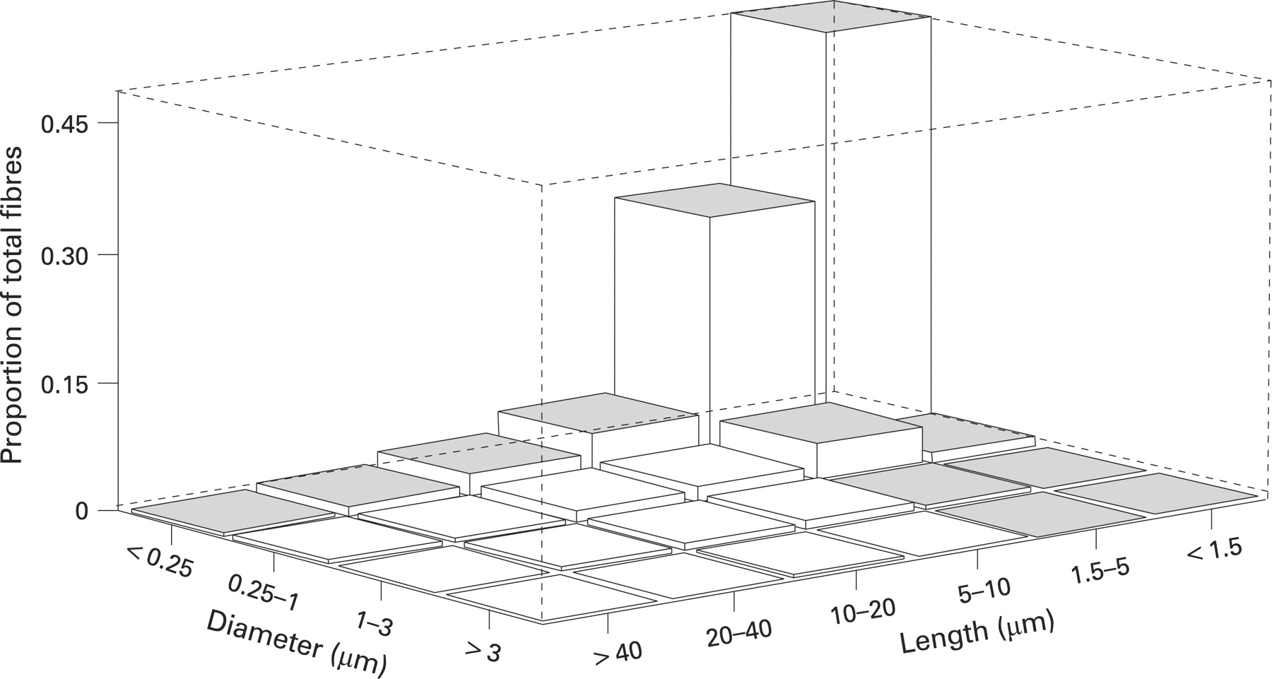
“Fibres shorter than 5 mm have traditionally not been counted by methods used for regulatory standards for asbestos because these methods were developed to provide a reproducible index of fibre exposure.
The findings from our analysis show that cumulative exposures to all fibre size indices, including fibres <5 mm in length, were highly statistically significant predictors of lung cancer or asbestosis mortality.”
Stayner et al. (2008) Occ. Env. Med 65(9):613
19

Slide 20
EMP Characteristics of Importance to Health
Length and width (all)
Persistence in biological tissue
Surface area
Mineral type and habit
Surface reactivity
Surface charge (Zeta potential)
23

