Slide 1
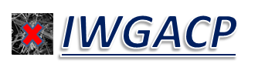
Recommendations from the IWGACP:
Data Reporting and Analysis (Subgroup 3) and Recap of Overall Preliminary Recommendations
Steven Wolfgang, Ph.D., Subgroup 3 Chair
Office of Cosmetics and Colors
U.S. FDA

Slide 2
Outline
Topic 1- Summary of IWGACP Subgroup 3 (SG3) Deliberations on Data Reporting and Analysis - Content and Format of Analytical Reports
Topic 2- Recap of IWGACP’s Overall Preliminary Recommendations on Testing of Talc-containing Products
IWGACP Public Meeting, 4 February 2020

Slide 3
IWGACP Deliberations and Recommendations
Disclaimer:
IWGACP preliminary recommendations are from individual scientists functioning as subject matter experts (SMEs) in their respective scientific fields, participating in a work group striving for consensus recommendations, and do not necessarily reflect the opinions or policies of their agencies, or represent proposed changes to any regulation of the U.S. Government.
Any mention of organizations, manufacturers, or products should not be considered as endorsement.

Slide 4
Topic 1
Summary of IWGACP Subgroup 3 Deliberations on Data Reporting and Analysis – Format and Content of Lab Reports

Slide 5
Subgroup 3 Charge
Focusing on lab reports, develop recommendations to reconcile “differences” between laboratories that test talc and talc-containing products for presence of asbestos and EMPs.
  Thus, SG3 aimed toward developing recommendations for a standard format and content of lab reports.

Slide 6
Subgroup 3 Deliberations on
Format and Content of Lab Reports
Which attributes of “mineral particles of concern” should labs report?
What is the suggested content of a lab report?
How should data be presented in the lab report so as to promote consensus in data analysis/interpretation?

Slide 7
Format and Content:
Can the report deliver the lab’s unbiased observations?
What should the lab report contain?
  How will the data be presented – what should be provided in narratives, tables, figures, images?
  How should a lab report EMPs that might be regarded as either asbestiform or a non-asbestiform mineral analog?
    We recognize there is ambiguity in what is regarded as asbestiform and non-asbestiform.
What is the client’s role in the interpretation of lab data?
  Characterization
  Health hazard assessment

Slide 8
Format and Content:
What data should every lab report provide?
Tabulation of data showing length, width for each countable particle.
      Include calculation of aspect ratio.
Identification of mineral constituents in each countable particle (covered minerals = amphibole, chrysotile).
Images of particles, spectra and diffraction patterns.
Detailed description of how microscope specimens were prepared and examined.
Measurements or estimations of amounts detected.

Slide 9
Lab Spreadsheet Examples
US EPA homepage contains many electronic deliverables suitable for labs performing analyses using PLM and/or TEM: https://www.epa.gov/superfund/asbestos-superfund-sites-technical-resources#nades.
Other references on reporting of lab data
  ISO 10312:2019
    Data recording (provide consensus on nomenclature used to classify and count EMP structures, e.g. cluster, bundle)
  ASTM D5756 (2008)
    Count sheet shown in figure 3
    Data recording

Slide 10
Topic 2
Recap of IWGACP’s Deliberations on Testing of Talc-containing Products in 3 Major Areas – Terminology/Definitions, Analytical Methods, and Data Reporting

Slide 11
IWGACP Deliberations on Mineral Terminology
Various terms are used to describe morphology exhibited by amphiboles in electron microscopy images:

Slide 12
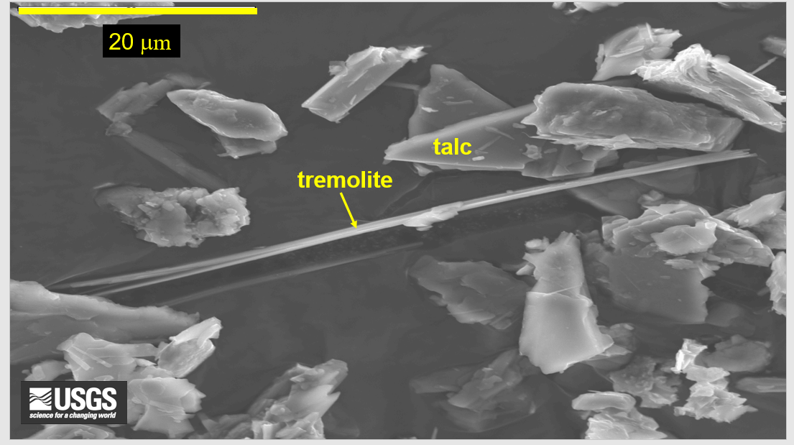
IWGACP Deliberations on Mineral Terminology
Terminology: Acicular or Asbestiform? Are there different implications based on which term we use?

Slide 13
IWGACP Deliberations on Analytical Methodology
Analytical toolbox contains following methods:
  XRD – bulk mineral composition with limited sensitivity to detect minerals present as “contaminants” or “impurities” in talc
  PLM – larger EMPs can be viewed; subject to limitations for “trace” levels of extremely fine EMPs
  TEM – able to detect EMPs too small to be visible using optical microscope; able to detect chrysotile fibrils and narrower bundles of fibers; TEM with SAED and EDS can deduce crystal structure and chemical composition
  SEM – provides superior image clarity showing fine structure of EMPs; cannot deduce crystal structure or internal structure

Slide 14
Key Conclusions/Recommendations
Terminology
  EMP is the preferred term to describe any mineral particle having a minimum aspect ratio 3:1.
Methodology
  TEM with EDS and SAED is regarded as the most definitive tool to detect EMPs of amphibole and chrysotile.
EMP reporting
  Covered minerals having minimum length of 0.5 microns
    Covered minerals are amphibole and chrysotile.
  Number of EMPs
    Mass percent can be a misrepresentation of relative inhalation hazard.

Slide 15
Consistency with Other Independent Bodies
NIOSH Current Intelligence Bulletin 62 (2011)
  “Asbestos Fibers and Other Elongate Mineral Particles: State of the Science and Roadmap for Research” http://www.cdc.gov/niosh/docs/2011-159/pdfs/2011-159.pdf.
United States Pharmacopeia (USP) Talc Expert Panel 1 (2010-2014) recommendations on analytical methods.
ISO 10312 standard’s approach to identify EMP structures and count fibers by TEM.
  Leverages superior sensitivity of TEM compared with light microscopy.
  Allows for enumeration of the finest particles present.

Slide 16
Closing Remarks

Slide 17
Preliminary Recommendations from the IWGACP
Adoption of the term EMP as “any mineral particle with a minimum aspect ratio of 3:1”.
Testing laboratories should report all EMPs having length ≥ 0.5 µm.
Test methods should specify reportable EMPs identified as amphibole or chrysotile particles as covered minerals.
Test methods should include directions enabling reporting and counting of primary and secondary structures (e.g., bundles, clusters and fibers) of covered EMPs as a function of sample mass.

Slide 18
Preliminary Recommendations from the IWGACP
5. Obligatory use of TEM with EDS and SAED to address deficiencies in sensitivity that cause false negatives by PLM.
  Scanning electron microscopy might be useful as a complementary method, but has significant shortcomings for identification of chrysotile and narrowest particles that can only be observed by TEM.
6. “Mass percent,” a unit that is frequently used to express content of asbestos in commercial bulk materials, is not appropriate for measurement of EMPs in talc and products containing talc.
  Mass percent does not correlate with the number of fibers.
  A single, atypically-wide EMP could dominate and skew the calculation of mass percent.

Slide 19
Research Needs:
Improving and Assuring Reliability of Analytical Methods
IWGACP recommendations for talc and talc-containing products with low levels of asbestos:
  Research to minimize false negative/positive rates; improve sensitivity and accuracy of counting
    Determine sources of variation in sampling
    Improve sample preparation methods (e.g., “concentration methods”)
    Reference standards specific to talc and talc-containing products
  Validation of analytical methods (XRD, PLM, TEM) specific to talc and cosmetic products containing talc
    Increase laboratory and analyst proficiency
    Increase inter-laboratory concurrence

