Slide 1
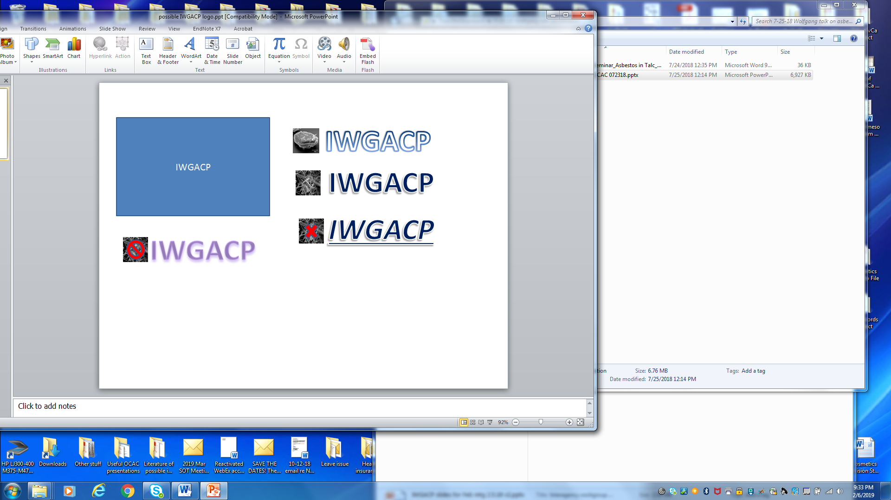
Analytical Methods for Detecting Mineral Fibers of Concern in Talc and Talc-Containing Consumer Products
Subgroup 2, IWGACP;
Paul C. Howard, Ph.D.
U.S. FDA

Slide 2
Disclaimer:
IWGACP preliminary recommendations are from individual scientists functioning as subject matter experts (SMEs) in their respective scientific fields, participating in a work group striving for consensus recommendations, and do not necessarily reflect the opinions or policies of their agencies, or represent proposed changes to any regulation of the U.S. Government.
Any mention of organizations, manufacturers, or products should not be considered as endorsement.
IWGACP Public Meeting, 4 February 2020

Slide 3
… the following are preliminary recommendations from the IWGACP SMEs regarding ‘analytical methods to consider and use in detecting asbestos in talc and talc-containing consumer products, including cosmetics’. The deliberations of the subgroup and working group focused on specific methods required for consistent identification and measuring mineral particles in talc and talc-containing consumer products.
IWGACP Public Meeting, 4 February 2020

Slide 4
IWGACP acknowledges the ongoing work by
(1) the U.S. Pharmacopeia (USP) Talc Expert Panel and (2) the American Society for Testing and Materials International (ASTM) Committee D22 to accomplish similar goals.
IWGACP worked independently of these organizations, and reviewed published procedures and information from USP, ASTM, International Standards Organization (ISO), government agencies, and scientific periodicals.
IWGACP Public Meeting, 4 February 2020

Slide 5
Goal of IWGACP Subgroup 2:
To develop a robust analytical protocol for detecting asbestos and other EMPs of health concern in talc and consumer products containing talc, including cosmetics
IWGACP Public Meeting, 4 February 2020

Slide 6
Charge questions (1):
What general techniques and published test methods should be considered for the identification of asbestos fibers in talc-containing products?
(e.g., methods for sample preparation, as well as instrumentation needed to make an assessment.)
What standard(s) should be developed for use to assess the presence of asbestos in talc-containing products? This can include reference materials as well as methodology.
IWGACP Public Meeting, 4 February 2020

Slide 7
Charge questions (2):
    What combination of analytical methods should be
    used?
    (a) Are screening methods useful for ‘if/then’
    approaches?
    (b) Do we need concentration method for screening?
    TEM or SEM?
    How many mineral fibers or grid openings should be
    measured/counted?
    Are there matrix issues from talc-based cosmetics?
    Sample preparation issues (e.g., alter the properties
    of the fibers).
IWGACP Public Meeting, 4 February 2020

Slide 8
Analytical Methods
IWGACP answered most of the charge questions, and these recommendations are presented as:
1. SAMPLING and HANDLING
2. SAMPLE PREPARATION
3. ANALYTICAL METHODS
X-Ray Diffraction (XRD)
Polarized Light Microscopy (PLM)
Transmission Electron Microscopy (TEM)
Scanning Electron Microscopy (SEM)
4. OVERVIEW
IWGACP Public Meeting, 4 February 2020

Slide 9
Sampling and Handling
Subgroup 2 did not submit specific recommendations regarding sampling size and frequency. FDA and other agencies have existing guidelines regarding sampling size and frequency for many different products, and these should be considered.
Sampling Plan issues that were identified:
  (1) talc (cosmetic product) batch size;
  (2) homogeneity of asbestos in talc or cosmetic;
  (3) other minerals & materials in the sample;
  (4) method specificity & sensitivity.
IWGACP Public Meeting, 4 February 2020

Slide 10
SAMPLING AND HANDLING:
Handling considerations
Common considerations should be in place:
  (1) Chain-of-custody;
  (2) Control against contamination;
  (3) Reserve sample & sample archive;
  (4) Management, SOPs, documentation
  (e.g. ISO 17025)
IWGACP Public Meeting, 4 February 2020

Slide 11
SAMPLE PREPARATION:
IMPROVING SAMPLE HOMOGENEITY
- Mixers, homogenization
- Tumbling, rotary, V-mixer, vibrating
- Milling
- Ball, jet (not recommended)
Validated methods need talc and/or cosmetic standards to understand the effect of the process on the size of the EMPs in samples.
IWGACP Public Meeting, 4 February 2020

Slide 12
SAMPLE PREPARATION:
B. REDUCE CONTENT OF INTERFERING MATERIALS and/or CONCENTRATE ASBESTOS MINERALS
IWGACP Public Meeting, 4 February 2020

Slide 13
SAMPLE PREPARATION:
B. REDUCE INTERFERING MATERIALS
- Gravimetric reduction
- Ashing
- Acid treatment
New York PM21 Environmental Laboratory
Approval Program (ELAP) Certification Manual 198.8;
EPA. 1993. EPA/600/R-93/116;
ISO 22262-2:2014;
CTFA J4-1
IWGACP Public Meeting, 4 February 2020

Slide 14
SAMPLE PREPARATION:
B. REDUCE INTERFERING MATERIALS
- Gravimetric reduction
- Separation techniques
Density centrifugation
(heavy liquid-based separation)
ISO 22262-2:2014;
New York PM21 Environmental Laboratory
Approval Program (ELAP) Certification
Manual 198.8
IWGACP Public Meeting, 4 February 2020

Slide 15
SAMPLE PREPARATION:
B. REDUCE INTERFERING MATERIALS
- Gravimetric reduction
- Separation techniques
Density centrifugation
(heavy liquid-based separation)
Fluidized Bed Asbestos Segregator (FBAS)
For soils:
Januch et al., 2013. Analy. Methods 5(7):1658-1668
Farcas et al., 2017. Environ. Earth Scis. 76(3):126
Wroble et al., 2017. PLOS-ONE 12(7):1-26
IWGACP Public Meeting, 4 February 2020

Slide 16
SAMPLE PREPARATION:
B. REDUCE INTERFERING MATERIALS
- Gravimetric reduction
- Separation techniques
Density centrifugation
(heavy liquid-based separation)
Fluidized Bed Asbestos Segregator (FBAS)
Other Techniques (e.g. solvation, sieving)
Each method may require (i) standards to quantify the effect of the process on the size & concentration of EMP in samples, and (ii) established protocols for consistent application.
IWGACP Public Meeting, 4 February 2020

Slide 17
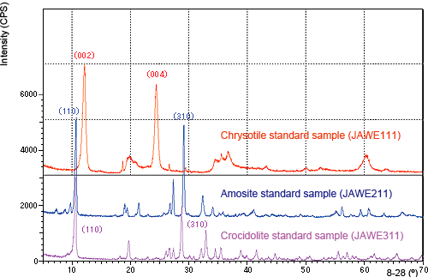
ANALYSIS:
A. X-Ray Diffraction (XRD)
Advantages; standard methods;
mineral identification through
specific diffraction patterns
- Disadvantages; sensitivity limit
- References: NIOSH 7500; NIOSH 9000; ISO 22262-3;
EPA/600/R-93/116; CTFA J4-1; ASTM WK 30352;
USP General Chapter 14; USGS report 01-041
- Need for standards with low levels of asbestos in talc
Image from www.Shimadzu.com
IWGACP Public Meeting, 4 February 2020

Slide 18
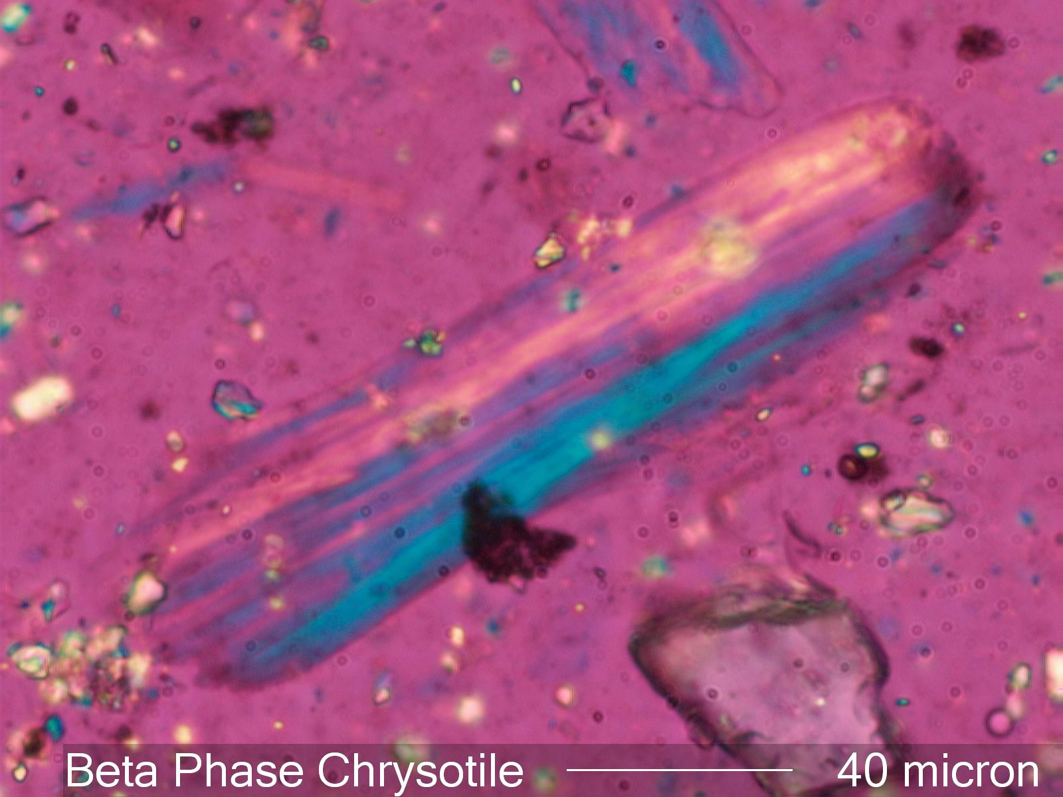
ANALYSIS:
B. Polarized Light Microscopy (PLM)
Advantages; standard
methods; mineral identification
through birefringence.
-Disadvantages; limits to
resolution; sensitivity limit.
-References: NIOSH 9002; OSHA 1901.1001; OSHA ID-160;
CTFA J4-1; EPA/600/R-93/116; ISO 10312
-Need for low-level standards
Image from www.microlabgallery.com
IWGACP Public Meeting, 4 February 2020

Slide 19
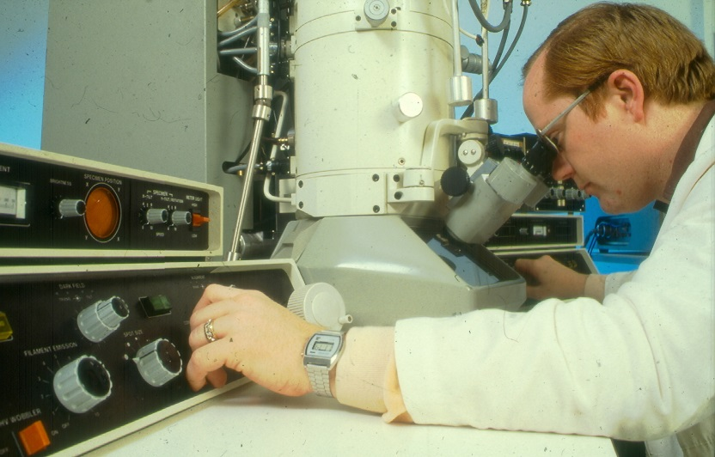
ANALYSIS:
C. Electron Microscopy
Why is electron
microscopy needed for
measuring EMP > 0.5 μm?
Image courtesy of Dan Crane
IWGACP Public Meeting, 4 February 2020

Slide 20
ANALYSIS:
C. Electron Microscopy
Why is electron
microscopy needed for
measuring EMP > 0.5 μm?
The limitations of visible light microscopy:
  Limit of resolution d = λ/(2n sinθ);
  PLM = >0.2 µm (OSHA ID-160; NIOSH 9002; EPA 600/R-93/116; NIOSH ID-191);
  TEM = ~ 0.0002 μm (0.2 nm).
Image courtesy of Dan Crane
IWGACP Public Meeting, 4 February 2020

Slide 21
ANALYSIS:
C. Electron Microscopy
Why is electron
microscopy needed for
measuring EMP > 0.5 μm?
The limitations of visible light microscopy (0.2 μm):
”Is there a situation where EMP were not detected by visible light microscopic methods (e.g. PLM), however, examination by electron microscopy (e.g. TEM) did detect EMP?”
Image courtesy of Dan Crane
IWGACP Public Meeting, 4 February 2020

Slide 22
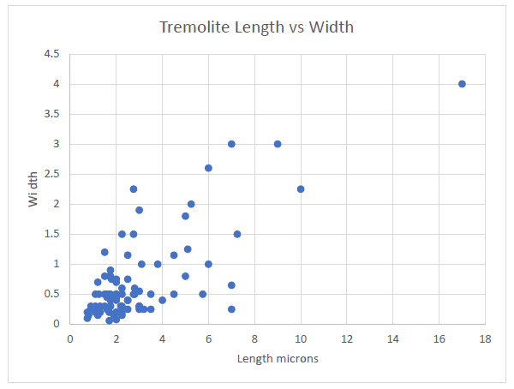
TEM Analysis of a Cosmetic Product where
PLM indicated “not-detected”
Image source: FDA's Investigation of Reports of Asbestos Contamination in Cosmetics 2017-2019; https://www.fda.gov/cosmetics/cosmetic-ingredients/talc.
IWGACP Public Meeting, 4 February 2020

Slide 23
ANALYSIS:
C. Electron Microscopy
Why is electron
microscopy needed for
measuring EMP > 0.5 μm?
The limitations of visible light microscopy (0.2 μm).
2. The application of advanced techniques available
with electron microscopy: (i) Individual particle
elemental analysis (EDS), (ii) Individual particle
electron diffraction pattern analysis (SAED)
Image courtesy of Dan Crane
IWGACP Public Meeting, 4 February 2020

Slide 24
ANALYSIS:
Transmission Electron Microscopy (TEM)
General Recommendations:
1. TEM operating at 200 kV
2. Elemental analysis using EDS
3. Mineral crystallographic analysis using SAED
IWGACP Public Meeting, 4 February 2020

Slide 25
ANALYSIS:
Transmission Electron Microscopy (TEM)
1. Recommend TEM
operating at 200 kV.
400 nm
Image from https://www.fda.gov/cosmetics/cosmetic-ingredients/talc
IWGACP Public Meeting, 4 February 2020

Slide 26
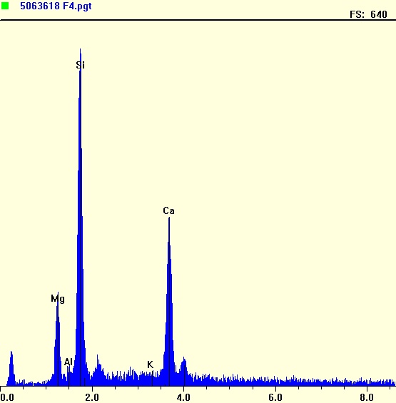
ANALYSIS:
Transmission Electron Microscopy (TEM)
2. Elemental analysis
using Energy
Dispersive Spectral
(EDS) X-ray
analysis
Image courtesy of Dan Crane, OSHA
IWGACP Public Meeting, 4 February 2020

Slide 27
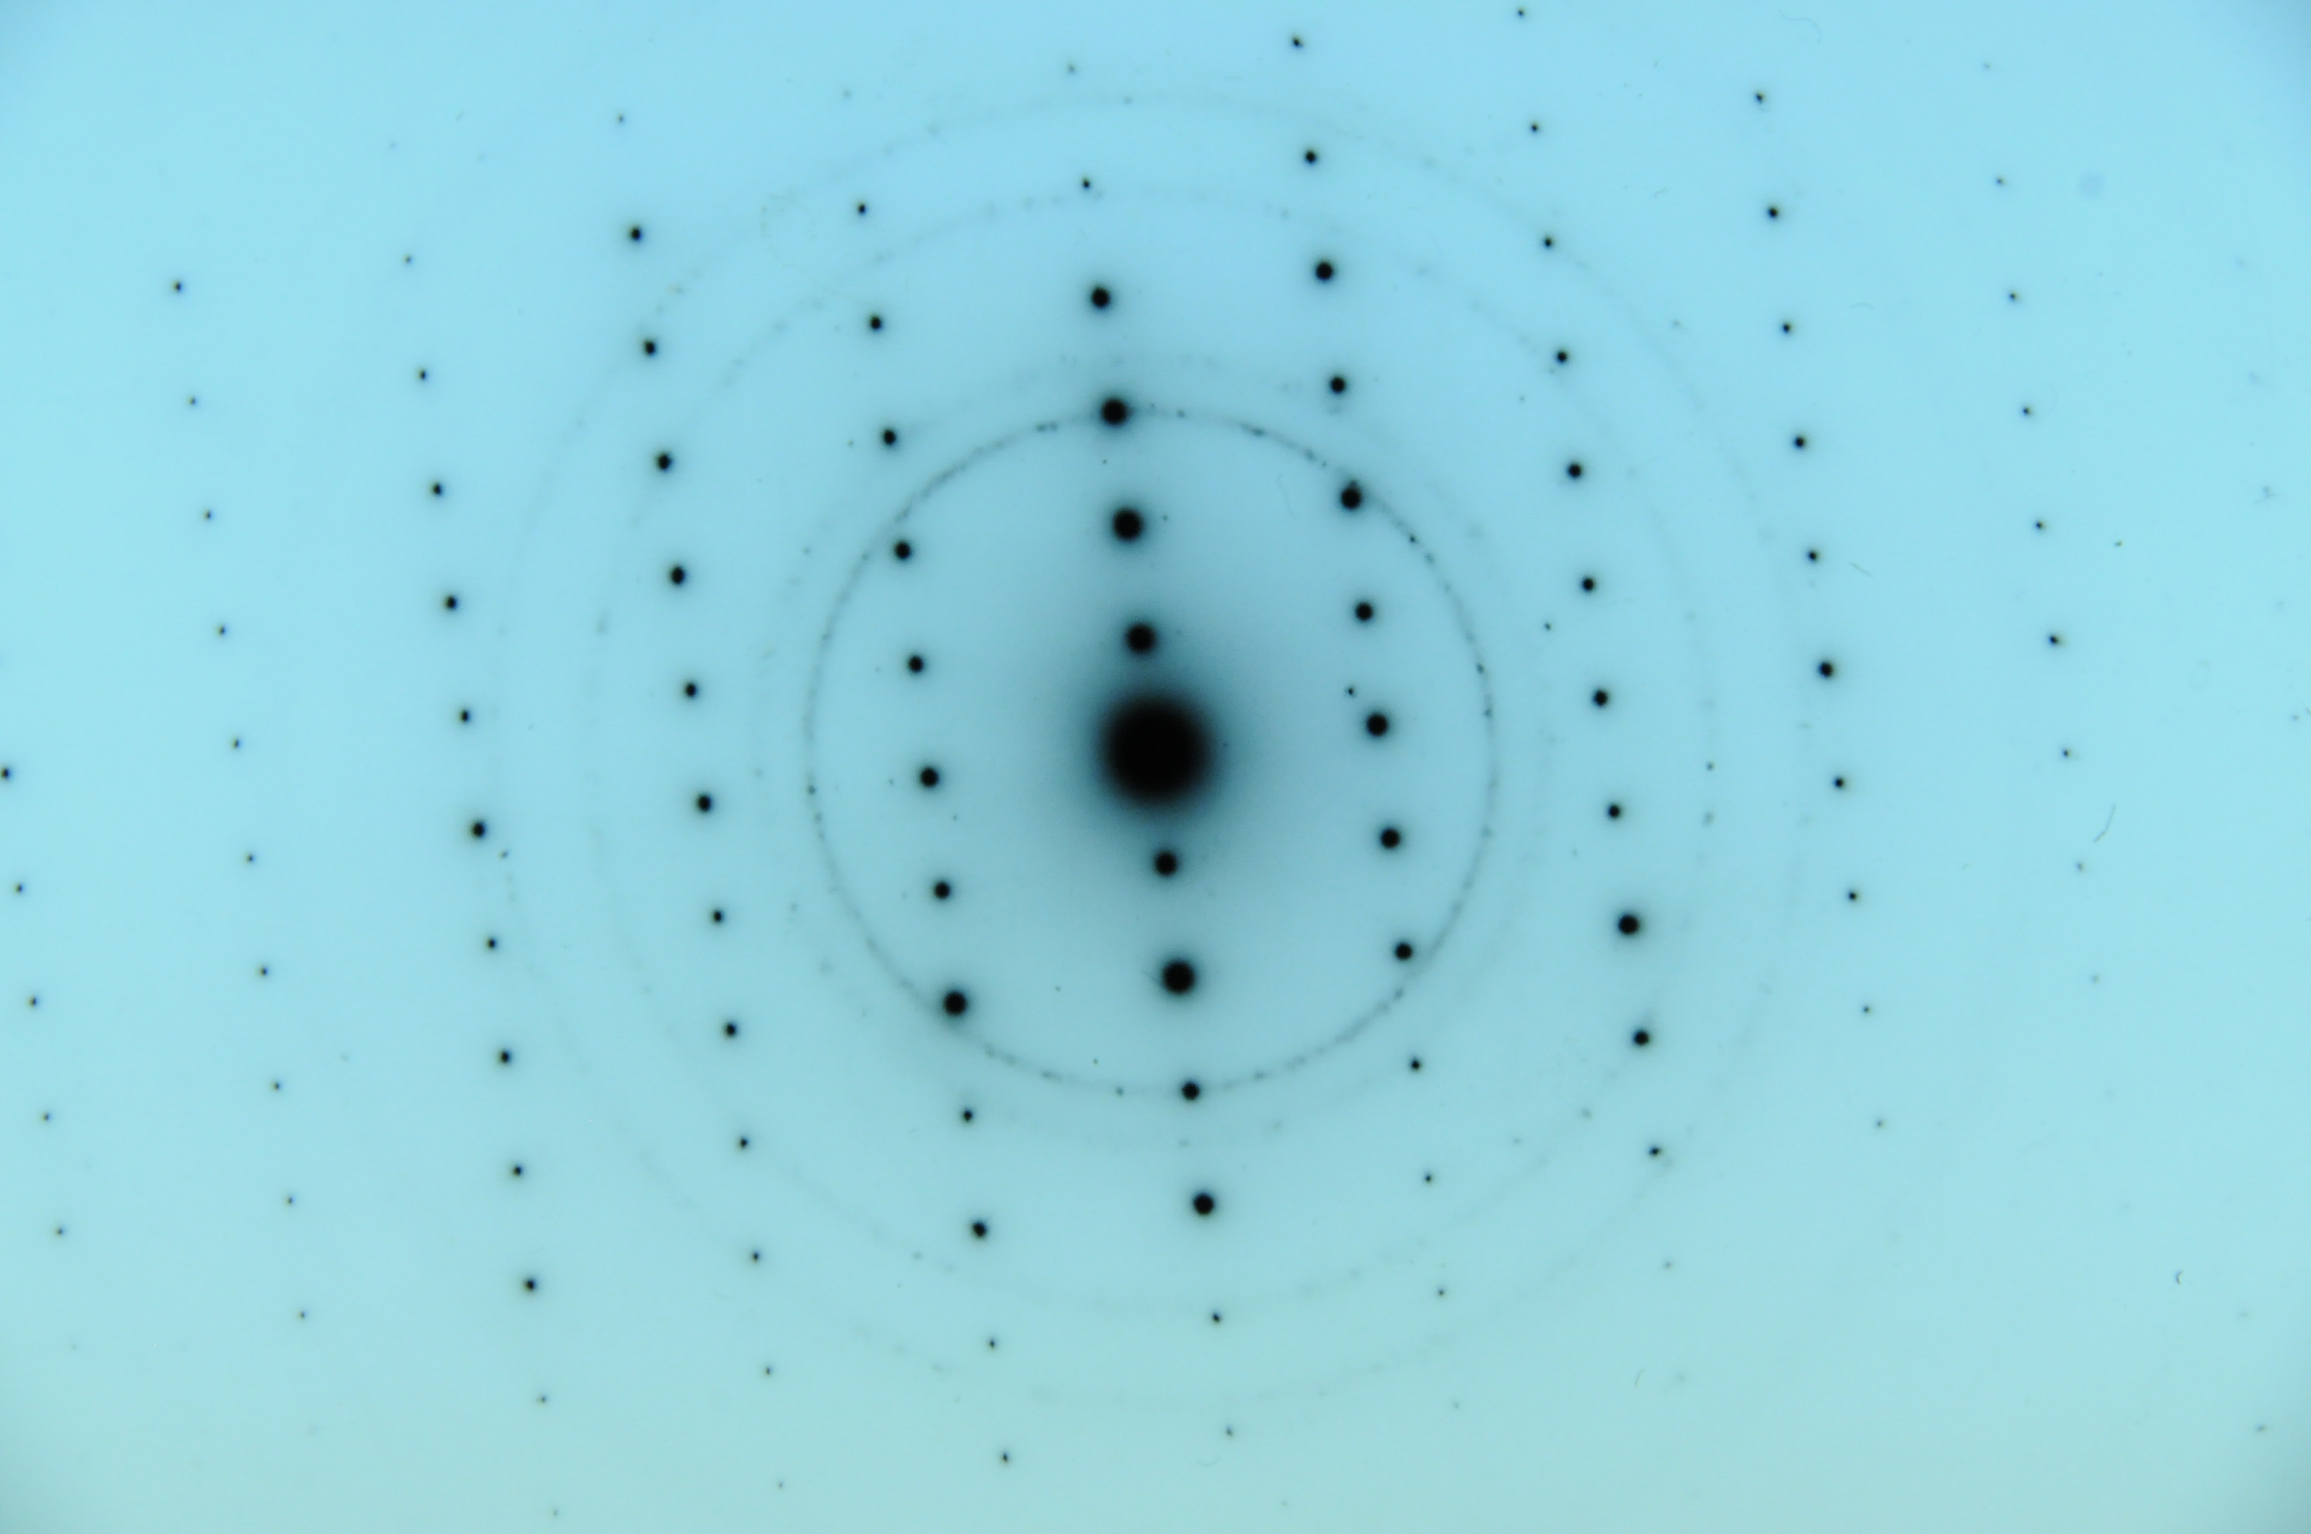
ANALYSIS:
Transmission Electron Microscopy (TEM)
3. Mineral
crystallographic
analysis using
Selective Area
Electron Diffraction
(SAED) analysis
Image courtesy of Dan Crane, OSHA
IWGACP Public Meeting, 4 February 2020

Slide 28
ANALYSIS:
Transmission Electron Microscopy (TEM)
Established methods for detection of asbestos:
ISO 10312; EPA/600/R-94/134,100.2; NIOSH 7402;
EPA/40 CFR Part 763 A-D Subpart E, AHERA.
IWGACP recommends standards of talc with various asbestos minerals at low levels be developed for validation of EM techniques and laboratories.
IWGACP Public Meeting, 4 February 2020

Slide 29
ANALYSIS:
Scanning
Electron
Microscopy
(SEM)
Excellent for
imaging samples
and Visualizing
EMP
Tremolite (from Death Valley
talc mine)
Image courtesy of B. Van Gosen, USGS
IWGACP Public Meeting, 4 February 2020

Slide 30
ANALYSIS:
Scanning Electron Microscopy (SEM)
Elemental analysis using Energy Dispersive Spectral (EDS) X-ray analysis
O
Si
tremolite
Mg
Images courtesy of B. Van Gosen, USGS
Ca
Fe
IWGACP Public Meeting, 4 February 2020

Slide 31
ANALYSIS:
Scanning Electron Microscopy (SEM)
Mineral crystallographic analysis using Selective Area Electron Diffraction (SAED) analysis
IWGACP Public Meeting, 4 February 2020

Slide 32
ANALYSIS:
Other Methods
Infrared (FTIR), Raman –
lack sensitivity to detect low levels of asbestos in talc; lack of appropriate standards at low levels of asbestos in talc and talc-containing cosmetics.
IWGACP Public Meeting, 4 February 2020

Slide 33
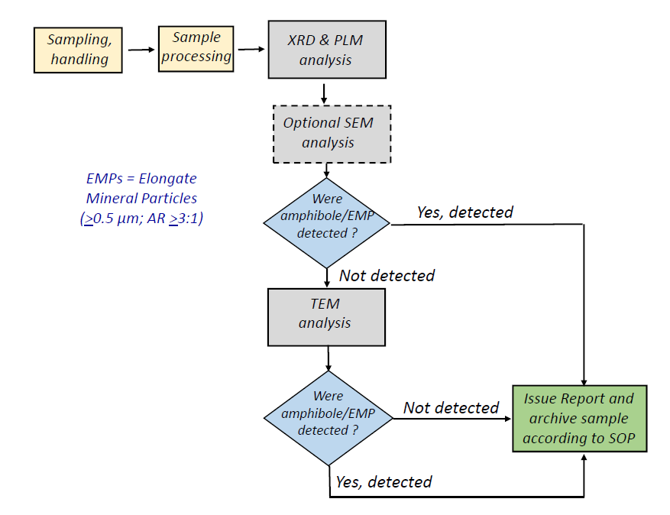
Summary:
IWGACP Public Meeting, 4 February 2020

Slide 34
IWGACP Public Meeting, 4 February 2020

