Slide 1
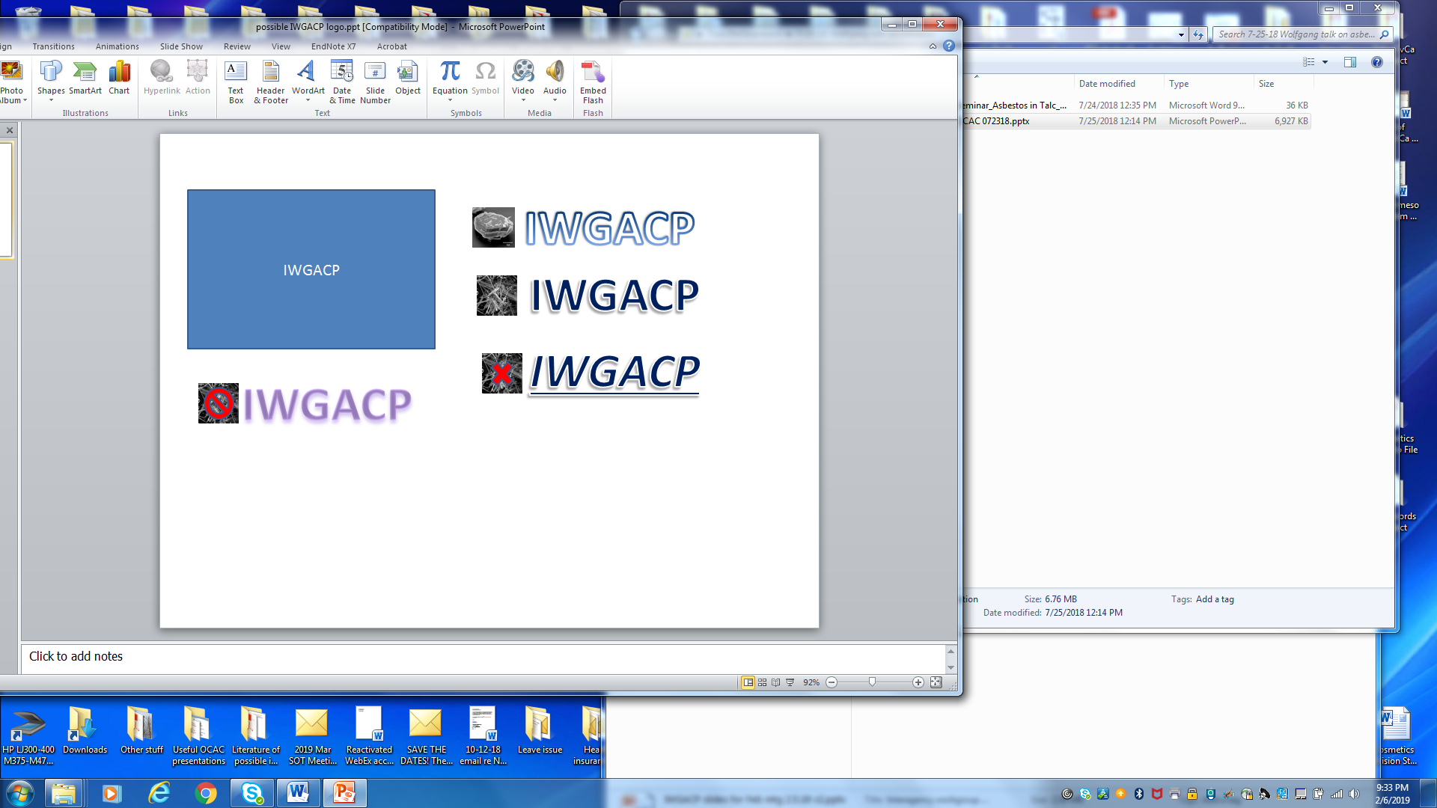
Terminology and Definitions of Mineral Fibers of Concern in Talc
Subgroup 1, IWGACP;
Paul C. Howard, Ph.D.
U.S. FDA

Slide 2
IWGACP Deliberations and Recommendations
Disclaimer:
The IWGACP preliminary recommendations are from individual scientists functioning as subject matter experts (SMEs) in their respective scientific fields, participating in a work group striving for consensus recommendations, and do not necessarily reflect the opinions or policies of their agencies, or represent proposed changes to any regulation of the U.S. Government.
IWGACP Public Meeting, 4 February 2020

Slide 3
IWGACP Deliberations and Recommendations
… the following are preliminary recommendations from the IWGACP Subgroup-1 SMEs regarding ‘terminology and definitions to use in addressing the levels of asbestos in talc and talc-containing consumer products, including cosmetics’. The deliberations of the subgroup and working group focused on terms and definitions required for consistent identification and measuring of minerals in consumer products.
IWGACP Public Meeting, 4 February 2020

Slide 4
Goal of IWGACP Subgroup 1
To establish consensus on terminology and definitions for mineral fibers of health concern in talc and talc-containing consumer products.
IWGACP Public Meeting, 4 February 2020

Slide 5
Mineralogy
SILICATES
Nesosilicates
Sorosilicates
Cyclosilicates (ring silicates)
Inosilicates, Single Chain (single chain silicate)
Inosilicates, Double Chain (double chain silicate)
Amphibole Group
Anthophyllite, Amosite, Tremolite, Actinolite, Crocidolite
Phyllosilicates (sheet silicates)
Chrysotile
Talc, Vermiculite, Kaolinite …
Tectosilicates (framework silicate)
IWGACP Public Meeting, 4 February 2020

Slide 6
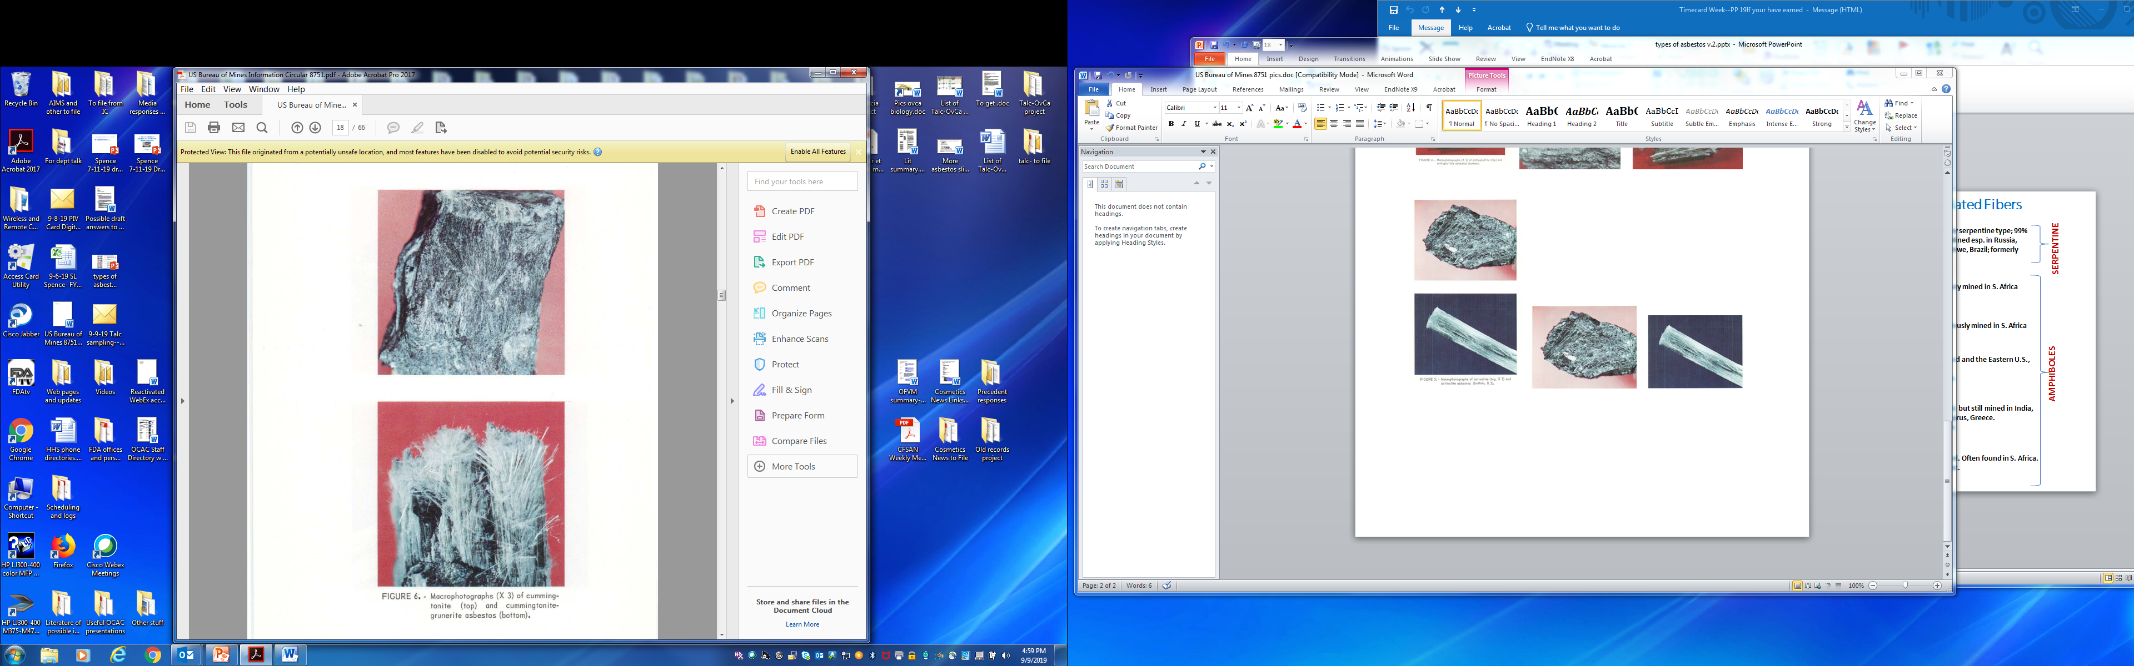
Mineralogy
Images from US Bureau of Mines publication 8751
Grunerite-Cummingtonite (non-asbestiform)
Amosite (asbestiform)
IWGACP Public Meeting, 4 February 2020

Slide 7
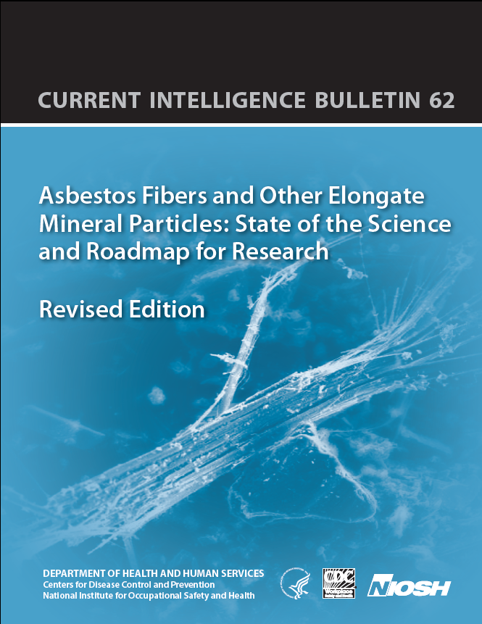
Terminology & Definitions
NIOSH Current Intelligence Bulletin 62,
“Asbestos Fibers and Other Elongate Mineral Particles: State of the Science and Roadmap for Research”
April 2011; HHS#2011-159
IWGACP Public Meeting, 4 February 2020

Slide 8
Terminology & Definitions
NIOSH Current Intelligence
Bulletin 62:
Peer-reviewed, coherent document.
Stood test-of-time for
8⁺ years.
A consensus and reference guide from a
US Gov. research agency.
IWGACP Public Meeting, 4 February 2020

Slide 9

Terminology & Definitions
IWGACP recommends the use of the term Elongate Mineral Particle (EMP):
EMP is defined by aspect ratio, ≥3:1
EMP is a broad term that that avoids the question of crystal habit
Asbestiform minerals (AR >3:1)
are a subset of EMP.
IWGACP Public Meeting, 4 February 2020

Slide 10
Terminology & Definitions
EMP
Subgroup 1 recommends recording & reporting:
  Minimum Length: ≥0.5 µm (≥ 500 nm)
  Maximum Length: none
Countable EMP
“… a particle that meets specified dimensional criteria and is to be counted according to established protocol.”
IWGACP Public Meeting, 4 February 2020

Slide 11
Justification for ≥0.5 µm EMP
Consistent with the counting rules for fibers established by the global standard for transmission electron microscope sampling and analysis,
ISO 10312:2019 (Appendix C).
Supported by published studies that indicate asbestos particles and EMPs of these dimensions could pose a health concern.
(a) Y. Suzuki and S.R. Yuen. 2002. Asbestos fibers contributing to the induction of human malignant mesothelioma. Ann. N.Y. Acad. Sci. 982: 160-176
(PMID: 12562635)
IWGACP Public Meeting, 4 February 2020

Slide 12
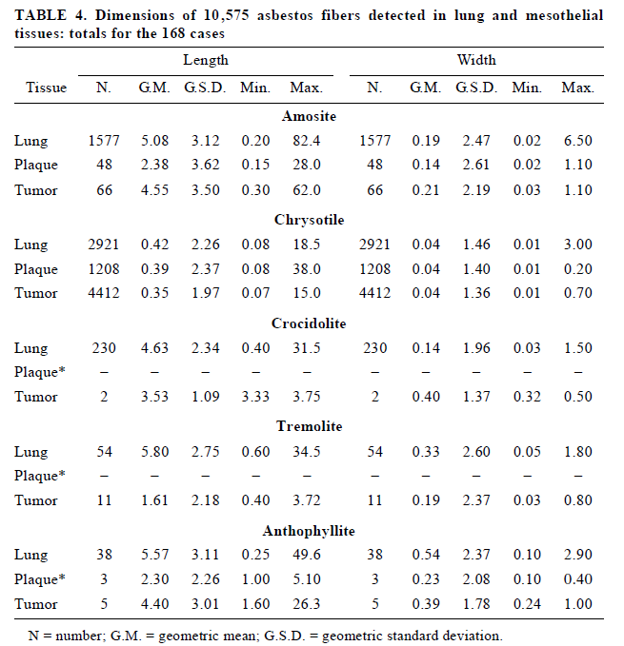
Justification for ≥0.5 µm EMP
Suzuki & Yuen. 2002.
IWGACP Public Meeting, 4 February 2020

Slide 13
Justification for ≥0.5 µm EMP
Suzuki & Yuen. 2002.
IWGACP Public Meeting, 4 February 2020

Slide 14
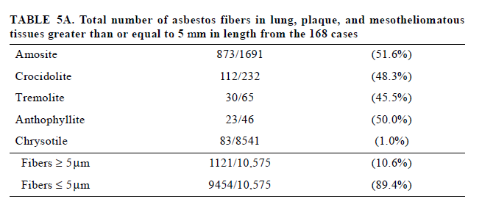
Justification for ≥0.5 µm EMP
µ
Suzuki & Yuen. 2002.
IWGACP Public Meeting, 4 February 2020

Slide 15
Justification for ≥0.5 µm EMP
(2.b.) Y. Suzuki, S.R. Yuen, R. Ashley. 2005. Short, thin, asbestos fibers contribute to the development of human malignant mesothelioma: pathological evidence. Int. J. Hyg. Environ. Health 208(3): 201-210 (PMID: 15971859)
IWGACP Public Meeting, 4 February 2020

Slide 16
Justification for ≥0.5 µm EMP
“… long, thin asbestos fibers comprised only 2.3% of total fibers (247/10,575) in these tissues.”
“… the majority (89.4%) of the fibers in the tissues examined were shorter than or equal to 5 µm in length (9,454 of 10,575), and generally (92.7%) smaller than or equal to 0.25 µm in width (9,808 of 10,575) … “
Suzuki et al., 2005.
IWGACP Public Meeting, 4 February 2020

Slide 17
Justification for ≥0.5 µm EMP
(2.c.) R.L. Dodson, M.A.L. Atkinson, J.L. Levin. 2003. Asbestos fiber length as related to potential pathogenicity: a critical review. Am. J. Ind. Med. 44: 291-297 (PMID: 12929149)
“… asbestos fibers of all lengths induce pathological responses and that caution should be exerted when attempting to exclude any population of inhaled fibers, based on their length, from being contributors to the potential for development of asbestos-related disease. ”
IWGACP Public Meeting, 4 February 2020

Slide 18
Justification for ≥0.5 µm EMP
(2.d.) G. Boulanger, P. Andujar, J.-C., Pairon, M.-A. Billon-Galland, C. Dion, P, Dumortier, P. Brochard, A, Sobaszek, P. Bartsch, C. Paris, M.-C. Jaurand. 2014. Quantification of short and long asbestos fibers to assess asbestos exposure: a review of fiber size toxicity. Environmental Health 13:59 (PMID: 25043725).
IWGACP Public Meeting, 4 February 2020

Slide 19
Justification for ≥0.5 µm EMP
The toxicity of asbestos fibers ≤ 5 µm cannot be dismissed.
It is unclear if the lower effect of < 5 µm asbestos fibers in comparison with ≥ 5 µm fibers found in animal studies is present in humans as few epidemiological studies took short fibers into consideration.
Limiting the measurement of asbestos fibers with a length ≥ 5 μm leaves out other types of fibers (≤ 5 μm) that may also have health adverse effects.
Boulanger et al. 2014.
IWGACP Public Meeting, 4 February 2020

Slide 20
Terminology & Definitions
EMP
Subgroup 1 recommends:
Minimum aspect ratio, > 3:1
Maximum aspect ratio = none
Minor axis (width)
Major axis
(length)
Aspect ratio (AR) = major axis:minor axis = length:width
IWGACP Public Meeting, 4 February 2020

Slide 21
Terminology & Definitions
Further recommendations of Subgroup 1 definition of EMP:
- any identified (detected) particle (>0.5 μm; >3:1 aspect ratio) should be a countable EMP.
- all efforts should be made to record the dimensions and mineral identify for each countable EMP.
IWGACP Public Meeting, 4 February 2020

Slide 22
Terminology & Definitions
Other definitions -
Covered Mineral:
Sec. 6.2: “… a mineral encompassed
by a specified regulation or
recommended standard.”
For Talc and Talc-Containing Products:
Covered minerals include chrysotile
(but not other serpentine minerals) and members of the amphibole group (inclusive; not restricted to the five amphiboles used commercially).
IWGACP Public Meeting, 4 February 2020

Slide 23
Preliminary Recommendations
Use the term EMP (elongate mineral particle) for
recording and reporting all particles:
- length:width aspect ratio ≥3:1
EMPs >0.5 µm be recorded and reported (countable EMP).
(3) EMPs have:
- no maximum length
- no maximum aspect ratio
(4) For counting and reporting purposes, obtain the
chemistry and mineral identity of every
countable EMP.
IWGACP Public Meeting, 4 February 2020

