Slide 1
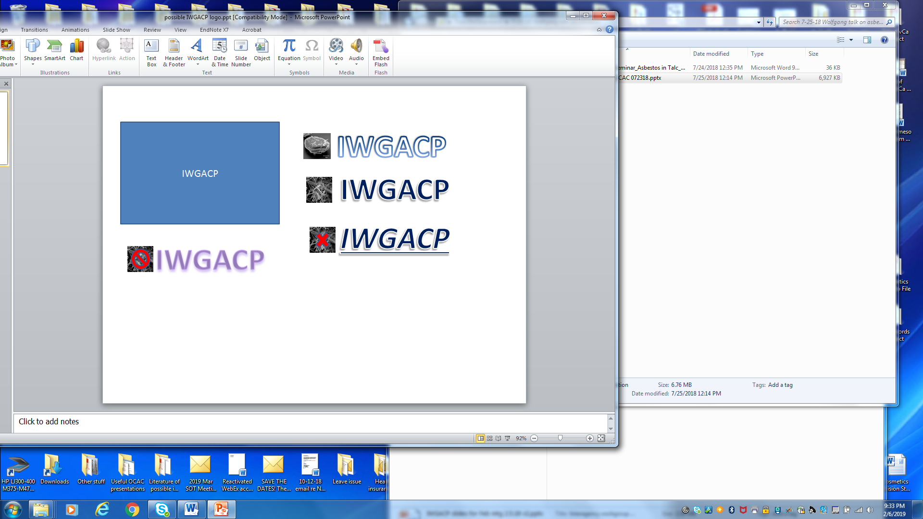
Interagency Working Group on Asbestos in Consumer Products (IWGACP) Overview
Deborah Smegal, Chair
Associate Director, Office of Cosmetics and Colors
U.S. FDA

Slide 2
IWGACP Purpose
To coordinate an effort amongst various US federal agencies to develop recommendations on key topics related to asbestos testing methodologies.
To harmonize criteria for data interpretation regarding the presence of asbestos and other potentially harmful elongate mineral particles (EMPs) as contaminants in regulated consumer products containing talc¹.
Today’s meeting will focus on cosmetic products containing talc.
¹ including cosmetics, foods, dietary supplements, drugs, medical devices, ceramics and art materials.
IWGACP Public Meeting, 4 February 2020

Slide 3
Current Representation
38 subject matter experts from 8 federal agencies:
  Dept. of Health and Human Services:
    Food and Drug Administration (FDA)
    National Institute of Occupational Safety and Health (NIOSH)
    National Institutes of Health (NIH)/ National Institute of Environmental Health Sciences (NIEHS)
  Dept. of Labor: Occupational Safety and Health Administration (OSHA)
  Environmental Protection Agency (EPA)
  Consumer Product Safety Commission (CPSC)
  Dept. of the Interior: U.S. Geological Survey (USGS)
  Dept. of Commerce: National Institute of Standards and Technology (NIST)
IWGACP Public Meeting, 4 February 2020

Slide 4
Joint Institute for Food Safety and Applied Nutrition (JIFSAN) “Asbestos in Talc” Symposium
November 2018
Topics focused on:
  Analytical methods
  Identification of mineral fibers using physicochemical characteristics
  Definitions and terms
  Quantification of mineral fibers
  Reporting and interpretation of analytical data
Symposium did not address health implications, which should be considered in deciding how to view and interpret data.
IWGACP Public Meeting, 4 February 2020
Notes:
.

Slide 5
Relevant Questions from JIFSAN Symposium
Considering the characteristics of fibers (e.g., length, width, aspect ratio, morphology), what criteria should be used in assessing if talc or a talc-containing product tests positive for asbestos fibers?
What general techniques and published test methods should be considered for the identification of asbestos fibers in talc-containing products? (i.e., methods for sample preparation, as well as instrumentation needed to make an assessment.)
How are the terms “asbestiform” and “cleavage fragment” relevant to categorize populations of fibers detected in the testing of talc?
Which unit of quantitation (weight or number of fibers) and what measurement criteria should be used to express the amount of asbestos in talc and talc-containing products?
What standard(s) should be developed for use to assess the presence of asbestos in talc-containing products? This can include reference materials as well as methodology.
IWGACP Public Meeting, 4 February 2020
Notes:
.

Slide 6
IWGACP Overview
Charter
Monthly Meetings
Formed 3 subgroups
Public Meeting
  Present IWGACP Executive Summary and preliminary recommendations
Goal to develop a white paper with recommendations
IWGACP Public Meeting, 4 February 2020

Slide 7
Ideally, recommendations in the white paper would:
  Resolve inconsistency in analytical methods and data interpretation
  Identify a testing approach and consistent terminology
  Build consensus on recommendations for analytical methods and acceptance criteria that can be utilized by regulatory agencies to prevent exposure to potentially hazardous EMPs
IWGACP Public Meeting, 4 February 2020
Notes:
.

Slide 8
Formation of Subgroups
Subgroup 1: Terminology and Definitions of Mineral Fibers of Concern in Talc
Subgroup 2: Analytical Methods for Detecting Mineral Fibers in Talc/Talc Containing Consumer Products
Subgroup 3: Data Reporting and Analysis: Content and Format of Analytical Reports
Encouraged dialogue amongst subject matter experts (SMEs).
IWGACP Public Meeting, 4 February 2020

Slide 9
Goal for Each Subgroup
Subgroup 1: Terminology and Definitions of Mineral Fibers of Concern in Talc
  To establish consensus on terminology and definitions for mineral fibers of health concern in talc and talc containing consumer products
Subgroup 2: Analytical Methods for Detecting Mineral Fibers in Talc/Talc Containing Consumer Products
  To develop a robust analytical protocol for detecting asbestos and other EMPs of health concern in talc and consumer products containing talc
Subgroup 3: Data Reporting and Analysis: Content and Format of Analytical Reports
  To establish concurrence on physiochemical attribute criteria for identification and counting of mineral fibers of concern during analysis of consumer products containing talc
IWGACP Public Meeting, 4 February 2020

Slide 10
Conclusion
IWGACP SMEs to present key information:
  Preliminary Recommendations from the IWGACP:
    Subgroup 1: Mineral Fiber Terminology and Definitions
    Subgroup 2: Analytical Methods
    Paul C. Howard PhD, Science Advisor, Office of Regulatory Science, Office of Regulatory Affairs (ORA), FDA
    Subgroup 3: Content and Format of Analytical Reports
    Summary of Research Needs
    Summary of IWGACP’s Preliminary Recommendations
    Steve Wolfgang PhD, Consumer Safety Officer, Office of Cosmetics and Colors, CFSAN, FDA
IWGACP Public Meeting, 4 February 2020

