Slide 1
Day in the Life:
Supervisory Consumer Safety Officer
James Hildreth
Supervisory Consumer Safety Officer
Office of Medical Device and Radiological Health Operations (OMDRHO), Division 3
Office of Regulatory Affairs
U.S. Food and Drug Administration

Slide 2
Presentation Series:
Day In the Life
5 Modules
  Introduction
  Consumer Safety Officer
  Supervisory Consumer Safety Officer
  Compliance Officer
  Recall Coordinator

Slide 3

Learning Objectives
Describe the overall group a supervisory consumer safety officer (SCSO) manages
Identify some core and infrequent responsibilities
Describe activities related to an “Official Action Indicated” (OAI) Case

Slide 4
The Group of a
Supervisory Consumer Safety Officer

Slide 5
Supervisory Group Background
Generally consists of 8 - 12 employees:
  Mostly Consumer Safety Officers (CSOs)
  All work in same program
  May include one or more administrative personnel

Slide 6
Supervisory Group Background
May be in same office, different city, or different state
Staff may have different levels of training and experience:
  New ⇨ Journeyman ⇨ Specialist or Expert

Slide 7
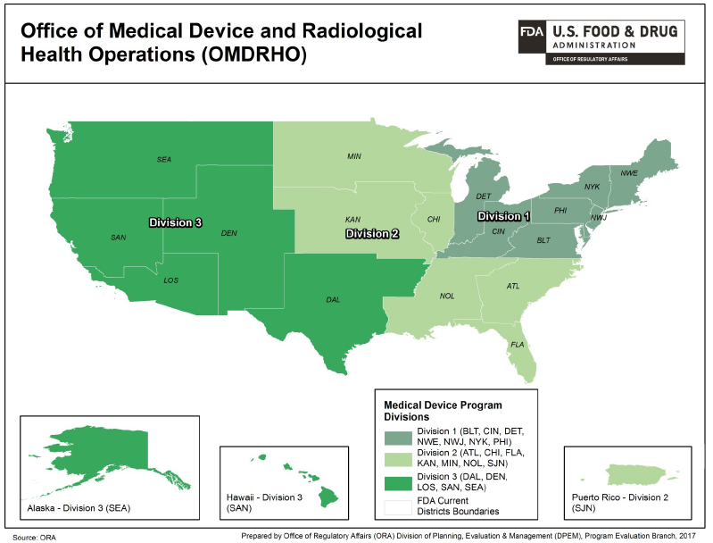
Source: https://www.fda.gov/downloads/AboutFDA/CentersOffices/OfficeofGlobalRegulatoryOperationsandPolicy/ORA/UCM558229.pdf

Slide 8
Core SCSO Responsibilities

Slide 9
Core SCSO Responsibilities
Field Surveillance Management
General Responsibilities
Infrequent Responsibilities
Uncommon Responsibilities

Slide 10
Field Surveillance Management
Prioritize and assign work assignments
  Factors include, but not limited to, priority, deadlines, resources, and training
Monitor foreign and domestic inspection performance

Slide 11
Field Surveillance Management
Provide operational direction to CSOs
  Individual or group meetings
  Inspections (before, during, and after)
Review and endorse Establishment Inspection Reports (EIRs), investigation memos

Slide 12
Field Surveillance Management
Determines next steps for work products, based on CSO findings
Coordinate needed action on work product
  Could involve offices internal and/or external to OMDRHO
    Internal: Division's Compliance Branch
    External: Center for Devices and Radiological Health (CDRH), OCI, another ORA program (e.g. Drugs, Biologics, etc)
Review and release Field Management Directive 145 (FMD-145) copies of EIRs

Slide 13
General Responsibilities
Evaluate and document employee performance
Provide training to group members
Provide operational data to FDA Management and Senior Leadership
Provide information to industry and trade groups
Participate in internal and external work groups

Slide 14
Infrequent Responsibilities
Assist in certain compliance actions
  Example: regulatory meetings
Coordinate disaster response and other emergency efforts
Perform on-site and certification investigator audits

Slide 15
Uncommon Responsibilities
Evaluate complaints reported to FDA for inspection or investigation follow-up
Monitor import for export shipments for domestic follow-up
Monitor and assign recall audit checks

Slide 16
Uncommon Responsibilities
Identify MDSAP* firms and modify inspectional obligation
Monitor inspections conducted under contract by states (examples: California, Texas)
Supervise satellite office operations
* MDSAP = Medical Device Single Audit Program

Slide 17
Example:
“Official Action Indicated” Case

Slide 18
Official Action Indicated
Official Action Indicated (OAI) means significant issues were found during an inspection that warrant action to be taken
CSOs will usually contact the SCSO during an inspection if significant issues are discovered
CSO and SCSO may discuss the identified issues and determine next steps/needed action

Slide 19
OAI Case
SCSO may contact other offices while the inspection is ongoing, if needed
  May contact the Division’s Compliance Branch/a Compliance Officer (CO)
  May contact CDRH, if applicable
SCSO may coordinate a final review of the significant issues
  May coordinate the review electronically or may call a meeting with CSO, Compliance Officer, and/or CDRH personnel (if applicable)
Once the Form FDA 483 is complete, the CSO holds a close-out meeting with the firm’s management.

Slide 20
OAI Case
CSO will write the EIR and submit the EIR to SCSO
SCSO reviews and endorses the EIR
  Provides a recommendation for inspection classification as OAI
  Provides recommendation for any needed follow-up action
SCSO forwards EIR to the assigned CO in the Compliance Branch

Slide 21
Summary
A supervisory consumer safety officer (SCSO) manages a team responsible for various field activities
A SCSO has a number of core and infrequent responsibilities
Complex cases, such as those involving an “Official Action Indicated,” involve collaboration and communication among responsible FDA groups

Slide 22
Your Call to Action
Understand the role a Supervisory Consumer Safety Officer may have with their interactions with you
View other modules in this series to learn more about the individual OMDRHO staff roles

Slide 23
Presentation Series:
Day In the Life
5 Modules
  Introduction
  Consumer Safety Officer
  Supervisory Consumer Safety Officer
  Compliance Officer
  Recall Coordinator

Slide 24


