Slide 1
Day in the Life:
Recall Coordinator
Cynthia Aycock
Division Recall Coordinator
Office of Medical Device and Radiological Health Operations (OMDRHO), Division 1
Office of Regulatory Affairs
U.S. Food and Drug Administration

Slide 2
Presentation Series:
Day In the Life
5 Modules
  Introduction
  Consumer Safety Officer
  Supervisory Consumer Safety Officer
  Compliance Officer
  Recall Coordinator

Slide 3
Have You Wondered
What can you do to expedite the processing of your recall?
What does Division Recall Coordinator do?

Slide 4

Learning Objectives
Describe the basic duties of a Division Recall Coordinator
Identify and explain the different classifications of recalls
Explain what FDA does with a recall
Describe interactions between the firm and FDA up through the termination of a recall
Discuss some common issues and questions about recalls

Slide 5
Where Do I Send My Recall?

Slide 6
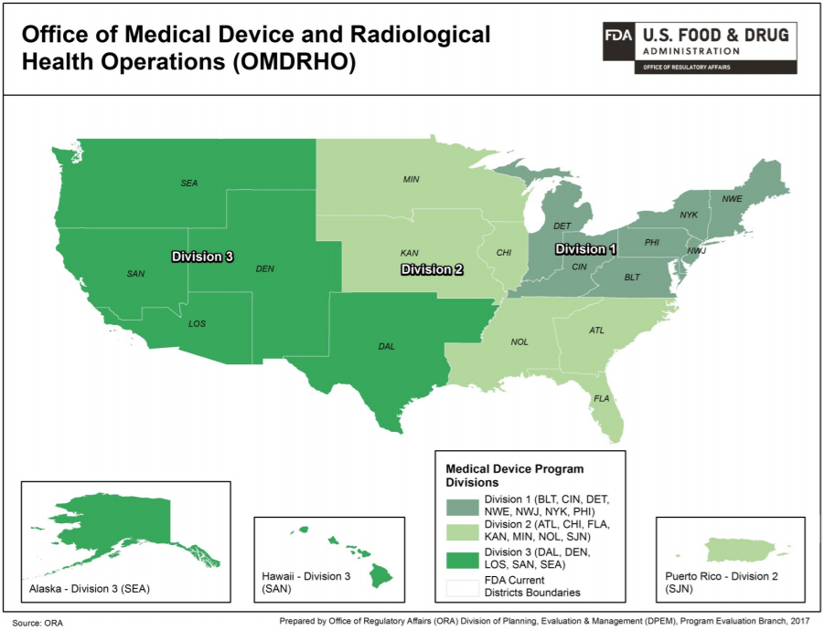

Slide 7
Recall Contact Information
For general inquiries, new recall submissions, and status reports:
  Division 1: oradevices1recalls@fda.hhs.gov
  Division 2: oradevices2recalls@fda.hhs.gov
  Division 3: oradevices3recalls@fda.hhs.gov

Slide 8
Division Recall Coordinator (DRC) Duties
Triage new recalls
Submit recall alerts and recommendations
Coordinate the recall with firm and FDA’s Center for Devices and Radiological Health (CDRH)
  Prepare classification and termination letters
  Review status reports and termination requests
Assign recall audit checks

Slide 9
What Does FDA do with a Recall?

Slide 10
New Recalls
Reported by firm or by FDA Consumer Safety Officers (CSOs)
DRCs are available to review customer letters
  Can provide template with necessary information
Submit 806 report within 10 days of recall initiation
  Report must include:
    The date the recall was initiated
    The method of notification used

Slide 11
Potential Class I Recall
Potential Class I Recalls have accelerated timelines
Alerts are submitted within 24 hours of notification
Supply all necessary information on time

Slide 12
What We Do with Your Recall
Enter information in Recall Enterprise System (RES)
  Recall Alert (basic information) is entered as soon as possible
  Recall Recommendation (detailed entry) submitted within 5 days of alert
DRC may contact firm for further information
  Please respond as soon as possible

Slide 13
What We Do with Your Recall
Event moves into queue for CDRH review
CDRH may contact you for more information
CDRH sends final classification decision to DRC

Slide 14
Recall Classification
Class I
Reasonable probability that use of, or exposure to, a violative product will cause serious adverse health consequences or death
Class II
Use of, or exposure to, a violative product may cause temporary or medically reversible adverse health consequences or where the probability of serious adverse health consequences is remote

Slide 15
Recall Classification
Class III
Use of, or exposure to, a violative product is not likely to cause serious adverse health consequences
Market Withdrawal
Minor violation not subject to FDA legal action, or no violation
Stock Recovery
Not marketed or has not left direct control of manufacturer

Slide 16
Recall Classification
After CDRH classifies the recall:
Recall is posted to FDA website
DRC prepares a Classification Letter
Classification Letter is emailed to firm
Classification Letter includes instructions on submitting status reports

Slide 17
What We Do with Your Recall
DRC may assign recall audit checks
DRC receives, reviews, and files a firm’s monthly status reports

Slide 18
Status Reports
Firm submits monthly status report
Includes the following:
  Number of consignees notified of the recall, and date and method of notification
  Number of products on hand at the time communication was received
  Number of products returned or corrected by each consignee contacted, and the number of products accounted for
  Estimated time frames for completion of the recall

Slide 19
Status Reports
Also includes results of effectiveness checks:
  Number of consignees responded to notification
    Response must be more than a delivery confirmation
    A customer response form is recommended
  Number of consignees who did not respond
  Identify further steps that will be taken with non-responding consignees

Slide 20
Effectiveness Checks
Q: Level A is contacting 100% of consignees. What if I make multiple attempts, but the consignee won’t respond?
A: Even if you cannot verify that 100% of consignees received notification, document your good-faith efforts to contact all consignees.

Slide 21
Final Product Disposition Plan
Plan should be submitted to DRC for review prior to performing any actions
Common Product Disposition Options
  Rework
  Destroy
    FDA would like the option to witness the destruction
    Submit destruction documentation once complete

Slide 22
Termination
You may request termination when:
  All reasonable efforts have been made to remove or correct violative product
  Final Product disposition is complete
  Preventive actions or corrections have been taken

Slide 23
Termination
Request termination by emailing the DRC
DRC will email you if we have any questions
When the DRC determines that the event is ready for termination, a termination letter will be sent to the recalling firm

Slide 24
Common Concerns

Slide 25
Customer Letters
Lack of health hazard statement
Lack of clear customer instructions
Lack of response form
Including the assumed event classification

Slide 26
806 Report Submission
Incomplete recall submission
Issues with information accessibility or file format
Firm refuses to send consignee information because it believes doing so violates HIPAA

Slide 27
Other Common Issues
Firm reworked product, but did not provide rework instructions
Effectiveness check plan is less than Level A 100%
Firm failed to submit information within the agreed- upon timeframes
Multiple emails/phone calls from firm to DRC in quick succession

Slide 28
Disagreements
Q: I thought my event was a Class II, but CDRH classified it as Class I. What do I do if I don’t agree with CDRH’s classification?
A: You may reach out to your DRC, and we can set up a meeting with CDRH for you to learn why they classified your event differently than what you expected.

Slide 29
Product Enhancement or Recall?
A device enhancement is
  (1) a change to improve the performance or quality of a device that is
  (2) not a change to remedy a violation of the FD&C Act or associated regulations enforced by the agency
Source: Distinguishing Medical Device Recalls from Medical Device Enhancements: Guidance for Industry and Food and Drug Administration Staff
https://www.fda.gov/downloads/medicaldevices/deviceregulationandguidance/guidancedocuments/ucm418469.pdf

Slide 30
Why haven’t I heard from FDA yet?
DRCs process all recalls throughout the United States
Class I recalls take precedence
Class II and III recalls are processed in order they are received
Complete submissions leads to faster processing

Slide 31
Termination Processing
FDA receives a high volume of termination requests
Processed in order they are received
DRCs notify you if there is missing information
You receive a termination letter once processing is complete

Slide 32
Reference Materials

Slide 33
Recall References
Enforcement Reports
  www.fda.gov/safety/recalls-market-withdrawals-safety-alerts/enforcement-reports
Guidance: Product Recalls, Corrections, and Removals
  www.fda.gov/safety/industry-guidance-recalls/guidance-industry-product-recalls-including-removals-and-corrections
  https://www.fda.gov/medical-devices/postmarket-requirements-devices/recalls-corrections-and-removals-devices
Industry Notices and Guidance Documents
    www.fda.gov/ForIndustry/IndustryNoticesandGuidanceDocuments/default.htm

Slide 34
Recall References
Investigations Operations Manual - Chapter 7
www.fda.gov/inspections-compliance-enforcement-and-criminal-investigations/inspection-references/investigations-operations-manual
Regulatory Procedures Manual - Chapter 7
https://www.fda.gov/inspections-compliance-enforcement-and-criminal-investigations/compliance-manuals/regulatory-procedures-manual
21 CFR Part 7 & 21 CFR Part 806
https://www.ecfr.gov/cgi-bin/text-idx?SID=3ee286332416f26a91d9e6d786a604ab&mc=true&tpl=/ecfrbrowse/Title21/21tab_02.tpl

Slide 35
Summary
The ORA Division Recall Coordinator plays an important role in the coordination and oversight of recall events.
FDA classifies recalls into Class I, II, or III, based on its potential for health consequences.
Class I recalls take precedence over other recall events.
Class II and III recalls are processed in order they’re received.
Providing complete submissions and timely responses are helpful to processing the recall event.

Slide 36
Your Call to Action
Review 21 CFR Part 806 to ensure that your recall procedures are adequate.
Be responsive to FDA with requests for information.
Notify your Division Recall Coordinator of any changes.
View other modules in this series to learn more about the individual OMDRHO staff roles.

Slide 37
Presentation Series:
Day In the Life
5 Modules
  Introduction
  Consumer Safety Officer
  Supervisory Consumer Safety Officer
  Compliance Officer
  Recall Coordinator

Slide 38
