Slide 1
Perspectives on a New Era of Smarter Food Safety:
The System for Enteric Disease, Response, Investigation, and Coordination (SEDRIC)
Ian Williams PhD, MS
Chief, Outbreak Response and Prevention Branch
Division of Foodborne, Waterborne, and Environmental Diseases
Centers for Disease Control and Prevention
FDA Public Meeting: A New Era of Smarter Food Safety
October 21, 2019
The findings and conclusions in this report are those of the author and do not necessarily represent the official position of the Centers for Disease Control and Prevention.

Slide 2
Multistate Foodborne Disease Outbreak Investigation Process
Multiple agencies and disciplines involved
  State, local, and federal
  Public health and regulatory
  Epidemiologists, laboratorians, and environmental health specialists
50+ State & Federal Agencies involved during a large investigation

Slide 3
A Gap in Multistate Outbreak Investigation Methods
An electronic system is needed to integrate information and facilitate communication between partners (CDC, state/local, other federal)
  Integrate “lab” and “epi” data to generate case counts and other descriptive data relating to describing the outbreak in person, place, and time
  Generate a hypothesis about a likely source
  Test that hypothesis
  Reconstruct how and where contamination is likely to have occurred
These processes historically done by email, phone, fax, and with databases/spreadsheets that cannot share data among partners
Notes:
3

Slide 4
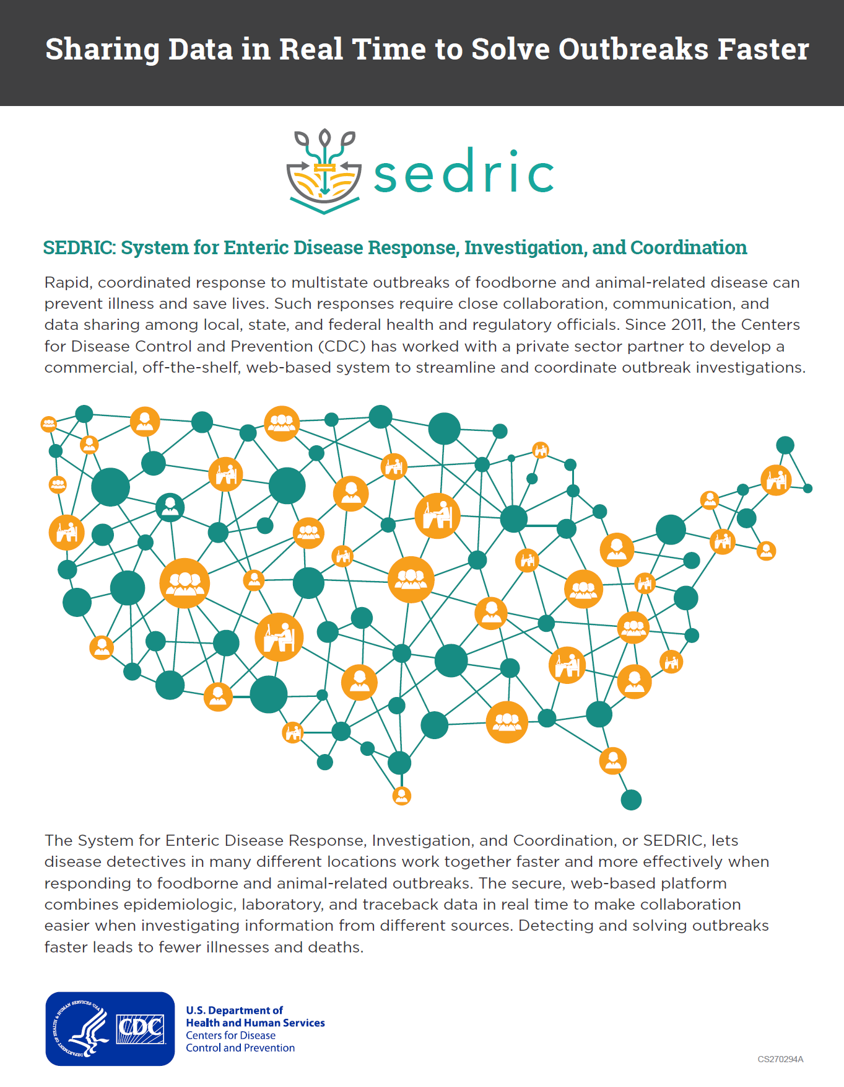
System for Enteric Disease, Response, Investigation, and Coordination
  Secure web-based platform for public health partners to facilitate collaborative multistate outbreak investigations
    Managed by CDC
  Four major capabilities
    Integrate multiple surveillance data sources in real time
    Visualize outbreak data rapidly in one place
    Provide a secure platform for partner collaboration
    Manage a repository of historic surveillance and outbreak data
https://www.cdc.gov/foodsafety/outbreaks/investigating-outbreaks/sedric.html

Slide 5
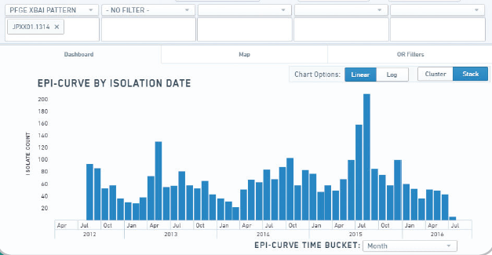
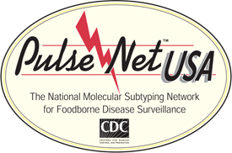
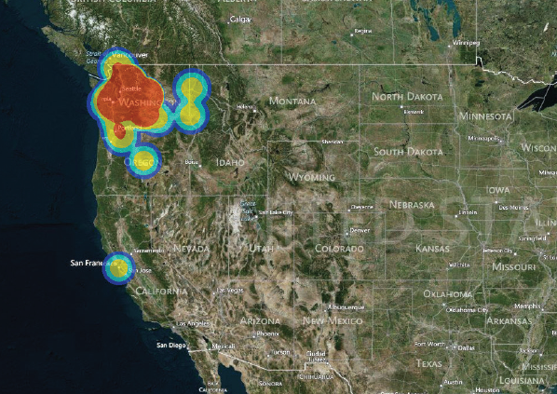
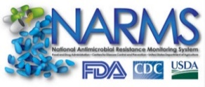

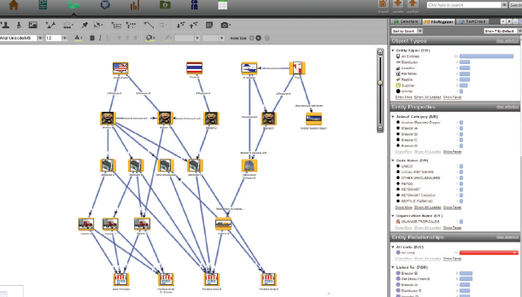



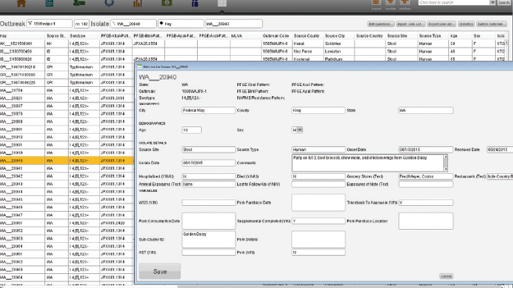



SEDRIC: Integrating multiple data sources in real time
Ingests surveillance and investigation data
Data exploration, secure sharing, and visualization
Investigation data from labs, epidemiologists, environmental health, regulatory agencies from state, federal partners

Slide 6


