Slide 1
Perspective on a Changing Food System
Dr. Mary Wagner, President
MK Wagner & Associates

Slide 2




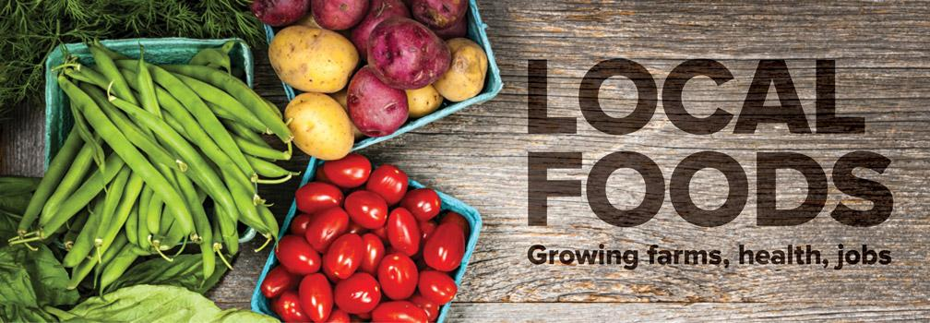




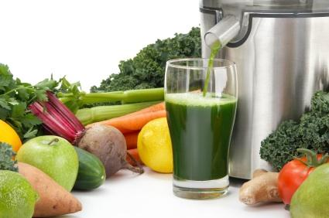
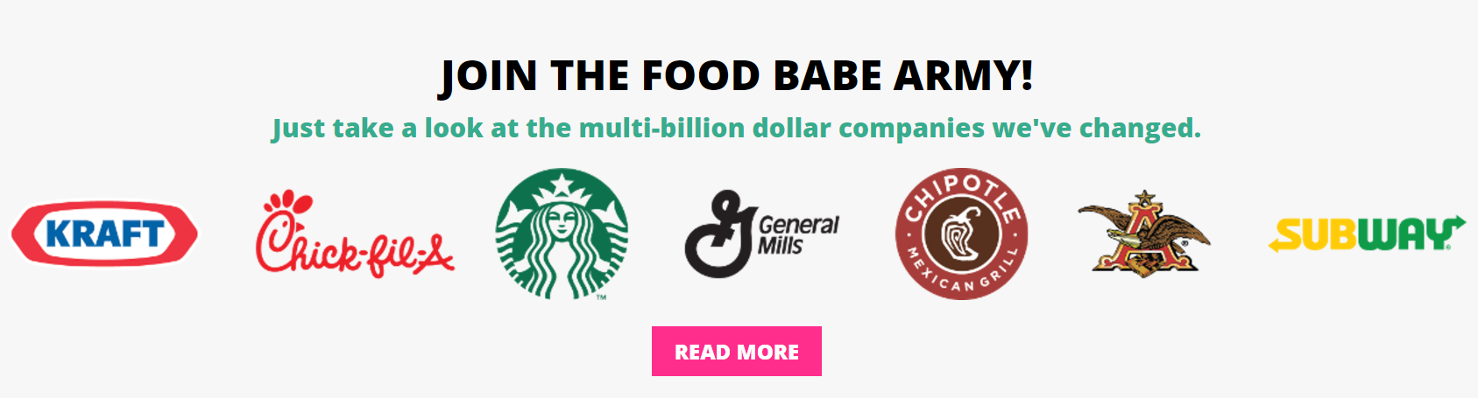
Consumer preferences and a heightened level of connectivity are reshaping the food & beverage industry
Higher Risk Preferences
Elevated connectivity
The New Consumer
The food and beverage industry is operating in a faster,
riskier environment with less tolerance from consumers

Slide 3
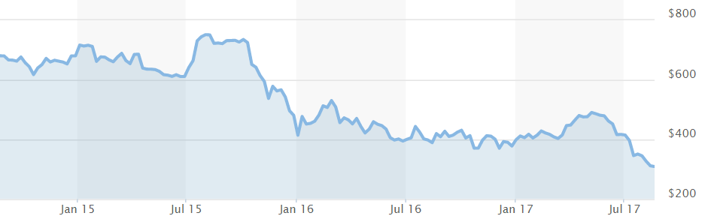
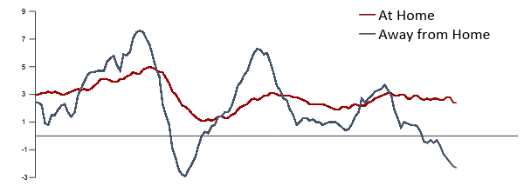
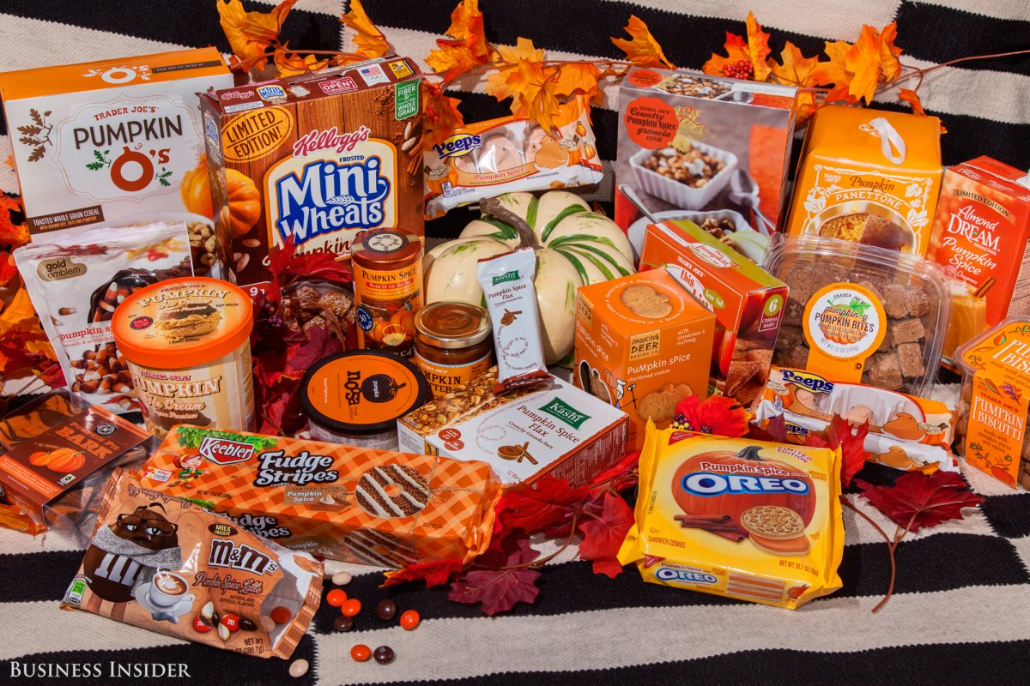
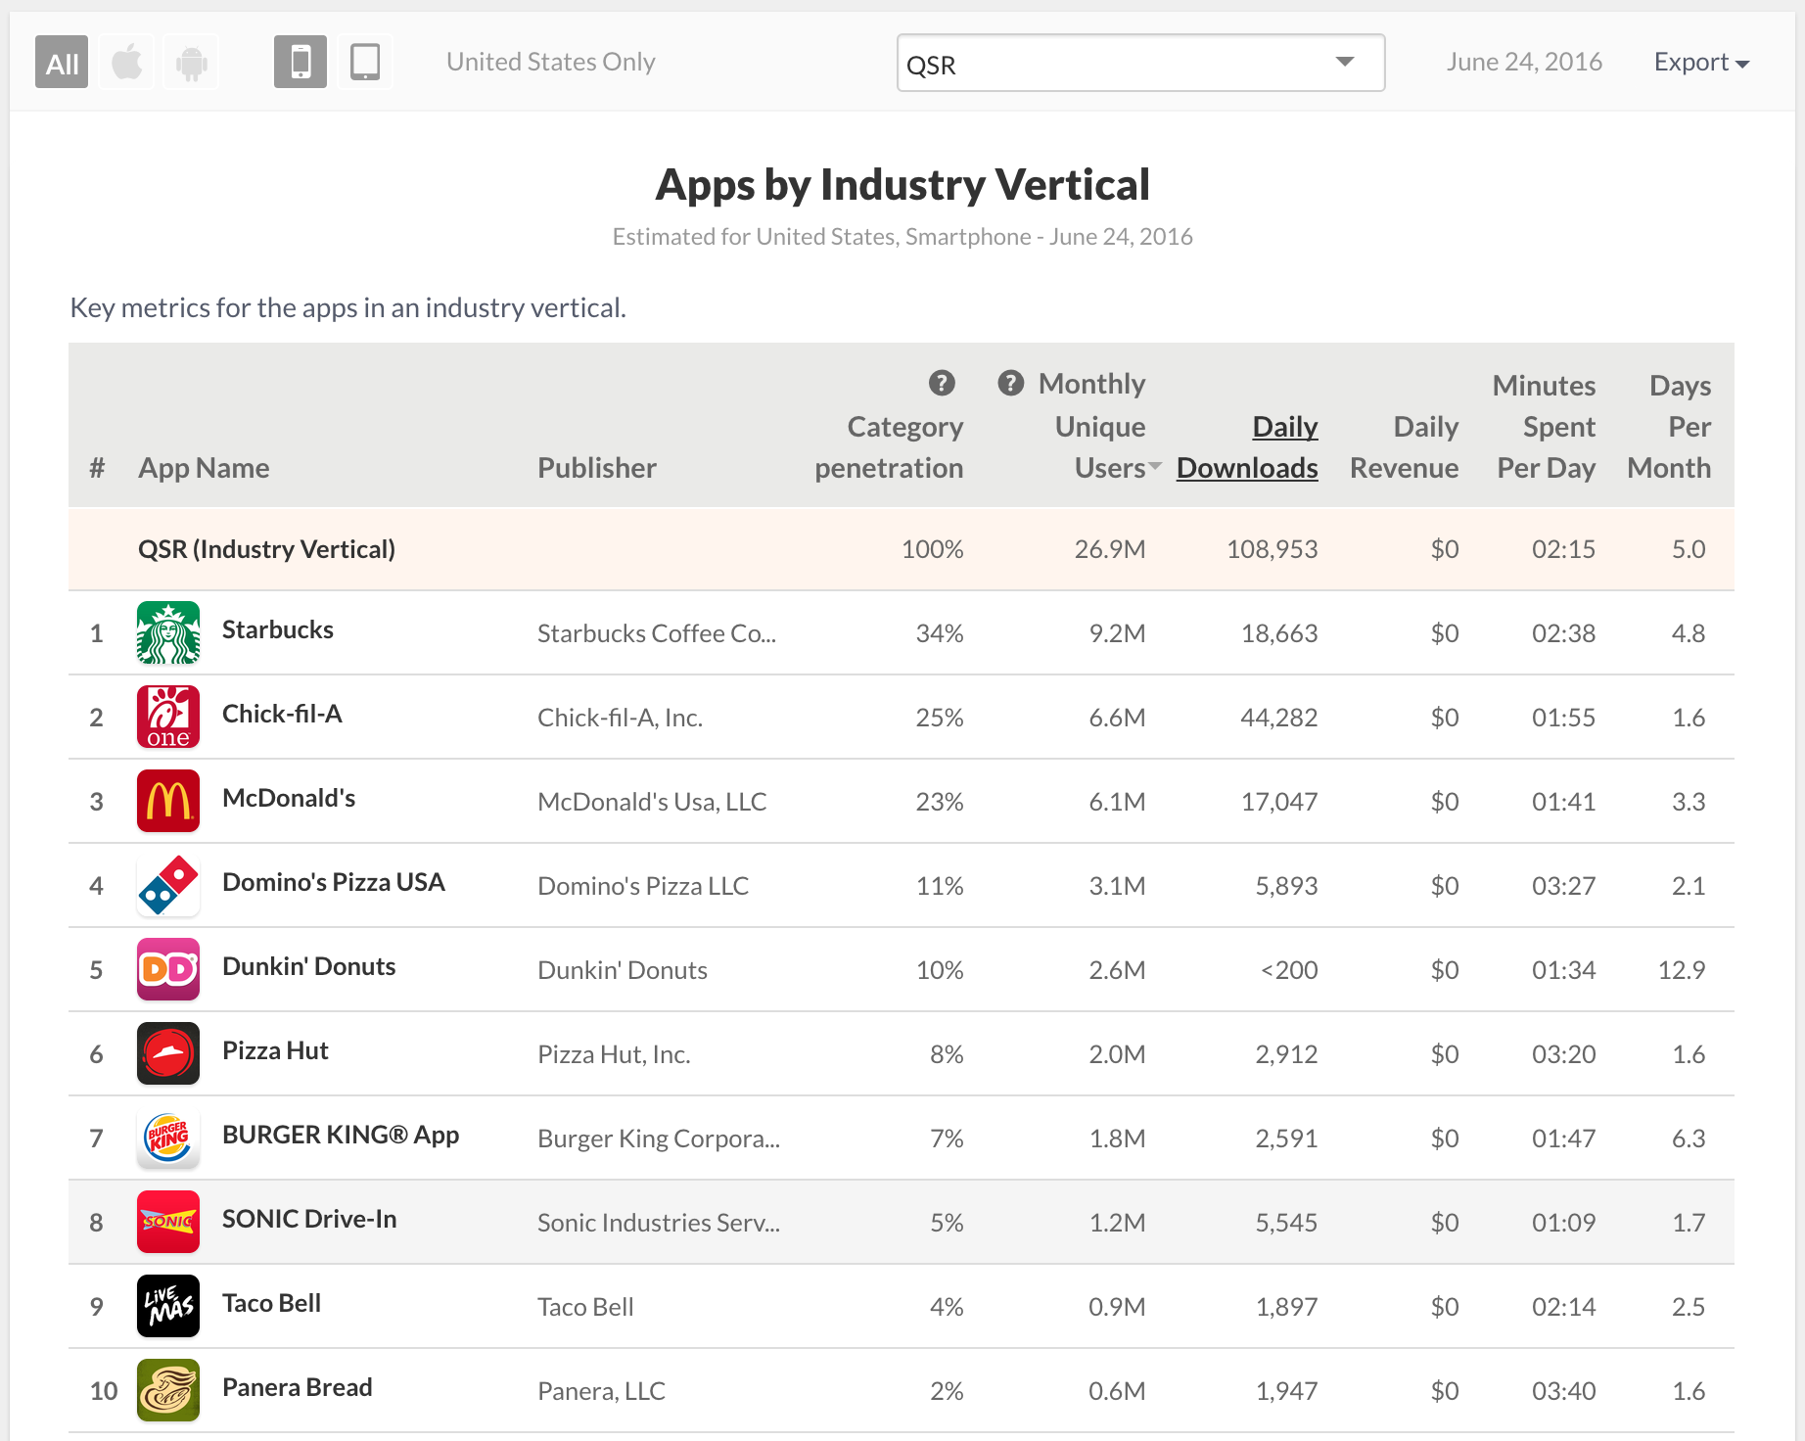
Internally, food & beverage businesses have found additional challenges
Increased leadership scrutiny
Competitive cost pressures
Chipotle Stock Price
Cost of Food²
$
12-month percent change in Consumer Price Index for All urban consumer
50%
Speed to market
Availability of tech resources
Sources: Yahoo Finance, Bureau of Labor Statistics; App Annie

Slide 4
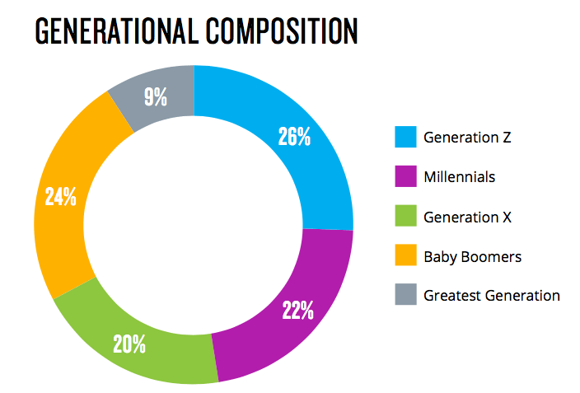

GENZ - A LARGE, TECHNOLOGICALLY ENABLED
& CONNECTED TRIBE
More than a quarter of America's population currently belongs to GenZ.
By the end of 2020, they will account for almost 40% of consumers.
Once thought of as millennials on steroids, we now know that GenZ is more different, than the same.
To start, they are much more racially and culturally diverse than any other previous generation.
Notes:
GenZ to have double the buying power of Milennials.
GenZ is hyper aware of the real or perceived meandering millennial.
They are determined to plan ahead and desire financial and job security, not that they won’t be entrepreneurs, but maybe the type that are looking for singles & doubles vs HM.
GenZ raised by individualistic, self-reliant parents who were themselves latch-key kids.
The financial crisis in 2008 was a cultural moment. GenZ that is entering the work force now came of age during recession, continued war (ISIS), terror threats, school shootings. ⅓ grew up in single parent HH. Growing climate crisis.
“They’re more like children of the 1930s, if children of the 1930s had learned to think, learn and communicate while attached to hand-held supercomputers,”

Slide 5

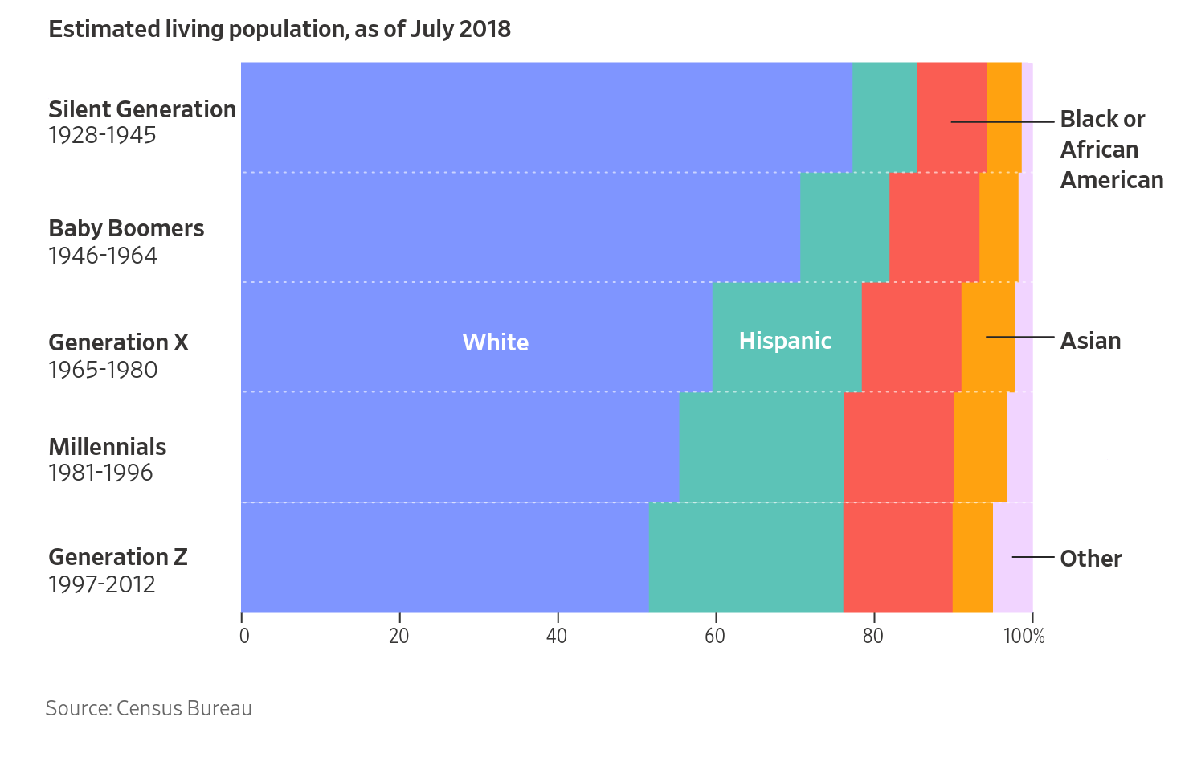
GENZ - A MORE GLOBAL PALATE
Population diversity will drive demand for global flavors​ & experiences.
GenZ will reshape the way we eat by demanding a more diverse selection that better represents their racial and cultural diversity.
“From 2010 to 2020, 89% of US population growth is forecast to come from racial and multicultural growth (non-white), which will directly impact how preferences for food will continue to diversify.”​
Notes:
62% of young adults aged 18-22 say they cook international cuisines at home from social media, compared to 46% of Millennials (aged 23-40) and 23% of Generation X consumers (aged 41-52) who cook at home.
GenZ will be last generation majority white
62% GenZ (18-22 say they cook international cuisines at home from social media, compared to 46% of Mille
nnials (aged 23-40) and 23% of Generation X consumers (aged 41-52) who cook at home
62% GenZ (18-22 say they cook international cuisines at home from social media, compared to 46% of Millennials (aged 23-40) and 23% of Generation X consumers (aged 41-52) who cook at home

Slide 6
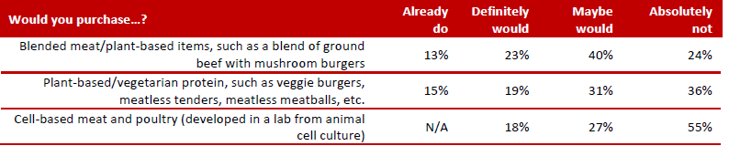
2019, Over Half of Adults have No Intention of
Eating Cell-based Meat & Poultry
FMI, The Power of Meat, 2019

Slide 7
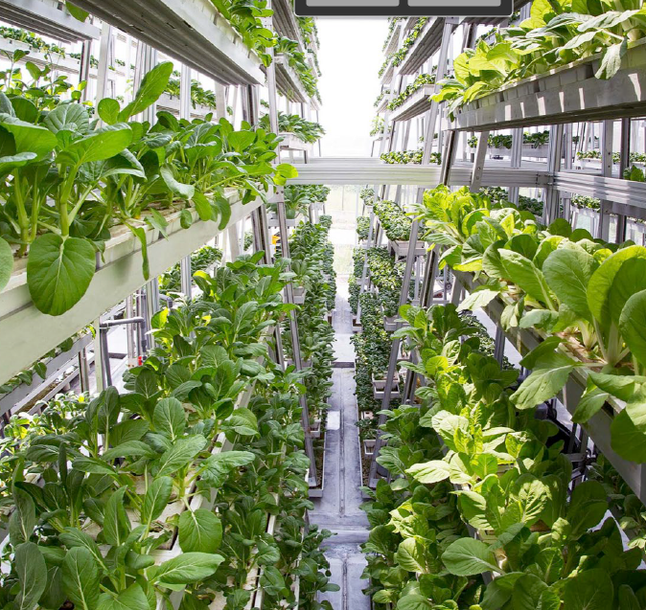
Vertical Farming, Hydroponics are the New Local;
60% Say Hydroponics Qualify as Local, 56% as Organic
42% have Seen Greenhouse- or Hydroponically- Grown Callouts on Produce Packages or Signage in Stores
Hydroponics Better Taste & nutrition > Convention produce
34% look for a sustainably grown claim; 43% of them are also core local shoppers, 41% look for hydroponic growing
Hyper-local Restaurants – Raise their Own Meats, Produce on Premise - #6 Hot Culinary Trend Overall 2019
FMI, The Power of Produce, 2019; FMI, U.S. Grocery Shopper Trends, 2018, 2019

Slide 8
Top Culinary & Restaurant Concepts in the Restaurant Industry in 2019
NRA, 2019, State-of-the-Restaurant Industry

