Slide 1



New Data Opportunities for Strategic Surveillance: A Regulator’s Perspective
21st Oct 2019

Slide 2

The tenets of FSA’s Strategic Surveillance service
Business
Users
Business
Users
Reusability (of data and algorithms)
From Open data to Intelligence (Predictive analytics)
Business Driven
Value Generation
Validation
Agile Approach – 10 week sprints
Data Science and Machine Learning

Slide 3
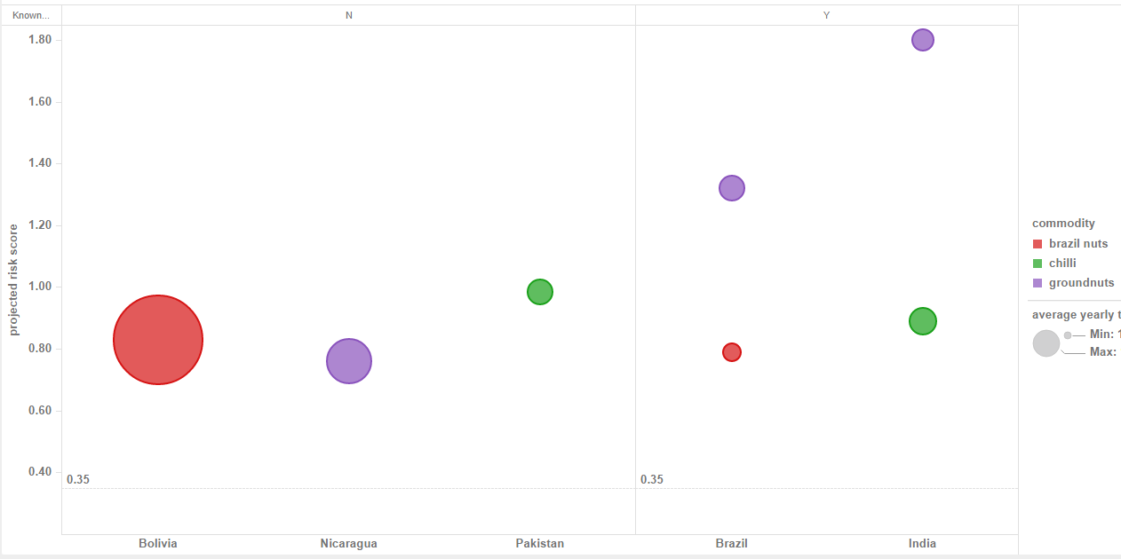
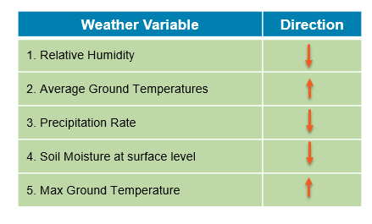

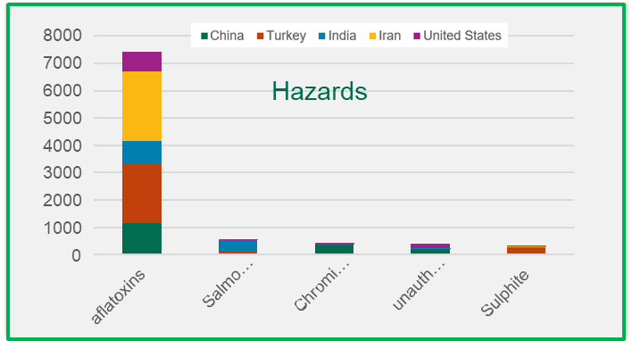
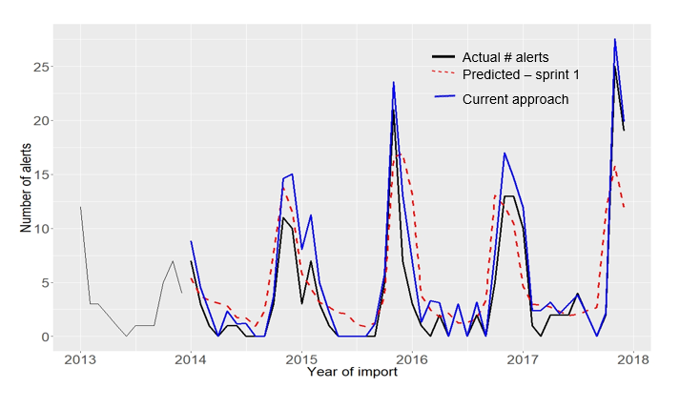
An example: Predicting Aflatoxin Risks with Climate Data
Importing food comes with risk
Bolivia
Brazil
Moving from ‘Known knowns’ to ‘Unknown unknowns’
Brazil nuts from Bolivia; Groundnuts from Nicaragua; Chillies from Pakistan
Weather variables impacting Aflatoxins
Aflatoxin Risk Prediction Model – Figs from Turkey
Notes:
Aflatoxin contamination is one of the highest sources of RASFF alerts
Can we predict Aflatoxin risk?
Used climate data along with historical RASFF data
Our model predicted Aflatoxin risk for figs coming from Turkey
Extended the model to other commodities and countries, hence moving from ‘known knowns’ to ‘unknown unknowns’
Brazil nuts from Bolivia are not currently subject to increased controls but are under consideration
Sampling survey commissioned by Imports confirmed our predictions
Extended the model to Pesticides
Value generated:
Provide predictive risk insights
Support targeted interventions by enabling effective sampling
Enable the FSA to respond rapidly, cost effectively and incrementally to emerging trends
Award won:
This was part of our work that won the Highly Commended prize in the Technical & Innovation category of the Office for Product Safety and Standards (BEIS) Regulatory Excellence awards 2019

Slide 4
Thank you!
- Julie Pierce (Julie.Pierce@food.gov.uk)
Director of Openness, Data and Digital
Food Standards Agency

