Slide 1

NAVIGATING A TRUST-ENABLED FOOD SYSTEM
Dirk Herdes
SVP, Nielsen

Slide 2






Slide 3

|
THE NEW NORMAL
DISLOYALTY
91%
READY TO DEFECT
Source: Nielsen Global Consumer Loyalty Survey, Q1 2019

Slide 4
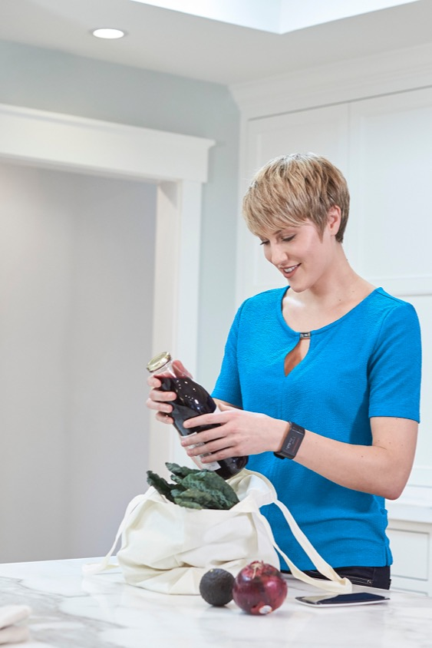
SPEAK THE WAY YOUR CONSUMERS DO
DOLLAR SALES & GROWTH OF PRODUCTS
THAT CLAIM TO HAVE ‘RECOGNIZABLE INGREDIENTS’
CATEGORY | SALES | GROWTH
PERFORMANCE NUTRITION | $13.8M | +77%
BEVERAGE ENHANCERS | $281M | +49%
ROLLS AND BUNS | $250M | +16%
DOUGH & BATTER PRODUCTS | $128M | +12%
CREAM AND NON-DAIRY CREAMER | $1.35B | +11%
Source: Nielsen Product Insider, powered by Label Insight, 52 weeks ended Sept. 29, 2019

Slide 5
“healthy for me & healthy for the world” can run at a premium
% Global Respondents – Willingness to pay a premium for a product that…
Source: Q2 2018 The Conference Board® Global Consumer Confidence Survey conducted in collaboration with Nielsen

Slide 6
THE AGE OF ONLINE
Today, trust can be earned through safe & convenient fulfillment of CPG
$1 in $3
11%
+24%
is spent on food-related items in US CPG e-commerce
of US CPG e-commerce sales is driven by click-and-collect purchasing
growth in spending per buyer online among Americans
From 2017 – 2018,
36% MORE
consumers claim to purchase meal kits.
Source: Nielsen E-commerce measurement powered by Rakuten Intelligence, Total U.S., 52 weeks ended Jan. 31, 2019; Nielsen Homescan US surveys conducted November – December of 2017 and October – November of 2018

Slide 7
THE MANY BENEFITS OF TRANSPARENCY
ICE CREAM
FDA PROTEIN & HEALTHY
+28% v. YEAR AGO
SUGAR ALCOHOLS
+2% v. YEAR AGO
READY TO DRINK COFFEE
COLD PRESSED
+57% v. YEAR AGO
FDA PROTEIN & ALL NATURAL INGREDIENTS
+19% v. YEAR AGO
BROTH
FDA LOW OR NO FAT
+13% v. YEAR AGO
ALL NATURAL INGREDIENTS
+6% v YEAR AGO
Source: Nielsen Product Insider, powered by Label Insight, 52 weeks ended Jan. 5, 2019 and Sept. 28, 2019

Slide 8
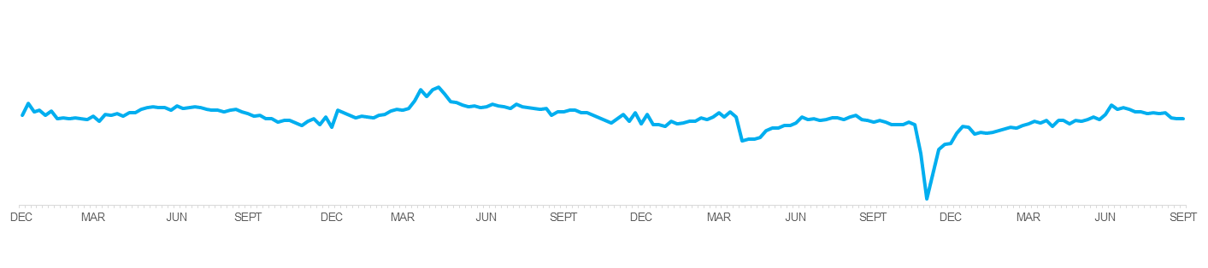
TRUST IS BROKEN FASTER THAN it CAN BE REBUILT
For romaine lettuce, the implications are still being felt
Romaine Lettuce – Weekly Sales Trend
2016
2017
2018
2019
2018 SALES PLUMMET
Down $136B vs. 2017
OTHER GREENS THRIVED
Arugula (+27%), Iceberg (+4%) and Green Leaf (+5%) lettuce all see growth vs. 2017
2019 AVG. PRICES RISE
+5.5% YTD 2019 vs. YEAR AGO
Source: Nielsen Retail Measurement Services, Total U.S., 52 weeks ended Dec. 29, 2018 vs. year-ago and Year-to-Date Sept. 28, 2019

Slide 9
5 STRATEGIES FOR WINNING WITH TRUST
1
LINK TRUSTED “FOR ME” WITH TRUSTED FOR “THE WORLD”
2
UNDERSTAND YOUR CONSUMERS AND THE ATTRIBUTES THEY DESIRE
3
OPTIMIZE TRANSPARENCY INITIATIVES ACROSS YOUR ENTIRE PORTFOLIO
4
MAKE TRANSPARENT AND HEALTHFUL PRODUCTS ACCESSIBLE TO YOUR CONSUMERS
5
INTEGRATE TRANSPARENCY AUTHENTICALLY INTO CONSUMER TOUCHPOINTS AND MARKETING

Slide 10
THE SCIENCE BEHIND WHAT’S NEXT TM

