Slide 1



Frank Yiannas
Deputy Commissioner
Food Policy and Response
Frank Yiannas
Deputy Commissioner
Food Policy and Response
@frankyiannasFDA
#smarterfoodsafety

Slide 2


New Era: a memorable or important date or
event, especially one that begins a new period in our history.
Notes:
This will take many forms:
We will understand the unique needs of our customers in each market, and serve them as a local store.
We will recruit and develop the best talent around the globe.
We will develop an engaged workforce by providing all of our associates opportunities to learn, grow and advance, and we will lead a special effort to develop women at all levels of our company.
We will share best practices and learn how to leverage our global supply chain.
Discussion question: What ideas do you have to help connect associates around the world?

Slide 3

A Modern Approach for Modern Times
People-Led * FSMA-Based * Technology-Enabled

Slide 4
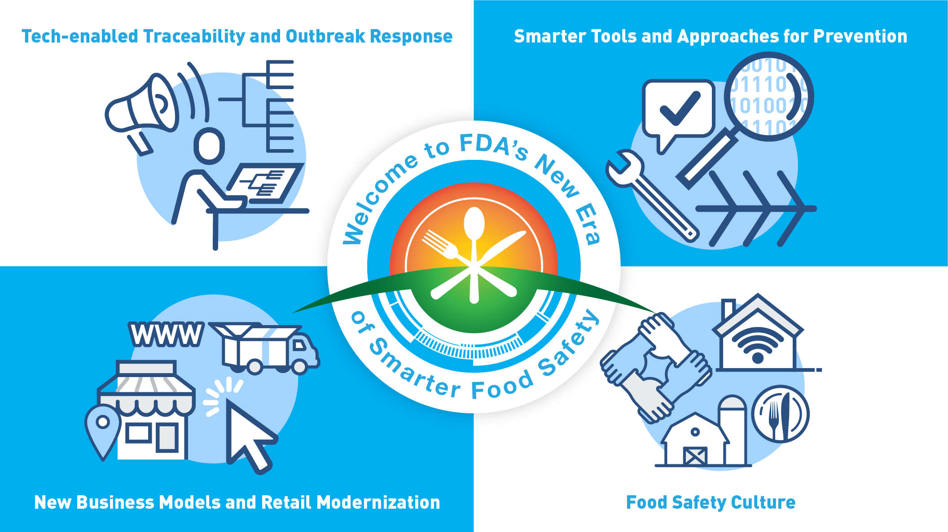

Slide 5
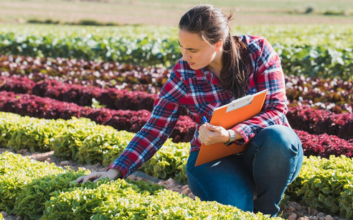


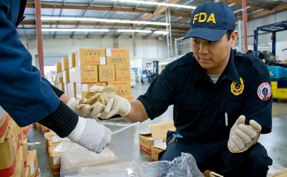


Slide 6

imagine
Food Safety
New
Paradigms

Slide 8

Smarter Food Safety
Together, a New Era of

