Slide 1
Modernizing Horizontal Approaches to Food Standards of Identity Modernization
Standards of Identity and Nutrition
Claudine Kavanaugh, PhD, MPH, RD
Senior Advisor for Nutrition Policy
Office of Food Policy and Response
Food and Drug Administration
September 27, 2019

Slide 2
Nutrition Innovation Strategy
(NIS)
FDA announced the NIS in March 2018 as part of an effort to reduce preventable death and disease related to poor nutrition.
Key goals of NIS:
  Empower consumers with information
  Facilitate industry innovation toward healthier foods that consumers want.
Agency is committed to engaging with stakeholders to explore how to best promote public health in the evolving food and beverage marketplace.

Slide 3
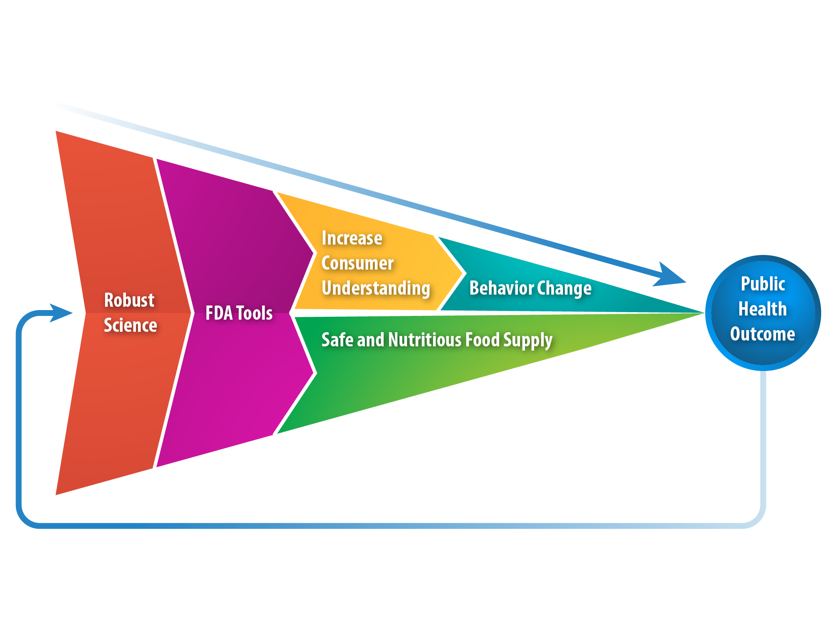
Conceptual Framework
FDA & Nutrition

Slide 4
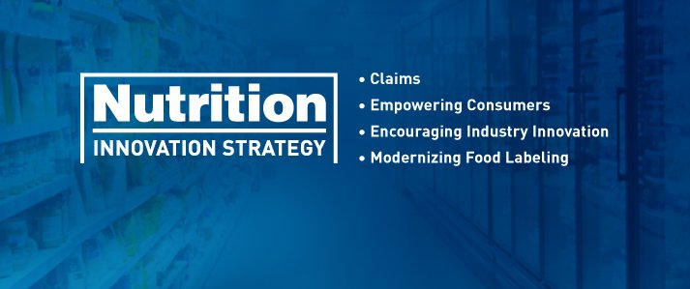
NIS Key Elements
Modernizing Claims
Modernizing Ingredient Labels
Implementing the Nutrition Facts Label and Menu Labeling
Reducing Sodium
Modernizing Standards of Identity

Slide 5
NIS Accomplishments
Current progress:
  Public Meeting in 2018
  Published final guidance documents for Nutrition Facts label and Menu labeling
  Consumer Education for menu labeling and the Nutrition Facts label
  Published guidance on Potassium Chloride Salt
  Continuing work on Sodium reduction targets
  Healthy Proposed rule

Slide 6
NIS and SOI
SOI modernization is a critical component of the NIS.
  There are over 280 standards of identity for widely consumed products such as milk, bread, juice, and pasta.
  Outdated SOI may stifle innovation and prevent manufacturers from producing healthier versions of standardized foods.

Slide 7
NIS Public Meeting
The FDA held a public meeting to discuss the Nutrition Innovation Strategy on July 26, 2018.
At the meeting, held two breakout sessions on standards of identity modernization
FDA received over 3,700 comments to the public meeting docket.
  FDA has reviewed all comments and is using this information to advance key NIS elements.

Slide 8
Horizontal Modernization
Approaches
What does FDA mean by horizontal approaches to modernization?
  Horizontal change: Modify SOI for cheeses to permit salt substitutes in place of sodium chloride.
  Products impacted: Standardized cheeses with mandatory salt requirements.
  Result: Modest sodium reductions in standardized cheeses.
  NIS Link: Support goal of reducing sodium in American diet.

Slide 9
History of SOI and Nutrition
Ensuring food meets nutritional expectations
  Requirement for mandatory Vitamin D fortification in evaporated milk.
  FDA requires fortification “[b]ecause evaporated milk products are used in infant feeding programs, and because the practice of fortifying evaporated milk products with Vitamin D is well accepted by nutritionists.” 43 FR 21670 (May 19, 1978)
§131.130 Evaporated milk.
(b) Vitamin addition. (1) Vitamin D shall be present in such quantity that each fluid ounce of the food contains 25 International Units thereof within limits of good manufacturing practice.

Slide 10
History of SOI and Nutrition
Supporting healthy diets
  Nutrient content claim regulations at 21 CFR 130.10 permit the modification of a standardized food to achieve a nutrition goal.
  Permitted nutrient content claims are discussed in 21 CFR 101.13 and include “reduced calorie” or “low fat.”
  FDA issued this regulation to assist consumers in maintaining healthy dietary practices. 58 FR 2446 (Jan. 6, 1993)

Slide 11
History of SOI and Nutrition
Addressing a documented public health need
  FDA issued regulations in 1996 to require folic acid be added to enriched cereal grains and related products that have a SOI under 21 CFR parts 136, 137, and 139 at levels ranging from 0.43 mg to 1.4 mg/lb of the finished product.
  Determined to be the most efficient way to help women of childbearing age to comply with the U.S. Public Health Service recommendation to consume at least 0.4 mg of folic acid each day and reduce their risk of having a pregnancy affected with spina bifida or other neural tube defects.

Slide 12

SOI in Nutrition Programs
SOI interface with federal feeding and nutrition programs
Specifications for USDA Foods may reference SOI
  National School Lunch Program
  Emergency Food Assistance Program

Slide 13
SOI and NIS Goals
SOI modernization goals:
  Protecting consumers against economic adulteration;
  Maintaining the basic nature, essential characteristics, and nutritional integrity of food; and
  Promoting industry innovation and providing flexibility to encourage manufacturers to produce more healthful foods.

Slide 14
