Slide 1
Standards of Identity History
& Current Status
Andrea Krause, Ph.D.
Food Technologist
Center for Food Safety and Applied Nutrition
Food and Drug Administration
September 27, 2019

Slide 2
A Look Back in Time…
All Photos from National Archives: https://www.flickr.com/photos/usnationalarchives
1906
1939-1960‘s
1993
2005
2018
1900
2020
1938
1977
1995
Today!

Slide 3
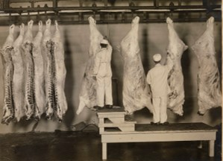
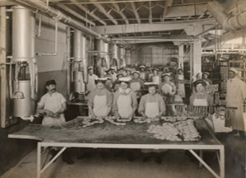
Pre-1906
Industrialization led to the increasing availability of mass-produced foods
Consumers did not know how foods were produced or what they contained
Patchwork of state laws for consumer protection
Legislation was introduced from 1879-1906, but was never enacted
1903: funding for the Bureau of Chemistry to investigate adulteration
Bureau of Chemistry developed more than 200 “recipes” for common foods
Top: Inspection of Carcasses, 1910
Bottom: Cudahy Packing Co., Omaha, Nebraska, 1910.
National Archives Collection.

Slide 4
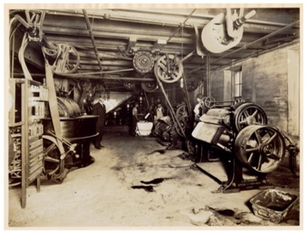
1906: Pure Food and Drug Act
Prohibited a food product if it contained "any added poisonous or other added deleterious ingredient which may render such article injurious to health“
Established definitions for adulteration and misbranding and subjected foods to seizure if they were in violation
Intended to prevent adulteration in the form of dilution, substitution of a valuable ingredient, concealment of inferiority, or use of harmful ingredients in foods
Candy factory inspection in 1908.
National Archives, Records of FDA

Slide 5
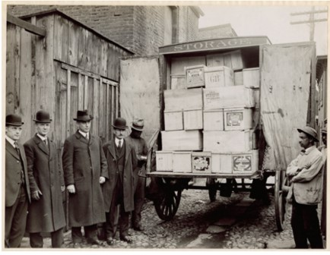
1906: Pure Food and Drug Act
Protected the consumer against contaminated food
  Prohibited products containing "filthy, decomposed, or putrid" ingredients
  Regulated the misbranding of food products only against presenting false and misleading information on the label
  Did not require foods to have an ingredient statement
No ability to establish mandatory standards
Allowed marketing of foods under ambiguous distinctive names
FDA inspectors seizing crates of contaminated frozen eggs.
National Archives, Records of FDA

Slide 6
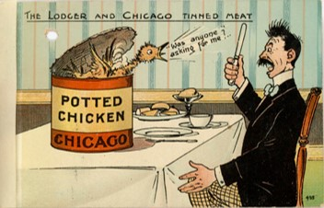
1938: Federal Food, Drug, and
Cosmetic Act (FD&C)
Contained provisions for establishing food standards to prevent economic adulteration and ensure that food meets consumer expectations
Section 401:
  “[w]henever in the judgment of the Secretary such action will promote honesty and fair dealing in the interest of consumers, he shall promulgate regulations fixing and establishing for any food, under its common or usual name so far as practicable, a reasonable definition and standard of identity, a reasonable standard of quality, and/or reasonable standards of fill of container.”
Letter from Acting Secretary of State Robert Bacon to U.S. Ambassador to the United Kingdom Whitelaw Reid Discussing Postcards Regarding the Chicago Meatpacking Industry, 1907.
National Archives Collection.

Slide 7
1938 FD&C Act: Highlights Pertaining to Standards
Section 403(g) a food is deemed misbranded if:
  “If it purports to be or is represented as a food for which a definition and standard of identity has been prescribed by regulations as provided by section 401, unless: (1) It conforms to such definition and standard, and (2) its label bears the name of the food specified in the definition and standard, and, insofar as may be required by such regulations, the common names of optional ingredients (other than spices, flavorings, and coloring) present in such food.”
Section 701(e)
  Issuance, amendment, or repeal of food standards required a formal trial-type administrative hearing procedure

Slide 8
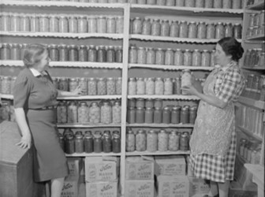
1938 FD&C Act: Highlights Pertaining to Standards
Required ingredient labeling only of optional ingredients in standardized foods
No preemption of state laws
  Provided only minimum standards
A product that purported to be or was represented as a standardized food but did not conform to the definition and standard could not be sold or had to be labeled as “imitation”
Consumers could rely on a common name which identified comparable products in a rapidly expanding marketplace
Created a “level playing field” for food producers
  Minimum amount of valuable ingredients
Mrs. Fidel Romero proudly exhibits her canned food, New Mexico.
National Archives Collection

Slide 9
USDA-FSIS Food Standards
Federal Meat Inspection Act (FMIA) and the Poultry Products Inspection Act (PPIA)
USDA-FSIS has established meat and poultry product standards of identity or composition
  9 CFR parts 319 and 381, subpart P for meat and poultry products, respectively

Slide 10
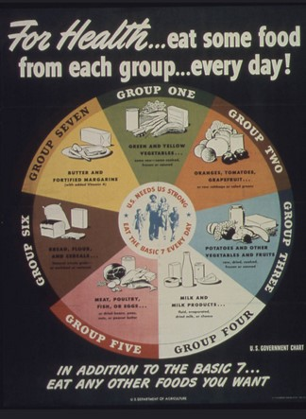
1939-1960’s
Flurry of activity: hearings, proposed rules, and final rules
“Recipe” approach:
  Detail about specific ingredients: mandatory and optional
  Some specified manufacturing procedures
  Added nutrients, those that had been lost in processing, or nutrients deemed critical to improving public health
  Specific methods of analysis
World War II Poster.
National Archives Collection

Slide 11
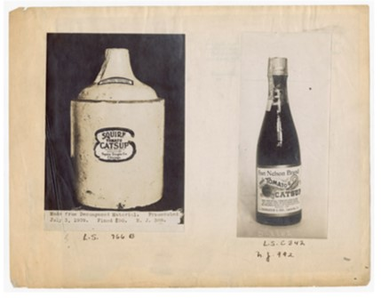
The Early Days of Food Standards
Standards of identity, quality and fill for canned tomatoes
Substandard canned tomatoes
Eggs, liquid whole eggs, liquid mixed eggs, frozen whole eggs, dried whole eggs, egg yolk, frozen egg yolk, dried egg yolk
Tomato puree, tomato paste, tomato catsup, tomato juice
Canned vegetables
Cream, whipping cream, evaporated milk, sweetened condensed milk, and dried skim milk
Canned peaches, canned apricots, canned pears and canned cherries
Fruit jams, fruit jellies, and fruit butters
Industrial age ketchup was often made from fermented tomato cores and skins, vinegar for flavor, and dyes to make it red.
National Archives, Records of FDA
Notes:
Added “Food” to the title

Slide 12
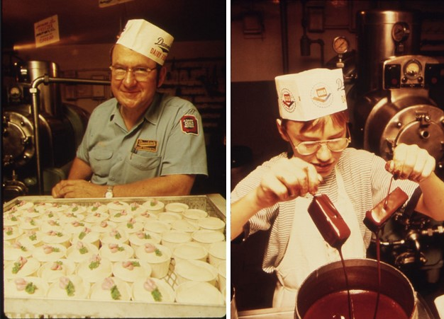
1960’s: Safe and Suitable
Passage of Food Additives Amendment of 1958 and Color Additive Amendments of 1960
FDA developed “safe and suitable” policy in 21 CFR 130.3(d) for functional ingredients
First applied this policy to frozen raw breaded shrimp (21 CFR 161.175)
Allowed additional flexibility in the selection of ingredients
Since this policy was established, many standards have been revised
Dairy Plant, New Ulm, MN
National Archives Collection

Slide 13
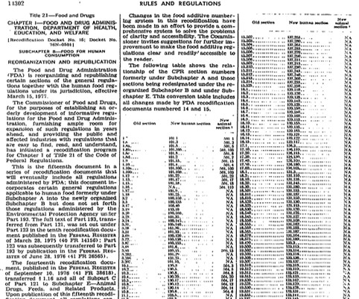
1977: Renumbering and Republication
42 FR 14302
Re-numbering into the CFR citations that we use today: 21 CFR 130-169

Slide 14
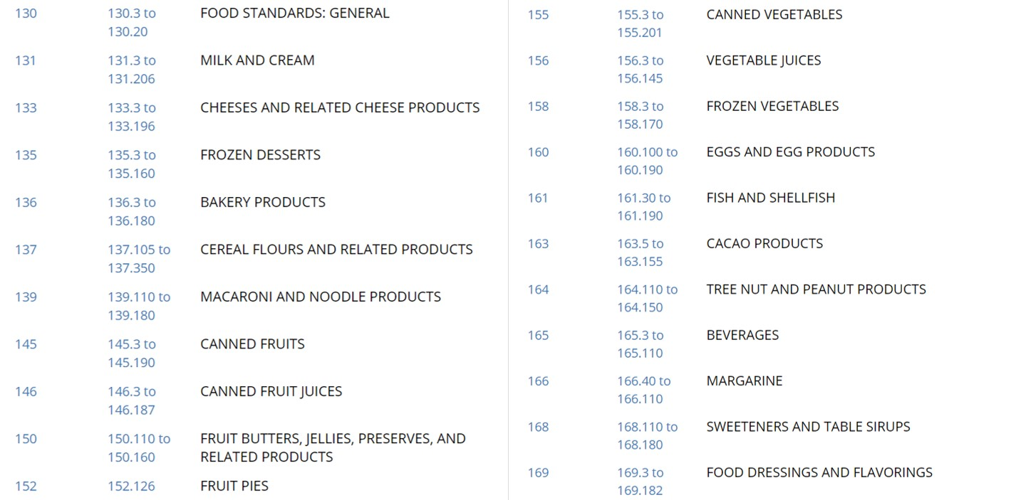
Modern Standards

Slide 15
Modern Standards

Slide 16
1990 FD&C Act Amendments:
Nutrition Labeling and Education Act
Section 403(i):
  Ingredient labeling: Removed language that limited full ingredient disclosure to non-standardized foods
  Color additives: Certified colors must be declared by their common or usual names rather than as “colorings”
Section 403A:
  Preemption: States may not establish/continue in effect a standard if it is not identical to the Federal standard
Section 701:
  Removed formal rule-making requirements for establishing, amending, or repealing standards for the vast majority of foods. The amendment or repeal of standards of identity for dairy products continues to be subject to formal rulemaking

Slide 17

1993: NLEA Labeling Changes
58 FR 2850-2896
Declaration of common or usual names of:
  All ingredients in standardized foods
  All color additives required to be certified by FDA
Other labeling changes:
  Provide uniform format for voluntary declaration of percentage ingredient information
  Permits inclusion of food source in the names of sweeteners defined in 21 CFR 168
  Require declaration of protein hydrolysates and identification of food source
  Require identification of a caseinate as a milk derivative in foods that claim to be non-dairy
  Require label declaration of sulfiting agents that have a functional effect in standardized food or at 10 ppm or more
  Provide certain exemptions for listing preservative coatings on fresh fruits and vegetables
After the 1906 Pure Food and Drugs Act passed, product labels advertised purity.
National Archives, Records of the Patent and Trademark Office

Slide 18
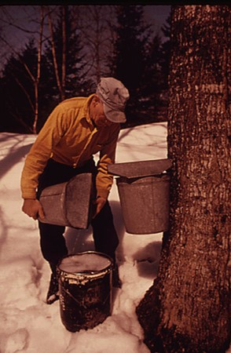
1993: NLEA Changes Affecting Standards
FDA also amended certain standards in 58 FR 2850
  Dairy products
  Maple syrup
  Canned tuna
Collecting maple sap in Vermont.
National Archives Collection

Slide 19
1993: NLEA
58 FR 2302
  Regulations defining nutrient content claims
  Established 21 CFR 130.10
    Modification of standardized foods to achieve a nutrition goal
    Covers foods that deviate from a standard due to compliance with an expressed nutrient content claim defined by FDA regulation
  Reduce the need for Temporary Marketing Permits

Slide 20
1995/1996 ANPRM
Advance notices of proposed rulemaking
  60 FR 67492 (FDA); 61 FR 47453 (USDA-FSIS)
Food Standards of Identity, Quality and Fill of Container; Common or Usual Name Regulations; Request for Comments on Existing Regulations
Requested public comment on the utility of food standards, naming conventions and provided several alternative approaches which could be considered
Five options were proposed

Slide 21
ANPRM Comments
FDA received 95 comments, USDA-FSIS received 28 comments
Most comments strongly supported the concept of food standards
Several requested that standards be eliminated
Comments expressed support for standards:
  Protecting consumers from fraudulent and substandard products
  Ensuring that products meet consumers' nutritional expectations/needs
  Lessening burden on consumers: nutrition labeling and ingredient declarations cannot substitute for food standards
  Ensuring a level playing field for industry because they provide direction and consistency across products
  Preventing interstate trade complications from variable state standards
  Providing a basis for International trade and harmonization

Slide 22
ANPRM Comments
However, few comments supported the existing food standards as currently written
Many requested that food standards be simplified, be made more flexible, or be clarified:
  Food standards be made more flexible to allow for alternative safe and suitable ingredients and alternative technologies
  Recommended limiting food standards to the name of the product and the essential characterizing properties of the product
  Recommended that FDA revise certain specific food standards
  Rescinding or modifying them on a case-by-case basis
  Recommended instituting advisory committees, contracting with independent groups, or forming nongovernment groups to revise food standards
  Establishing general or "guiding“ principles or a fundamental philosophy for reviewing food standards and revising them
  Revisions to standards should be initiated by petitions and supported by adequate data
  FSIS and FDA food standards should be consistent, and that we should attempt to harmonize our efforts

Slide 23
1997-2005
In 1996, FDA convened an internal agency task force to discuss the current and future role of food standards and to draft a set of principles for reviewing and revising FDA’s food standards regulations
In January 1997, a joint FDA and FSIS Food Standard Work Group was formed
The group determined the most suitable option was to create general principles to use when assessing food standards
  Used to revise, eliminate, or establish standards in response to petitions submitted by external parties or on FDA or USDA initiative

Slide 24
2005 Proposed Rule
70 FR 29214
FDA + USDA joint proposed rule
Proposal to establish a set of 13 general principles for food standards
  21 CFR 130.5 (FDA); 9 CFR 410.1 (USDA)
Establish the criteria that the agencies would use in considering whether to establish, revise, or eliminate a food standard
  Citizen petition
  Agency initiative

Slide 25
2005 Proposed Rule Comments
General support for idea of general principles
Specific comments on the 13 principles
Multiple comments that the agencies should allow greater flexibility

Slide 26
Horizontal Approach
Grocery Manufacturers Association (GMA) Citizen Petition (2006)
  Proposes amending 21 CFR part 130 to modernize food standards
  Docket ID: FDA-2007-P-0463-0367
Identified six categories of variations from food standards that GMA believed should be permitted to provide flexibility

Slide 27
2018
Nutrition Innovation Strategy (NIS) agency initiative
Public Meeting, July 2018
Docket for public comments on the multiple initiatives for the NIS
FDA has reviewed these comments and is working to proceed

Slide 28
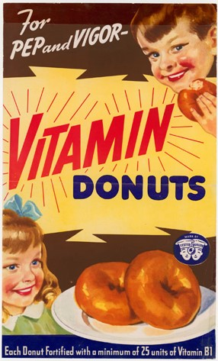
2019
Unified Agenda
  Revocation of several standards: Low-fat yogurt and non-fat yogurt, French dressing, Frozen cherry pie
  Re-open the comment period on the 2005 Proposed Rule
FDA has been holding listening sessions with stakeholders who are interested in specific standards upon request
Public meeting focusing on Standards
Docket for written comments, open after this meeting
The Doughnut Corporation sought endorsement from the Nutrition Division of the War Food Administration for its Vitamin Doughnuts campaign.
National Archives,
Records of the Agricultural Marketing Service

Slide 29


