Slide 1

Setting the Table for Healthy Eating
Presented by
March 2021

Slide 2

Introduction
2
Notes:
Welcome and thanks for joining us today. Let’s go around the room and introduce ourselves. Please tell us your name and say a few words about why you’re here and what you hope to get out of today’s program.

Slide 3
Objectives
To learn how to read and use the Nutrition Facts label on packaged foods and beverages.
To explore ways to make healthier food choices at home and while eating out.
3
Notes:
Our objective today is two-fold:
First, we’ll learn how to read and use the Nutrition Facts label to make informed food choices that support a healthy diet.
Second, we’ll explore how you can take an active role in making healthier choices at home and while eating out.

Slide 4
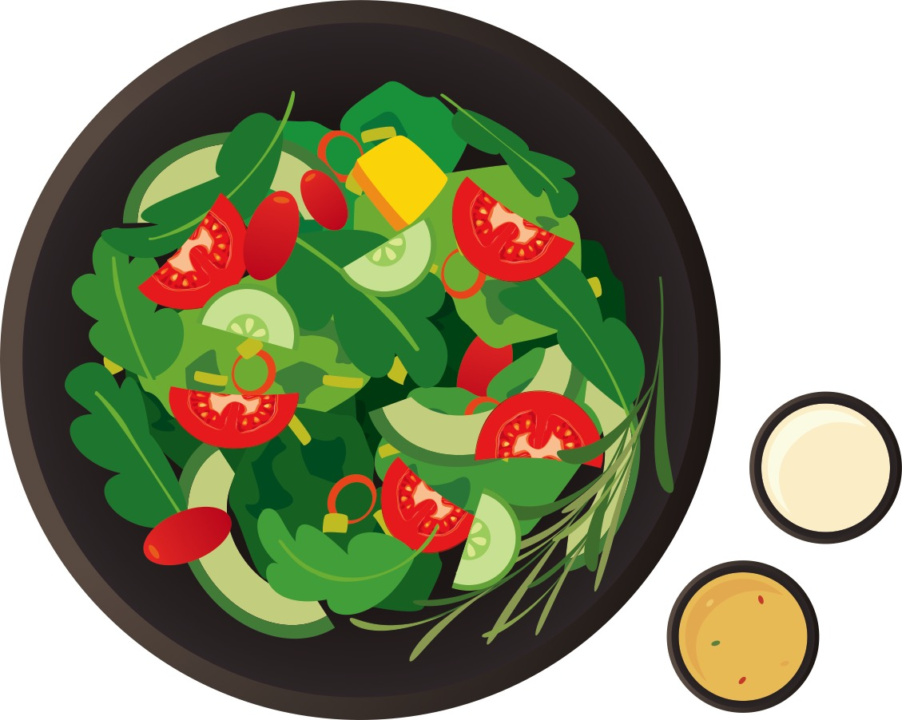

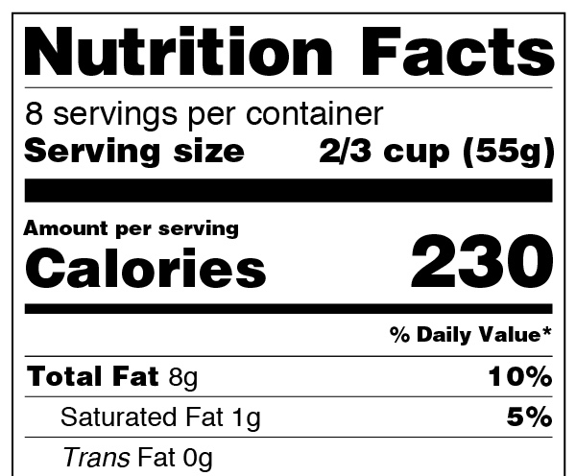
Key Messages
Small Changes Add Up.
Healthy Cooking and Eating Start with Smart Food Shopping.
Know Your Options When Eating Out.
4
Notes:
We hope you leave here today with three key messages about good nutrition practices:
Small changes add up. Focusing on small, manageable shifts to healthier food and beverage choices can lead to healthy, lifelong changes.
Healthy cooking and eating start with smart food shopping. Knowing how to read and use the Nutrition Facts label while shopping can help you make smart, healthy food purchasing decisions for you and your family.
Know Your Options When Eating Out. When you’re eating out, making informed choices can help support your health goals.

Slide 5
Definitions
Calories: the total number of calories, or “energy,” supplied from all sources (fat, carbohydrate, protein, and alcohol) in a serving of the food.
Nutrient: a substance in food that is used by the body to function and grow. Examples: fats, carbohydrates, proteins, vitamins, minerals, and water.
% Daily Value (%DV): shows how much a nutrient in a serving of the food contributes to a total daily diet. It can help you determine if a serving of the food is high or low in an individual nutrient and to compare food products.
5
Notes:
Before we start, let’s define some key terms.
First, what is a “calorie”? A calorie is a unit used to measure the energy content of foods and beverages. Our bodies need energy to function, grow, and thrive.
Second, what is a “nutrient”? A nutrient is a substance in food that our body uses to function and grow. We get nutrients from what we eat and drink. Fats, carbohydrates, proteins, vitamins, minerals, and water are all examples of nutrients. Fats, carbohydrates and proteins also supply calories to the foods and beverages that you eat and drink.
Third, what is “Percent Daily Value”? Percent Daily Value tells you how much a nutrient in a serving of the food contributes to a total daily diet. It can also help you determine if a serving of the food is high or low in a nutrient and to compare food products.
You’ll find both calories and Percent Daily Value useful terms to know when using the label to compare food products. Are there any questions?

Slide 6
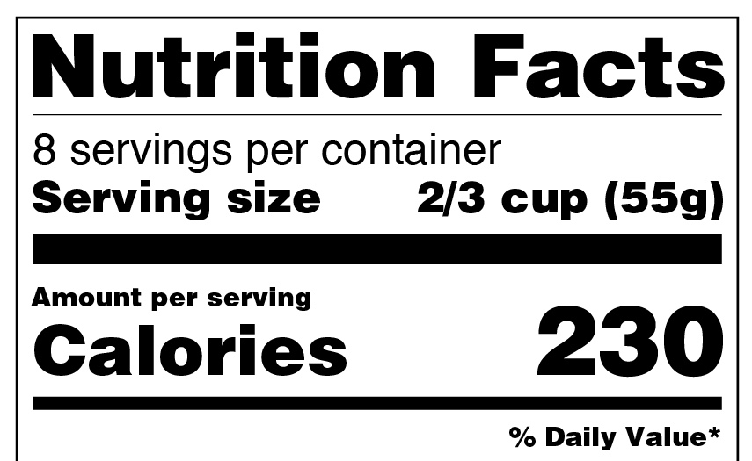
Nutrition Facts Label
6
Notes:
Now we’re going to turn our attention to the Nutrition Facts label. Once you become familiar with it and how to use it, the label can be an extremely valuable tool for you and your family to help you make healthier food choices.

Slide 7
Nutrition Facts Label
7
Notes:
Pose the following questions and ask for volunteers to help answer them:
Question: What is the Nutrition Facts label?
Answer: The Nutrition Facts label is regulated by the U.S. Food and Drug Administration and is required on most food and beverage packages. It provides important information about the nutritional content of foods and beverages.
Question: Where is the label usually found?
Answer: The label generally is found on food and beverage packaging and containers such as boxes, bags, bottles, and cans.
Question: Why is the Nutrition Facts label important?
Answer: The Nutrition Facts label is important because it can help us make informed decisions about the foods and beverages we consume – decisions that promote good nutrition and good health.
Question: Do you currently use the Nutrition Facts label? Why or why not?

Slide 8
Original (Current) Nutrition Facts Label
8
Notes:
Here’s the original Nutrition Facts label. Does it look familiar?
As I mentioned, the Nutrition Facts label provides nutrition information about foods and beverages. For example, it shows the serving size, the number of servings per container, the calories per serving, the various nutrients contained in the product per serving, and the Percent Daily Value of most nutrients per serving. Percent Daily Value helps you determine if a serving of food is high or low in a nutrient, and to compare food products.

Slide 9
New, Improved Nutrition Facts Label
9
Notes:
Now, let’s take a closer look at the new Nutrition Facts label.

Slide 10
Learning Activity
Original Label vs. New Label: A Side-By-Side Comparison
10
Notes:
The U.S. Food and Drug Administration (FDA) has updated the Nutrition Facts label.
Has anyone seen the new label?
You may already be seeing the new label on food and beverage packages in local stores.
What differences do you see between the original and the new Nutrition Facts label? Let’s go through them as a group:
Serving sizes have been updated to be more realistic to reflect what people actually eat and drink.
The number of calories is also in a larger, bolder font.
Calories from Fat has been removed, since research shows that the type of fat a person consumes is more important than the amount.
Added sugars, in grams and as a Percent Daily Value, is now required on the label. Grams aren’t required for single-ingredient sugars, like table sugar, maple syrup, or honey.
The list of nutrients has been updated.
Vitamin D and potassium are now required on the label because Americans don’t always get the recommended amounts.
Vitamins A and C are no longer required since deficiencies of these vitamins are rare today.
The actual amount (in milligrams or micrograms) in addition to the Percent Daily Value must also be listed for vitamin D, calcium, iron, and potassium.
The daily values for nutrients have been updated based on new scientific evidence. The footnote at the bottom of the label has also changed to better explain the meaning of Percent Daily Value.

Slide 11
What the New Nutrition Facts Label Tells Us
1. Servings per container
The total number of servings in the entire food package or container
2. Serving size
The amount of a food that most people typically eat at one time. People should adjust the amount of food they eat based on calorie and nutritional needs. The serving size is a guide rather than a recommendation of how much to eat.
The nutrition information listed on the label is based on the serving size listed on the label.
11
Notes:
Let’s start at the top. The first line tells you the servings per container, which is the total number of servings in the entire food package or container. It’s common for one package of food to contain more than one serving.
The second line is serving size. The serving size is based on the amount of food people typically eat at one time and is not a recommendation of how much you should eat. The nutrition information listed on the Nutrition Facts label is based on the serving size listed on the label, and, if there is a second column based on the amount per package, that column of nutrition information will be based on the entire package the entire package. Serving size is shown as a common household measure that is appropriate to the food (such as cup, tablespoon, piece, slice, or jar), followed by the metric amount. When comparing calories and nutrients in different foods, always check the serving size to make an accurate comparison.

Slide 12
What the New Nutrition Facts Label Tells Us
3. Calories per serving
General guideline: 2,000 calories per day.
Remember - calorie needs are different for each person.
12
Notes:
The next line is “Calories per serving.”
Calories refer to the total number of calories, or “energy,” supplied from all sources (fat, carbohydrate, protein, and alcohol) in a serving of the food.
To achieve or maintain a healthy weight, balance the number of calories you eat and drink with the number of calories your body uses. 2,000 calories a day is used as a general guide for nutrition advice. Your calorie needs may be higher or lower and vary depending on your age, sex, height, weight, and level of physical activity. Later, you’ll learn how to find out your personal calorie needs.

Slide 13
What the New Nutrition Facts Label Tells Us
4. % Daily Value (%DV)
%DV = how much a nutrient in a serving of the food contributes to a total daily diet. It helps you determine if a serving of food is high or low in an individual nutrient and to compare food products.
5% DV or less of a nutrient per serving is considered low
20% DV or more of a nutrient per serving is considered high.
13
Notes:
Next, we have the Percent Daily Value. Percent Daily Value, or percent DV, shows how much a nutrient in a serving of the food contributes to a total daily diet. Use the %DV to determine if a serving of the food is high or low in an individual nutrient and to compare food products – but make sure the serving size is the same.
As a general guide: 5% DV or less of a nutrient per serving is considered low, and 20% DV or more of a nutrient per serving is considered high.
Please note, some nutrients, such as protein and trans fat, on the Nutrition Facts label do not have a %DV, so use the number of grams as a guide.

Slide 14
What the New Nutrition Facts Label Tells Us
5. List of Nutrients
Nutrients to get less of: saturated fat, trans fat, sodium, and added sugars.
Nutrients to get more of: dietary fiber, vitamin D, calcium, iron, and potassium.
14
Notes:
The label lists the different nutrients contained in the food product. Use this section of the label to help choose products that are lower in nutrients you want to get less of and higher in nutrients you want to get more of.
Nutrients to get less of include saturated fat, trans fat, sodium, and added sugars. Most Americans exceed the recommended limits for these nutrients—and diets higher in these nutrients are associated with an increased risk of developing some health conditions (such as cardiovascular disease and high blood pressure). Compare and choose foods to get less than 100% DV of these nutrients each day. Note: Trans fat does not have a %DV. So, use the number of grams for comparison and keep the intake of trans fat as low as possible.
Nutrients to get more of include dietary fiber, vitamin D, calcium, iron, and potassium.
Many Americans do not get the recommended amount of these nutrients. Compare and choose foods to get 100% DV of these nutrients on most days.

Slide 15
Learning Activity
What the New Nutrition Facts Label Tells Us
How many calories are in one serving?
How many servings are in a package?
15
Notes:
Let’s test our knowledge.
What is the serving size of this food?
How many calories are in one serving?
How many servings are in the entire container?
How many calories are in the entire container?
Question: How did you get that answer?
Answer: By multiplying the servings per container by the calories per serving.
How much sodium is in the entire container in mg? What about the %DV of sodium?
Keep in mind, if you eat or drink two (or more) servings of the food or beverage, you are getting double (or more of) the calories and nutrients that are listed on the label.

Slide 16
Facts About Fat
Provides calories, helps absorb vitamins, and supports several key body processes.
Saturated and Trans Fat
Required on Nutrition Facts label.
In general, diets higher in saturated fat and trans fat are associated with increased levels of total cholesterol and/or low-density lipoprotein (LDL or "bad") cholesterol.
Found in foods like animal fats (e.g., butter), vegetable shortening, meat and poultry, whole and 2% dairy products, mixed dishes (such as burgers, sandwiches, and pizza), processed meats and poultry products (such as bacon, hot dogs, and some luncheon meats), baked goods, snack foods, and sweets.
Monounsaturated and Polyunsaturated Fats
Voluntary on the Nutrition Facts label.
Found in foods like avocados, fish, nuts, seeds, olives, and vegetable oils.
16
Notes:
The Nutrition Facts label shows the total amount of fat contained in the product and its Percent Daily Value, as well as two types of fat: saturated and trans fats.
Dietary fat is a necessary nutrient for the human diet. It provides energy, helps the body absorb important fat-soluble vitamins, is important for growth and development, and supports several key body processes.
Saturated fat is found in a variety of foods including animal fats (such as butter or lard), meats and poultry, processed meats and poultry products (such as bacon and hot dogs), dairy products, snack foods, sweets, and spreads (such as butter, stick margarine, cream cheese, and sour cream).
Trans fat is found naturally in small amounts in some animal products (such as meats and dairy products). Trans fat formed artificially is found primarily in foods that contain partially hydrogenated oils, such as baked goods, coffee creamer, fried fast foods, ready-to-use frostings, refrigerated dough products, frozen pizza, snack foods, stick margarine, and vegetable shortening. It’s important to note that as of 2018 partially hydrogenated oils in the U.S. food supply are not generally recognized as safe, which means that most uses of artificial trans fat have been eliminated. There is evidence that diets higher in saturated fat and trans fat are associated with increased levels of total cholesterol and/or low-density lipoprotein (LDL or "bad") cholesterol—which, in turn, are associated with an increased risk of developing cardiovascular disease, the leading cause of death in both men and women in the United States. Replacing saturated fats with unsaturated fats, especially polyunsaturated fats, which I will share examples of as we go on, is associated with reduced levels of total cholesterol and of low-density lipoprotein-cholesterol. The Nutrition Facts label shows the amount of saturated fat in grams and the Percent Daily Value and the amount of trans fat in grams for a serving of the food.
When you’re shopping for food to cook at home or when eating out, compare and choose foods to get less than 100% DV (about 20 grams) of saturated fat each day and keep the intake of trans fat as low as possible. Look for ways to replace saturated fat with monounsaturated and polyunsaturated fats when possible.
Food manufacturers may also voluntarily list the amount in grams per serving of monounsaturated fat and polyunsaturated fat. Monounsaturated and polyunsaturated fats can be found in foods like avocados, fish, nuts, seeds, and vegetable oils such as canola, olive, and soybean oils.
Before we go on, are there any questions?

Slide 17
What are Added Sugars?
Sugars added during food processing, or are packaged as such (e.g., a bag of table sugar).
Sugars added to your diet such as maple syrup on pancakes or honey or sugar in your tea or coffee.
Sugars from concentrated fruit or vegetable juices (e.g. often used in jams and jellies).
17
Notes:
What are “Added Sugars”?
Added sugars includes sugars that are either added during the processing of foods, or are packaged as such (for example, a bag of table sugar), sugars from syrups and honey, and sugars from concentrated fruit or vegetable juices. It also includes sugars that you may add to your diet such as syrup on pancakes or sugar in your tea or coffee.

Slide 18
Where to Find Added Sugars?
On the new Nutrition Facts label
Ingredient list
Common names for added sugars:
Sugar, brown sugar, corn syrup, dextrose, fruit juice concentrates, glucose, high-fructose corn syrup, honey, lactose, maltose, malt syrup, maple syrup, molasses, and sucrose.
Added sugars are often found in:
Baked goods, desserts, salad dressings, sauces, spreads, condiments, gravies, sugar-sweetened beverages, and sweets.
18
Notes:
Added sugars are included on the new Nutritional Facts label in the “Total Carbohydrate” section under “Total Sugars.” You can also look for added sugars on the ingredient list on food packages. Examples include: Brown sugar, corn syrup, dextrose, fruit juice concentrates, glucose, high-fructose corn syrup, honey, lactose, maltose, malt syrup, maple syrup, molasses, and sucrose. We’ll talk more about other things to look for on the ingredient list later.
Can you guess what some of the main sources of added sugars in the typical American diet might be?
Answers:
Baked goods (such as cakes, cookies, pastries, and pies)
Desserts (such as ice cream and puddings)
Salad dressings, sauces, spreads, condiments, and gravies
Sugar-sweetened beverages (such as energy drinks, flavored waters, fruit drinks, soft drinks, sports drinks, and sweetened coffee and tea)
Sweets (such as candies, jams, sweet toppings, and syrups)

Slide 19
How Much Added Sugar is Too Much?
Too Much Added Sugar:
For a 2,000 calorie diet - more than 50 grams or 12 teaspoons per day
(To convert grams to teaspoons, divide by 4.)
Check the Nutrition Facts Label
5% DV or less per serving = low in added sugars
20% DV or more per serving = high in added sugars
19
Notes:
How much added sugars is too much, and why?
When sugars are added to foods and beverages, it increases calories without contributing important nutrients. Diets high in calories from added sugars can make it difficult for people to meet their daily recommended levels of important nutrients while staying within calorie limits. The Dietary Guidelines for Americans recommend consuming less than 50 grams per day of added sugars based on a 2,000-calorie daily diet. This is equal to about 12 teaspoons of added sugars per day (to convert grams to teaspoons, divide the number of grams by four). You can also check %DV on the Nutrition Facts label to see if a food is high or low in added sugars. 5% DV or less per serving of added sugars is considered low, and 20% DV or more per serving of added sugars is considered high.

Slide 20

Learning Activity
Nutrients and %DV
20
Notes:
Now, let’s test our knowledge. Take a look at this Nutrition Facts label. Which nutrients have a high %DV? Which nutrients have a low %DV? Which of these nutrients do you want to get more of? Which of these nutrients do you want to get less of?

Slide 21

Bringing Nutrition Into Your Daily Life
21
Notes:
Good nutrition can lead to better health for you and your family. Knowing how to make healthier food choices when shopping, cooking, and eating is the key to improving your nutrition. And, of course, the Nutrition Facts label can help. Let’s talk about some practical ways to bring good nutrition into your daily life.

Slide 22

Healthy Cooking and Eating Starts with Smart Food Shopping
22
Notes:
Healthy eating starts with smart food shopping and cooking. Can you think of some instances when your food shopping choices have influenced how you ate? For example, do you think you usually cook and eat healthier meals at home when you have planned ahead and purchased items you need for recipes at the store? Does anybody want to share?

Slide 23

Shop Smart!
Read the Nutrition Facts label and ingredient list.
Consult your “Quick Tips for Reading the Nutrition Facts Label” wallet card.
Eat before you shop.
Use fresh vegetables and fruits that are in season.
Try canned or frozen fresh fruits and vegetables.
Think outside the store with Farmers markets and farm stands.
23
Notes:
As mentioned, healthy eating starts with smart food shopping and cooking. Here are some ideas on how to be a smart shopper.
Always check the Nutrition Facts label.
Consult your “Quick Tips for Reading the Nutrition Facts Label” wallet card (see Handout #3).
Eat before you shop. Grocery shopping hungry can lead to impulse buying and unhealthy food choices.
Use fresh vegetables and fruits that are in season. They are easy to get, have more flavor, and are usually less expensive.
Try canned or frozen fruits and vegetables. Canned and frozen items may be less expensive than fresh. For canned items, choose fruit canned in 100% fruit juice without added sugars and vegetables with “low sodium” or “no salt added” on the label.
Think outside the store. Farmers markets and farm stands can be great options for picking up fresh produce at a discount.

Slide 24

Shop Smart!
Compare foods:
Serving size
Calories: find out how many you need at https://www.fda.gov/downloads/Food/LabelingNutrition/UCM606203.pdf
%DV
  5% DV or less per serving of a nutrient = low
  20% DV or more of a nutrient = high
24
Notes:
Use the label to compare foods. When comparing products for calories and nutrients, be sure to check the serving size and be aware of any differences. The serving size is based on the amount of food typically eaten at one time and is not a recommendation of how much to eat.
Also, to achieve or maintain a healthy body weight, balance the number of calories you eat and drink with the number of calories your body uses. To find out your personal calorie needs, visit https://www.fda.gov/downloads/Food/LabelingNutrition/UCM606203.pdf. Then, compare and choose food products with calories that fit your needs.
Look at Percent Daily Value. 5% Daily Value or less per serving of a nutrient is considered low. 20% Daily Value or more per serving of a nutrient is considered high. Choose products lower in nutrients you want to get less of, and higher in nutrients you want to get more of. Next, we’ll talk more about what those might be. Are there any questions?

Slide 25
Nutrients to Get LESS Of:
Saturated fat
Trans fat
Sodium
Added sugars
25
Notes:
Most Americans exceed the recommended limits for saturated fat, trans fat, sodium, and added sugars —and diets higher in these nutrients are associated with an increased risk of developing some health conditions (such as cardiovascular disease and high blood pressure). Compare and choose foods to get less than 100% DV of these nutrients each day. Note: Trans fat does not have a %DV. So, use the number of grams for comparison and keep the intake of trans fat as low as possible.

Slide 26
Nutrients to Get MORE Of:
Dietary fiber
Vitamin D
Calcium
Iron
Potassium
26
Notes:
Many Americans do not get the recommended amounts of dietary fiber, vitamin D, calcium, iron, and potassium. Compare and choose foods to get 100% DV of these nutrients on most days.

Slide 27

Food Shopping Tips
Choose bread products that are higher in fiber.
Make half of your grains whole grains.
In the dairy aisle, choose fat free (skim) or low-fat (1%) products.
Choose snacks with less sodium and added sugar.
Choose more fruits and vegetables (fresh, frozen, or canned)
Look for low-sodium/unsweetened versions of canned and frozen products.
Drink water instead of sugar-sweetened beverages.
27
Notes:
Here are a few ways you can make healthy choices at the grocery store.
In the bread aisle, look for breads that are higher in dietary fiber.
Make half of your grains whole grains. When looking for whole grains check the ingredient list and choose products that name a whole-grain ingredient first on the list. Look for “whole wheat,” “brown rice,” “bulgur,” “buckwheat,” “oatmeal,” “whole-grain cornmeal,” “whole oats,” or “whole rye.”
Try low- or non-fat dairy products like skim milk, non-fat yogurt, and reduced fat cheese that contain less saturated fat and sodium than full-fat products and can be healthier choices.
Compare snacks and choose versions that are lower in saturated fat, sodium, and added sugars. Fruits and vegetables are always good snack options.
Choose more fruits and vegetables - fresh, frozen, or canned.
When buying frozen or canned foods like fruits, vegetables, soups, and beans, look for versions without added sauces, and labeled low- or no-sodium and “unsweetened,” or “no sugar added.”
Instead of buying sugar-sweetened beverages, bottle your own water to carry with you. It’s easy on your wallet and has zero calories!
Keeping this advice in mind and as space permits, if you see an item on sale, stock up. Freeze or store extras until you need them.

Slide 28
Check the ingredient list
What ingredients do you want to get more of?
What ingredients do you want to get less of?
28
Notes:
In addition to the Nutrition Facts label, the ingredient list is also a helpful tool. The ingredient list shows each ingredient in a food by its common or usual name. Ingredients are listed in descending order by weight, so the ingredient with the greatest contribution to the product is listed first, and the ingredient contributing the least by weight is listed last.
Check the ingredient list on foods before you buy them. Use the list to find out whether a food or beverage contains ingredients that are sources of nutrients you want to get more of, such as whole grains, and sources of nutrients you want to get less of, such as added sugars and partially hydrogenated oils (trans fat). Before we continue, are there any questions?

Slide 29

Learning Activity
What are three things you can do to make healthier food choices while food shopping?
29
Notes:
Based on what you’ve learned here today, can you make a list of three changes you can make to choose healthier foods while grocery shopping? Does anybody want to share?

Slide 30
Making Healthy Choices at Home- Recommendations from USDA’s MyPlate
30
Notes:
It’s also important to make healthy food choices at home.
Let’s go over some practical tips together.

Slide 31
Making Healthy Choices at Home- Recommendations from USDA’s MyPlate
Focus on making healthy food and beverage choices from all five food groups.
Focus on variety, amount, and nutrition.
Make half your plate fruits and vegetables.
Make leaner and more varied selections of protein foods.
Make at least half your grains whole grains.
Move to fat-free (skim) or low-fat (1%) dairy milk or yogurt (or lactose-free dairy or fortified soy versions).
Choose foods and beverages with less added sugars, saturated fat, and sodium.
31
Notes:
Focus on making healthy food and beverage choices from all five food groups including vegetables, fruits, grains (especially whole grains), protein foods, and dairy or fortified soy alternatives to get the nutrients you need.
Focus on variety, amount, and nutrition. All food and beverage choices matter.
Make half your plate fruits and vegetables. Focus on whole fruits and vary your veggies.
When eating protein foods, choose seafood and lean proteins like skinless chicken and lean cuts of meat. Don’t forget about other sources of protein like beans, peas, lentils, eggs, soy products, nuts, and seeds.
Try whole grains (such as oatmeal, popcorn, and brown rice) as snacks or side dishes and switch from refined to whole grain versions of commonly eaten foods (such as breads, cereals, and pasta). Whole grains are important sources of nutrients such as zinc, magnesium, B vitamins, and fiber.
Try fat-free (skim) or low-fat (1%) dairy products (such as milk, cheese, and yogurt). If you are lactose intolerant, choose low-lactose and lactose-free dairy products, or fortified soy beverages to get your calcium. Dairy products provide important nutrients like calcium and Vitamin D.
Choose foods and beverages with less added sugars, saturated fat, and sodium.

Slide 32

Make Healthy Choices at Home
Use MyPlate as a guide to plan weekly meals.
Check out https://www.myplate.gov/eat-healthy/healthy-eating-budget/make-plan for meal planning tips.
Cook healthy meals with a friend or family member.
32
Notes:
Use MyPlate as a guide to plan weekly meals. You don’t have to have every food group in each meal, but aim to include all of the food groups throughout the day by making smart choices at meals and snacks. Use the MyPlate Plan to help you plan your meals throughout the week: https://www.myplate.gov/myplate-plan
Check out https://www.myplate.gov/eat-healthy/healthy-eating-budget/make-plan for meal planning tips.
Ask a friend or family member to join you in planning and preparing meals. Cooking together can be a fun, easy, creative activity.

Slide 33

Tips for Healthy Cooking and Eating at Home
Cooking at home can help you eat healthier.
Prepare ingredients ahead of time.
Try healthy, new ways to prepare food.
Choose simple, healthy recipes that call for ingredients like fresh vegetables and lean proteins.
Visit the MyPlate website for recipes and cookbooks: https://www.myplate.gov/myplate-kitchen/recipes
Cook with herbs, spices, or no-salt seasonings, which add flavor without adding sodium.
Chill and save leftovers to eat later.
33
Notes:
Save time by preparing ingredients ahead of time. For example, chop the vegetables for the dinner recipe you plan to make in advance. Put each of the chopped vegetables in a separate container or storage bag. Keep the chopped vegetables in the refrigerator until you are ready to start cooking.
Try healthy, new ways to prepare food. Instead of frying, try baking, broiling, grilling, or steaming. These cooking methods often do not add extra calories.
Collect and try simple, nutritious recipes. You’ll find plenty of healthy and delicious recipes online, in cookbooks, or in magazines. Ask friends and family members for their favorite healthy recipes. Organize recipes online, in a mobile app, or in a file box or binder.
Visit the MyPlate website for new recipes, cookbooks, and more healthy cooking resources: https://www.myplate.gov/myplate-kitchen/recipes
Add flavor to dishes with herbs, spices, or no-salt seasoning blends instead of using salt, butter, or creamy sauces. Prepare extra servings of your favorite healthy dish to eat throughout the week.
Make leftovers part of your plan, which can save time. You’ll find all the information we’ve just covered in Handout #2: Tips for Bringing Nutrition into Your Daily Life.
Are there any questions before we move on?

Slide 34

Know Your Options When Eating Out
34
Notes:
In today’s busy world, Americans eat and drink about one-third of their calories from foods prepared away from home. Eating out can be convenient and fun, but it can be challenging when you want to make healthy choices. In this next section, we’ll explore how to make healthy food and beverage choices when you’re away from home.

Slide 35
Know Your Options When Eating Out
Find out your personal daily calorie needs.
Visit https://www.fda.gov/downloads/Food/LabelingNutrition/UCM606203.pdf.
Look for calorie information at chain restaurants and other similar retail food establishments.
Compare calorie information to help you make better decisions before you order.
35
Notes:
Meals eaten away from home are more likely to be higher in calories, sodium, and saturated fat than home-cooked meals. Here are simple steps you can take to make healthier choices when eating out.
The first step is to find out what your total daily calorie needs are. As we have discussed, 2,000 calories a day is used as a general guide for nutrition advice. Your calorie needs may be higher or lower and vary depending on your age, sex, and physical activity level.
You can find your personal daily calorie needs at https://www.fda.gov/downloads/Food/LabelingNutrition/UCM606203.pdf. Once you know your number, you can monitor your calorie intake throughout the day.
Calorie information can be found on menus and menu boards of restaurants and other food establishments that are part of a chain of 20 or more locations, and written nutrition information is available upon request. This will help you know your options and make it easier to eat healthy when eating out.
Once you have the calorie and nutrition information, you can make the choice that’s right for you.

Slide 36

Where to Find Calorie and Nutrition Information
Look for calories on menus, menu boards, self-service foods, and foods on display at certain food establishments that are part of a chain with 20 or more locations, such as:
Chain restaurants
Chain coffee shops
Bakeries
Ice cream shops
Self-service food locations
Movie theaters
Amusement parks/convenience stores
Additional nutrition information, such as saturated fat, sodium, and dietary fiber, is available upon request. Don’t hesitate to ask!
36
Notes:
Look for calories on menus, menu boards, self-service foods, and foods on display at certain food establishments that are part of a chain with 20 or more locations, such as:
Chain restaurants
Chain coffee shops
Bakeries
Ice cream shops
Self-service food locations, such as buffets and salad bars
Movie theaters
Amusement parks/convenience stores
Places you won’t see calorie information include:
Foods sold at deli counters and typically intended for further preparation
Food purchased in bulk in grocery stores, such as loaves of bread from the bakery section
Bottle of liquor displayed behind a bar
Food in transportation vehicles, such as food trucks, airplanes, and trains
Food on menus in elementary, middle, and high schools
In addition to calorie information, food establishments that are part of a chain of 20 or more locations are also required to provide written nutrition information such as saturated fat, sodium, and dietary fiber upon request. So, don’t hesitate to ask for more nutrition information.

Slide 37
Know Your Options When Eating Out
Here are three steps for making eating out choices that are healthy and delicious:
Find out your calorie needs.
Look for calorie and nutrition information.
Make the best choice for you
37
Notes:
Find out your calorie needs. Knowing your calorie needs is important to manage your daily food and beverage choices. You can use 2,000 calories a day as a guide, but your calorie needs may vary based on your age, sex, and physical activity level. To find out your specific calorie needs, visit https://www.fda.gov/downloads/Food/LabelingNutrition/UCM606203.pdf.
Look for calorie and nutrition information. This information can help you make informed and healthy meal and snack choices.
Make the best choice for you and your family.

Slide 38
Know Your Options When Eating Out
Make the best choice for you:
Comparing calorie and nutrition information can help you make better decisions before you order.
Side dishes can add many calories to a meal.
Calorie information can help you decide how much to enjoy now and how much to save for later.
Asking for sauces and salad dressings on the side lets you choose how much to use.
Foods described with words like creamy, fried, breaded, battered, or buttered are typically higher in calories than foods described as baked, roasted, steamed, grilled, or broiled.
Calories from beverages add up quickly.
38
Notes:
Comparing calorie and nutrition information can help you make better decisions before you order.
Side dishes can add many calories to a meal. Steamed, grilled, or broiled vegetables and fruit are often lower-calorie options. With calorie information, you can make the best choice for you.
Calorie information can help you decide how much to enjoy now and how much to save for later.
Asking for sauces or salad dressings on the side lets you choose how much to use.
Foods described with words like creamy, fried, breaded, battered, or buttered are typically higher in calories than foods described as baked, roasted, steamed, grilled, or broiled. Use calorie information to help you make the choice that is right for you.
Calories from beverages add up quickly. With calorie information, you can find lower-calorie options.

Slide 39
Learning Activity
What actions can you start taking today to make healthier choices while eating away from home?
1.
2.
3.
39

Slide 40
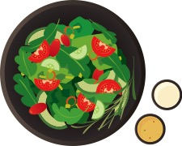
Small Changes Add Up!
Always…
Try to choose from the five food groups: vegetables, fruits, grains (especially whole grains), protein foods, and dairy.
When eating out…
Compare calorie and nutrition
information to make the
best choice for you.
At home…
Try baking, broiling, steaming,
or grilling instead of frying.
Get creative with herbs and spices.
40
Notes:
Remember, small changes add up. Making healthier choices doesn’t have to mean making big changes all at once. Focusing on manageable, small changes in your shopping, cooking, and eating habits can lead to healthy, lifelong changes.
When shopping, cooking at home, or eating out, choose from the five food groups: vegetables, fruits, grains (especially whole grains), protein foods, and dairy.
When eating out, compare calorie and nutrition information to help you make better decisions before you order.
Cook with herbs and spices to add flavor to meals without adding sugar or salt.

Slide 41
Recap: The New Label: What’s New?
41
Notes:
Now, let’s take our last few minutes to review the main points we’ve covered today:
The FDA’s Nutrition Facts label is your daily tool for good nutrition. The new label features:
Servings size in bolder font.
Updated serving sizes.
Calories in larger font.
Updated daily values.
Added Sugars.
Changes in required nutrients with actual amounts.
And a new and easier-to-understand footnote that better explains percent Daily Value.

Slide 42
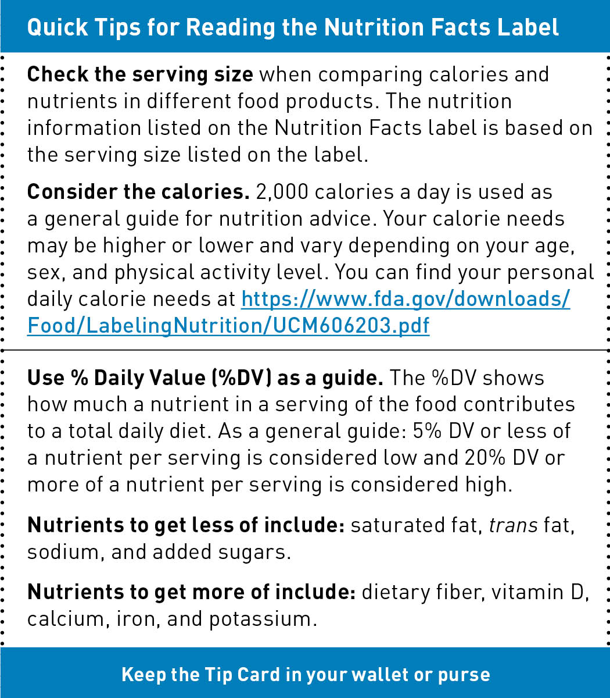
Recap: Making Healthy Choices
At the store:
Shop smart.
Look for the Nutrition Facts label
on food and beverage packages.
Use your Quick Tips wallet card.
42
Notes:
At the store:
Shop smart.
Look for the Nutrition Facts label on food and beverage packages.
Use your Quick Tips wallet card.

Slide 43
Recap: Making Healthy Choices
At home:
Choose foods from all five food groups.
Plan weekly meals.
Try new, healthy recipes and ways to prepare food.
Make time to cook and eat together.
43
Notes:
At home:
Choose foods from all five food groups.
Plan weekly meals.
Try new, healthy recipes and ways to prepare food.
Make time to cook and eat together.

Slide 44

Recap: Know Your Options When Eating Out
When eating out:
Find out your daily calorie needs. Use https://www.fda.gov/downloads/Food/LabelingNutrition/UCM606203.pdf.
Check calorie and nutrition information.
Make the best choice for you.
44
Notes:
When eating out:
Find out your calorie needs. Visit https://www.fda.gov/downloads/Food/LabelingNutrition/UCM606203.pdf.
Check calorie information on menus and menu boards when purchasing, and don’t hesitate to ask for additional nutrition information.
Make the best choice for you:
Compare foods – use your Quick Tips wallet card.
Side dishes can add many calories to a meal. Steamed, grilled, or broiled vegetables and fruit are often lower-calorie options. With calorie information, you can make the best choice for you.
Calorie information can help you decide how much to enjoy now and how much to save for later.
Asking for sauces or salad dressings on the side lets you choose how much to use.
Foods described with words like creamy, fried, breaded, battered, or buttered are typically higher in calories than foods described as baked, roasted, steamed, grilled, or broiled. Use calorie information to help you make the choice that is right for you.
Calories from beverages can add up quickly. With calorie information, you can find lower-calorie options.

Slide 45

Final Questions or Comments?
45
Notes:
Before we end, are there any final questions or comments about any of the topics we covered today? If you still have questions after you leave here today, review the information on your handouts, and feel free to contact me.

Slide 46

For More Information:
Contact:
First Lastname
(XXX) XXX-XXXX
xxxxx@xxxxx.xxx
Visit FDA’s website.
Review your handouts.
46
Notes:
Please feel free to contact me if you have questions or would like more information about any of the topics we covered today. Remember to visit FDA’s website and review the handouts you received today.

Slide 47
Resources
Toolkit website
www.fda.gov/food/nutrition-education-resources-materials/health-educators-nutrition-toolkit-setting-table-healthy-eating
FDA Calories Chart
https://www.fda.gov/downloads/Food/LabelingNutrition/UCM606203.pdf
MyPlate Meal Planning Tips https://www.myplate.gov/eat-healthy/healthy-eating-budget/make-plan
MyPlate Recipes and Menus
https://www.myplate.gov/myplate-kitchen/recipes
FDA’s education resources on nutrition
www.fda.gov/nutritioneducation
47
Notes:
Here are the online resources we talked about today.

Slide 48

Thank You!
48
Notes:
Thank you for coming!
We hope you’ve enjoyed our discussion and that you’ve learned some valuable information that you’ll take home and think about.
Everything we talked about today takes time and practice. If you use the FDA’s Nutrition Facts label as your guide to good nutrition, follow the practical tips we talked about, and use the handouts you received as handy reference guides, you’ll be well on your way to making lifelong healthier food choices for yourself and your family.
Please get home safely and have a great day!

