Slide 1












#MetsCNS2019
#CNSMetsWorkshop2019
Session II:
Key Issues for Clinical Development for Brain Mets
Nancy Lin, MD, Co-Chair, Dana Farber Cancer Institute
Chana Weinstock, MD, Co-Chair, US Food and Drug Administration

Slide 2

Selecting Drug Candidates for Treatment of Brain Metastases
Nancy U. Lin, MD
Associate Chief, Division of Breast Oncology, Dana-Farber Cancer Institute
Associate Professor of Medicine, Harvard Medical School
Workshop on Product Development for CNS Metastases
March 22, 2019

Slide 3
Disclosures
Research support
  Genentech
  Seattle Genetics
  Oncothyreon
  Novartis
  Pfizer
Advisory Board
  Seattle Genetics
  Daichii
  Puma

Slide 4
Historical Paradigms
Patients with brain metastases experience very poor survival
  Corollary 1: by the time brain metastases occur, disease is highly refractory and unlikely to respond to any systemic therapy
  Corollary 2: patients with brain metastases will not be good candidates for clinical trials, as the competing risk of death/deterioration will prevent proper evaluation of a new therapeutic strategy
Penetration across the intact blood-brain barrier is required for activity
  Corollary 1: if a drug does not show good CNS penetration across an intact BBB in animal models, it is pointless to study the drug for treatment for brain metastases, and those patients should be excluded from all phases of drug development
  Corollary 2: BBB penetration is as/more important than MoA/target of drug

Slide 5
Historical Paradigms
The end result of these assumptions is that patients with brain metastases have been largely excluded from cancer clinical trials, despite a very high prevalence in some tumor types.
But…are these assumptions true?
How should we be selecting drug candidates for clinical trials?

Slide 6
Assumption #1:
Patients with brain metastases experience very poor survival

Slide 7
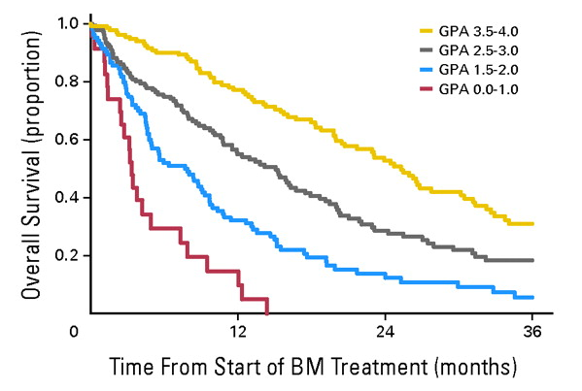
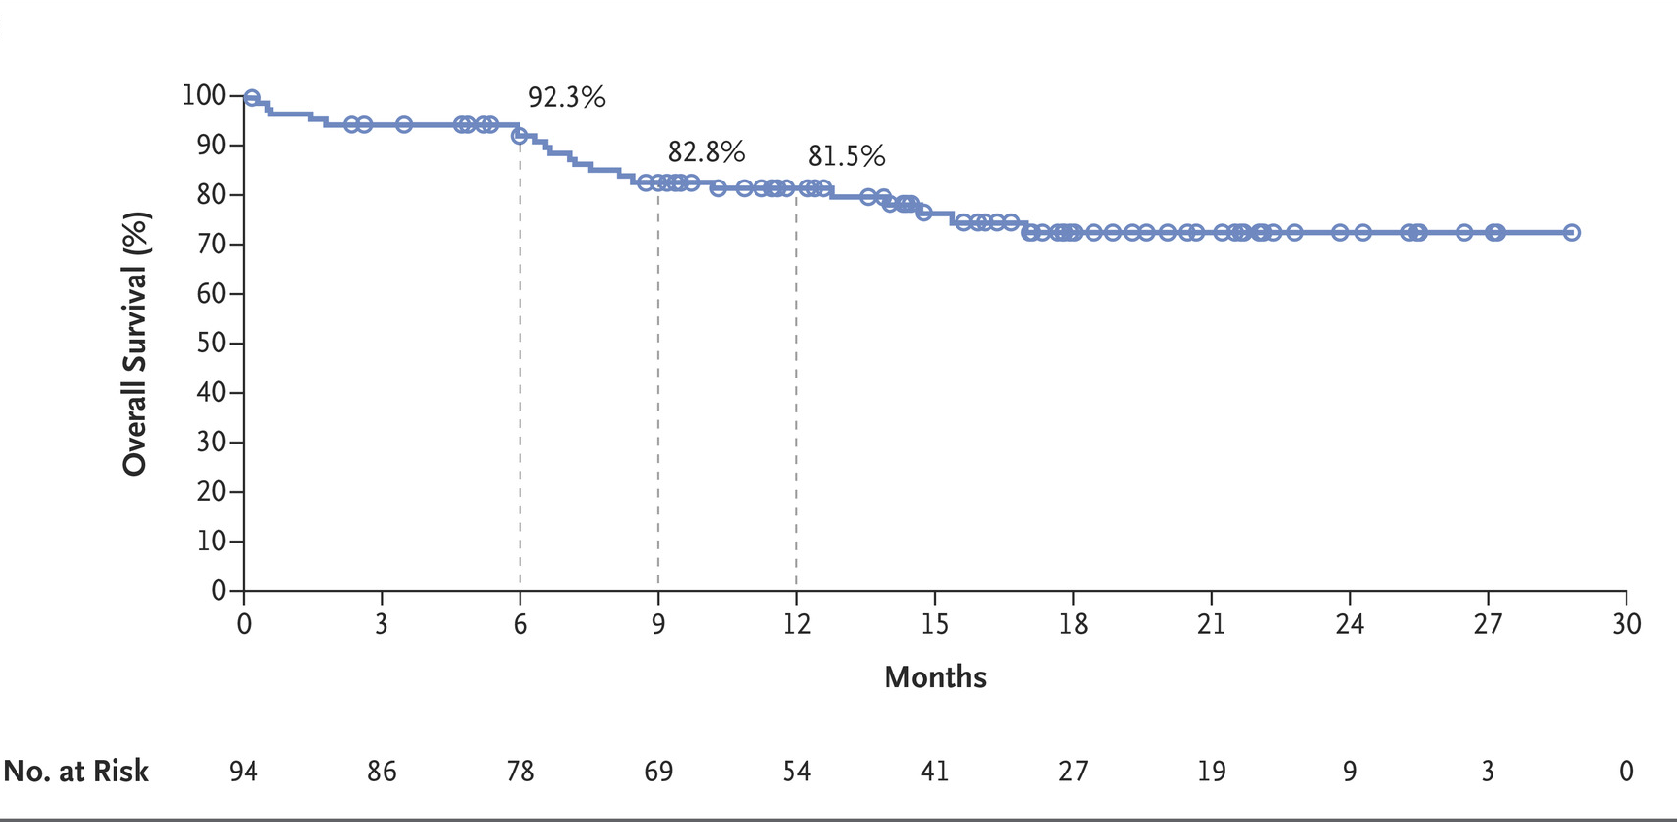
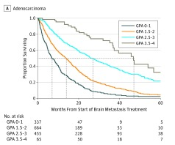
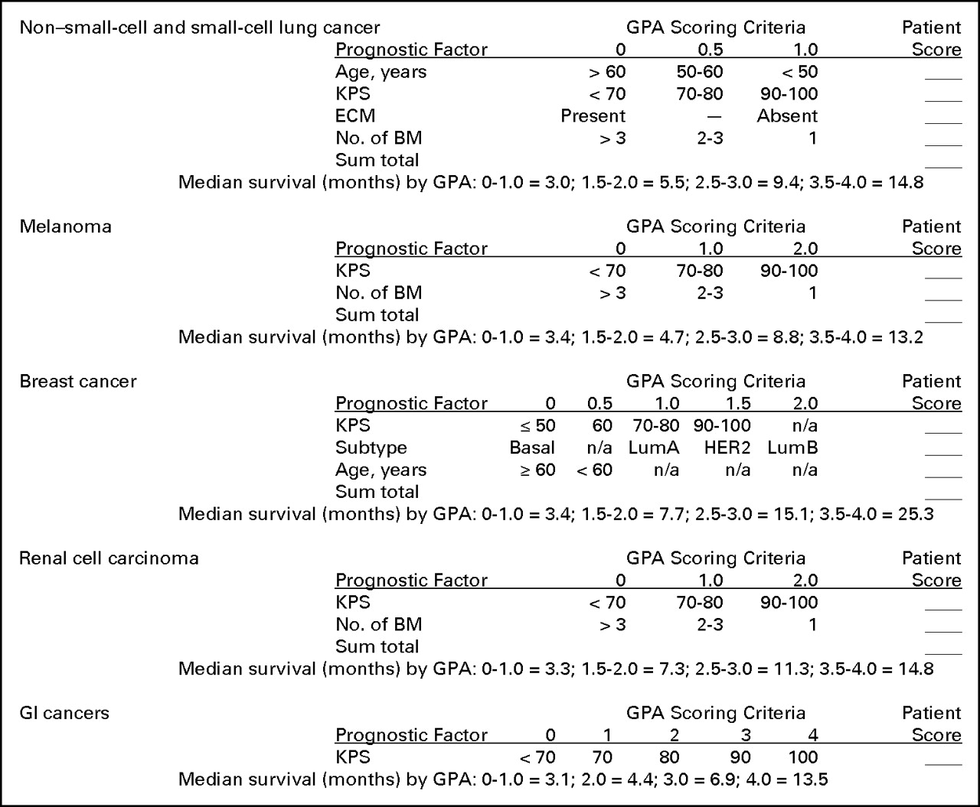
Survival after Brain Met Dx Has Improved
BREAST CANCER
MELANOMA
LUNG ADENOCA
Tawbi et al, NEJM 2018
Prognostic factor GPA Scoring Criteria
0 0.5 1.0
Age, years >70 <70 NA
KPS <70 80 90-100
ECM Present NA Absent
# brain mets >4 1-4 NA
Gene status EGFR neg/unk NA EGFR pos or ALK pos
and ALK neg/unk
Patients entered 1985-2007
Sperduto et al. JCO 2012;30:419-425
Pts entered 2006-2014
Sperduto et al. JAMA Oncol 2017

Slide 8
Assumption #2:
Penetration across the intact blood-brain barrier is required for activity

Slide 9
BBB penetration is irrelevant if the drug is inactive against the target cancer
Regimen | Reference | # breast cancer pts | CNS ORR
TMZ* | Trudeau et al, Ann Oncol 2006 | 10 | 0%
TMZ* | Siena et al, Ann Oncol 2010 | 51 | 4%
WBRT +/- TMZ* | Cao et al, Ann Oncol 2015 | 100 | No difference in CNS ORR, PFS or OS with TMZ
*prospective trial

Slide 10
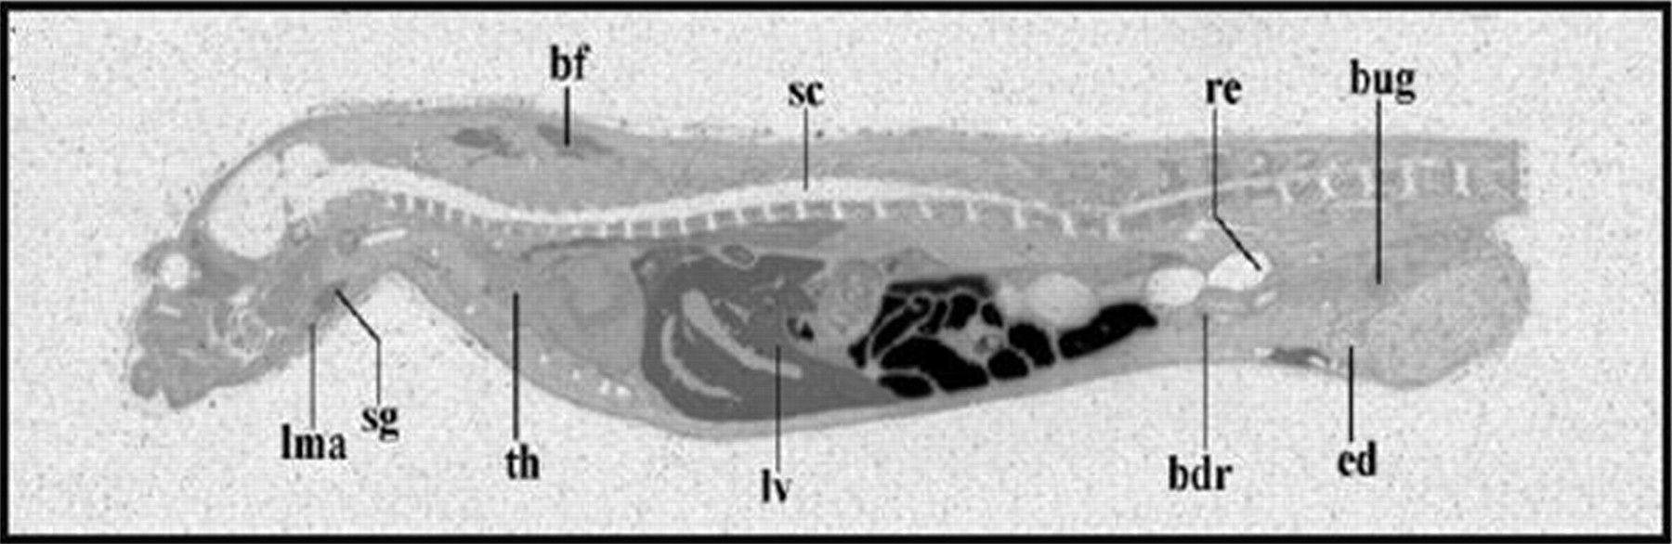
Lack of intact BBB Penetration does not preclude activity against established brain mets
Whole-body autoradiography of [¹⁴C]lapatinib in male Han Wistar rats after a single oral dose of 10 mg/kg
Brain/plasma ratio < 0.13
Presumably related to efflux transporters in the BBB
Polli et al, Drug Metab and Disposition, 2008

Slide 11
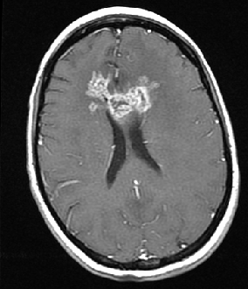
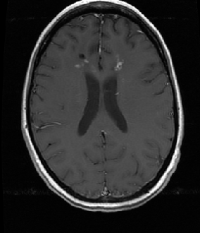
Lapatinib +Capecitabine for HER2+ BCBM
Study | N | Prior RT | CNS ORR | TTP/PFS | OS
Lin et al CCR 2009 | 50 | 100% | 20% | 3.6 mo | NR
Sutherland et al, Br J Ca 2010 (LEAP) | 34 | 94% | 21% | 5.1 mo | NR
Metro et al, Ann Oncol 2011 | 22 | 86% | 32% | 5.1 mo | 11 mo from start of LC
Lin et al, J Neuro-Oncol 2011 | 13 | 100% | 38% | NR | NR
Bachelot et al, Lancet Oncol 2013 | 45 | 0% | 66% | 5.5 mo | 91% alive at 6 mo
Patient treated with lapatinib monotherapy
on DFCI trial 04-199
Notes:
RR in 1st lapatinib trial was 5.2 % using a 50% volume cutoff. None of pts in LANDSCAPE had received prior L or T. Non-CNS ORR was 43% which is higher than the 23% (TTP 6.2 mo) seen in the pivotal trial. None of these studies included a capecitabine-alone control arm, but given the data from the pivotal trial, doing a cape alone arm just to prove the point is unattractive. In addition, in several of the studies, responses were seen in cape-pre-treated pts . IN Metro study, 3 of 4 pts treated in upfront setting had a CNS PR

Slide 12
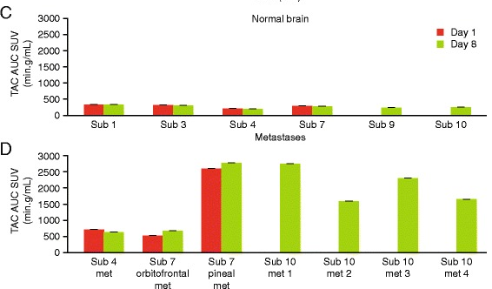
Lapatinib bio-distribution in normal brain vs brain metastases
6 patients recruited
(3 with brain metastases)
Dosed with [¹¹C]lapatinib before and after
8 days of oral lapatinib
PET scan done Day 1 and Day 8
Saleem et al, EJNMMI Res 2015
Also see, Morikawa et al, Neuro Oncol 2015
for direct measurement of lapatinib drug levels in resected brain mets

Slide 13
Many other examples of drugs which do not freely penetrate an intact BBB having clear CNS anti-tumor efficacy in patients
Lapatinib
Neratinib
TDM1
Capecitabine
Platinums
Anthracyclines
Vemurafenib
Dabrafenib
Pembrolizumab
Nivolumab
Ipilumumab
Gefinitib
Erlotinib
Crizotinib
Platinums
Sunitinib
Sorafenib
Bevaciumab

Slide 14
Is the penetration across the intact BBB relevant at all?
Existing data strongly tells us that lack of penetration across an intact BBB does NOT preclude efficacy against established brain metastases
  Thus, lack of CNS update across BBB in standard preclinical models should NOT lead to automatic exclusion of brain metastasis patients from clinical trials of that agent
Does better BBB penetration lead to more or more durable CNS efficacy?
Does better BBB penetration correlation with prevention effects?

Slide 15
Crizotinib vs Alectinib
Crizotinib
Alectinib
  Very little crosses intact BBB
  Early observations of CNS-only progression
  Though CNS responses seen, numerically higher systemic ORR vs CNS ORR
  Excellent CNS penetration including into CSF in preclinical models (not a p-glycoprotein substrate)
  High and similar systemic ORR and CNS ORR in early phase trials
Note: We learned this from clinical trials because patients with active brain mets
were included early in drug development

Slide 16
ALEX Trial
Alecitinib 600 mg BID
ALK+ NSCLC
Untreated, advanced dz
PS 0-2
Asymptomatic brain met or
LMD eligible
Crizotinib 250 mg BID
Primary endpoint = investigator-assessed PFS
Secondary endpoints = IRC-PFS, time to CNS PD, ORR, OS
Stratification factors: PS, race (Asian vs non-Asian), CNS mets at baseline

Slide 17
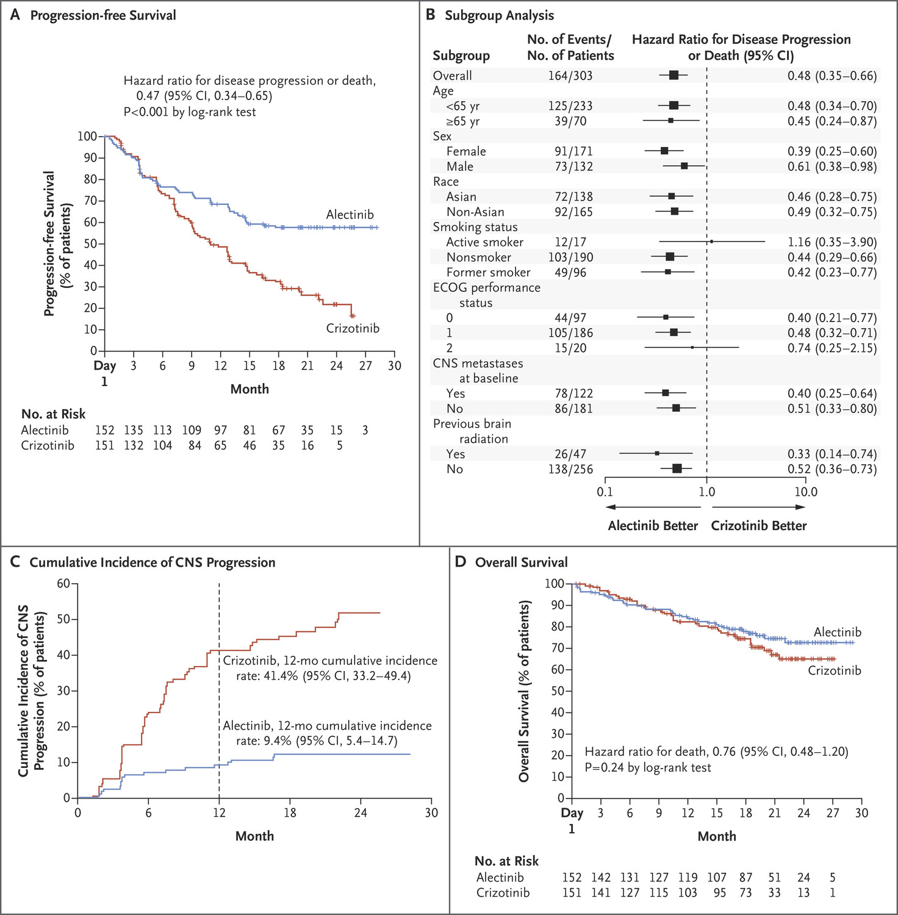
~40% of study population had
brain mets at baseline
CNS imaging at baseline and
Q8 weeks was mandated
per protocol in ALL patients
regardless of whether or
not brain mets were
present at baseline or not
CNS ORR 50% vs 81%
Favoring alectinib
Peters et al, NEJM 2017

Slide 18
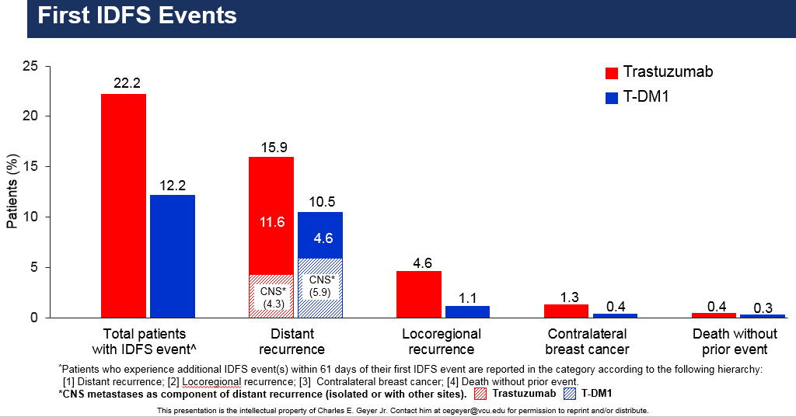
KATHERINE: TDM1 vs Trastuzumab for patients with residual disease after neoadjuvant therapy
Advances in Adjuvant HER2-Directed Therapy Have Not Resulted in Reductions in CNS Relapse
A HIGH proportion of 1st events are in CNS
No CNS prevention effect of TDM1

Slide 19
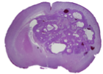
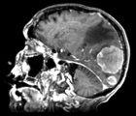


Can better preclinical models help with drug selection?
Intracranial injection
DF-BM354
+Luciferase
Evaluation of
Anti-cancer drugs
DF-BM355
Patient BCBM
SCID mouse
Slide, courtesy of Jean Zhao, PhD

Slide 20
Rethinking our assumptions
Conditions for efficacy of systemic therapy against established brain metastases
  Rational target
  Active against the underlying disease
  Achieves therapeutic levels in tumor tissue, or exerts effects independent of penetration into tumor tissue
  Penetration across intact BBB is not required
Conditions for prevention effect
  Rational target
    Active against underlying disease
    And/or, might there be agents in the future that directly affect brain metastatic potential?
  Existing data suggests that penetration across intact BBB may be associated with more prevention potential (at least for drugs which need to exert action at the tumor site)
Preclinical models
  Standard drug distribution studies in normal animals not enough
  Intracranial tumor models better
  Time will tell how different models compare to each other in terms of predicting clinical success

