Slide 1
Revised Draft Guidance for
Mitigation Strategies to Protect Food
Against Intentional Adulteration:
Public Meeting
April 17, 2019

Slide 2
Why should we protect against IA?
Intentional adulteration has the potential to cause:
  Significant public health consequences
  Widespread public fear
  Devastating economic impacts
  Loss of public confidence in the safety of food and effectiveness of government
  Disruption of trade

Slide 3
IA Rule Background
Last of 7 foundational rules
Establishes requirements to prevent or significantly minimize acts intended to cause wide-scale public health harm
Coverage
  Facilities that manufacture, process, pack or hold human food
Exemptions

Slide 4
IA Rule Background
Requirements
  Food defense plan
    Vulnerability assessment (VA)
    Mitigation strategies
    Procedures for food defense monitoring
    Food defense corrective action procedures
    Food defense verification procedures
    Reanalysis
  Training
  Records

Slide 5
IA Rule Background
Compliance dates
  Very small businesses: Five years (July 26, 2021)
  Small businesses (a business with fewer than 500 full-time equivalent employees): Four years (July 27, 2020)
  All other businesses: Three years (July 26, 2019)

Slide 6
Guidance Overview
Substantial interaction with stakeholders
  History of food defense collaboration
  Dialogue with stakeholders since rule publication
  Significant compliance cost has been raised in the context of
    Need for more flexibility
    Counting existing activities toward compliance
    Industry-estimated costs
    Paperwork burden

Slide 7
Guidance Overview
FDA incorporating stakeholder input, when/where appropriate
  Committed to making implementation for industry as practical and flexible as possible, while also achieving public health goal
  Protecting against an inside attacker
  Addressing misconceptions (flexibility, food safety vs food defense priorities, high-cost mitigation strategies, existing measures)

Slide 8
Guidance Overview
FDA incorporating input - Examples of flexibility
  Vulnerability Assessment
    Key Activity Types (KATs), 3 Fundamental Elements, Hybrid Approach
    Element 1 approaches include volume of food at risk or contaminant-based approaches
    Scoring flexibility in 3 Fundamental Elements
    Writing explanations

Slide 9
Guidance Overview
FDA incorporating input - Examples of flexibility
  Mitigation strategies
    Numerous options
    Facility-wide security measures?
    Existing measures?
  Food defense monitoring
    Incorporate into existing responsibilities
    Leverage food safety activities?
    Exception records
  Education, training, or experience

Slide 10
Guidance Overview
FDA incorporating input – Other examples
  Protection against insiders
    How can industry assess this?
      Assumptions to bound assessment
    How can industry protect against this?
      Reducing risk by implementing mitigation strategies

Slide 11
Guidance Overview
FDA incorporating input – Other examples
  Very costly mitigation or monitoring activities?
    No need to reengineer facilities
    No need to hire additional employees solely for peer monitoring
    Build monitoring into existing responsibilities
    Exception records

Slide 12
Guidance Overview
10 chapters, 4 appendices published in 3 rounds (Round 1 published June 2018)
Rounds 1 - 2 are intricately connected, with sections of the VA chapter published in both rounds
Round 2 is incorporated into one document with Round 1, issued as Revised Draft published March 2019
Inter-chapter themes: risk-based, flexible, and practical

Slide 13
Guidance Overview
Introduction¹
Ch 1 The Food Defense Plan¹
Ch 2 Vulnerability Assessment to Identify Significant Vulnerabilities and Actionable Process Steps¹ ⁻ ²
  Sections 2A-E, including background and Key Activity Types as a Method for Conducting a VAs ¹
  Sections 2F-H , including Evaluating the Three Fundamental Elements, Identifying Significant Vulnerabilities and Actionable Process Steps Using the Three Fundamental Elements, and Identifying Actionable Process Steps Using the Hybrid Approach²
Ch 3 Mitigation Strategies for Actionable Process Steps¹
Ch 4 Mitigation Strategies Management Components: Food Defense Monitoring¹
Ch 5 Mitigation Strategies Management Components: Food Defense Corrective Actions³
Ch 6 Mitigation Strategies Management Components: Food Defense Verification³
Ch 7 Reanalysis³
Ch 8 Education, Training, or Experience²
Ch 9 Records³
Appendix 1. Food Defense Plan Worksheets¹ ⁻ ²
Appendix 2. Mitigation Strategies in the Food Defense Mitigation Strategies Database³
Appendix 3. Calculating Small Business and Very Small Businesses Sizes³
Appendix 4. Vulnerability Assessment Examples²
1 = Installment 1, 2 = Installment 2, 3 = Installment 3

Slide 14
Guidance Overview
1st installment
  Background and definitions
  Relatively simple and cost-effective method to identify vulnerable points (i.e., KAT Method)
  Numerous ways to reduce vulnerabilities
  Numerous ways to check that strategies are functioning as intended
  Worksheets to assist industry in thinking through, and documenting, requirements

Slide 15
Guidance Overview
2nd installment
  Identifying vulnerabilities in a way that includes an in-depth analysis and can be tailored to a facility (i.e., 3 Fundamental Elements)
  Identifying vulnerabilities in a way that combines strengths of KAT and 3 Element approaches (i.e., Hybrid Approach)
  Education, training, or experience
  Additional examples of worksheets
  VA examples

Slide 16
Guidance Overview
3rd installment
  Food defense corrective actions
  Food defense verification
  Reanalysis
  Records
  Appendices

Slide 17
Guidance: Introduction

Slide 18
Guidance: Introduction
Purpose of guidance
Scope of rule and guidance
Glossary of terms and abbreviations
Exemptions

Slide 19
Guidance: Introduction - Exemptions
Very small businesses
Holding of food, except holding of food in liquid storage tanks
Packing, repacking, labeling, or relabeling of food where the container that directly contacts the food remains intact
Activities of a farm subject to the Produce Safety Rule
Manufacturing, processing, packing, or holding food for animals
Alcoholic beverages at certain facilities (under specified conditions)
On-farm manufacturing/processing, packing, or holding by a small or very small business, of eggs (in-shell, other than RACs) or certain types of game meats, if such activities are the only activities conducted by the business subject to section 418 of the FD&C Act

Slide 20
Guidance: Food Defense Plan (FDP)
Set of written documents that is based upon food defense principles and incorporates a VA, includes mitigation strategies, and delineates food defense monitoring, corrective action, and verification procedures to be followed

Slide 21
Guidance: FDP - Components
Must include:
  Vulnerability assessment
  Mitigation strategies and explanations
  Food defense monitoring procedures
  Food defense corrective actions procedures
  Food defense verification procedures
  Owner/operator signature

Slide 22
Guidance: FDP
Individuals to assist with developing a FDP
  Food Defense Qualified Individuals
  Food Defense Team
    Flexibility - personnel from security, maintenance, food production (including equipment experts), sanitation, food safety quality assurance or quality control, engineering, purchasing, human resources, or laboratory.
    Others

Slide 23
Guidance: Food Defense Plan
Formatting the FDP
  Flexibility - no standardized or required format
  FDA provides sample worksheets in Appendix 1
Changing the FDP
  Reanalysis
Maintaining the FDP
  FDP is a record
  Owner/operator must sign FDP
  Sensitive nature of FDP

Slide 24
Guidance: Vulnerability Assessment (VA) - Purpose and Scope

Slide 25
Guidance: VA - Purpose and Scope
Purpose
  Assess each point, step, or procedure (PSP) to identify those points at highest risk, i.e., actionable process steps (APSs)
Scope
  Only include PSPs related to manufacturing, processing, packing, or holding of the food product
  Do not include mail handling procedures, human resources procedures, utilities and processing aids that do not come into contact with or that are not incorporated into the food, facility emergency evacuation procedures

Slide 26
Guidance: VA - Requirements
For each PSP, a facility must consider, at a minimum these fundamental elements:
  Potential public health impact
  Degree of physical access to product
  Ability of an attacker to successfully contaminate the product
Must consider the possibility of an inside attacker
Write explanation for decision at each PSP

Slide 27
Guidance: VA - Preliminary Steps
Assemble a food defense team – flexibility
Describe product
Develop/use process flow diagram - flexibility
Describe process steps

Slide 28
Guidance: VA - Methods
Flexibility
  Key Activity Types
  3 Fundamental Elements
  Hybrid Approach

Slide 29
Guidance: VA - Key Activity Type Method

Slide 30
Guidance: VA - Key Activity Type Method
KATs
  General categories of manufacturing/processing identified as most vulnerable, regardless of commodities
  How were the KATs created?
    Homeland Security Presidential Directive 9
    Collaboration with government partners, academia, and industry
    “FDA has done most of the work for you”

Slide 31
Guidance: VA - Key Activity Type Method
What are the KATs?
  Bulk liquid receiving and loading
  Liquid storage and handling
  Secondary ingredient handling
  Mixing and similar activities

Slide 32
Guidance: VA - Key Activity Type Method
Identifying APSs using the KAT Method
  Assess each PSP to determine whether they fit within a KAT

Slide 33
Guidance: VA - Key Activity Type Method
KATs
  Bulk liquid receiving & loading
  Liquid storage & handling
  Secondary ingredient handling
  Mixing & similar activities
Notes:
Description for graphic: This graphic portrays part of a sample process flow diagram, the 4 KATs, and arrows connecting KATs to examples processes.

Slide 34
Guidance: VA - Key Activity Type Method
Identifying APSs using the KAT Method
  Points that align are APSs
  Write explanation describing your decision

Slide 35
Guidance: VA - 3 Fundamental Elements

Slide 36
Guidance: VA - 3 Fundamental Elements
3 Fundamental Elements
  Most important factors to identify vulnerable points at a facility level
How were the 3 elements created?
  Homeland Security Presidential Directive 9
  Collaboration with government partners, academia, and industry

Slide 37
Guidance: VA - 3 Fundamental Elements
What are the 3 elements?
  Potential public health impact
  Degree of physical access
  Ability of an attacker to contaminate the product

Slide 38
Guidance: VA - 3 Fundamental Elements
2 considerations to be evaluated when analyzing each element
  Inside attacker
  Inherent characteristics

Slide 39
Guidance: VA - 3 Fundamental Elements
Inside attacker - scenario of highest risk
  Legitimate access to facility
  Basic knowledge of facility operation and products
  Ability to acquire/deploy contaminant that is highly lethal, capable of withstanding food production process, and undetectable via simple observation if added to food
  Intend to cause wide scale public health harm

Slide 40
Guidance: VA - 3 Fundamental Elements
Inherent characteristics
  Conditions, activities, practices, or characteristics that are integral to the operation of a PSP
  PSP could not properly operate without these inherent characteristics in place
  Not easily changed or altered

Slide 41
Guidance: VA - 3 Fundamental Elements
Inherent characteristics examples - flexibility
  Type and nature of equipment
    Enclosed or pressurized?
  Nature of processing
    High rate of speed? Homogenous mixing?
  Worker safety mechanisms built into equipment
  Required presence of employees in immediate area

Slide 42
Guidance: VA - 3 Fundamental Elements
Element 1 – potential public health impact
  Assigning a score for each PSP
  3 approaches to evaluate potential public health impact - flexibility
    Volume of food at risk
    Representative contaminant approach
    Contaminant-specific approach
  Additional factors for consideration - flexibility

Slide 43
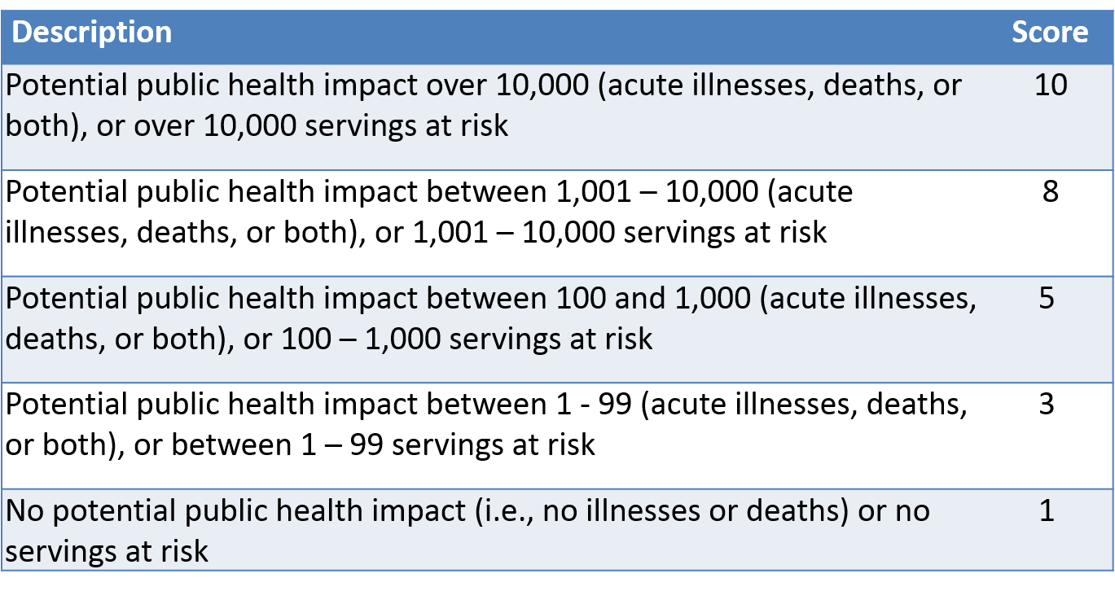
Guidance: VA - 3 Fundamental Elements
Element 1 – assign a score
Notes:
Description of Table – this table provides a descriptions and corresponding scores for different levels of public health impact

Slide 44
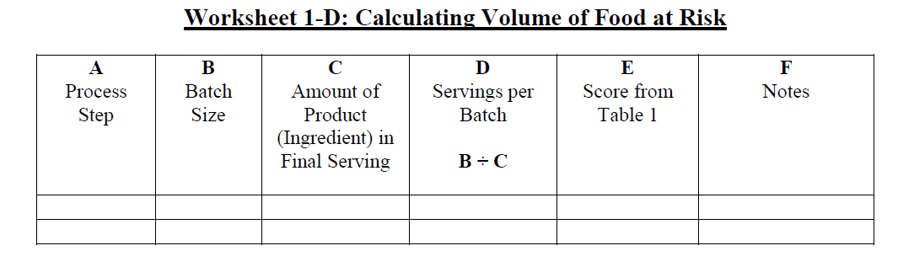
Guidance: VA - 3 Fundamental Elements
Element 1 – potential public health impact approaches
  Volume of food at risk
    Calculate volume of food in batch process or continuous flow process to use as proxy for public health impact
Notes:
This is a worksheet that can be used to calculate volume of food at risk.

Slide 45
Guidance: VA - 3 Fundamental Elements
Element 1 – potential public health impact approaches
  Volume of food at risk
    Match calculated number with description in previous table and assign corresponding score for each PSP
9,000
8
Notes:
This slide includes the worksheet that can be used to calculate volume of food at risk and the table that provides a descriptions and corresponding scores for different levels of public health impact. There is an arrow pointing from the corresponding score to the example volume of food at risk.

Slide 46
Guidance: VA - 3 Fundamental Elements
Element 1 – potential public health impact approaches
  Volume of food at risk
    Beneficial to include written rationale for score
    Simplest, but also least specific, of three approaches

Slide 47
Guidance: VA - 3 Fundamental Elements
Element 1 – potential public health impact approaches
  Representative contaminant approach
    Not an actual contaminant, but based on amalgam of characteristics from actual contaminants
    Incorporates characteristics that would allow attacker to achieve goal of causing wide scale public health harm
      Acquisition is possible, and in some cases, readily so
      Highly lethal
      Survives food production process
      Undetectable via simple observation if added to the food

Slide 48
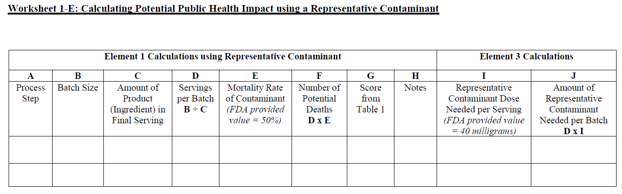
Guidance: VA - 3 Fundamental Elements
Element 1 – potential public health impact approaches
  Representative contaminant approach
    Calculate volume of food at risk, incorporate LD50
    Match calculated number with description in previous table and assign corresponding score for each PSP
    Beneficial to include written rationale for score
    More calculations than volume of food at risk approach, but also more specific
    Since calculations are not based on actual contaminant, results are not as sensitive
Notes:
This is a worksheet that can be used to calculate public health impact using the representative contaminant approach.

Slide 49
Guidance: VA - 3 Fundamental Elements
Element 1 – potential public health impact approaches
  Contaminant-specific approach
    Should use multiple biological, chemical, and radiological contaminants for each PSP
    At a minimum, contaminants should have similar characteristics to representative contaminant

Slide 50
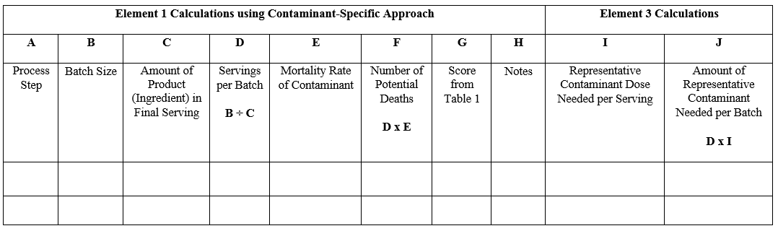
Guidance: VA - 3 Fundamental Elements
Element 1 – potential public health impact approaches
  Contaminant-specific approach
    Uses same calculations in representative contaminant approach but replaces amalgam values with actual contaminant values
Notes:
This is a worksheet that can be used to calculate public health impact using the contaminant-specific approach.

Slide 51
Guidance: VA - 3 Fundamental Elements
Element 1 – potential public health impact approaches
  Contaminant-specific approach
    Use largest public health impact to assign score
    Match calculated number with description in previous table and assign corresponding score for each PSP
    Beneficial to include written rationale for score

Slide 52
Guidance: VA - 3 Fundamental Elements
Element 1 – potential public health impact approaches
  Contaminant-specific approach
    More calculations than volume of food at risk approach, but also more specific
    Calculations are based on actual contaminant, so results may be sensitive
    Number of contaminants and data gaps are problematic

Slide 53
Guidance: VA - 3 Fundamental Elements
Element 1 – potential public health impact
  Additional factors for consideration - flexibility
    End use of food
      Ingredient vs finished product
    Consumer packaging
      Servings per distribution unit

Slide 54
Guidance: VA - 3 Fundamental Elements
Element 2 – degree of physical access to product
  Assigning a score for each PSP
  Evaluate barriers, or lack thereof, to food
    Inherent characteristics
    Inside attacker

Slide 55
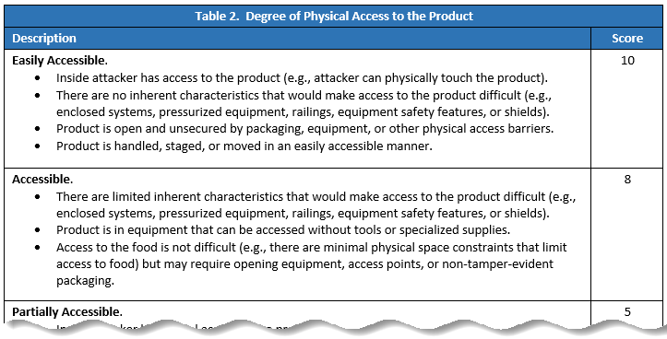
Guidance: VA - 3 Fundamental Elements
Element 2 – assign a score
Notes:
Description of Table – this table provides a descriptions and corresponding scores for different levels of degree of physical access to the product

Slide 56
Guidance: VA - 3 Fundamental Elements
Element 2 – degree of physical access to product
  Match degree of physical access of PSP with description in previous table and assign corresponding score
    Every condition in description need not be present to assign score - flexibility
  Beneficial to include written rationale for score
  Easiest element to evaluate, recommend beginning with this

Slide 57
Guidance: VA - 3 Fundamental Elements
Element 3 – ability of an attacker to contaminate product
  Assigning a score for each PSP
  Evaluate ability of attacker to contaminate product – flexibility
    Inherent characteristics
    Inside attacker
    Level of observation at PSP?
    Sufficient volume of contaminant added?
    Workers in the area?

Slide 58
Guidance: VA - 3 Fundamental Elements
Element 3 – ability of an attacker to contaminate product
  Considerations when using a contaminant-specific approach in Element 1
    Amount of contaminant needed
Notes:
This is a worksheet that can be used to calculate the amount of representative contaminant needed per batch to cause wide scale public health harm.

Slide 59
Guidance: VA - 3 Fundamental Elements
Element 3 – ability of an attacker to contaminate product
  Considerations when using a contaminant-specific approach in Element 1
    Concentration or dilution
    Removal
    Neutralization

Slide 60
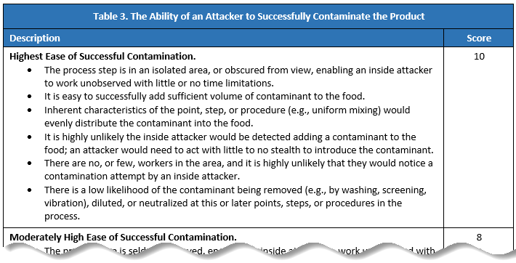
Guidance: VA - 3 Fundamental Elements
Element 3 – assign a score
Notes:
Description of Table – this table provides a descriptions and corresponding scores for different levels of ability of an attacker to contaminate the product

Slide 61
Guidance: VA - 3 Fundamental Elements
Element 3 – ability of an attacker to contaminate product
  Match ability of attacker to contaminant product at PSP with description in previous table and assign corresponding score
    Every condition in description need not be present to assign score – flexibility
  Beneficial to include written rationale for score

Slide 62
Guidance: VA - 3 Fundamental Elements
Identifying APSs using the 3 Elements
  What is wide scale public health harm?
    Elevated presence of Element 1 and Element 2 and Element 3
    In context of this rule, threshold of morbidity and mortality is not the only determinative factor
  If a step has a significant vulnerability, all three elements will have some elevated presence
    When a PSP has an element with a score of 1, then “automatically” not an APS

Slide 63
Guidance: VA - 3 Fundamental Elements
Identifying APSs using the 3 Elements
  Summing element scores
  Ranking summed scores

Slide 64
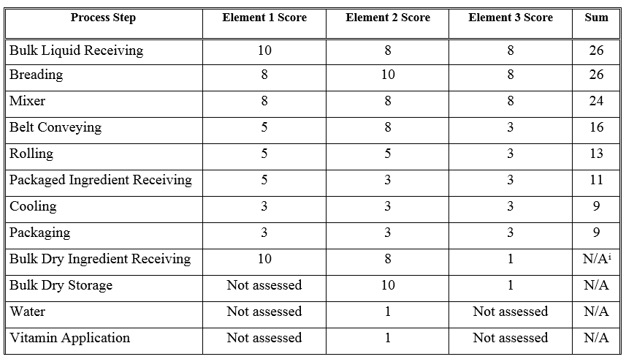
Guidance: VA - 3 Fundamental Elements
Notes:
This is a table that is an example of how to sum element scores, and rank sums, for process steps.

Slide 65
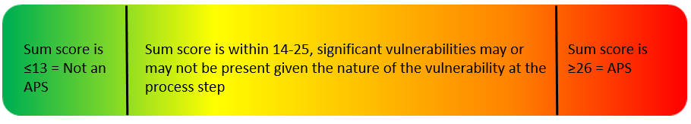
Guidance: VA - 3 Fundamental Elements
Identifying APSs using the 3 Elements - flexibility

Slide 66
Guidance: VA - 3 Fundamental Elements
Identifying APSs using the 3 Elements
  Writing explanations for determination as to whether each step is, or is not, an actionable process step – flexibility
    “This step is significantly vulnerable because the score > 25.”
    “Relatively low public health impact. Step is hardly accessible. Low ease of attack. Minimal timeframes for contaminant introduction and surrounding workers prevent an inside attacker from working unobserved for enough time to contaminate any significant amount of product.”

Slide 67
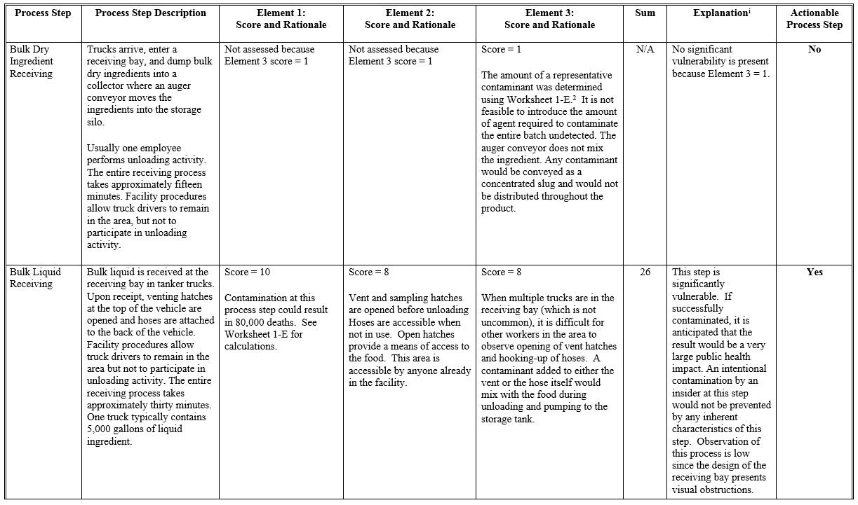
Guidance: VA Example Worksheet - 3 Fundamental Elements
Notes:
This graphic is an example for how you can document your vulnerability assessment using the three fundamental elements

Slide 68
Guidance: VA - Hybrid Approach
What is the Hybrid approach?
  Combination of KAT and 3 Elements methods
  Includes benefits of both methods

Slide 69
Guidance: VA - Hybrid Approach
Identifying APSs using the KAT Method
  Assess each PSP to determine whether they fit within a KAT

Slide 70
Guidance: VA - Hybrid Approach
KATs
  Bulk liquid receiving & loading
  Liquid storage & handling
  Secondary ingredient handling
  Mixing & similar activities
Notes:
Description for graphic: This graphic portrays part of a sample process flow diagram, the 4 KATs, and arrows connecting KATs to examples processes.

Slide 71
Guidance: VA - Hybrid Approach
Identifying APSs using the Hybrid approach
  Decision to use 3 Elements for some steps (that align with KATs) is due to factors present at the steps (e.g., inherent characteristics) that would further inform the analysis as to whether a significant vulnerability exists

Slide 72
Guidance: VA - Hybrid Approach
KATs
  Bulk liquid receiving & loading
  Liquid storage & handling
  Secondary ingredient handling
  Mixing & similar activities
??
Notes:
Description for graphic: This graphic portrays part of a sample process flow diagram, the 4 KATs, and arrows connecting KATs to examples processes.

Slide 73
Guidance: VA - Hybrid Approach
Identifying APSs using the Hybrid approach
  Then, use 3 Elements to conduct a more in-depth evaluation of some of the steps
  Write explanation describing your decision as to whether each PSP is an APS

Slide 74
Guidance: Mitigation Strategies

Slide 75
Guidance: Mitigation Strategies
Overview of requirement
  You must identify and implement mitigation strategies at each actionable process step to provide assurances that the significant vulnerability at each step will be significantly minimized or prevented
Mitigation strategies are:
  Risk-based, reasonably appropriate measures that a person knowledgeable about food defense would employ to significantly minimize or prevent significant vulnerabilities identified at actionable process steps, and that are consistent with the current scientific understanding of food defense at the time of the analysis

Slide 76
Guidance: Mitigation Strategies
Mitigation Strategies are
  Customized to the process step at which they are applied;
  Tailored to existing facility practices and procedures; and
  Directed toward the actionable process step’s vulnerability, including vulnerability to an inside attacker
  Facilities have flexibility to identify and implement appropriate strategies
Key Term
  Significantly minimize means to reduce to an acceptable level, including to eliminate

Slide 77
Guidance: Mitigation Strategies
What Mitigation Strategies are supposed to do
  Minimize accessibility of the product to an inside attacker (Element 2)
  Reduce ability of an inside attacker to contaminate the product (Element 3)
Categories of strategies
  Personnel and operations-based strategies
  Technology-assisted strategies

Slide 78
Guidance: Mitigation Strategies
Facility-wide security measures
  General, non-targeted practices to protect personnel, property, or product
  Generally not targeted to particular processing steps but are rather practices that address the security of the facility as a whole (e.g., perimeter security) or are practices internal to the facility but that are conducted broadly throughout the facility (e.g., visitor sign-in and escort)

Slide 79
Guidance: Mitigation Strategies
Facility-wide security measures
  These measures do not require a VA to inform their identification and implementation – not directed toward individual points, steps, or procedures
  May serve as a foundation to a mitigation strategy (e.g., using existing badging to identify authorized personnel around an APS) – flexibility
  There are cases when a facility-wide security measure could be identified as a mitigation strategy if it specifically addresses a significant vulnerability at an actionable process step – flexibility

Slide 80
Guidance: Mitigation Strategies
Existing measures
  There may be measures in place, for reasons other than food defense (e.g., quality control, worker safety), at a particular process step that also could serve as mitigation strategies – flexibility
  Generally, such measures are not inherent characteristics of the step’s operation and the VA should not consider these practices when identifying whether the process step is an actionable process step
  These measures should be evaluated when determining whether they could serve as a mitigation strategy in current or altered form and whether an additional mitigation strategy is needed to augment the existing practice

Slide 81
Guidance: Mitigation Strategies
Existing measures examples
  A process step where a worker is a senior employee or an employee who has undergone additional vetting to establish increased trustworthiness. For example, the more trusted employee may be posted at the step because an ingredient is costly or is a trade secret
  A process step where you require a buddy system for worker safety. For example, your cold storage facility uses buddy systems to prevent workplace injury when working in an area

Slide 82
Guidance: Mitigation Strategies
Examples in the guidance for minimizing accessibility to the product
  Restricting the area to only authorized personnel
  Use tamper-evident tape or seals for partially used ingredient containers
  Install locking mechanisms on equipment access points
  Block access pathways to equipment (e.g., ladder cages, locking gates on access gangways)

Slide 83
Guidance: Mitigation Strategies
Examples in the guidance for reducing the ability to successfully contaminate the product
  Increase observation of highly vulnerable areas
  Require workers at actionable process steps to wear uniforms or clothing without pockets or other means of concealing items
  Install access indicators that would notify other workers that a piece of equipment has been opened

Slide 84
Guidance: Mitigation Strategies
Examples in the guidance for using cameras and closed circuit TV systems (CCTV)
  Cameras can facilitate remote observation of an APS
  The mitigation strategy is the act of observation and CCTV or other technologies can be used to facilitate the increased observation
  Observation does not need to be constant or dedicated (e.g., workers might oversee several processing activities from a control room, including observing an APS via a CCTV screen)

Slide 85
Guidance: Mitigation Strategies
Using multiple Mitigation Strategies
  Layering two or more mitigation strategies together at an APS may be needed to achieve sufficient protection of an APS – flexibility
  Two or more inexpensive mitigation strategies may be more cost effective than a single expensive one (e.g., one that requires capital investment or installation of protective equipment)

Slide 86
Guidance: Mitigation Strategies
Explanations
  Each strategy must include an explanation of how it significantly minimizes or prevents the significant vulnerabilities associated with the actionable process step
  The written explanations help facilitate proper application of mitigation strategies management components

Slide 87
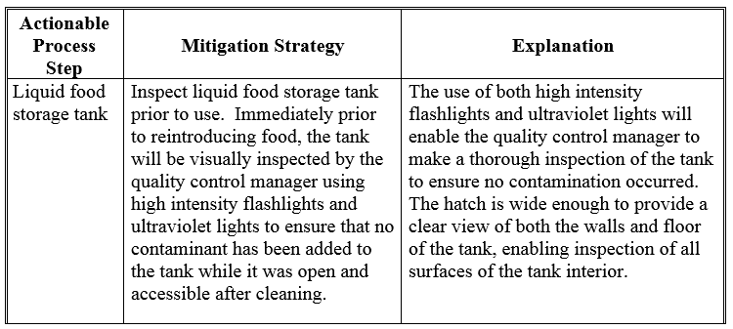
Guidance: Mitigation Strategies
Example mitigation strategy and explanation

Slide 88
Guidance: Food Defense Monitoring

Slide 89
Guidance: Food Defense Monitoring
Overview of requirement
  Conduct a planned sequence of observations or measurements to assess whether mitigation strategies are operating as intended
  Must establish and implement written procedures, including the frequency with which they are to be performed
Difference between food safety and food defense
  Food safety monitoring more likely to document a minimum or maximum value for a parameter is met, and is frequently continuous
  Food defense monitoring observes whether the strategy is operating as intended and often occurs less frequently

Slide 90
Guidance: Food Defense Monitoring
What and how to monitor
  Flexibility to determine
    What to monitor
    How often the monitoring will occur
    Who will monitor the mitigation strategy
  As long as procedures allow you to assess whether the strategies are operating as intended

Slide 91
Guidance: Food Defense Monitoring
What and how to monitor
  How often the monitoring will occur
    Less frequently than food safety monitoring
    Periodic basis but at irregular intervals can be beneficial
      More difficult for an inside attacker to anticipate, and
      Requires less human and other resources than more frequent monitoring

Slide 92
Guidance: Food Defense Monitoring
What and how to monitor
  Flexibility
    Develop a new procedure to monitor a strategy, or
    Assign an employee to observe whether the strategy is operating as intended, or
    Use an electronic monitoring access control device
    Build monitoring into employee’s existing responsibilities

Slide 93
Guidance: Food Defense Monitoring
Examples in guidance
  Mitigation strategy: secure access hatch on ingredient storage tank with lock
  Monitoring procedure
    Employee observes whether lock is in place and locked at the beginning/end of the tank’s 48-hour cleaning cycle
  Example where monitoring frequency depends on mitigation strategy – depends on cleaning cycle

Slide 94
Guidance: Food Defense Monitoring
Examples in guidance
  Mitigation strategy: tamper-evident seals on conveyances
  Monitoring procedure
    Check seals for integrity or indications of tampering and match seal or documentation numbers upon arrival of the load
  Example of monitoring conducted concurrently with mitigation strategy’s implementation
  Example where monitoring frequency depends on mitigation strategy frequency – depends on frequency of inbound shipments

Slide 95
Guidance: Food Defense Monitoring
Specific example of Cameras / CCTV
  Mitigation strategy: Increase observation of liquid storage tank, via use of camera (camera facilitates observation; camera, itself, is not the strategy). Assigned employee, who is already observing other feeds, periodically observes camera feed from liquid storage tank area
  Monitoring procedure
    Once per shift, manager observes whether employee assigned to observe feeds is doing so on the pre-determined frequency (i.e., the employee is periodically observing the camera feed). Manager documents monitoring by recording either a ‘Yes” if the employee is observing the feed or “No” if the employee is not observing the feed

Slide 96
Guidance: Food Defense Monitoring
Monitoring records
  Document monitoring in records that are subject to verification
  Record information at time of observation
  Should capture observations/actual values, along with the time and date observation was made, and person’s signature or initials who made observation

Slide 97
Guidance: Food Defense Monitoring
Monitoring records
  Exception records – flexibility
    Demonstrating a deviation--document monitoring with record of when the strategy is not functioning, or operating, as intended
    Compared to affirmative records, which demonstrate that mitigation strategy is functioning as intended
    Exception records are adequate in some, but not all, circumstances
Continuation of Chapter 3 scenarios

Slide 98
Guidance: Food Defense Monitoring
Monitoring records
  Exception records example
    Automated monitoring system alarm indicates that a gate around an APS is not secured. Whenever the system alarms, an automatically generated exception record documents the instance where the mitigation strategy was not operating as intended
    Responsibilities of personnel working in area around an APS are modified to include monitoring the area for personal items. An exception record is generated when an unauthorized personal item is discovered in the area by these employees (who are monitoring for personal items in the restricted area)

Slide 99
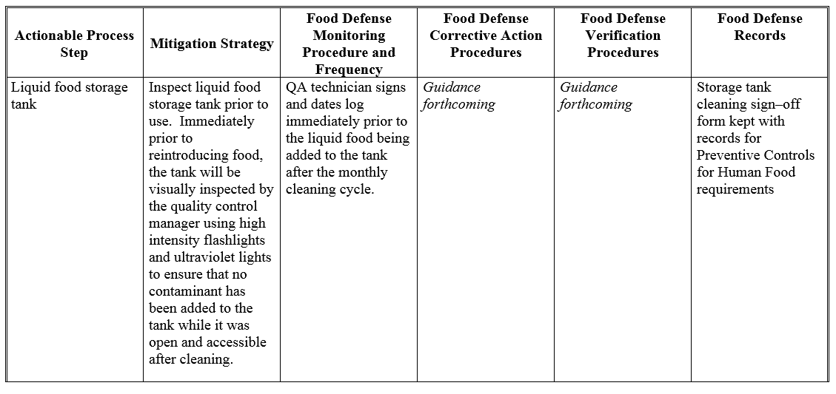
Guidance: Food Defense Monitoring
Example food defense monitoring written procedure

Slide 100
Guidance: Education, Training, or Experience

Slide 101
Guidance: Education, Training, or Experience
Overview of requirement
Qualified Individuals
Individuals assigned to APSs
  Food defense awareness – flexibility
  Proper implementation of mitigation strategy – flexibility
Food Safety Preventive Controls Alliance (FSPCA)

Slide 102

Guidance: Education, Training, or Experience
FSPCA Training Course | Delivery Method | Intended Audience
Food Defense Awareness |  | Workers at Actionable Process Steps (e.g., front line food workers) Supervisors of Workers at Actionable Process Steps Satisfies requirement in § 121.4(b)(2)
Overview of IA Rule |  | Any stakeholder interested in learning more about the IA rule requirements This course is not associated with any IA rule training requirement
Notes:
This is a table that describes the Alliance training course names, delivery method, and intended audience
-FD Awareness has been accessed ~48,000 times since the course launched in June 2018

Slide 103
Food Defense Qualified Individuals
Requirement for special qualifications for individuals who do or oversee the following activities, which require the most food defense expertise:
  Preparation of the FDP
  Conduct of the VA
  Identification and explanation of mitigation strategies
  Performance of the reanalysis

Slide 104
Food Defense Qualified Individuals
Such an individual must meet the following requirements:
Education, training, or experience (or a combination thereof) necessary to properly perform the activities; and
Successful completion of training for the specific function that is at least equivalent to that received under a standardized curriculum recognized as adequate by FDA, or
Be otherwise qualified through job experience to conduct the activities.
  Job experience may qualify an individual to perform these functions if such experience has provided an individual with knowledge at least equivalent to that provided through a standardized curriculum recognized as adequate by FDA.

Slide 105


Guidance: Education, Training, or Experience
FSPCA Training Course | Delivery Method | Intended Audience – Food Professionals who do the following:
Conducting Vulnerability Assessments (VAs) using Key Activity Types (KAT) |  | Conduct VAs using the KAT Method only
Conducting Vulnerability Assessments |  | Conduct VAs using the 3 Fundamental Elements This 1-day course must be taught by trained FSPCA VA Lead Instructors
Identification and Explanation of Mitigation Strategies |  | Identify Mitigation Strategies to implement at Actionable Process Steps
Food Defense Plan Preparation and Reanalysis |  | Prepare the Food Defense Plan Conduct Reanalysis activities
Notes:
This is a table that describes the Alliance training course names, delivery method, and intended audience

Slide 106
Food Defense Qualified Individuals
Preparation of the FDP
Conduct of the VA
Identification and explanation of mitigation strategies
Performance of the reanalysis
  You have flexibility to determine how many and which people will be food defense qualified individuals at your facility

Slide 107
FDA Food Defense Plan Builder v1.0

Slide 108

FDA Food Defense Plan Builder v1.0
User-friendly desktop software tool to assist food industry with developing a food defense plan
Released in 2013
Developed under on voluntary food defense framework
Over 56,500 downloads

Slide 109
FDA Food Defense Plan Builder v2.0
Updated FDPB content and functionality to align with FDP requirements of the IA Rule
Conducted usability study with food industry participants April 4-5, 2019
New sections for monitoring, corrective actions, verification procedures, signature, etc.
Coming soon!

Slide 110
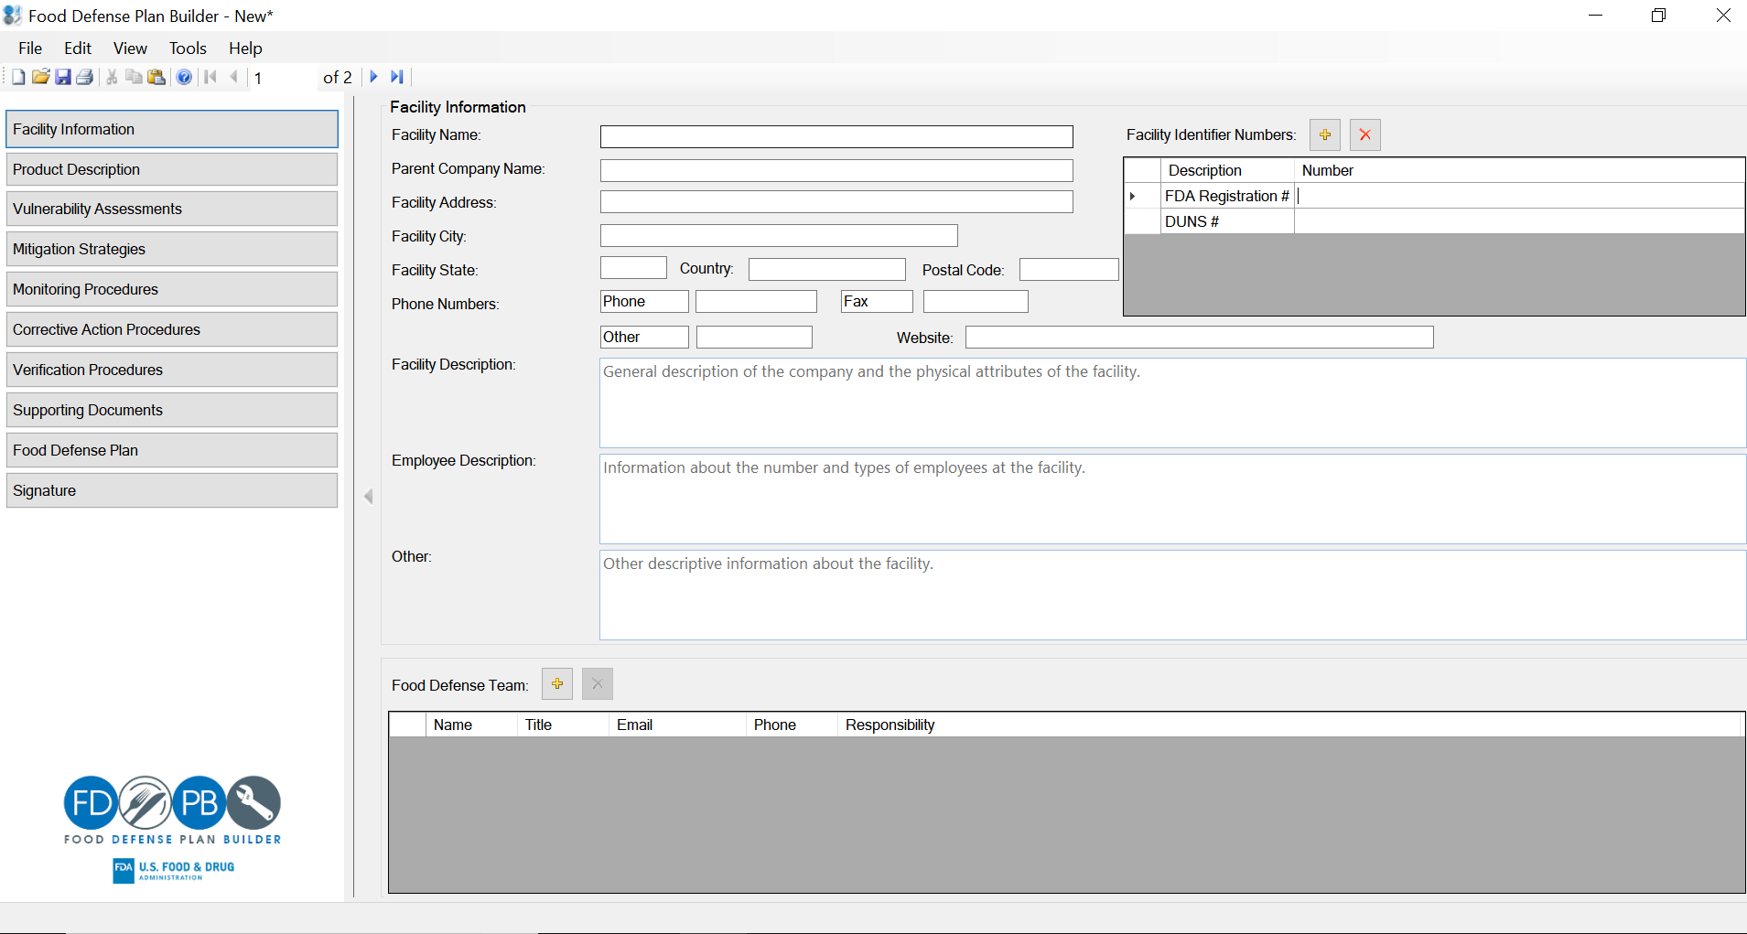
Facility Information

Slide 111
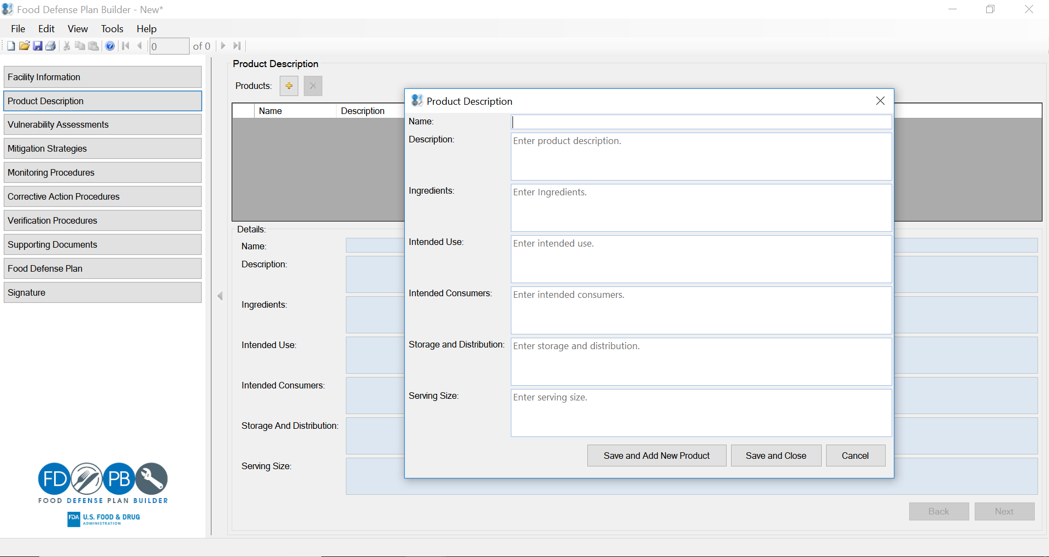
Product Description

Slide 112
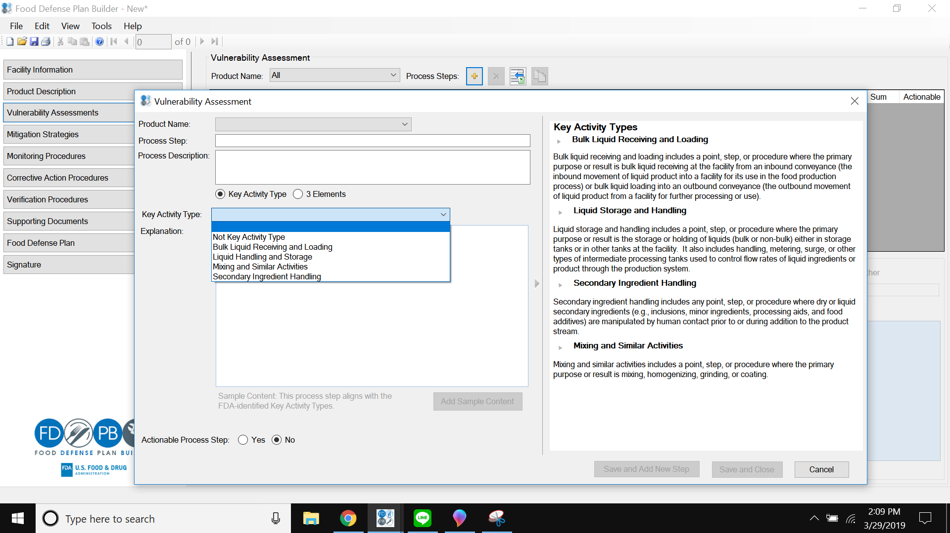
Vulnerability Assessment

Slide 113
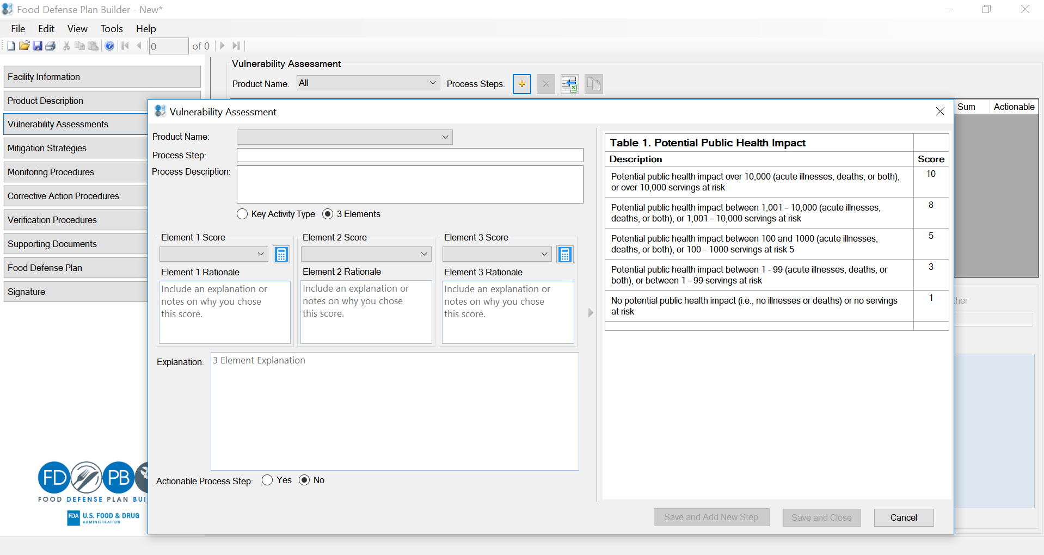
Vulnerability Assessment

Slide 114
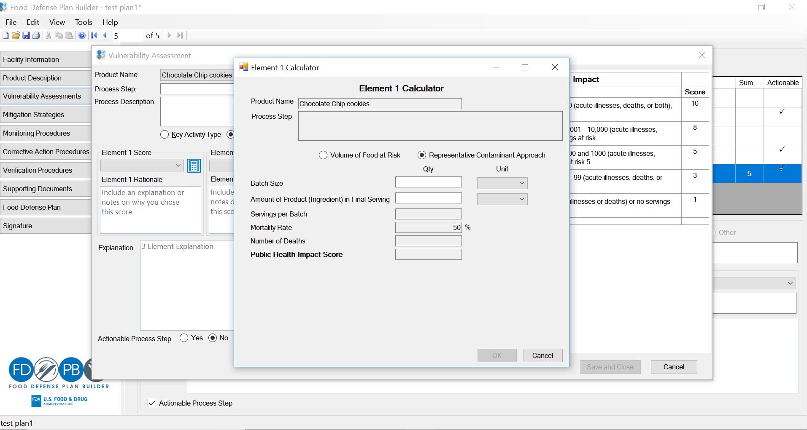
Vulnerability Assessment

Slide 115
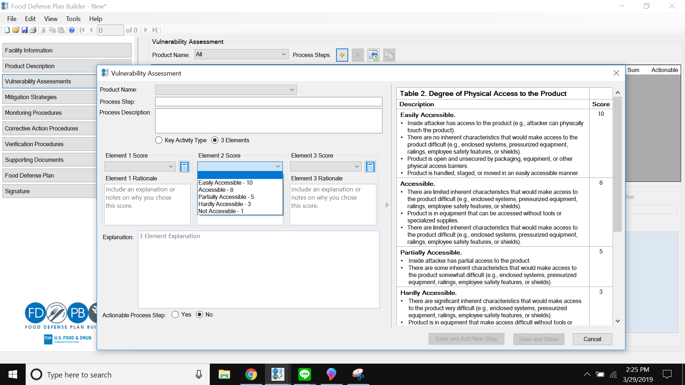
Vulnerability Assessment

Slide 116
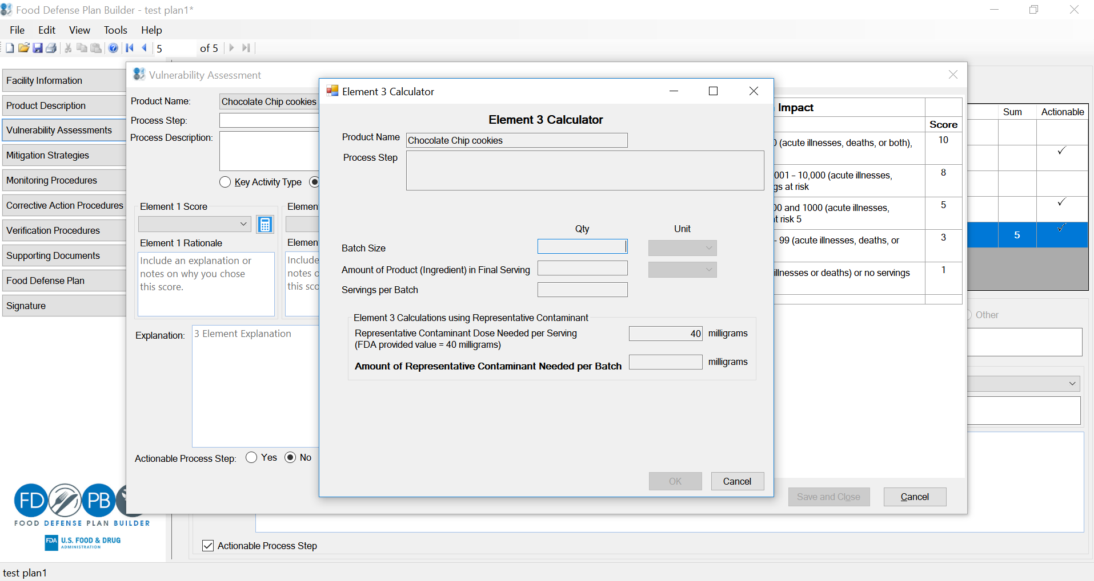
Vulnerability Assessment

Slide 117
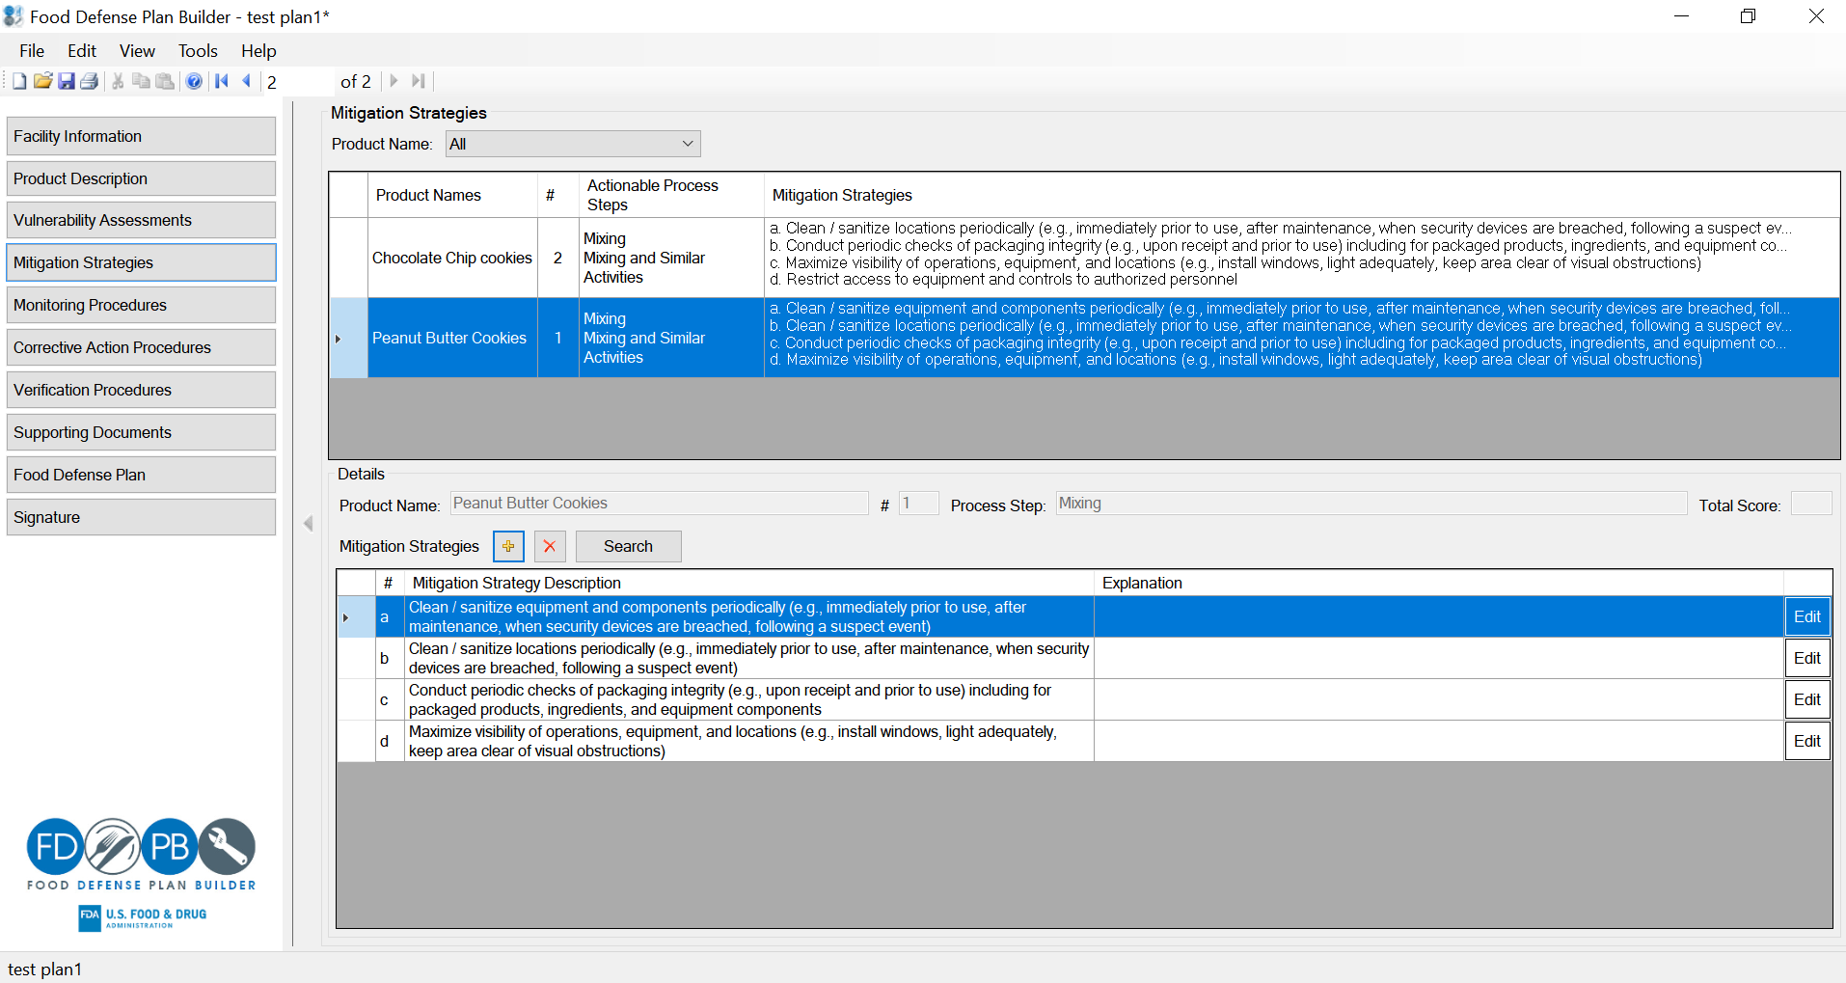
Mitigation Strategies

Slide 118
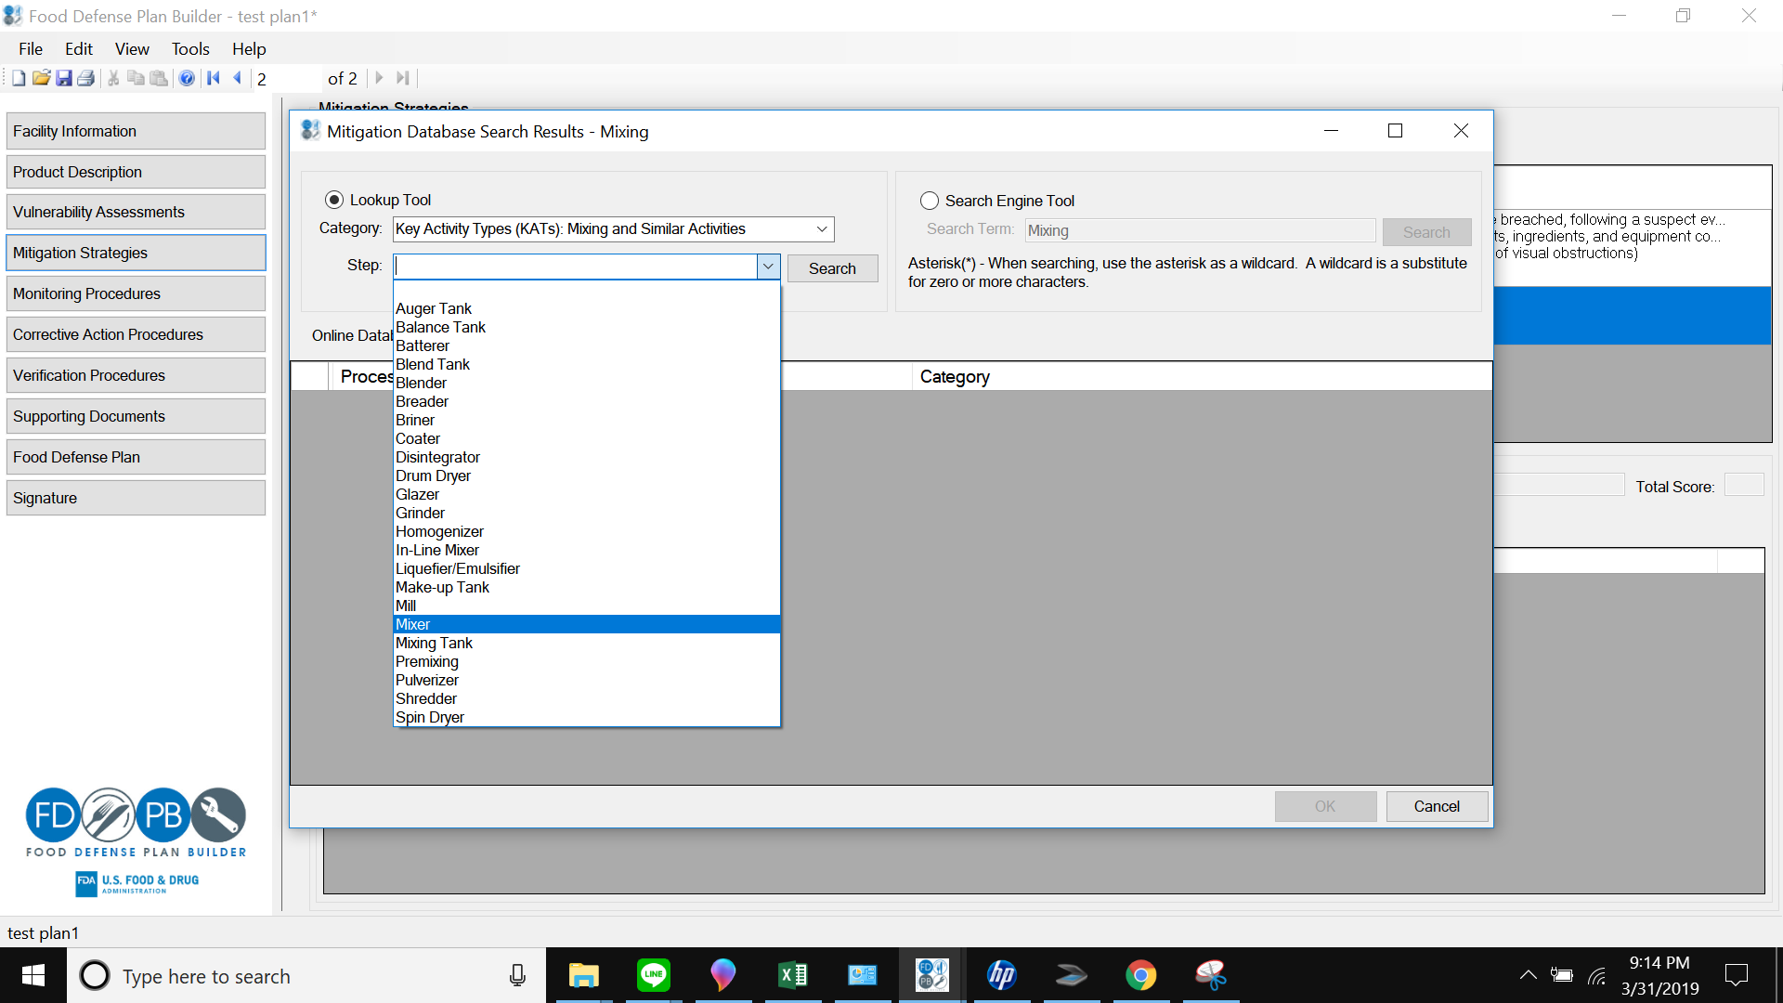
Mitigation Strategies

Slide 119
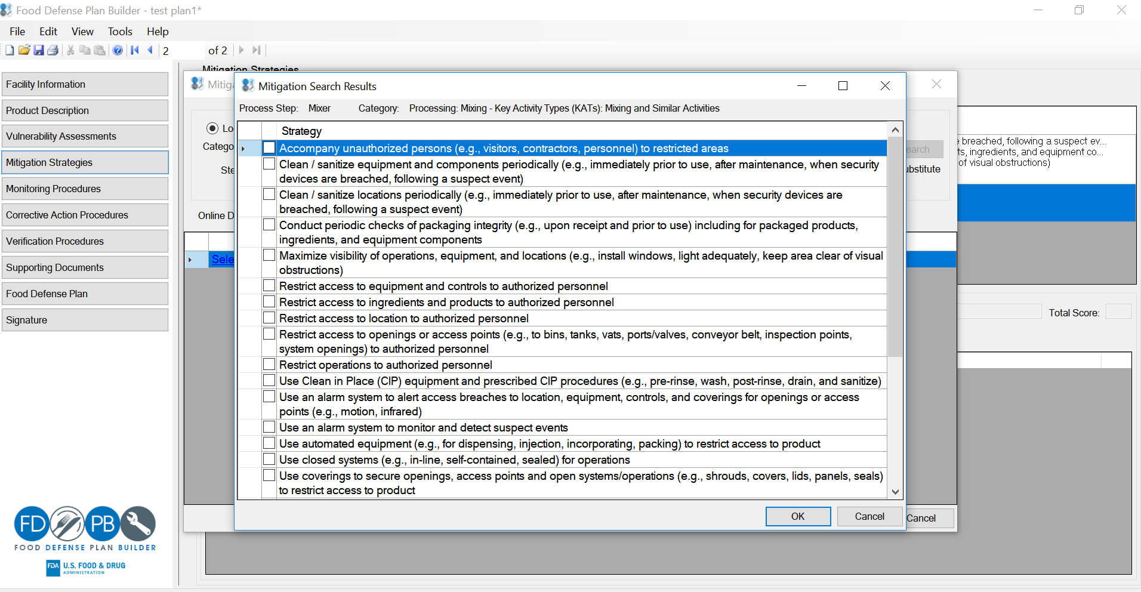
Mitigation Strategies

Slide 120
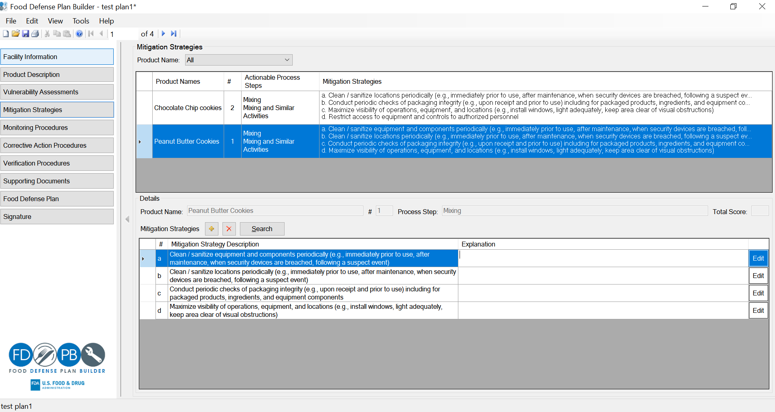
Mitigation Strategies

Slide 121
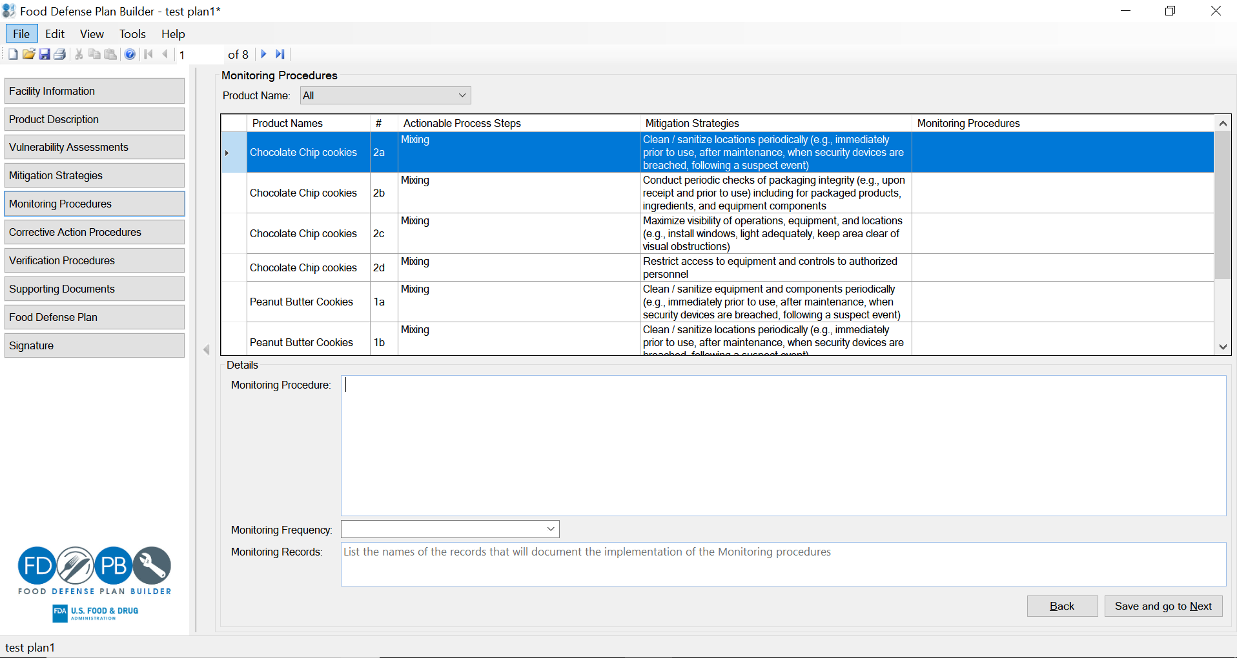
Monitoring Procedures

Slide 122
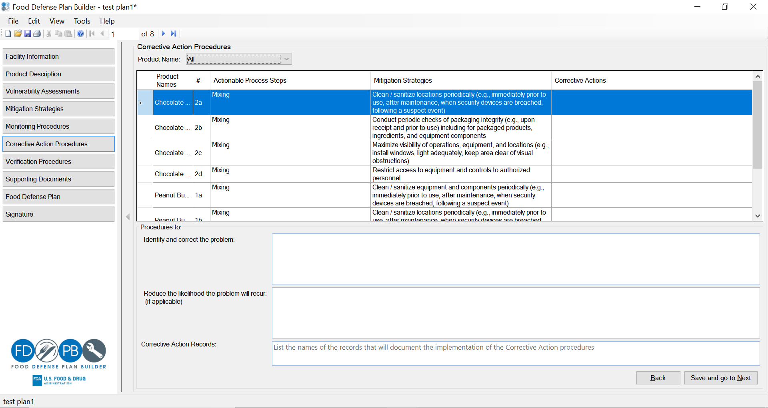
Corrective Action Procedures

Slide 123
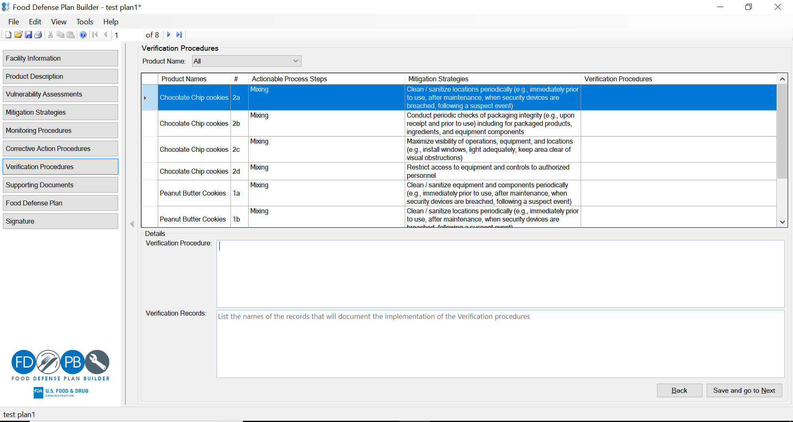
Verification Procedures

Slide 124
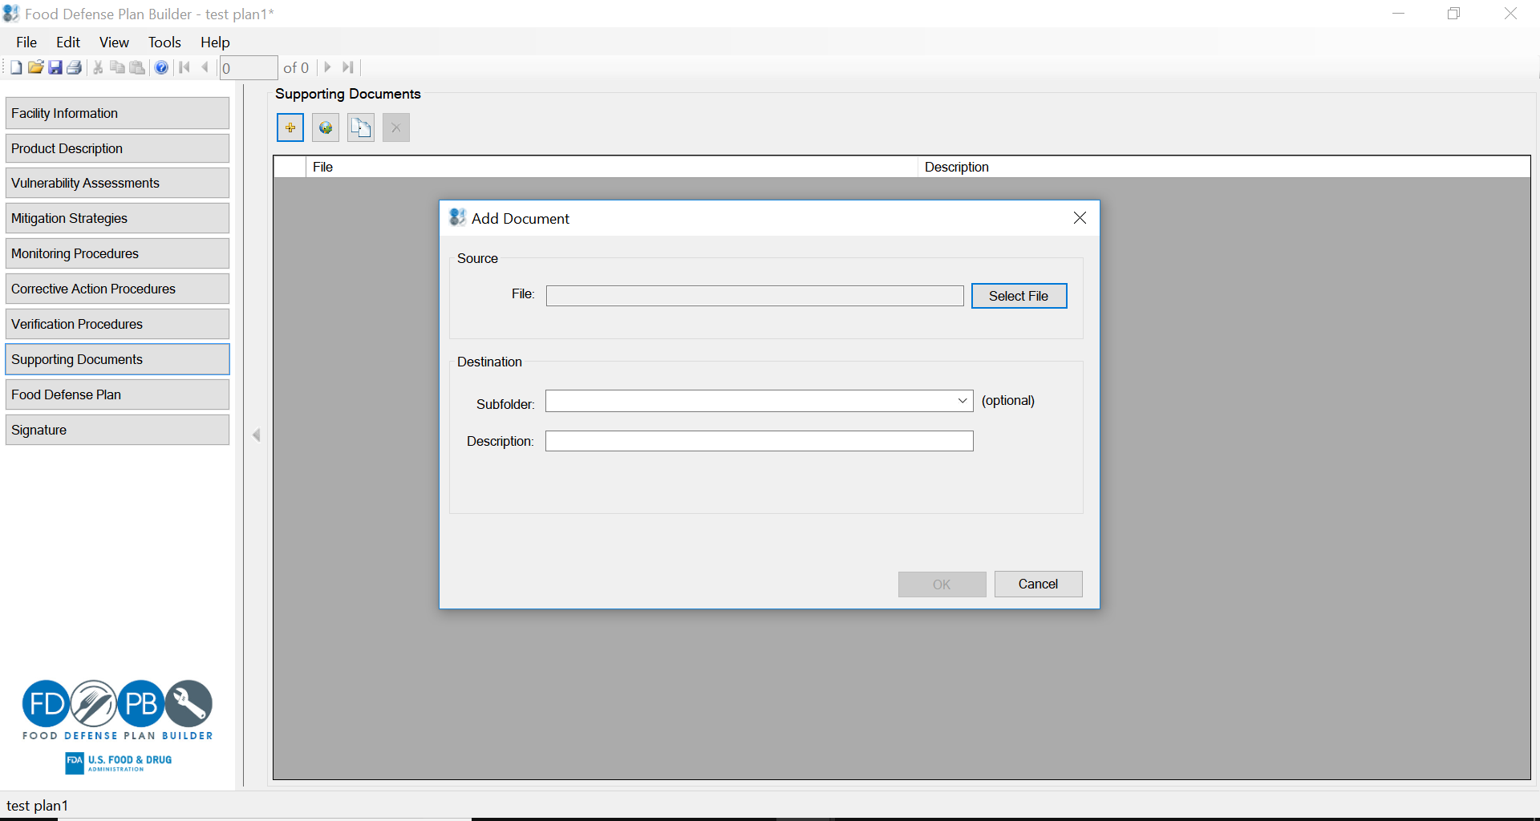
Supporting Documents

Slide 125
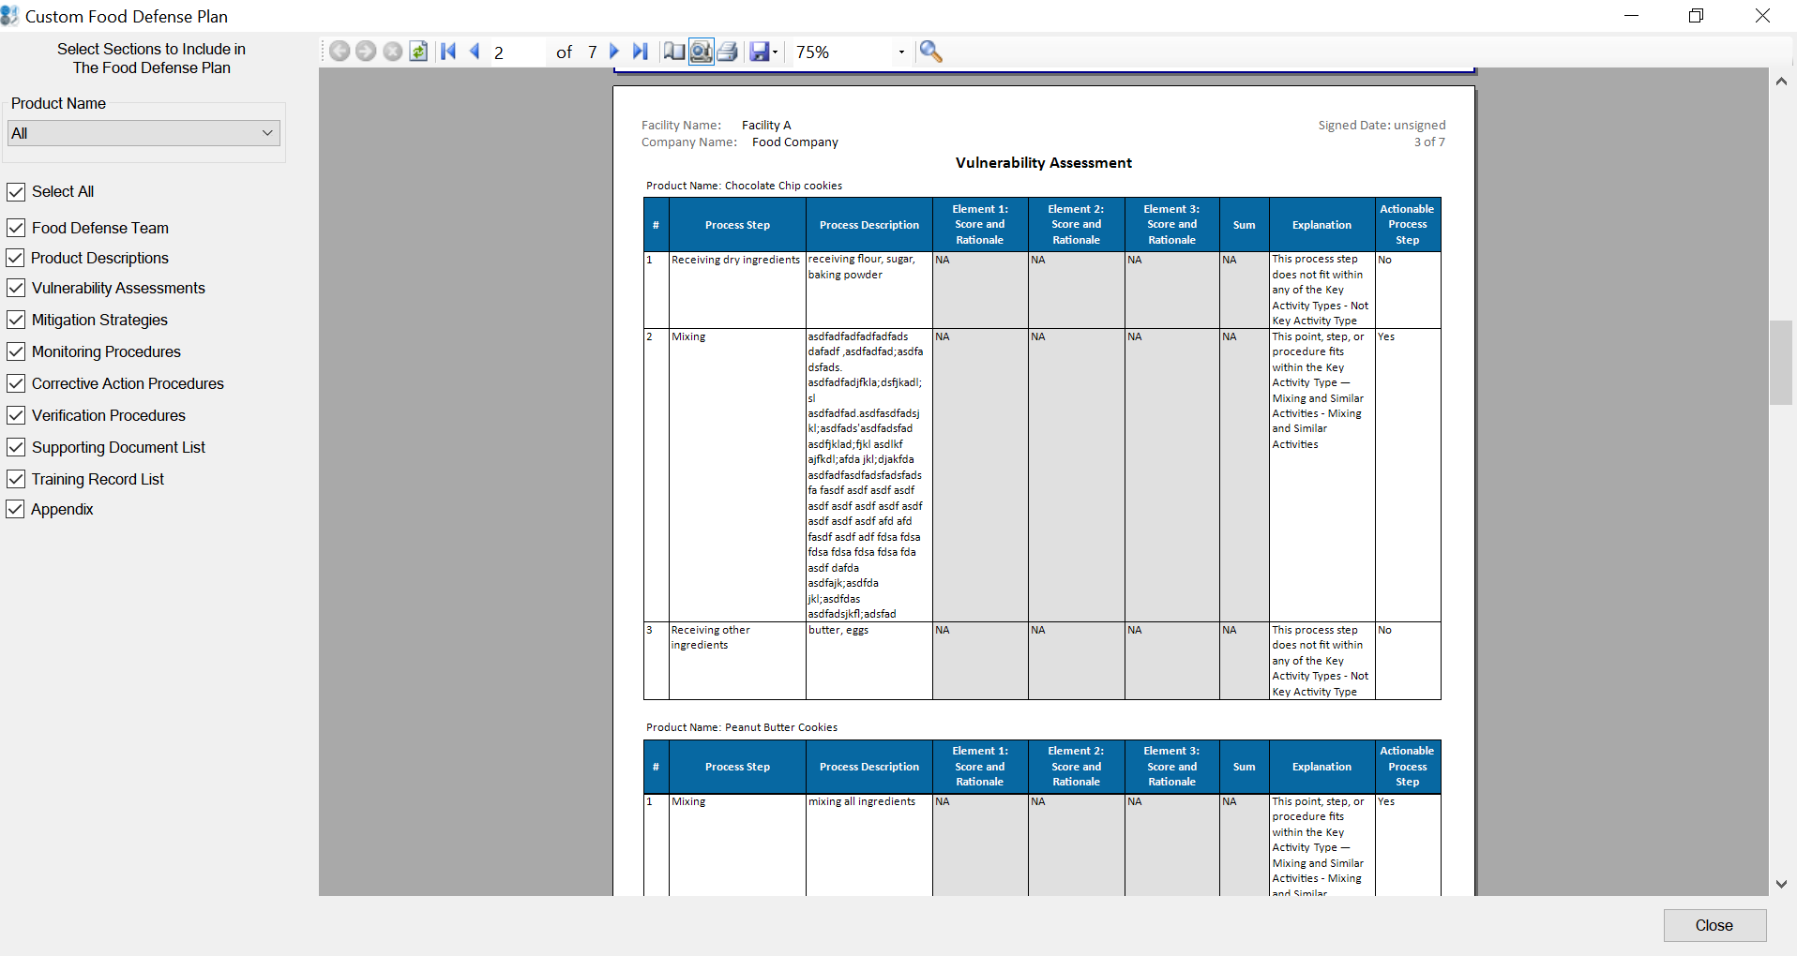
Food Defense Plan

Slide 126
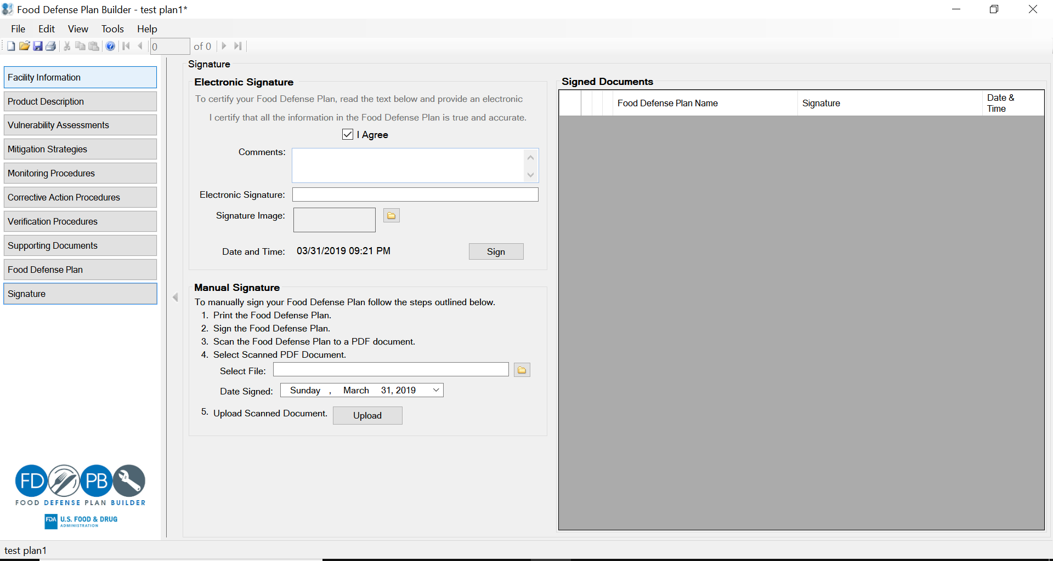
Signature

Slide 127
Questions and Answers Session

Slide 128
Public Comments Session

Slide 129
Closing Remarks

