Slide 1

Transparency in Service of Public Health:
FDA’s Nutrition Innovation Strategy
FDA Public Meeting, July 26, 2018
Laura MacCleery
Policy Director
Center for Science in the Public Interest

Slide 2
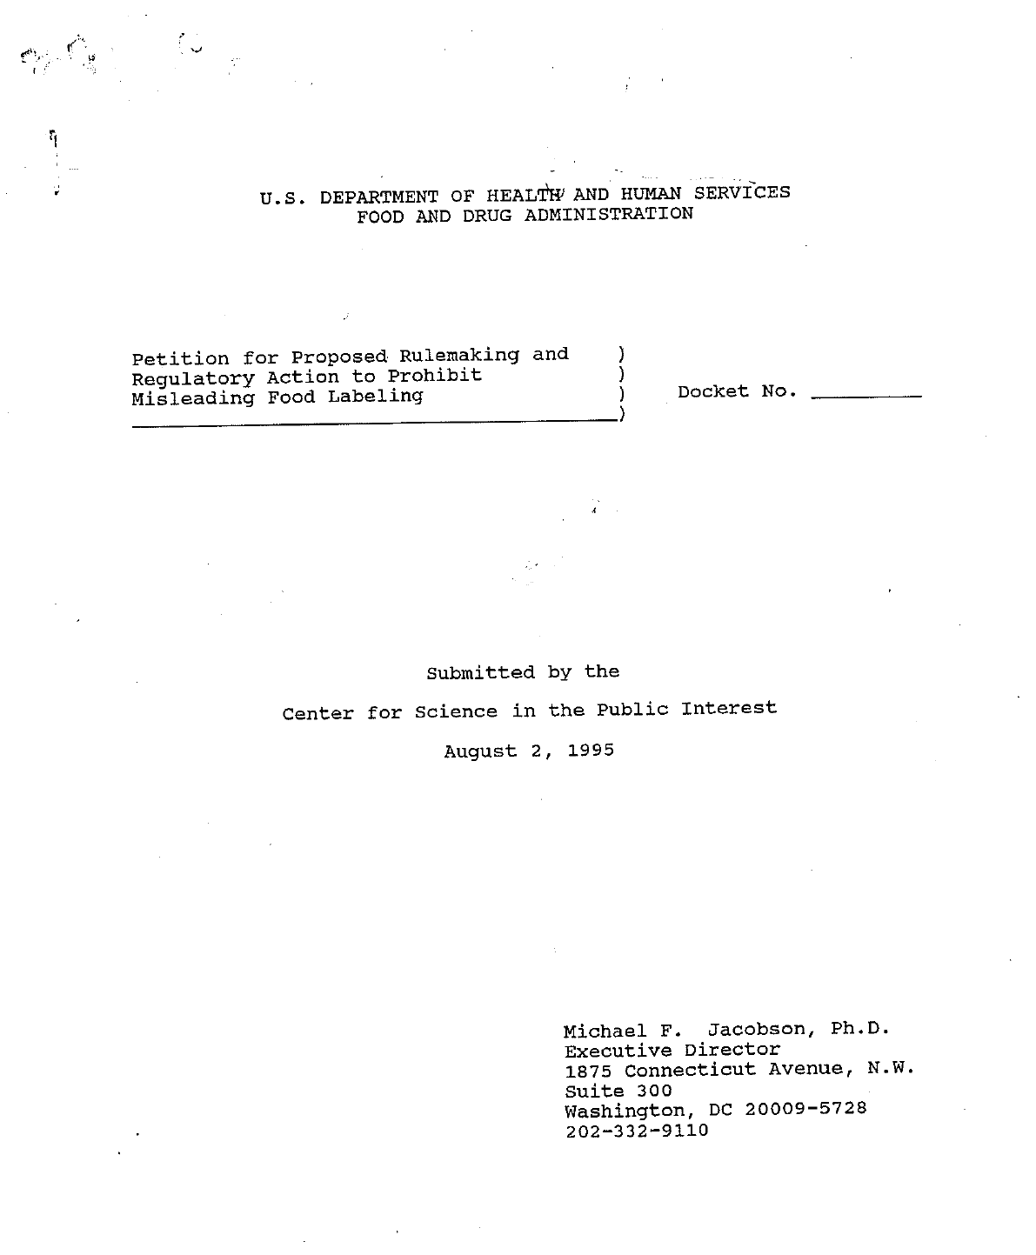
Petition to Prohibit Misbranding of Whole Wheat Products and to Promulgate Food Labeling Regulations Concerning Products Made with Whole Wheat, June 25, 1993
Petition for Proposed Rulemaking and Regulatory Action to Prohibit Misleading Food Labeling, August 2, 1995
Petition for Regulatory Action to Prevent the Unapproved Use of the Term “Energy” on Food Labels, November 27, 1996
Petition for Proposed Rulemaking to Require Percentage Ingredient Labeling, March 26, 1997
Petition for Proposed Rulemaking to Establish Format Requirements for Ingredient Lists, July 26, 2001
Petition for Rulemaking on Functional Foods and Request to Establish an Advisory Committee, March 21, 2002
Petition for Advance Notice of Proposed Rulemaking on the Use of Symbols on the Principal Display Panel to Communicate the Healthfulness of Foods, November 30, 2006

Slide 3

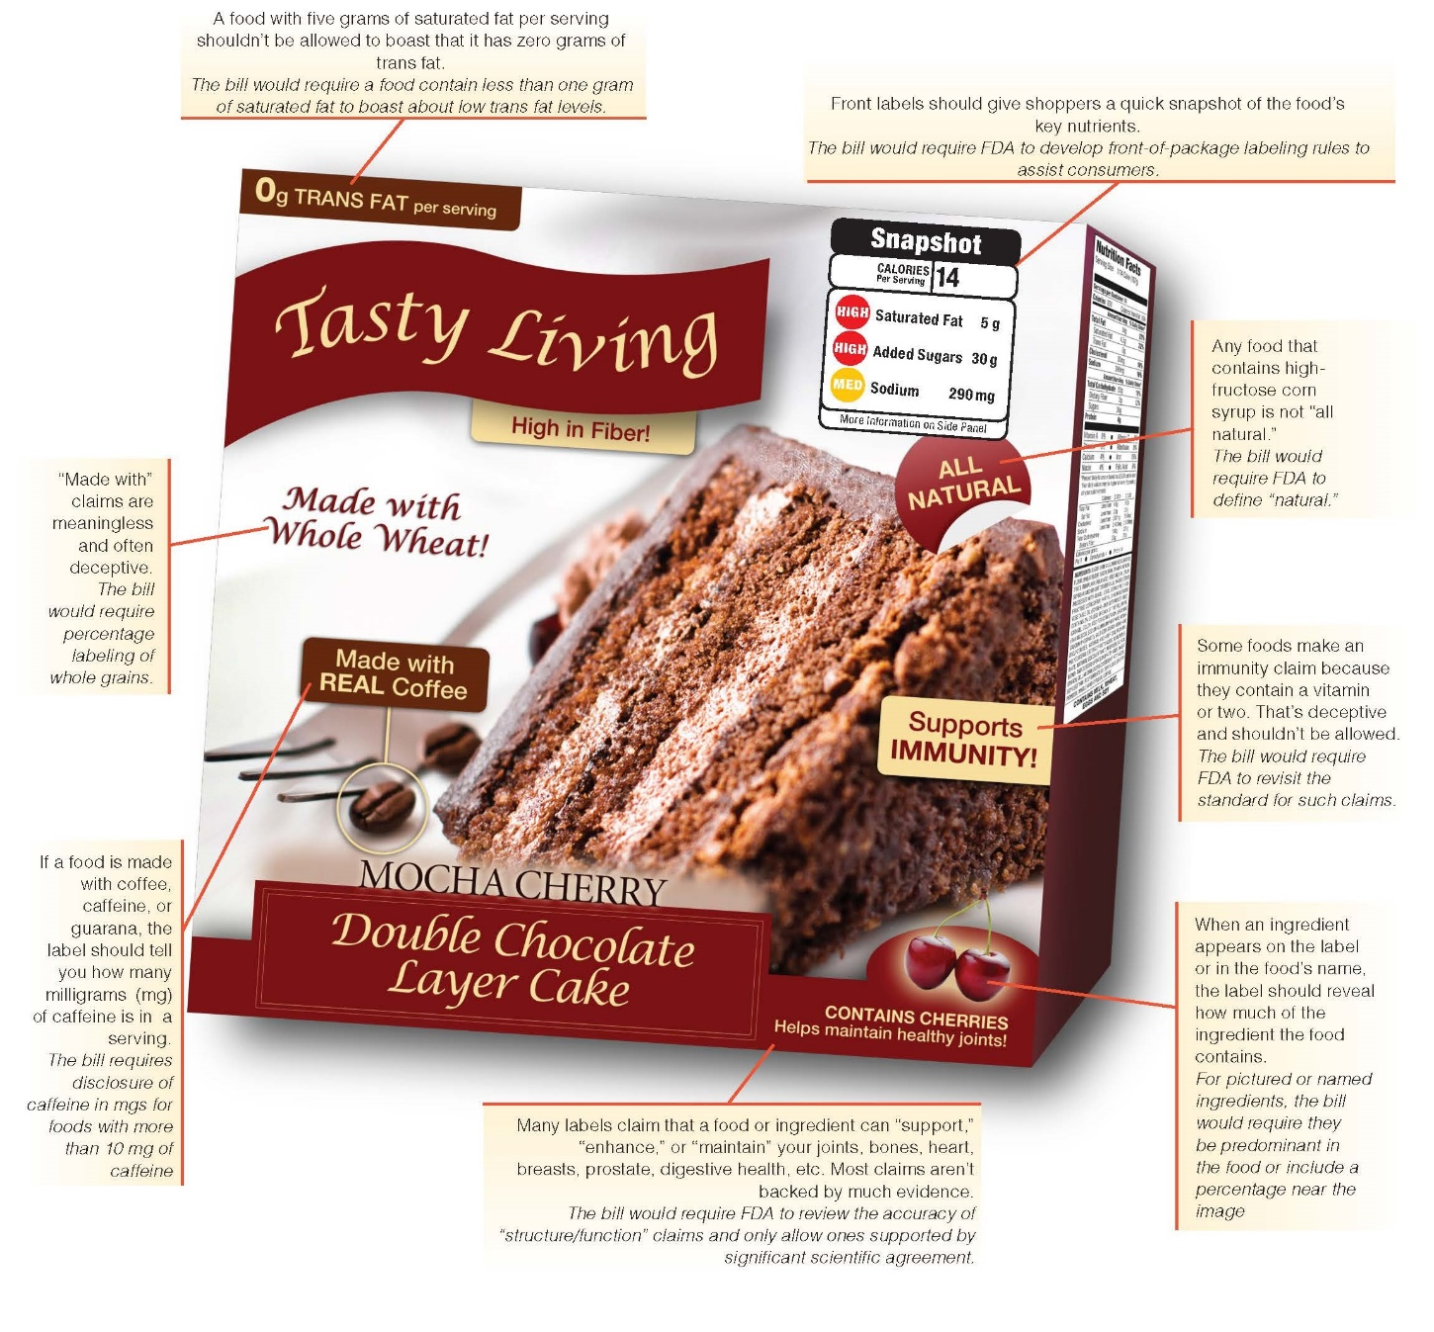

Slide 4
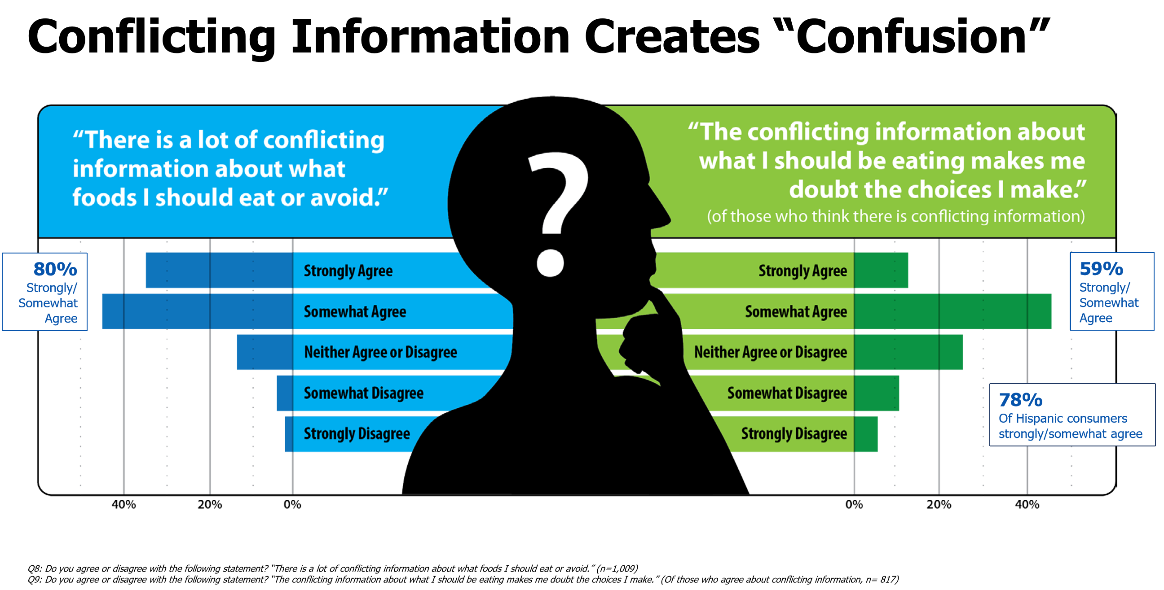
2018 International Food Information Council findings:

Slide 5
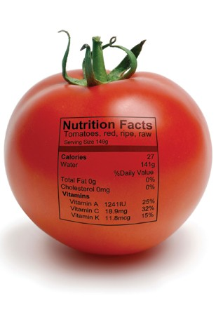

Slide 6
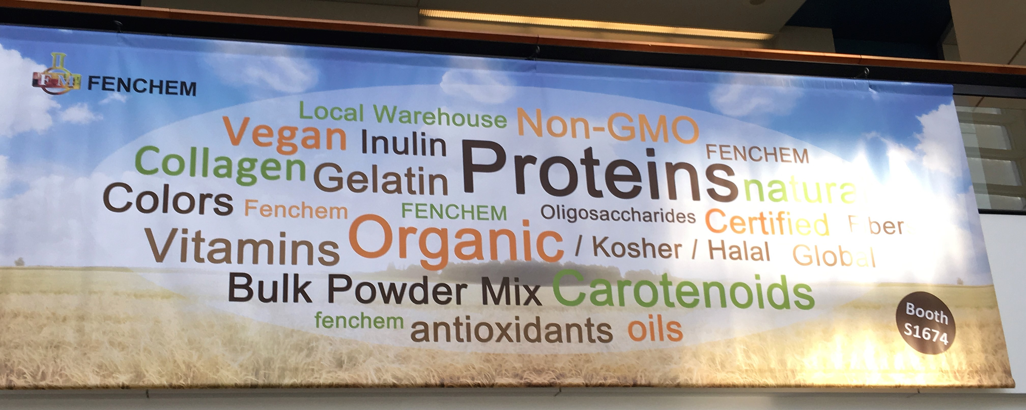

Slide 7
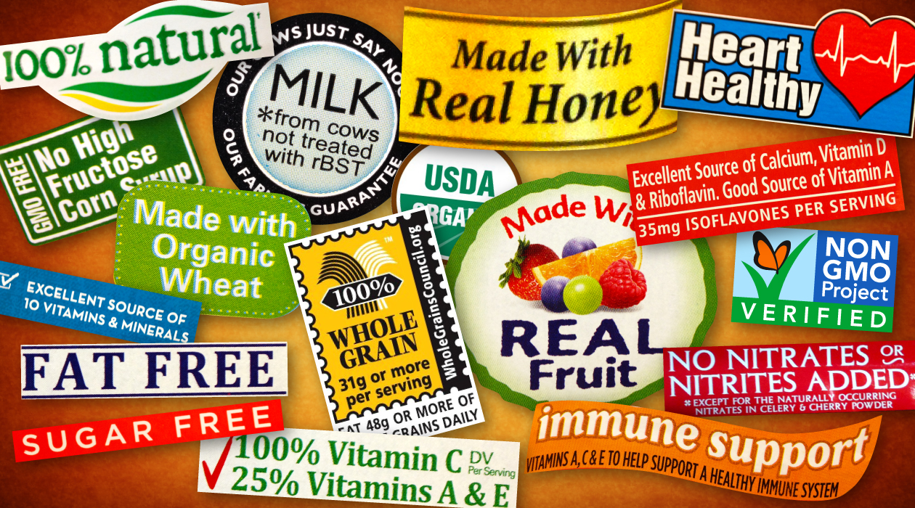
Labeling Claims

Slide 8
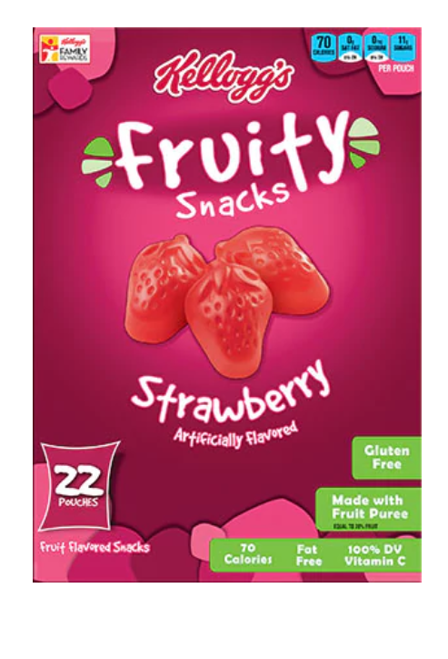
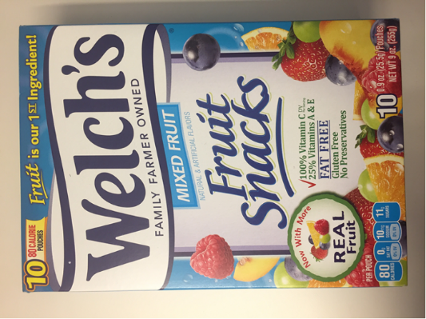
“Fruit” Snacks or
“Fruity”
Snacks?

Slide 9
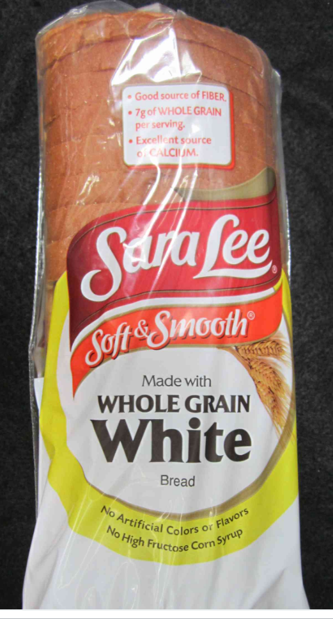
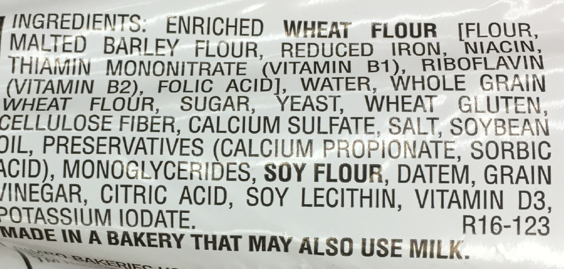
Recommended Disclosure:
* 7 g of Whole Grain per serving
23 g of Refined Grain per serving

Slide 10
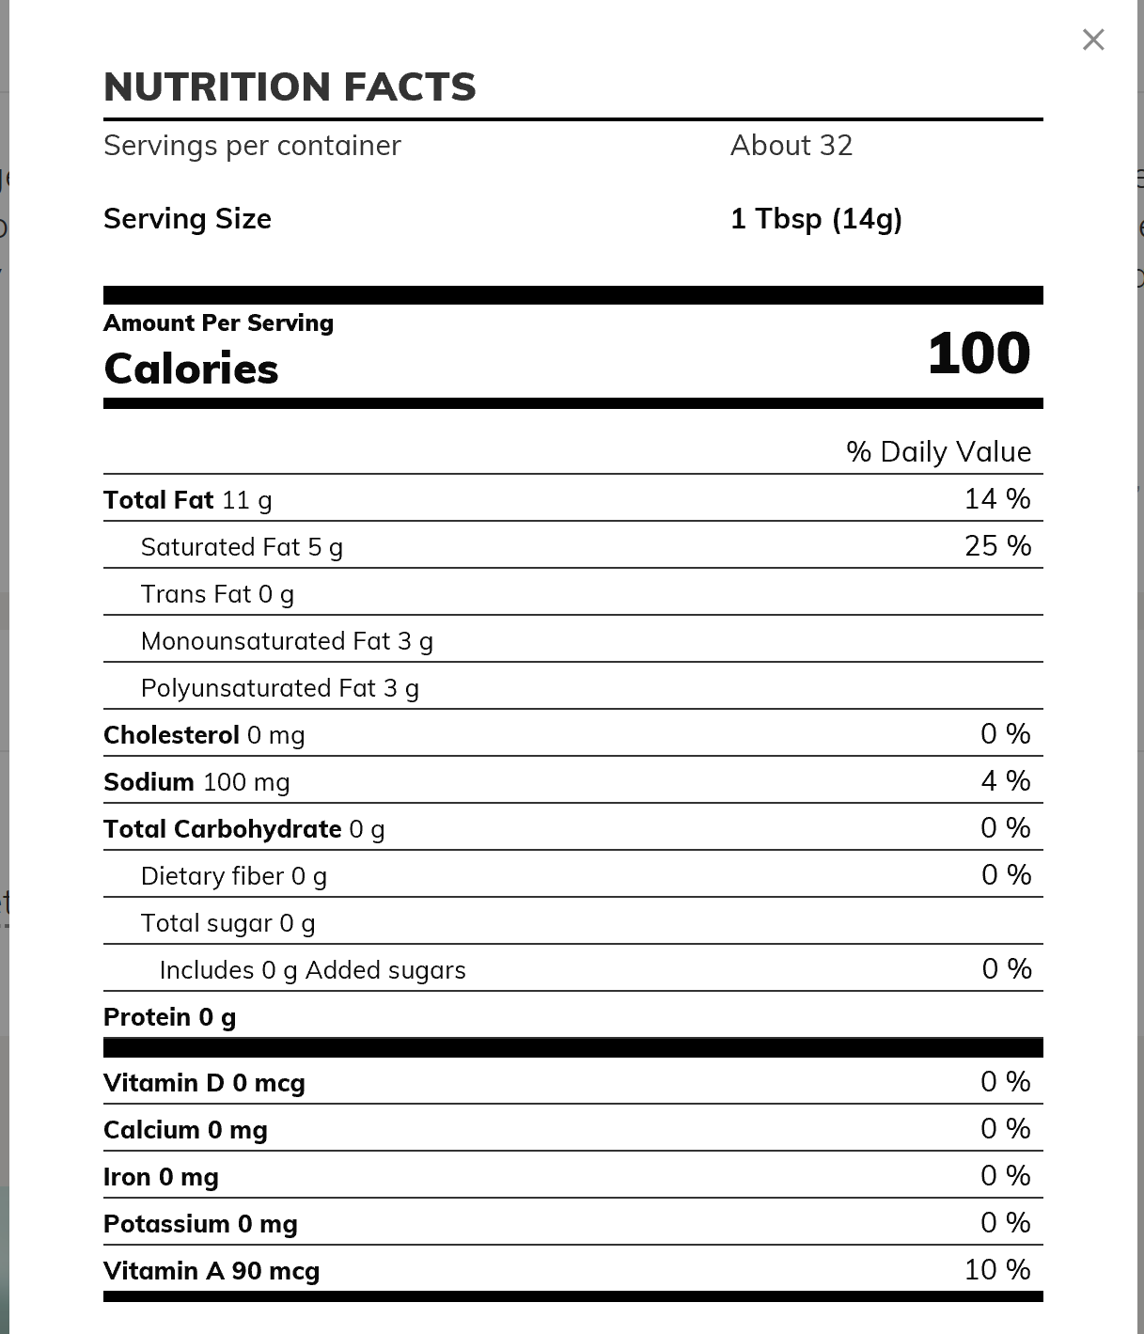
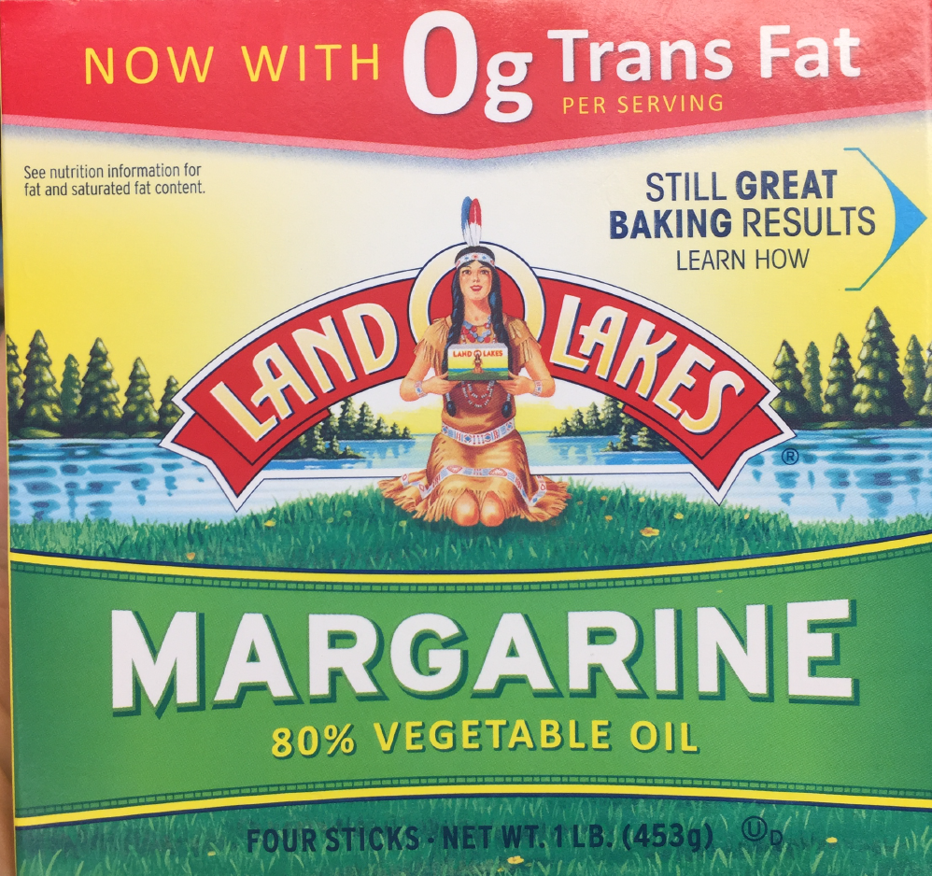

Slide 11
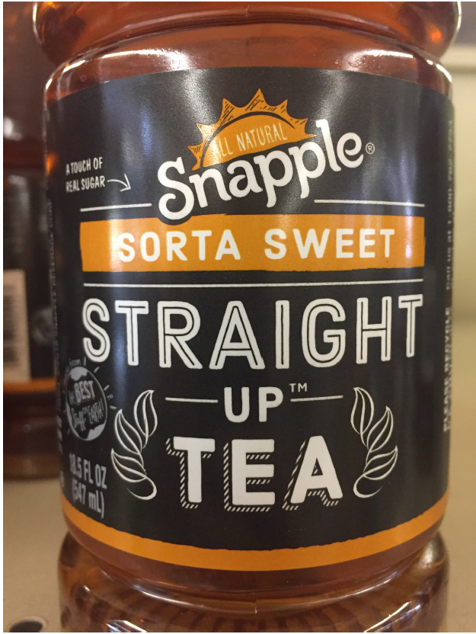
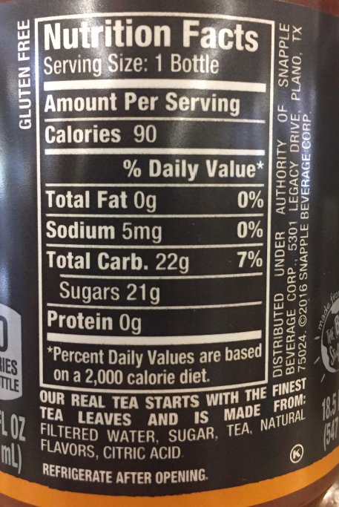

Slide 12

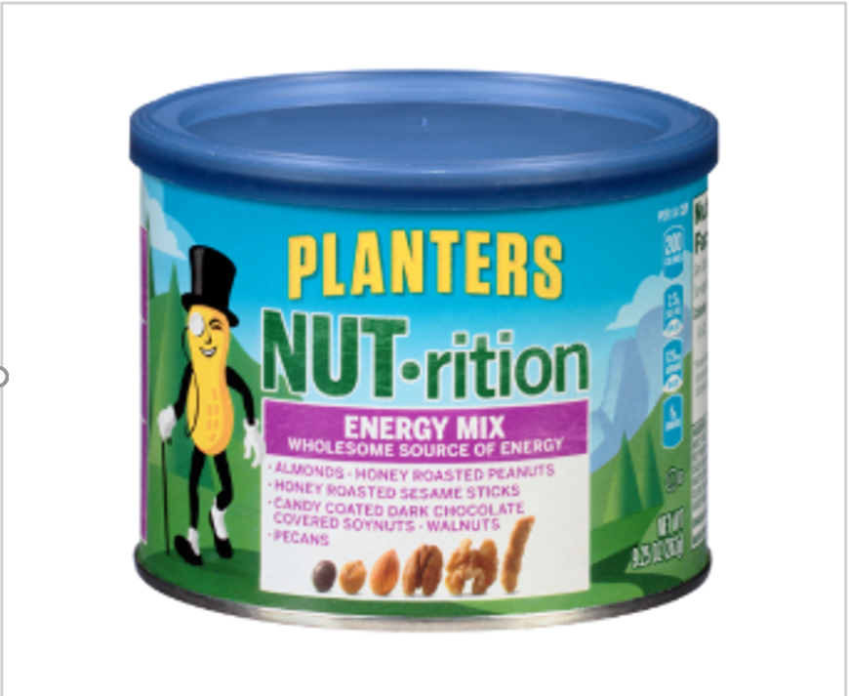
belVita Breakfast Biscuits 4 HOURS OF NUTRITIOUS STEADY ENERGY
One of the unique benefits of belVita Breakfast Biscuits is the 4 hours of nutritious steady energy they provide all morning long. The delicious biscuits are made with a combination of grains that are carefully baked to release energy regularly and continuously to fuel your body throughout the morning

Slide 13



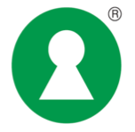


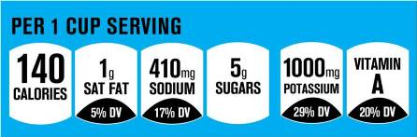
Some FOP Labeling Systems
Australia/New Zealand
North America
Sweden
The Netherlands
United States
(will be phased out)

Slide 14

Thank You

