Slide 1
Development of a List of pre-Dietary Supplement Health and Education Act
Dietary Ingredients
FDA Public Meeting
October 3, 2017
Jay Sirois, Ph.D.
Senior Director, Regulatory & Scientific Affairs
Consumer Healthcare Products Association (CHPA)

Slide 2
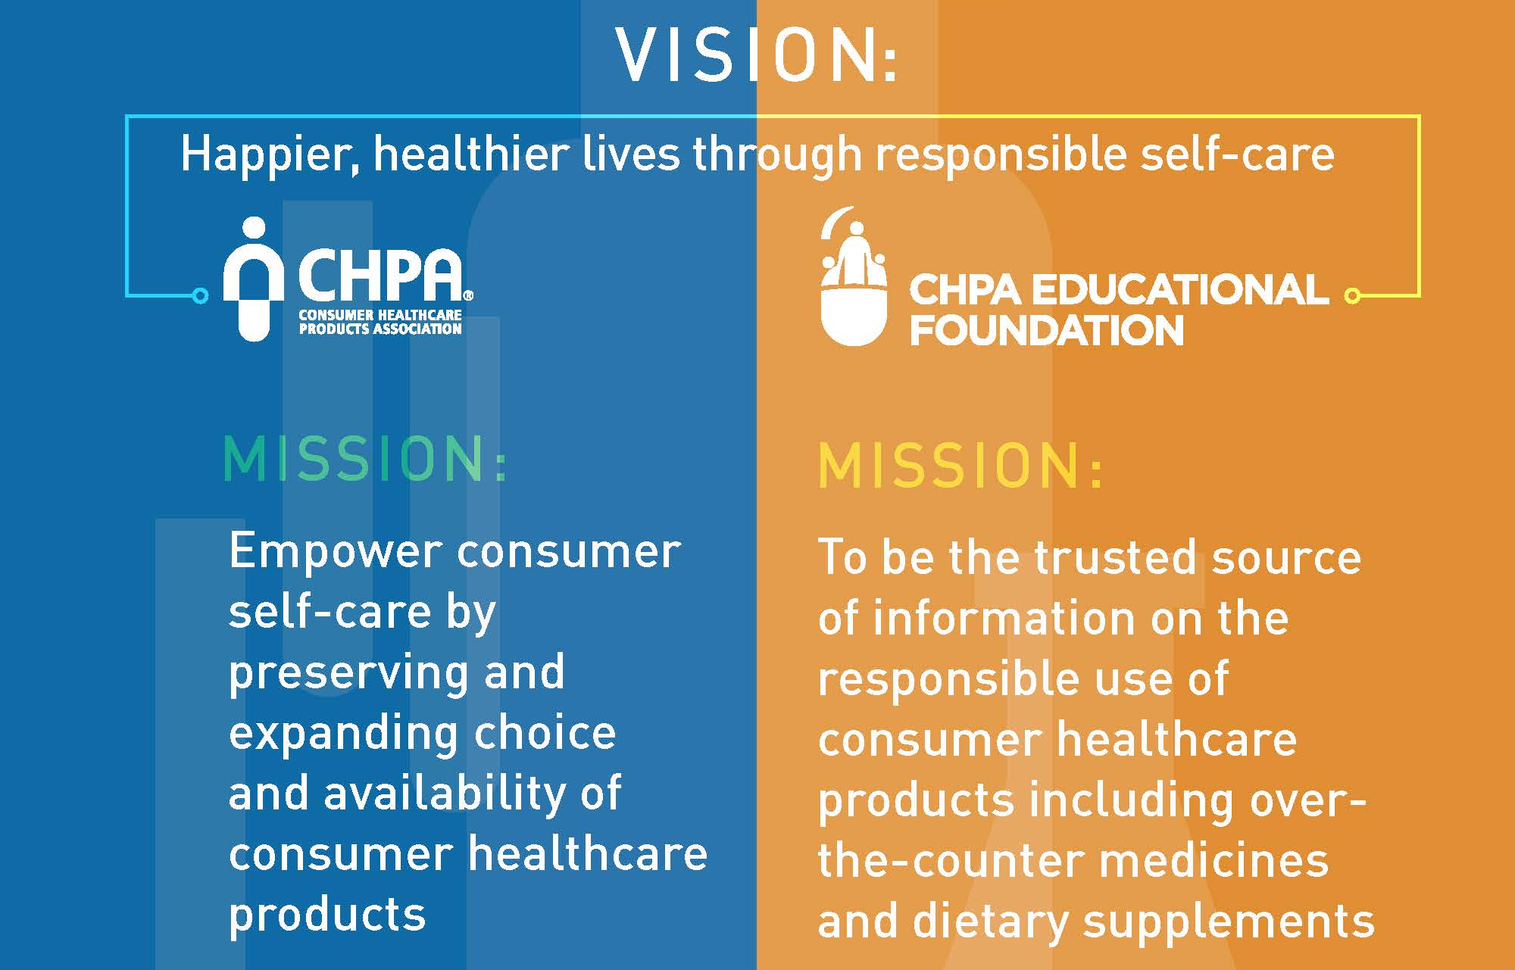
Vision

Slide 3
Process used to develop a list of pre-DSHEA Ingredients
TOPICS FOR DISCUSSION
Processes for nominating and reviewing ingredients
Should an outside panel be convened? If so, what should the composition be?
How should confidential information be handled?
What should the ultimate list look like?

Slide 4
Agenda
Lessons Learned from the OTC Drug Review
History of the Food, Drug, and Cosmetic Act (FDCA)
  Drug Efficacy Study Implementation (DESI Review)
Ingredient Review Process
Expert Panel Composition
End product (“Final Monograph”)
Key Considerations for the pre-DSHEA Ingredient Review Process

Slide 5
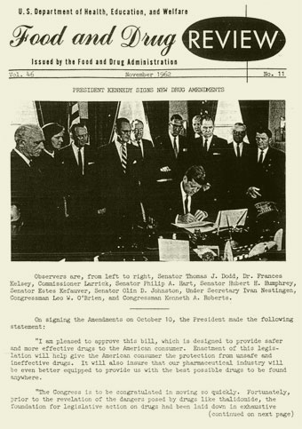
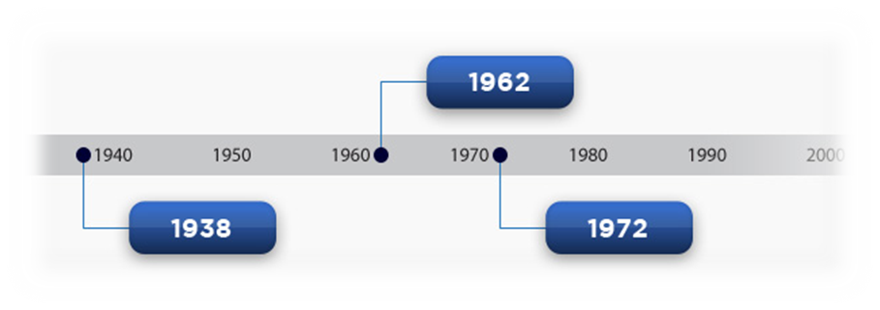
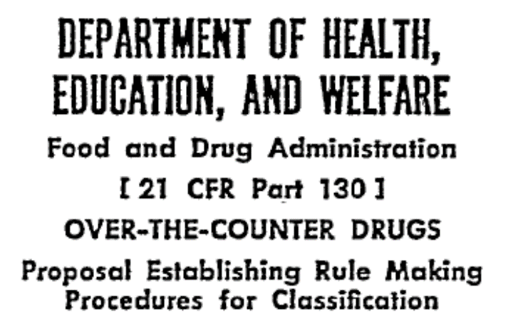
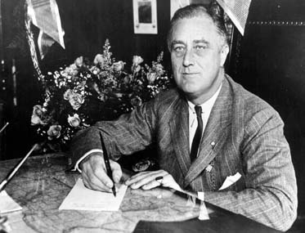
FDCA History
Kefauver-Harris Amendments
DESI Review 1966
Food, Drug and Cosmetic Act
OTC Monograph review

Slide 6

OTC Drug Review (1972)
Goal
Ensure OTC drugs (100,000-500,000) are safe and effective
Process
Review evidence by therapeutic drug class
17 panels; 27 classes of ingredients
Expert Panel
7 voting members chosen by FDA Commissioner
Professional, consumer and industry group recommendations
Designated consumer (1) and industry (1) members (non-voting)

Slide 7
OTC Drug Review (1972)
3-step rulemaking process with availability for public comment
Advanced Notice of Proposed Rulemaking
Tentative Final Monograph
Final Monograph
Ingredient Status
Category I - Generally Recognized As Safe and Effective (GRAS/E)
Category II - not GRAS/E
Category III - more data needed
PROS
CONS
Able to review large number of ingredients
Constructive review by key stakeholders
Public comments
Lengthy
No longer feasible – proposing to move to an Administrative Order process

Slide 8
Key Considerations – pre-DSHEA Dietary Ingredient Review
Expert Panel
Dietary Ingredient List
Evidence review
Public comment
Decision – pre-DSHEA or not
1
2
3
4
5
7 voting members
FDA Commissioner decision
Consumer\Industry reps
Enforcement discretion
FDA call for ingredients \evidence Confidentiality
Prioritization by FDA\Expert Panel
Expert Panel review
Fed Reg publication
Comment on Expert Panel decision
FDA issues final decision
Time to address insufficient evidence finding
Arbitration process

Slide 9
Expert Panel
Voting members (7)
FDA (3) Industry (3)
Additional (1) agreed upon by FDA and industry
Non-voting members (2)
Consumer (1) Industry (1)
Suggested by consumer and industry groups
All participants chosen by FDA Commissioner
Dietary Ingredients
FDA issues notice of enforcement discretion (e.g., “ODI” list)
FDA public call for dietary ingredients\evidence of marketing
Allow submitters to claim confidentiality of information
FDA\Expert Panel prioritization of dietary ingredients for review

Slide 10
Dietary ingredient review
Expert Panel review of evidence
Use criteria agreed upon by Panel
Issues Report to FDA on dietary ingredient status
2 outcomes
Confirmed as a dietary ingredient (Section 413(c))
Insufficient evidence of pre-DSHEA marketing

Slide 11
Public comment/End product
FDA publishes Panel decision in Fed Reg
Public comment period
FDA issues Final decision on dietary ingredient status Maintains a pre-DSHEA ingredient list
Considerations
Identify timeframe for companies to respond to a finding of “insufficient evidence” of pre-DSHEA marketing
Insufficient evidence does not necessarily preclude an ingredient from being marketed
Arbitration process for cases in which submitter and Expert Panel disagree on evidence for pre-DSHEA marketing

Slide 12
Summary
OTC Drug Review pre-DSHEA List
Expert panel review of all available information?
Review administered according to impacting legislation?
Opportunity for Public Comment?
Ingredient
Yes Yes
Yes (FDCA) Yes (DSHEA)
Yes Yes
Monograph,
Non-monograph
Inclusion\Exclusion

