Slide 1
Natural Products Association
October 3, 2017
Daniel Fabricant, Ph.D.
CEO/President
FDA Public Meeting for the
Development of a List of Pre-DSHEA Dietary Ingredients

Slide 2
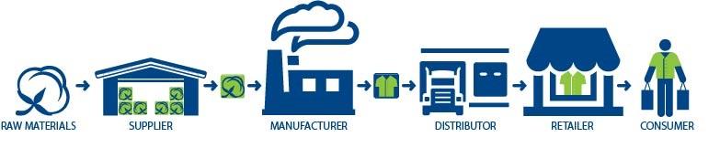
About
Leading Trade Association For Natural Industry:
Dietary Supplements | Conventional Foods (Natural) | Probiotics|
Sports Nutrition | Medical/Functional Foods | Home Care | Homeopathics | Personal Care/Cosmetics
1,000 Members
Representing Full Supply Chain

Slide 3
NDI Issues
1) Master File (eliminate need for unnecessary duplicate filings of the same NDI
2) Grandfathered list of old dietary ingredients
3) Clarification on 201(ff)(1)(E)
4) Synthetic copies of naturally-occurring constituents
5) IP Protection
6) Listing of chemical processes that would and would not lead to a “chemically altered” ingredient

Slide 4
What does the Law say?
FDA does not have the authority for this particular process, so they must abide by “Reg Flex”
Agencies must adopt policies that impose the least burden on small entities, OR mandate exemptions for small entities.
Requires agencies to examine public policy issues using an analytical process that identifies, among other things, barriers to small business competitiveness
Examine public policy that seeks a level playing field for small entities, not an unfair advantage or disadvantage
Regulatory Flexibility Act asks agencies to be aware of the economic structure of the entities they regulate AND the effect their regulations may have on small entities
Therefore, agencies must analyze the economic impact of proposed regulations, guidance, policy when there is likely to be a significant impact on a substantial number of small entities, AND to consider regulatory alternatives that will achieve the agency’s goal while minimizing the burden on small entitites.

Slide 5
“Dietary Substance for Use by Man ….” 201(ff)(1)(E) – Wide Open
Case Law – What can be a Dietary Ingredient
Where do synthetic copies of botanical constituents qualify under?
FDA claims there is no definition of “dietary substance” so they have defined it
FDA NDI Guidance
  “Because the ‘dietary substance’ category is defined in part by history of use, a synthetic copy of a botanical ingredient may qualify as a dietary ingredient under section 201(ff)(1)(E) if the synthetic copy has been used as a lawfully marketed ingredient in the conventional food supply. For example, a synthetic copy of a botanical ingredient would be a dietary ingredient under section 201(ff)(1)€ if the synthetic copy has been used as an ingredient in the conventional food supply. Two common examples are vanillin and cinnamic acid, botanical constituents that, for economic reasons, are usually produced synthetically for use as flavorings in food.”
There is no statute or regulation supporting “used as a lawfully marketed ingredient in the conventional food supply
FDA believes 201(ff)(1)(E) is meant only for GRAS, FAP compounds

Slide 6
“Dietary Substance for Use by Man ….” 201(ff)(1)(E)
Case Law – What can be a Dietary Ingredient
There is a definition for “dietary substance” in case law
888 F. Supp. 381 (E.D.N.Y. 1995) United States v. Ten Cartons, Ener-B Nasal Gel.
Ener-B was a B vitamin swabbed up the nose, wanted to be a DS, but court said they were a drug, they argued that vitamin B was a dietary substance and therefore was only a food, but the intent is what made them regulated as a drug
Eastern District NY – The circuit recognized that the FDA’s determination regarding classification of a substance as either a ‘food’ or a ‘drug’ under the Act is generally to be accorded such deference.”
Dietary means consumed through ingestion and thus absorbed into the body through the alimentary canal

Slide 7
“Dietary Substance for Use by Man ….” 201(ff)(1)(E)
Case Law – What can be a Dietary Ingredient
Dietary Substance (888 F. Supp. 381 (E.D.N.Y. 1995) United States v. Ten Cartons, Ener-B Nasal Gel)
  Must be consumed by ingestion and could be a food or drug ingredient and whether it is a food or drug depends on intent or representations made about the product through the product label or in product labeling
Dietary ingredients
  By definition dietary ingredient can’t be FDA drug ingredients, BUT if the botanical was ingested in Traditional Chinese Medicine as a drug, the synthetic copy of that botanical could qualify as a dietary ingredient, as long as it is not an article approved as a new drug or authorized for investigation as a new drug, antibiotic, or biological
  The circuit ruling on “substance” upheld FDA’s view to mean “food” or “drug”
  Dietary substance is not confined to a lawfully marketed conventional food

Slide 8
Independent and Verifiable?
2016 NDI Guidance … “[W]e are prepared to develop an authoritative list of pre-DSHEA ingredients, based on independent and verifiable data.”
“Because FDA does not generally have access to marketing records for dietary ingredients and dietary supplements, the documentation of pre-DSHEA marketing would have to be supplied by industry.”
“[W]e are not likely to regard … an affidavit alone, without any sort of objective, verifiable documentation from the time of marketing, as an adequate basis to establish pre-DSHEA marketing of a substance as a dietary ingredient for use in or as a dietary supplement.”
“Catalogues, Bills of Lading……”

Slide 9
Is it an Ironclad Safe
Harbor?
IF FDA finds a SAFETY issue with any old dietary ingredients (ODIs) or anything on the pre-DSHEA list of dietary ingredients, they can still be examined with post-marketing data and pharmacovigilance tools. FDA has authority to act on all safety concerns.
FDA has the right to go after any dietary ingredient to remove it from the marketplace that is found to be adulterated, misbranded, cause illness/injury
Just because an ingredient is NOT on the list does not mean someone does not have independent and verifiable evidence to conclude it is an old dietary ingredient
Adverse Health Effect
(Illness or Injury)
Biological
Chemical
Physical Agent
Condition of Food

Slide 10
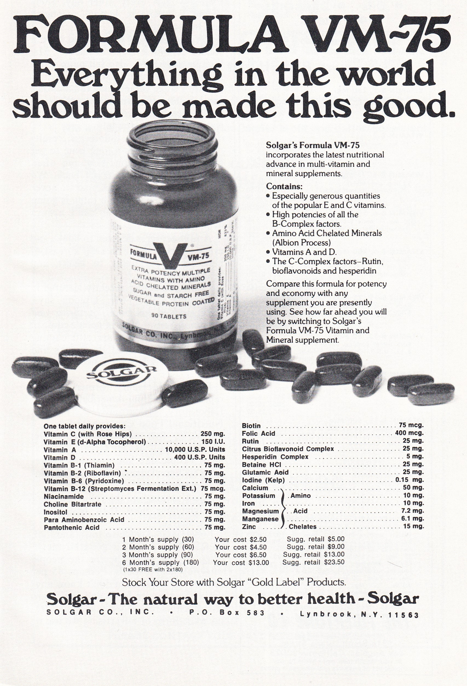
Safe Harbor Database
In Response to FDA’s NDI Guidance:
List of dietary ingredients marketed prior to DSHEA in 1994
Includes 2,100 ingredients
This list includes verified ingredients from media reports, advertising, and other public sources
Includes processes exempted in the Legislative History Statement of Agreement
Verify that your ingredient is on this list before you submit a NDI submission
Addresses evidence FDA is seeking for a company to prove it was a pre-DSHEA ingredient
NO OTHER lists will be excepted by the FDA

Slide 11
Processes Included in Statement of Agreement
Statement of Agreement, 140 Cong. Rec. S14801 (daily ed. Oct. 7, 1994):
[T]he term ‘chemically altered’ does not include the following physical modifications:
  Minor loss of volatile components
  Dehydration
  Lyoph[i]lization
  Milling
  Tincture
  Solution in water
  Slurry
  Powder
  Solid in suspension
“Tincture” is also referred to as a “solution in aqueous ethanol” in the NDI guidance
NPA’s Pre-DSHEA List of Ingredients therefore covers extracts of ingredients in water and ethanol

Slide 12
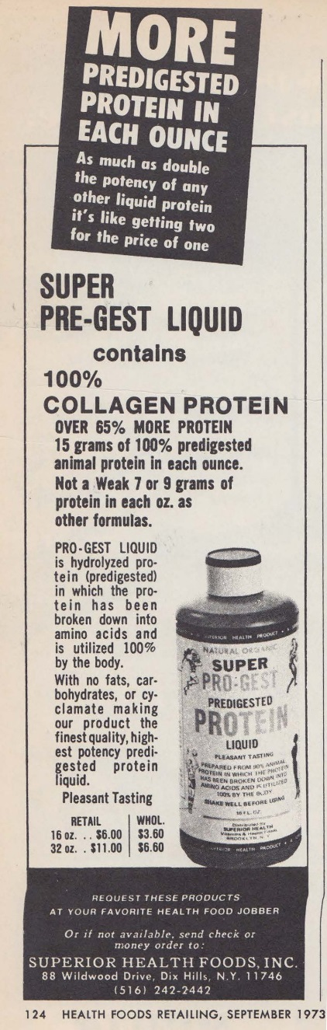
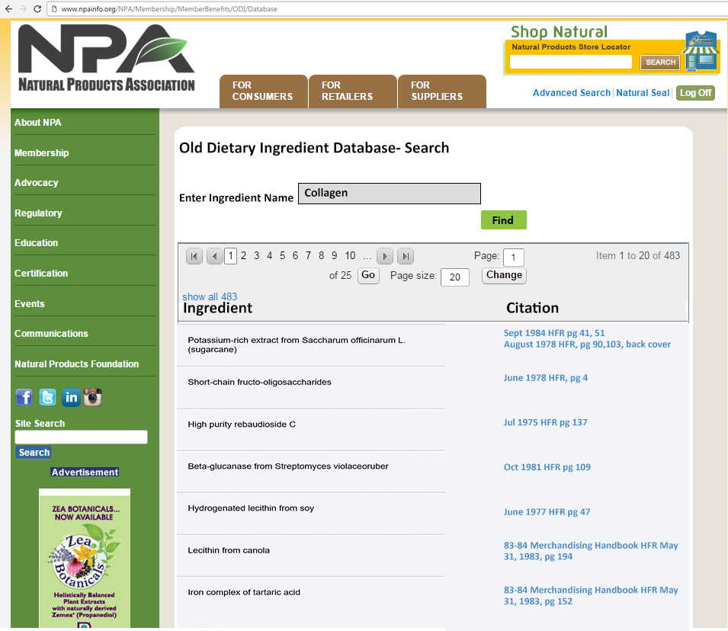
Safe Harbor/ODI Database- Searchable

Slide 13
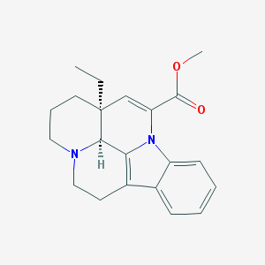
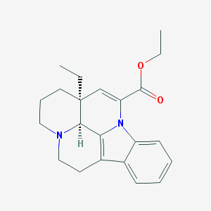
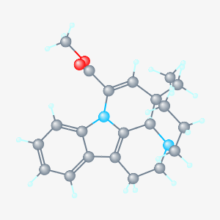
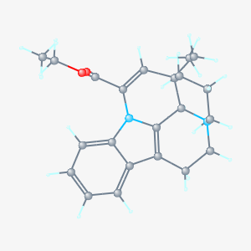
Active Moiety (Esters/Salts of ODIs)
Addition of groups that are functionally removed upon ingestion (e.g. ester groups) do not lead to a chemically altered ingredient
Therefore, addition of ester groups to ingredients in pre-DSHEA list would be eligible for safe harbor
Ester Groups
“Active Moiety”
Apovincamine
Vinpocetine
Under 21 CFR 316.3(b)(2), “active moiety” means "the molecule or ion, excluding those appended portions of the molecule that cause the drug to be an ester, salt (including a salt with hydrogen or coordination bonds), or other noncovalent derivative (such as a complex, chelate, or clathrate) of the molecule, responsible for the physiological or pharmacological action of the drug substance." See also 21 CFR 314.108(a).

Slide 14
Probiotics
Bacteria | Bacteria | Fungi
Acetobacter | Lactococcus | Yeast
Acinetobacter | Leucobacter | Brettanomyces/Dekkera
Aeromonas | Leuconostoc | Candida
Agrococcus | Macrococcus | Cryptococcus
Alcaligenes | Marinilactibacillus | Geotrichum/Galactomyces
Arthrobacter | Marinomonas | Hanseniaspora
Bacillus | Microbacterium | Issatchenkia
Bifidobacterium | Micrococcus | Kluyveromyces
Brachybacterium | Morganella | Metschnikowia
Brevibacterium | Mycetocola | Pichia
Brevundimonas | Natrinema | Rhodotorula
Brochothrix | Paenibacillus | Saccharomyces
Carnobacterium | Pantoea | Schizosaccharomyces
Chryseobacterium | Pediococcus | Torulaspora
Citrobacter | Proteus | Trichosporon
Clostridium | Providencia | Yarrowia
Corynebacterium | Pseudoalteromonas | Zygosaccharomyces
Enterobacter | Psychrobacter | Molds
Erwinia | Raoultella | Alternaria
Flavobacterium | Serratia | Aspergillus
Hafnia | Shewanella | Aureobasidium
Halalkalibacillus | Sphingobacterium | Botrytis
Halobacterium | Sphingomonas | Byssochlamys/Chrysosporium
Halococcus | Stenotrophomonas | Cladosporium
Halomonas | Tetragenococcus | Fusarium
Halorubrum | Tetrathiobacter | Monilia
Kocuria | Weissella | Mucor
Lactobacillus |  | Penicillium
 |  | Rhizomucor
 |  | Rhizopus
 |  | Scopulariopsis/Trichothecium
Probiotics – unique class of dietary ingredients
Probiotics are generally safe
Used for thousands of years
NPA provided in its December 2016 NDI comments a list of genera that have an established safety record and long history of safe use in dietary supplements/food supply
This list of food-borne bacteria and fungi (by genera) have long been used in foods and in fermented foods
This probiotic list does not imply that everything is on a safe harbor
For NDI purposes, a firm’s probiotic would have to be:
  1) listed here AND
  2) meet the identity and safety requirements indicated below in the flow chart

Slide 15
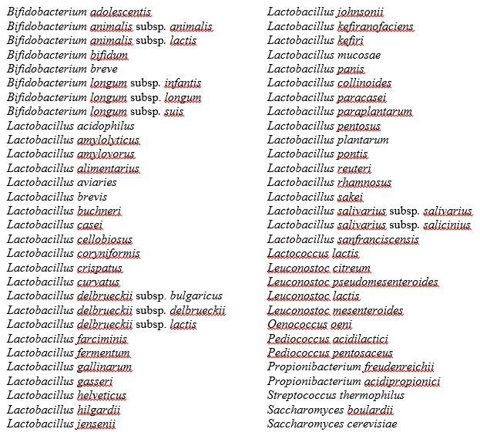
Probiotics
Example list of genera with species previously established as safe by global regulatory authorities
Safe probiotics at species level that do not require an NDI
% Homology is already very similar in the strains of these species
Outside of these species, what % homology is required to acknowledge strain in a given species
If % homology is not known, then decision matrix

Slide 16
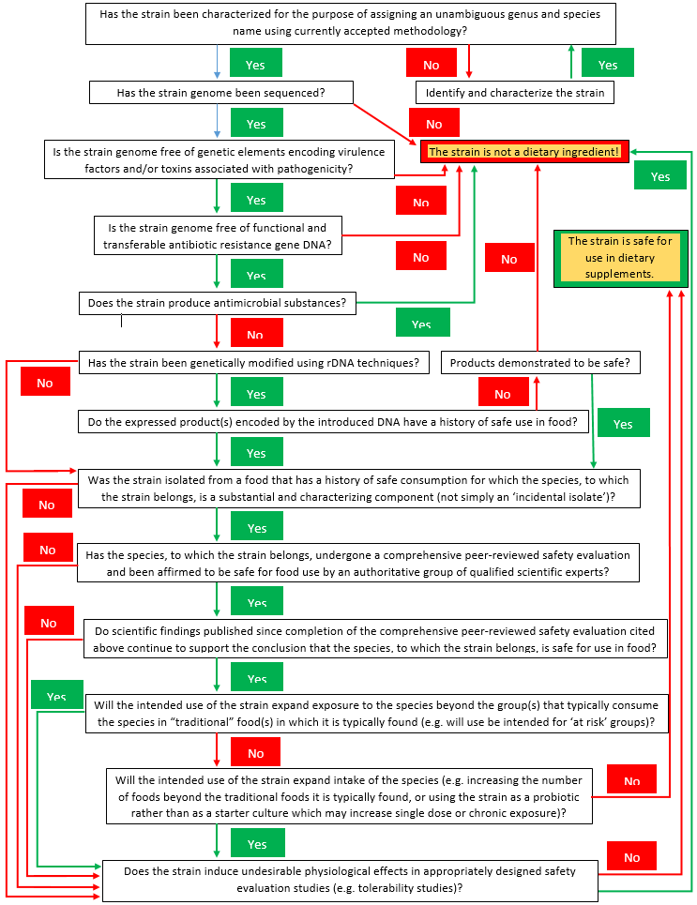
Probiotics – Decision Matrix
Decision matrix for determining whether to file an NDI for live microbial ingredients (see NPA’s December 2016 NDI Comments)
Analysis at species and strain level
This matrix covers aspects that are unique to probiotics as dietary ingredients in determining identity and safety
sequenced
free of genetic elements encoding virulence factors/toxins, transferable antibiotic resistance, antimicrobial substances
genetic modification?
hx of safe use in food, not simply an incidental isolate
peer reviewed safety evaluation/affirmed to be safe for food use by authoritative group of qualified scientific experts
does scientific evidence continue to support that the species is safe
Does the strain induce undesirable physiological effects in safety evaluation studies (e.g. tolerability)

Slide 17
In Closing….
Luck is not a reasonable compliance strategy
This should be the start of the discussion on time in the marketplace correlated with safe usage
AERs and other data can inform that decision
FDA has ample authority to deal with any safety issue
Reg Flex – this is the start of the discussion

Slide 18
THANK YOU!

