Slide 1
Creating a path forward
Duffy MacKay, ND
SVP, Scientific and Regulatory Affairs
Council for Responsible Nutrition

Slide 2

Creating A Path Forward
October 15, 1994 - DSHEA
October 3, 2017 - Today
  20+ years later and we are starting from scratch
The task
  Identify independent and verifiable evidence that ingredients were sold 20+ years ago
  This exercise alone is not likely to result in the desired certainty around a significant number of dietary ingredients

Slide 3
What is the Goal?
Stakeholders desire transparency and regulatory certainty regarding a long list of common dietary supplement ingredients
Stakeholders want consumers to have access to safe dietary supplements
Industry embraces its obligation to file a 75-day pre-market notification for new dietary ingredients
  when there is no evidence to support a history of safe use
Industry does not support unnecessary regulatory submissions for ingredients
  when there is a history of safe use

Slide 4
Dietary Supplement Safety Standard
“reasonable expectation of safety”
On the market in 1994 (ODI) – presence in the marketplace provides adequate history of use to establish a “reasonable expectation of safety”
New dietary ingredient (NDI) – requires that history of use or other evidence of safety that establishes the ingredient is “reasonably expected to be safe” is submitted to FDA 75-days prior to marketing
Ingredients already in the food supply – presence in the food supply provides adequate history of use to establish a “reasonable expectation of safety”
  No notification required for “…ingredients which have been present in the food supply as an article used for food in a form in which the food has not been chemically altered”

Slide 5
Creating A Path Forward
Limiting the current efforts to only developing a list of pre-1994 ingredients is not an efficient use of FDA and industry resources
A suggestion for a better path forward:
The scope of this effort should be expanded to establish clarity with regard to ALL dietary ingredients that can be used in dietary supplements without a 75-day pre-market notification to FDA (NDIN)

Slide 6
The Path Forward
The task: create a comprehensive list of all dietary ingredients that can be used in dietary supplements without filing a 75-day pre-market notification to FDA
  Pre-1994 ingredients (ODIs)
  New Dietary Ingredients (NDIs) notified to FDA
  Ingredients already in the food supply
This list would provide a significantly more meaningful resource for industry and FDA as compared to a short list of ingredients that can be appropriately coupled with 20+ year old documents

Slide 7
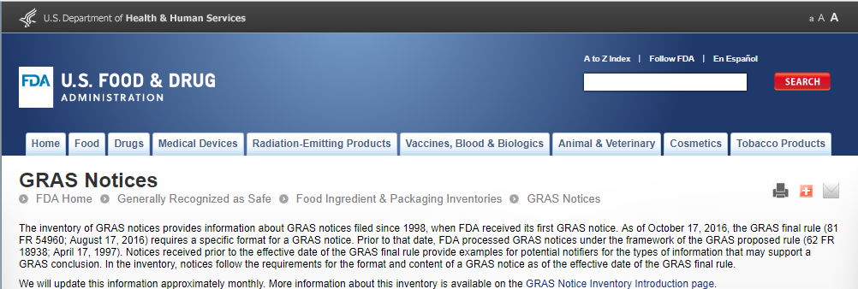
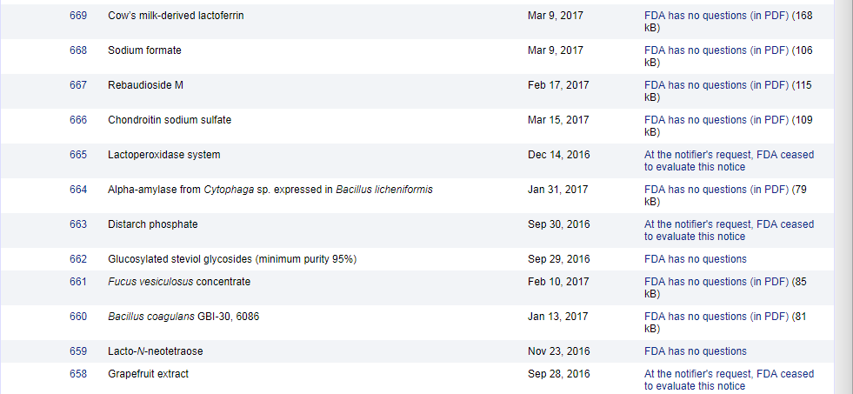
GRAS Notices

Slide 8
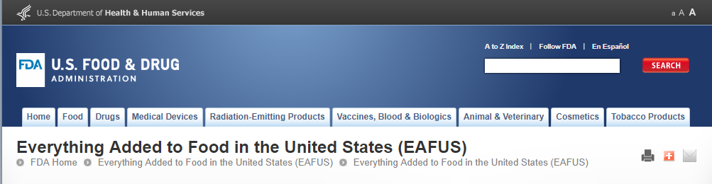

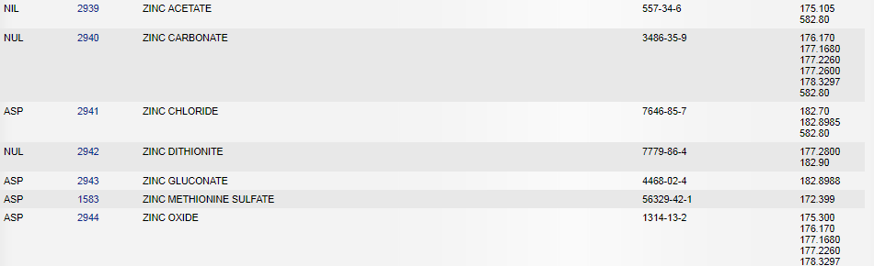
Everything Added to Food in the US

Slide 9
Summary
A reasonable path forward is…
Develop a comprehensive list of all dietary ingredients that can be used in dietary supplements without filing a 75-day pre-market notification to FDA
  Pre-1994 ingredients (ODIs)
  New Dietary Ingredients (NDIs) notified to FDA
  Ingredients already in the food supply

Slide 10
Two important considerations
Ingredients in the food supply are considered distinctly different and separate than isolated bioactive ingredients (constituents) found within the same food
Manufacturers always have an obligation to evaluate the safety of all finished dietary supplements to ensure they meet the dietary supplement safety standard
  Even when the manufacturer is not required to file a notification with FDA

Slide 11
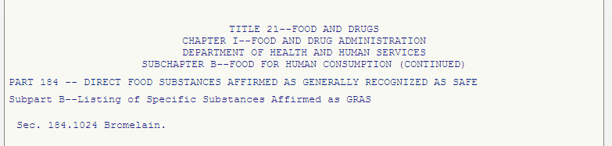
Ingredient ≠ Constituent
Pineapple is an ingredient in the food supply
  pineapple has a long history of safe use
  dried, ground, water or alcohol extracts of pineapple do not chemically alter and no notification is required
Bromelain is a chemical constituent found in pineapple
  completely separate ingredient; requires its own regulatory path to market and can’t piggy back under pineapple
  exposure data related to pineapple consumption may provide supportive evidence, but a separate safety assessment is needed (GRAS or NDIN)

Slide 12
Safety of Dietary Supplements
Section 342 - A food shall be deemed to be adulterated—
(f)(1) If it is a dietary supplement or contains a dietary ingredient that—
  (A) presents a significant or unreasonable risk of illness or injury under—
    (i) conditions of use recommended or suggested in labeling, or
    (ii) if no conditions of use are suggested or recommended in the labeling, under ordinary conditions of use;
21 U.S.C. § 342(f)(1)(A)(i) and (ii)
All manufacturers are required to meet the dietary supplement safety standard with or without the requirement to file a pre-market safety assessment with FDA

Slide 13
Conclusion
A reasonable path forward is…
Develop a comprehensive list of all dietary ingredients that can be used in dietary supplements without filing a 75-day pre-market notification to FDA
  Pre-1994 ingredients (ODIs)
  New Dietary Ingredients (NDIs) notified to FDA
  Ingredients already in the food supply

