Slide 1

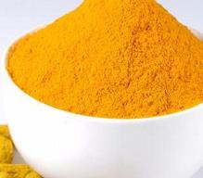



Public meeting to discuss the development of a list of pre-DSHEA dietary ingredients
Loren Israelsen, President
United Natural Products Alliance
Center for Food Safety & Applied Nutrition
College Park, Maryland
October 3, 2017

Slide 2

Panel 1: “What evidence is necessary to show that an ingredient was marketed before Oct. 15, 1994?”
UNPA © 2017

Slide 3
Presentation objectives
A timeline perspective
Where we are in 2017
Defining the scope of ODI evidence

Slide 4
This is a very old issue. Dietary supplements did not fit into a binary food/drug regulatory system.
Hence, the passage of the Dietary Supplement Health and Education Act (DSHEA) in 1994.
UNPA © 2017

Slide 5
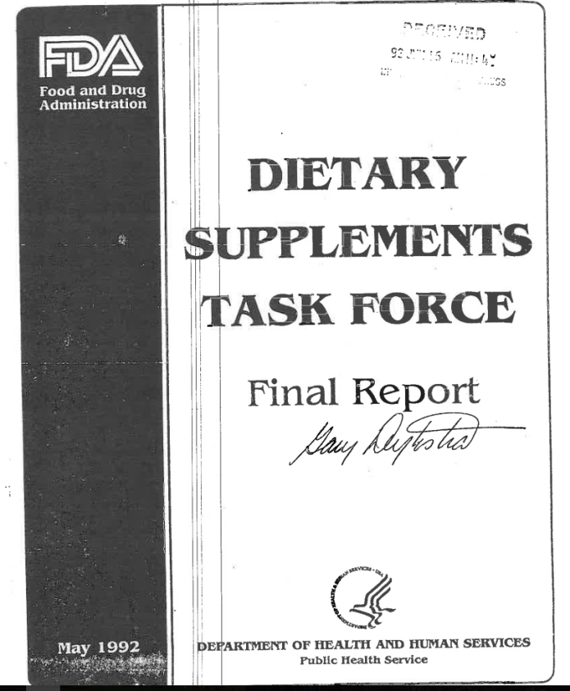
1992:
The battle lines are drawn …
UNPA © 2017

Slide 6
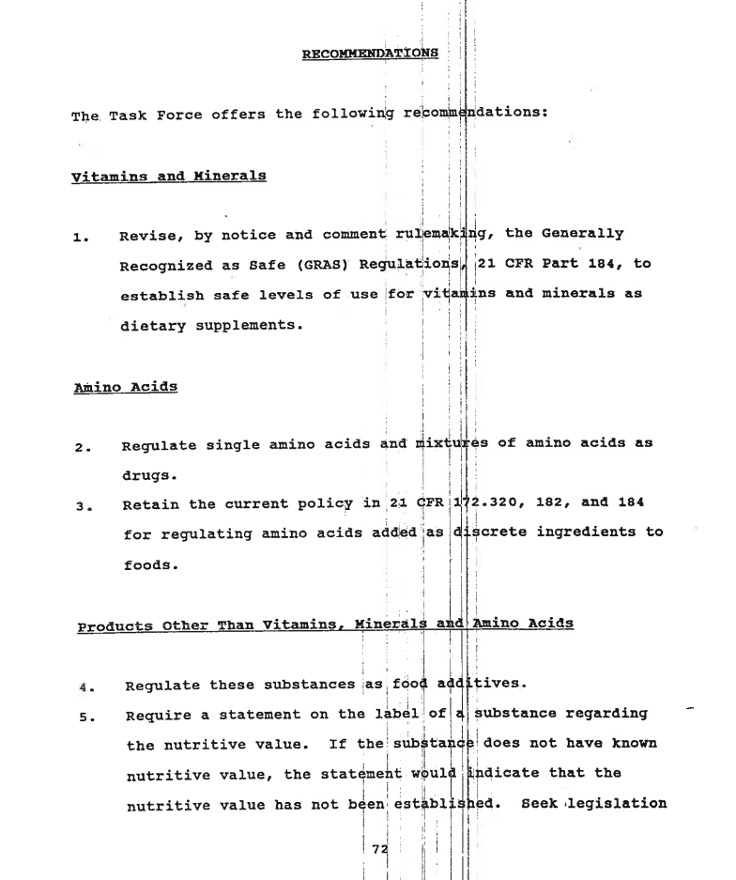
Caps vitamin and mineral potencies.
Amino acids are drugs.
Everything else is a food additive.

Slide 7
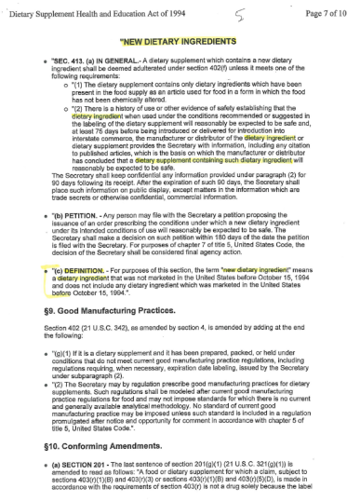
Congress responded by passing DSHEA in 1994

Slide 8
The state of technology in 1994
UNPA © 2017

Slide 9





1994…
Your ODI records?
UNPA © 2017

Slide 10
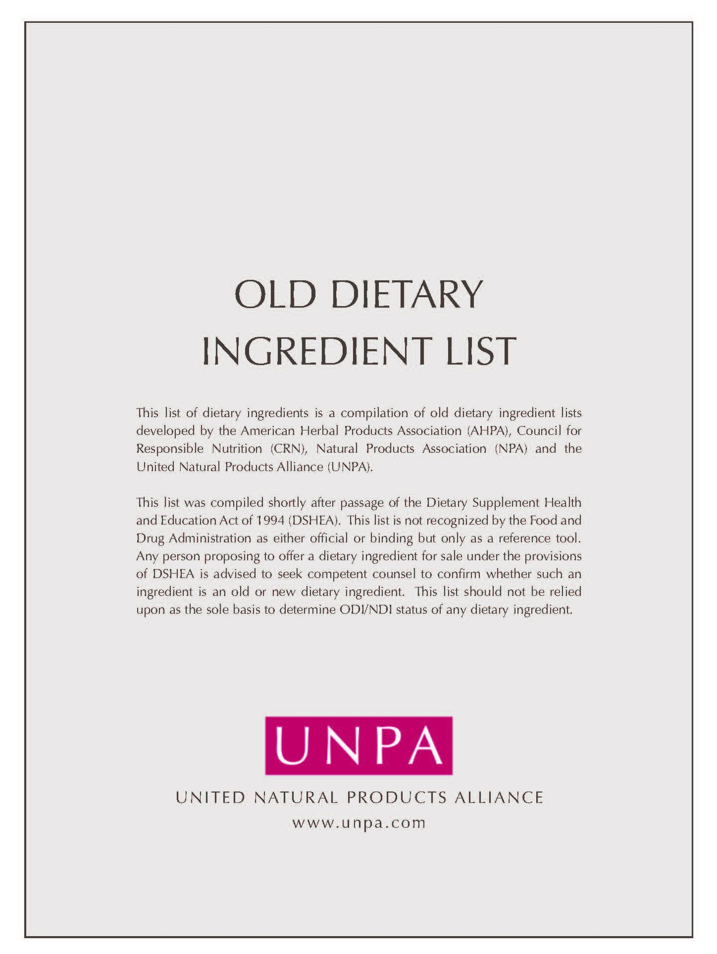
The industry trade associations, AHPA, CHPA, CRN, NPA (NNFA), and UNPA produced an ODI list in the early, post-DSHEA era.
UNPA © 2017

Slide 11
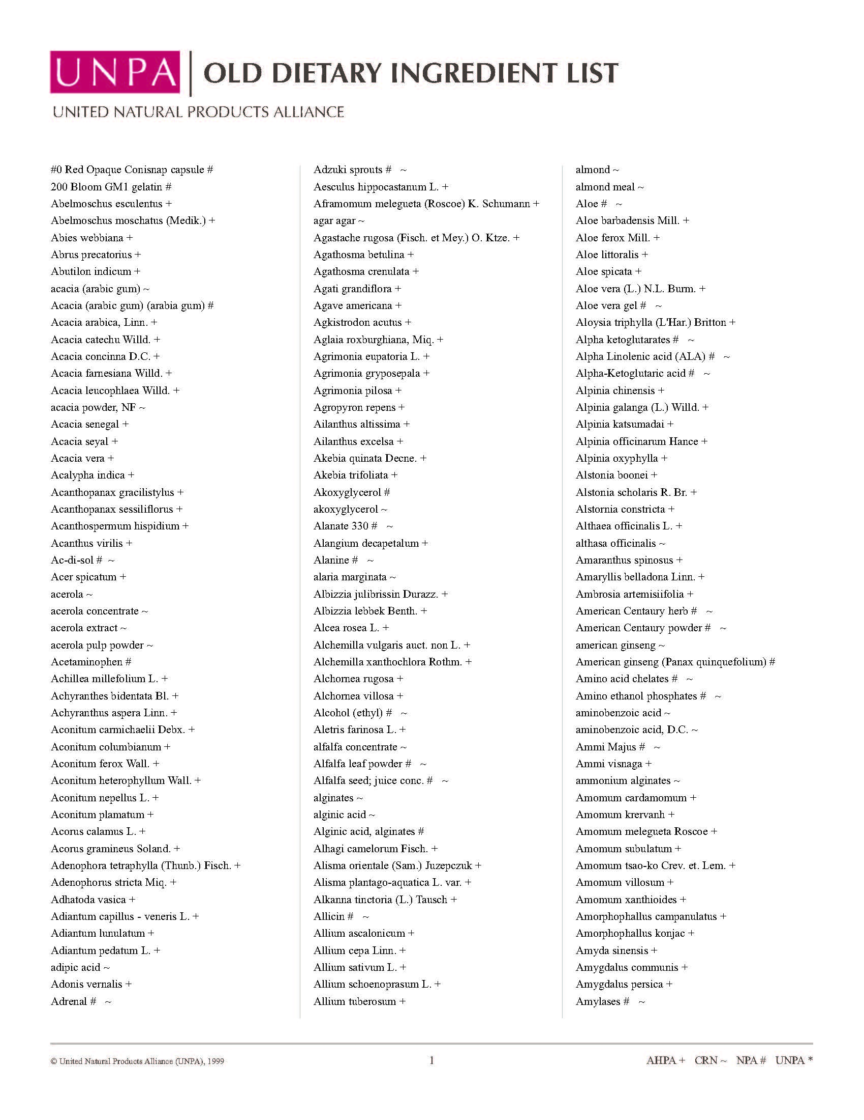
Objective: Identify ingredients, such as:
Alfalfa leaf powder
Aloe vera (L.) N.L. Burm.
Amino acid chelates

Slide 12
August 2016: publication of FDA’s draft NDI guidance
UNPA © 2017

Slide 13
NDI Guidance II
& Substances Generally Recognized As Safe
SEPTEMBER 8, 2016 Polling questions
Results of attendee polling at a UNPA conference

Slide 14
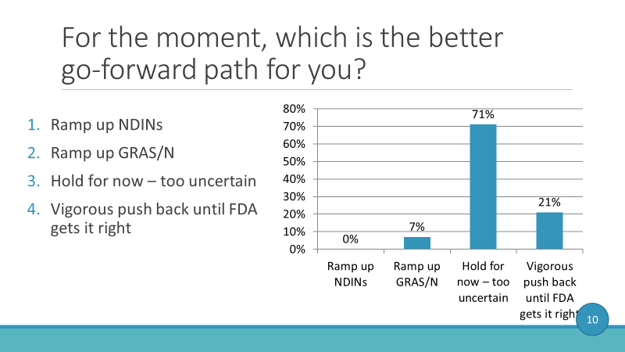
For the moment, which is the better go-forward path for you?

Slide 15
NDI Guidance III:
Roadmap to a Viable Policy
February 9, 2017 Polling questions
Results of attendee polling at a UNPA conference

Slide 16
Defining the scope of ODI evidence
UNPA © 2017

Slide 17
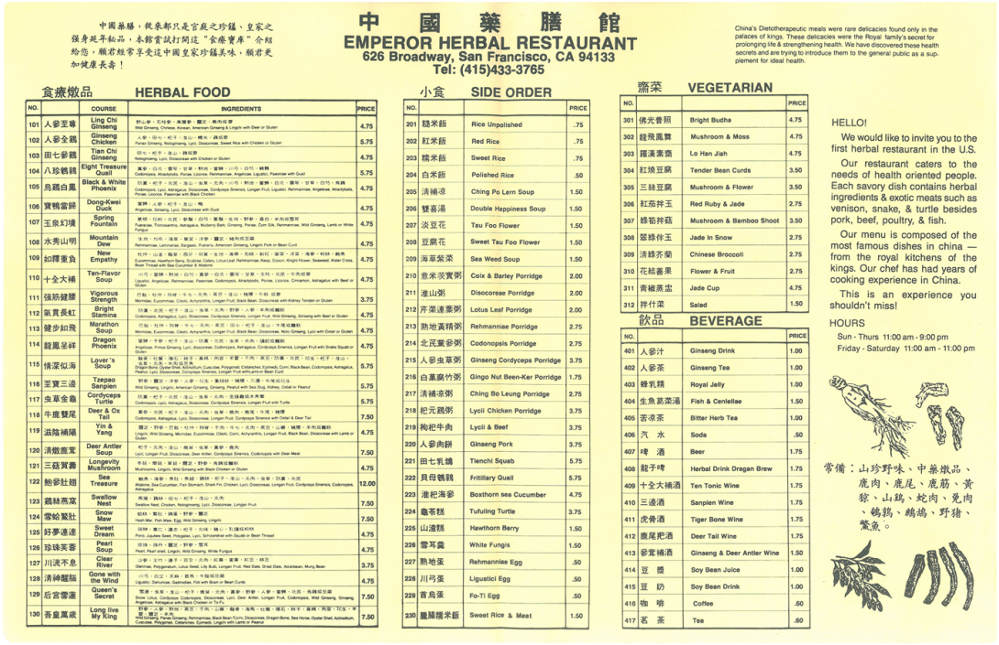
Restaurant menu circa mid-1980s
UNPA © 2017

Slide 18
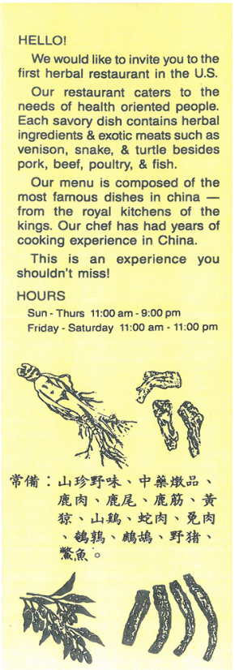
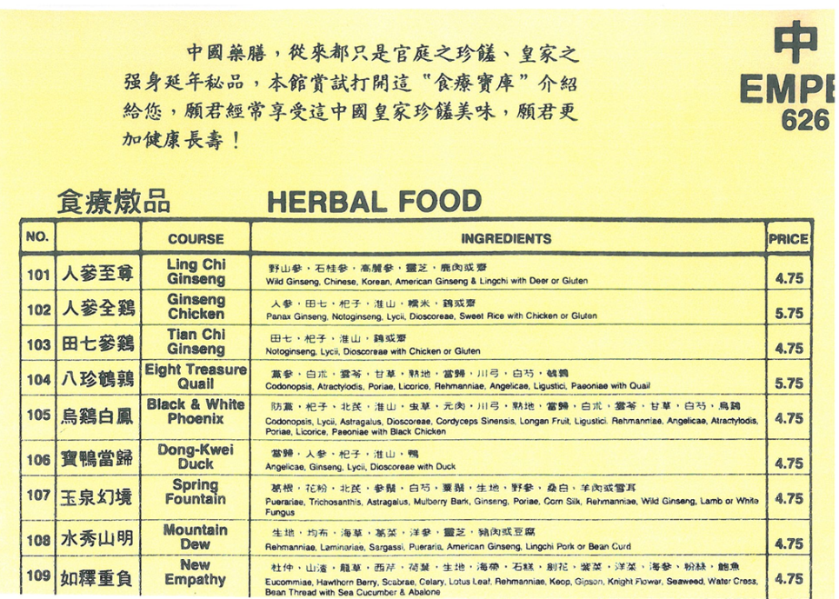
Restaurant menu

Slide 19
Summary
DSHEA established a statutory “home” for dietary supplements
This included a “new” and “old” ingredient provision to ensure consumer access to existing products
Confirming ODI status is urgent (23 years later)
and impedes the notifications of NDIs
The evidence to establish ODI status should be:
  A date in time prior to Oct. 15, 1994
  Credible evidence of use as a “dietary supplement” and relevant food use

Slide 20
Summary (cont’d)
Passage of time = loss of records
Loss of records = uncertainty over ODI status
Finally, the issues of chemical alteration, manufacturing changes, and combination products must be co-resolved before a meaningful ODI list can be achieved

Slide 21


Loren Israelsen
United Natural Products Alliance
1075 E. Hollywood Ave.
Salt Lake City, UT 84105 p: 801.474.2572 loren@unpa.com unpa.com
Thank you!
© 2017 UNPA

